Slide 1
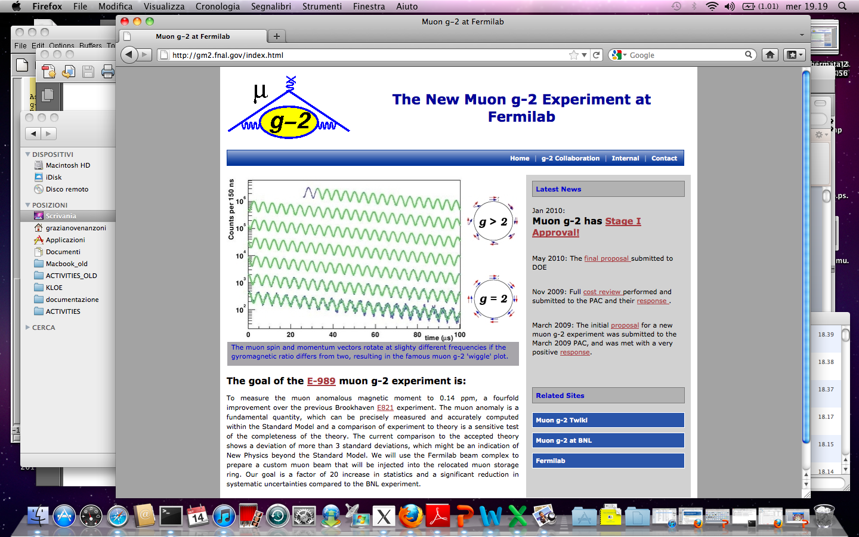
G. Venanzoni
“Afternoon Meet. on the muon g-2”, LNF 3 November 2011

Slide 2
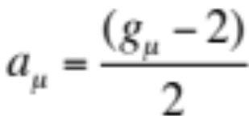
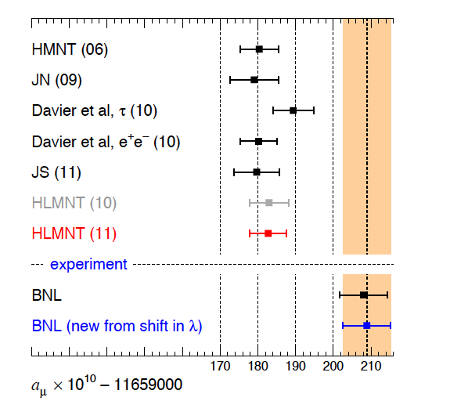
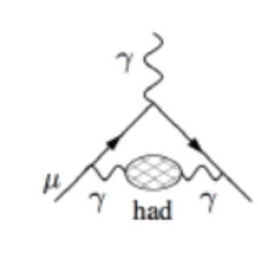
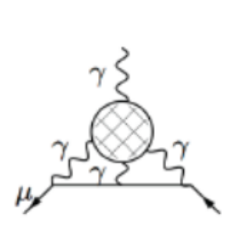
Muon anomaly as precision test of the SM
Long established discrepancy (>3σ) between SM prediction and BNL E821 exp.
A twofold improvement on δa_{μ} ^{TH-EXP} from 2001 (thanks to BNL and new e⁺e⁻ measurements)!
Theoretical error δa_{μ}SM (5÷6x10⁻¹⁰) dominated by HLO VP (4÷5x10⁻¹⁰) and HLbL (2.5÷4x10⁻¹⁰).
Experimental error δa_{μ}^{EXP} =6.3 x10⁻¹⁰ (0.54 ppm), E821. Plan to reduce it to 1.6 10⁻¹⁰ (0.14 ppm) by the new g-2 experiments at FNAL (E989) and J-PARC.
Hagiwara et al. arxiv:1105.3149
T.Teubner, PHIPSI08
In 2001 a_{μ}^{EXP}-a_{μ}^{TH}=(23±16)•10⁻¹⁰
H LbL
HLO VP
a_{μ}^{HLO} = (690.9±4.4)10⁻¹⁰
[S.Eidelman, TAU08]
a_{μ}^{HLbL} =(10.52.6)10⁻¹⁰ [P. dR&V. 08]
(11 ±4)10⁻¹⁰ (J.N.)
δa_{μ}^{HLO} ~0.6%
δa_{μ}^{HLbL} ~25-40%
Notes:
Ccorreggere extract fpi …

Slide 3
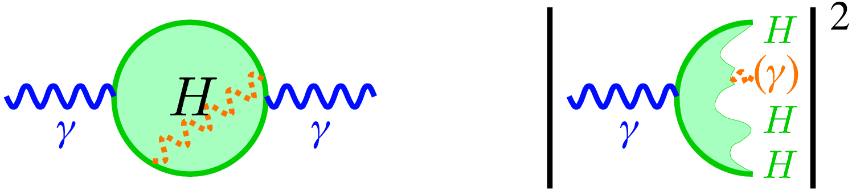
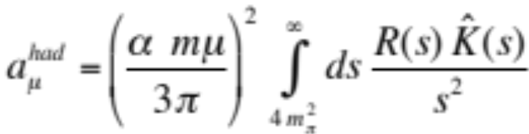

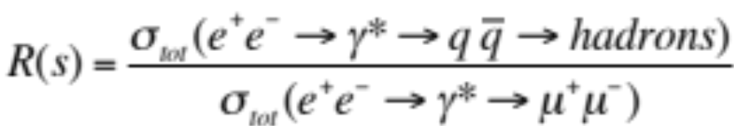
a_{μ}^{HLO}:
L.O. Hadronic contribution to a_{μ} can be estimated by means of a dispersion integral:
H
1 / s² makes low
energy contributions
especially important:
in the range < 1 GeV
contributes to 70% !
- K(s) = analytic kernel-function
- above sufficiently high energy value, typically 2…5 GeV, use pQCD
Input:
a) hadronic electron-positron cross section data
b) hadronic τ- decays, which can be used with the help of the CVC-theorem
and an isospin rotation (plus isospin breaking corrections)
(G.dR 69, E.J.95, A.D.H.’97,….)
(A., D., H. ’97)
Notes:
Mettere le referenze

Slide 4
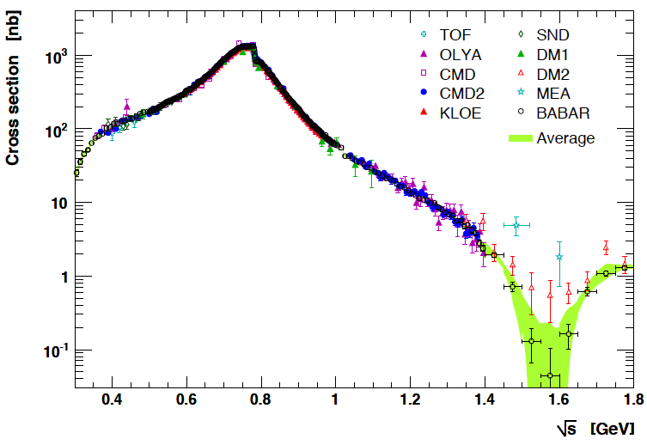
Measured Cross section for e⁺e⁻ →π⁺ π⁻
08

Slide 5
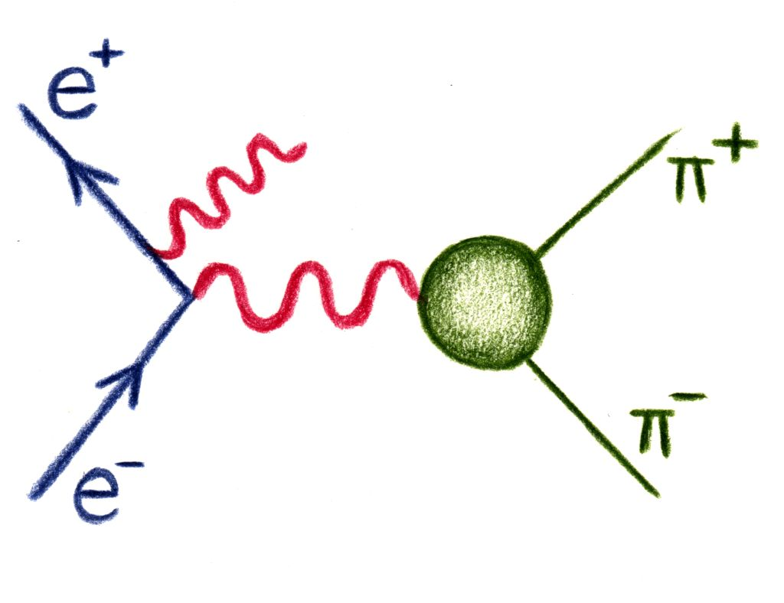
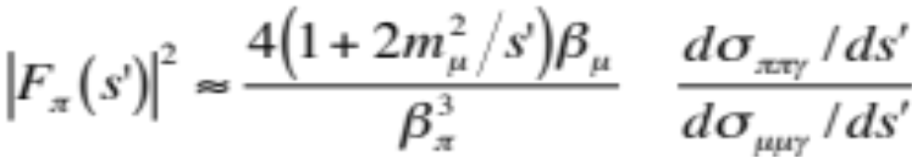
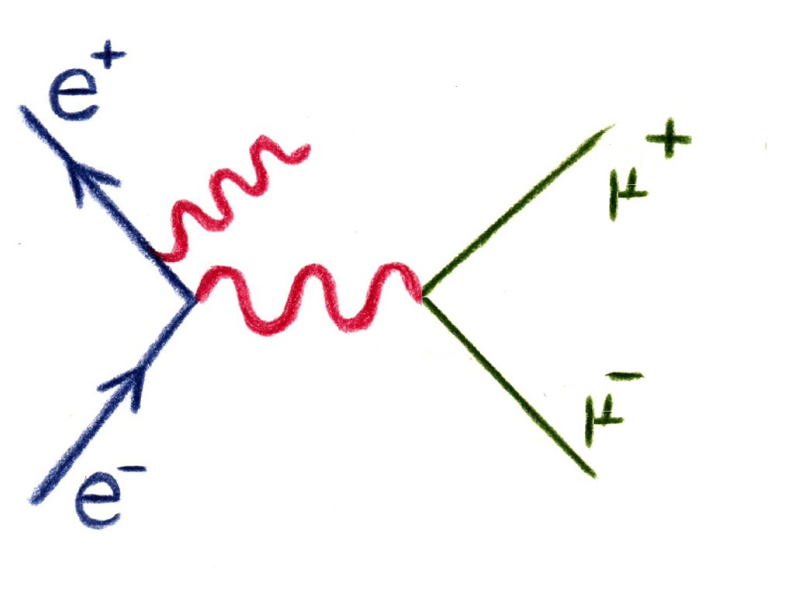
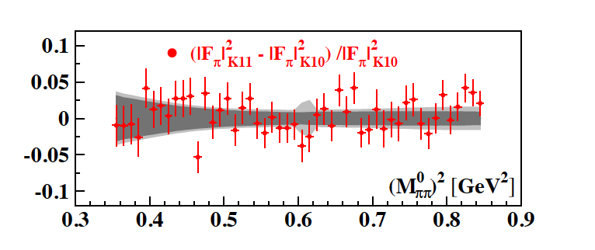
New KLOE result on e⁺e⁻ →π⁺ π⁻ by ππγ/μμγ ratio (ISR)
An alternative way to obtain |F_{π}|² is the bin-by-bin ratio of pion
over muon yields (as done by BaBar).
meas. quantities
Many radiative corrections drop out:
radiator function
int. luminosity from Bhabhas
Vacuum polarization
preliminary
See Mandaglio’s talk
Good agreement with previous measurement!

Slide 6
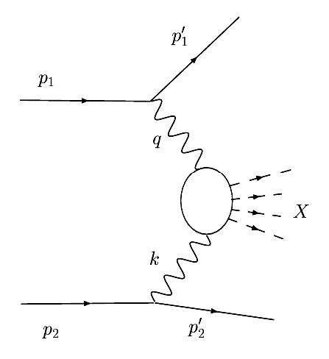
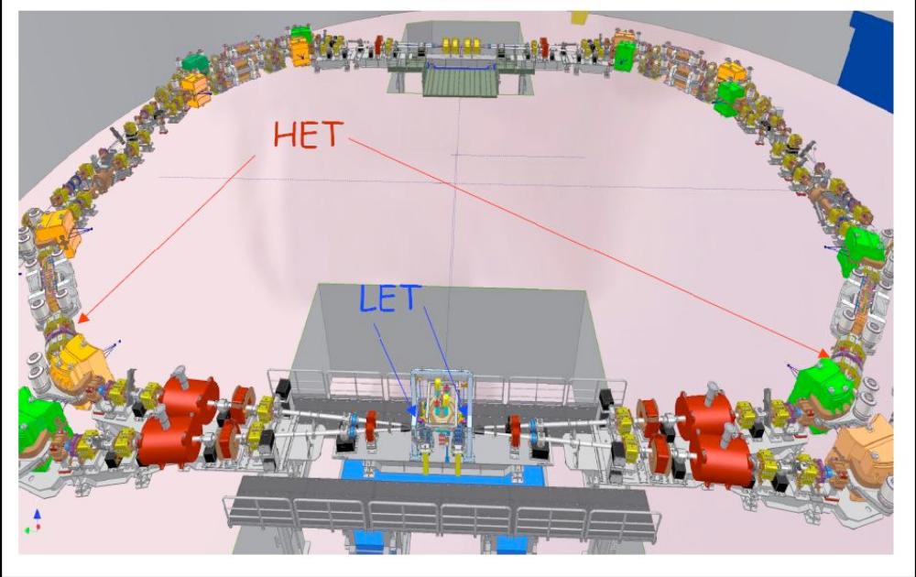
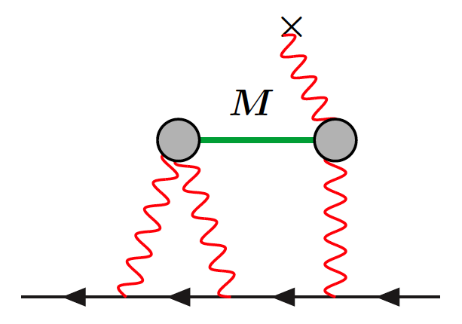
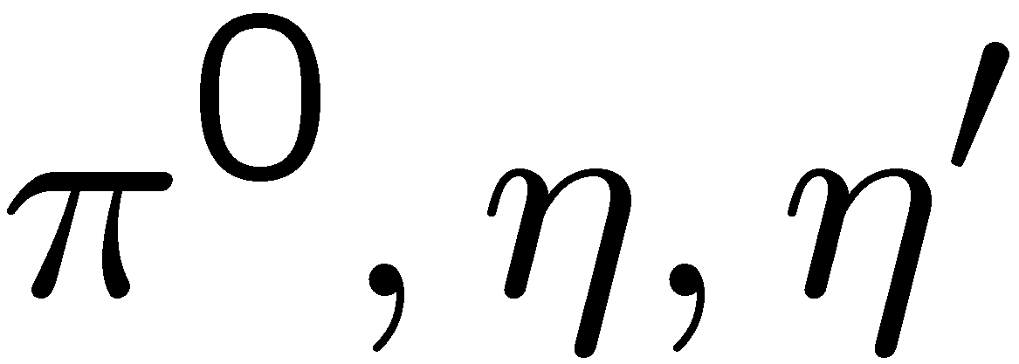
KLOE-2 to measure γγ∗ → hadrons to constrain HLBL
Constrain the on-shell amplitudes and remove a significant portion of the theoretical uncertainty on the HLBL
A reasonable improvement on a_{μ}^{π0}
For more details see Moricciani’s talk

Slide 7
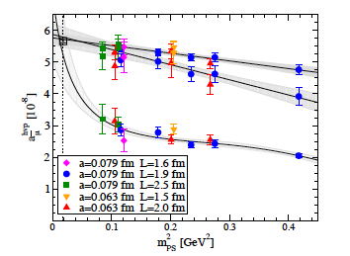
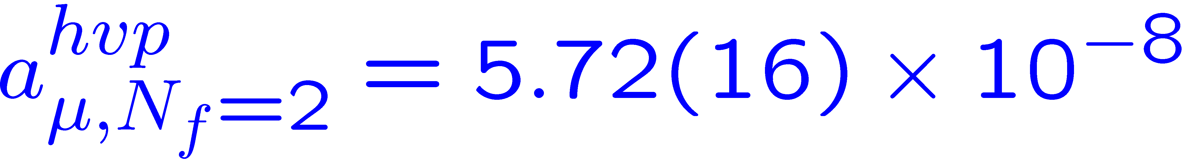
What about the lattice?
A new 2-3% lattice result for the lowest-order hadronic (u,d quarks only)contribution:
Very promising results!
Prospects for HLBL?
See Jansen’s talk
Feng, Jansen, Petschlies, Renner, arXiv:1103.4818v1 [hep-lat]

Slide 8
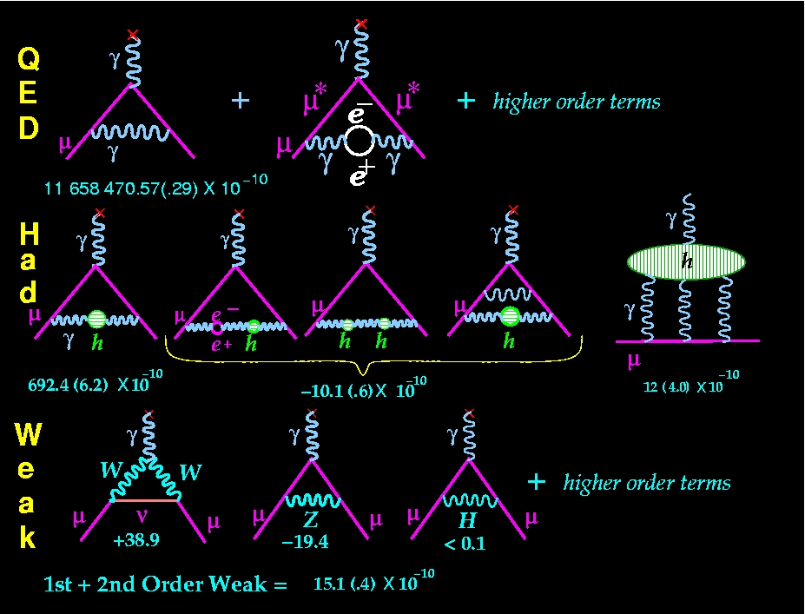
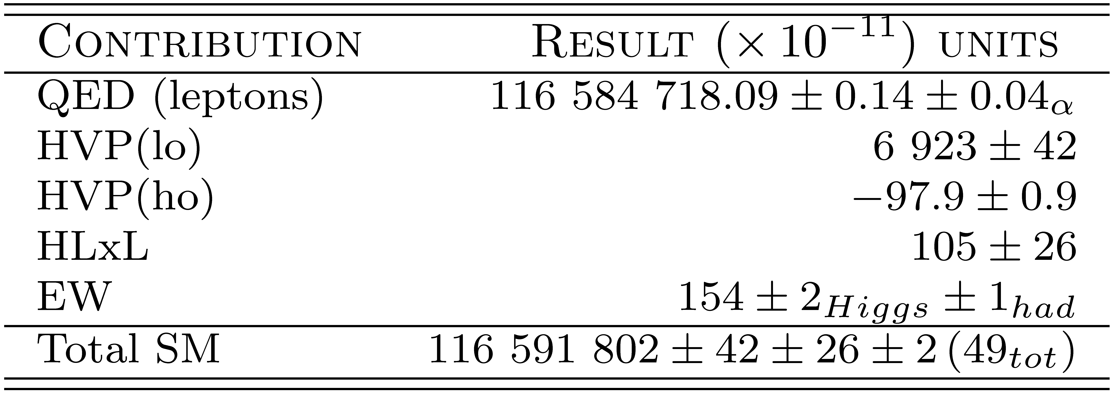
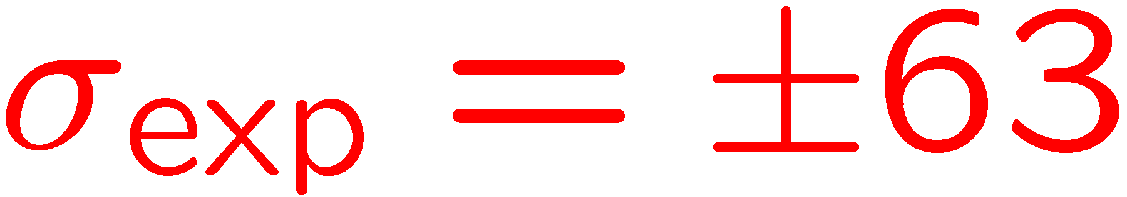
The SM Value for a_{μ} from e⁺e⁻ → hadrons
well known
significant work ongoing
M. Davier, et al., Eur. Phys. J. C (2011) 71: 1515
For more details see Passera’s talk

Slide 9
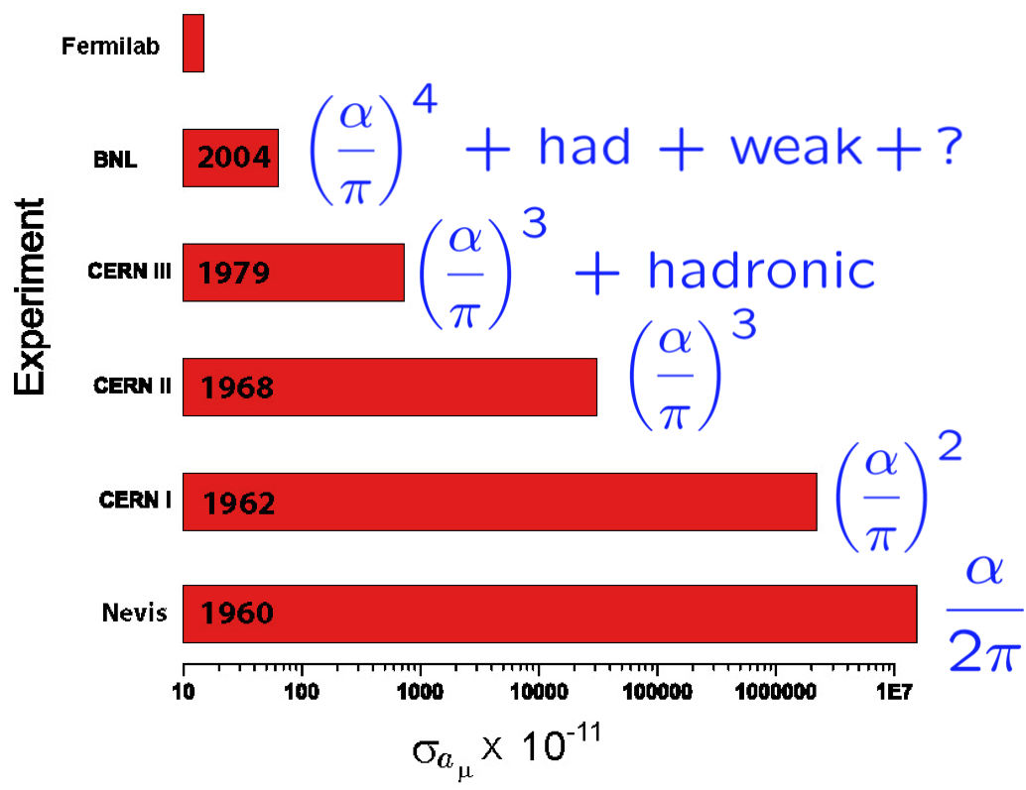
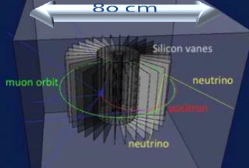
We need a new (possibly more) (g-2)_{μ} experiment(s)!
Current discrepancy limited by experimental uncertainty. Two proposals to improve it x4:
New experiment at FNAL (E989) at magic momentum, consolidated method. 20 x μ w.r.t. E821. Relocate the BNL storage ring to FNAL. Has got a Stage-1 approval!
Alternative proposal at J-PARC w/out magic momentum and no E field, requiring ultra-slow muons generated from laser-ionised muonium atoms (see talk of Saito)
Precision target ~ 16 10⁻¹¹ (0.14 ppm) . If the central value remains the same ⇒ >7σ from SM!

Slide 10
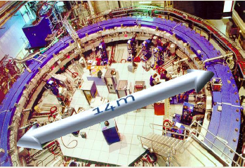
We need a new (possibly more) (g-2)_{μ} experiment(s)!
Current discrepancy limited by experimental uncertainty. Two proposals to improve it x4:
New experiment at FNAL (E989) at magic momentum, consolidated method. 20 x μ w.r.t. E821. Relocate the BNL storage ring to FNAL. Has got a Stage-1 approval!
Alternative proposal at J-PARC w/out magic momentum and no E field, requiring ultra-slow muons generated from laser-ionised muonium atoms (see talk of Saito)
Precision target (E989): 16x10⁻¹¹ (0.14 ppm) . If the central value remains the same ⇒ >7σ from SM!

Slide 11





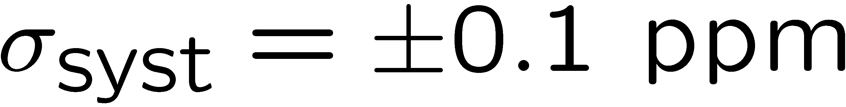
Fermilab (g-2) Experiment:
E821 at Brookhaven
E989 at Fermilab
  move the storage ring to Fermilab, improved shimming, new detectors, electronics, DAQ
  new beam structure that takes advantage of the multiple rings available at Fermilab, more muons per hour, less per fill of the ring

Slide 12
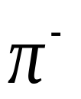
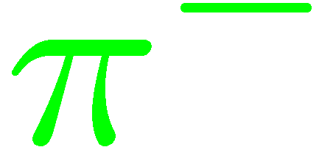
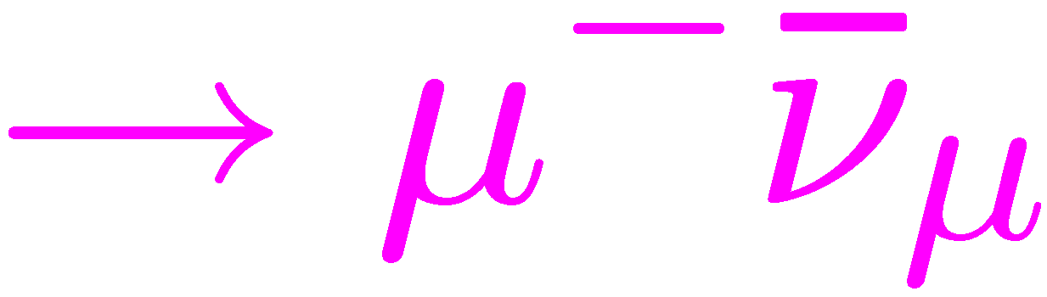

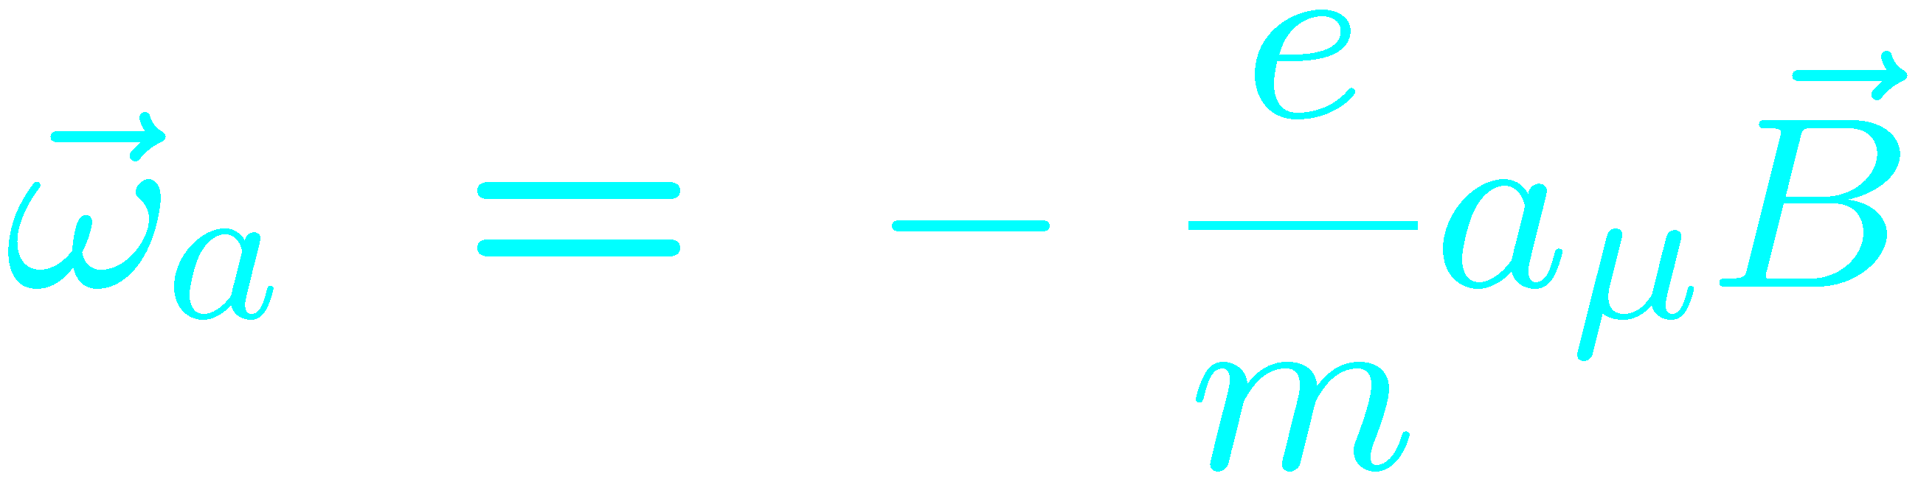
Experimental Technique
25ns bunch of ≥ 1 X 10¹² protons
x_{c} ≈ 77 mm
β ≈ 10 mrad
B·dl ≈ 0.1 Tm
Pions
Inflector
p=3.1GeV/c
Target
(1.45T)
Muon polarization
Injection orbit
Central orbit
Muon storage ring
injection & kicking
Storage
ring
Kicker
Modules
focus with Electric Quadrupoles
24 electron calorimeters
R=711.2cm
d=9cm
R
R
β
Electric Quadrupoles
x_{c}
B. L. Roberts, Fermilab , 3 September 2008
- p. 12/68
Notes:
12

Slide 13
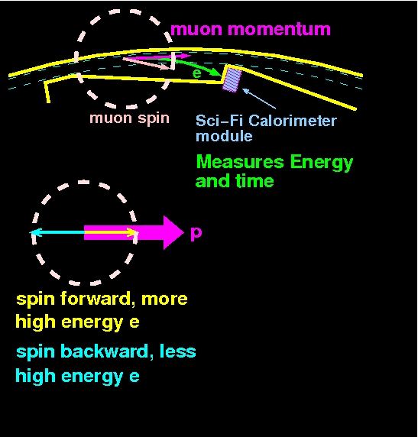
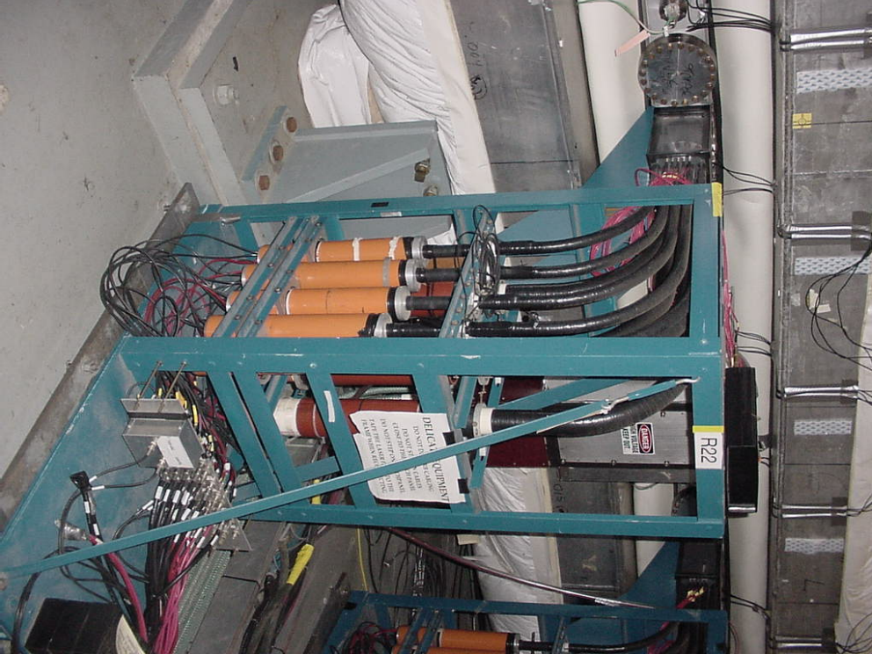
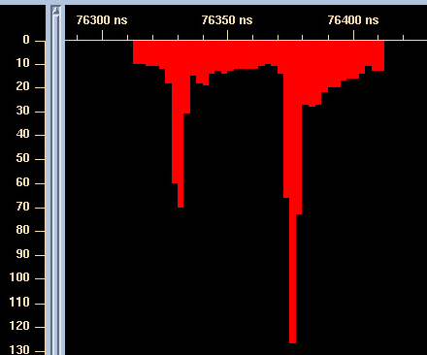
Picture of a Lead-Scifi Calorimeter from E821
In E989 we plan to us W-SciFi Calorimeters
Waveform digitizer gives t, E

Slide 14

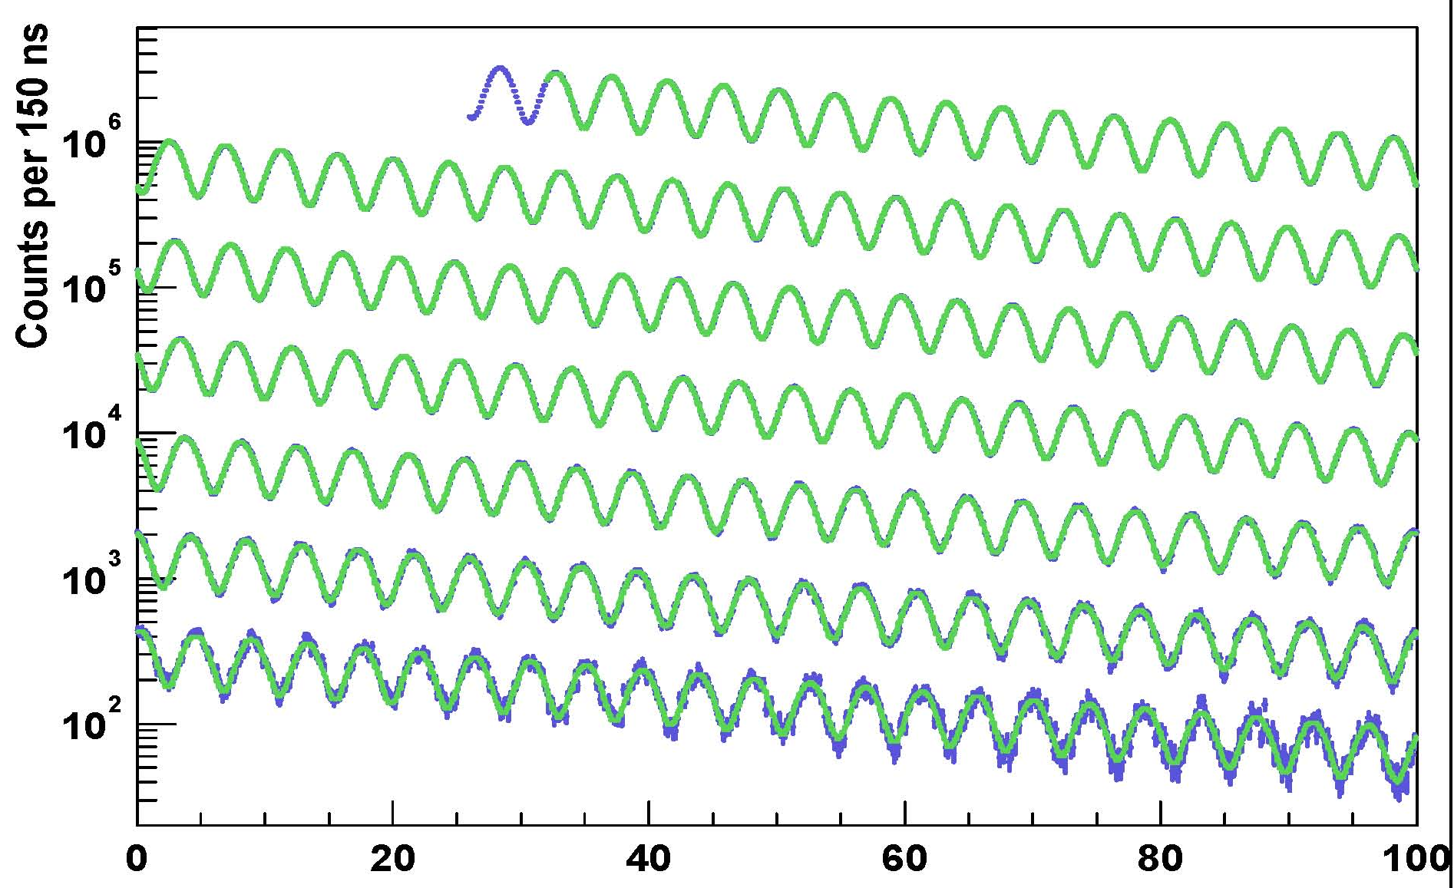
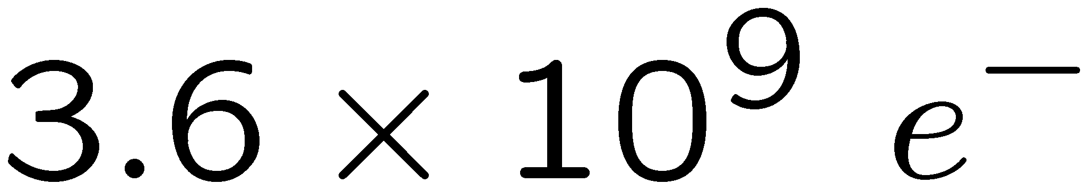
The arrival time spectrum of high-energy e⁻
γτ
E_{e} ≥ 1.8 GeV
γτ_{μ} = 64.4 μs; (g-2): τ_{a} = 4.37 μs; Cyclotron: t_{C} = 149 ns
μs
Systematic uncertainty on ω_{a} expected to be reduced by 1/3 at E989 (compared to E821) thanks to reduced pion contamination,the segmented detectors, and an improved storage ring kick of the muons onto orbit.

Slide 15
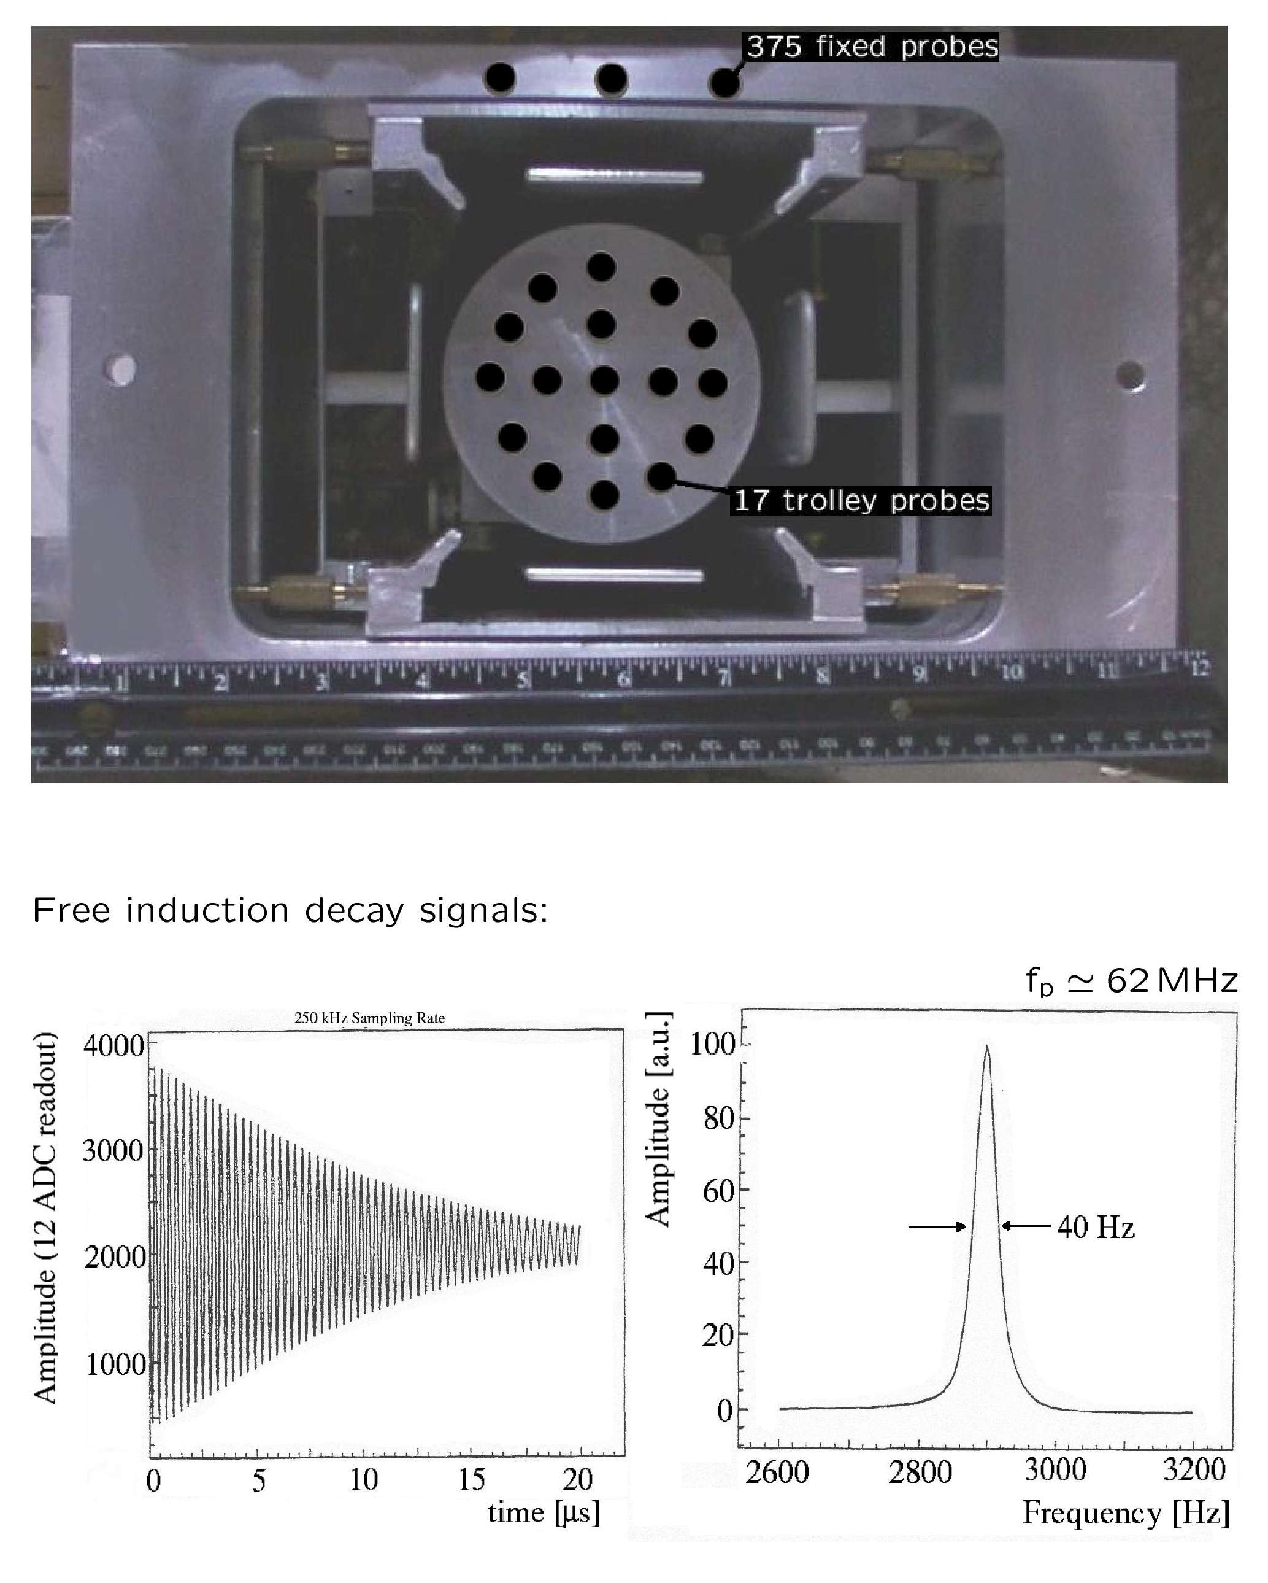
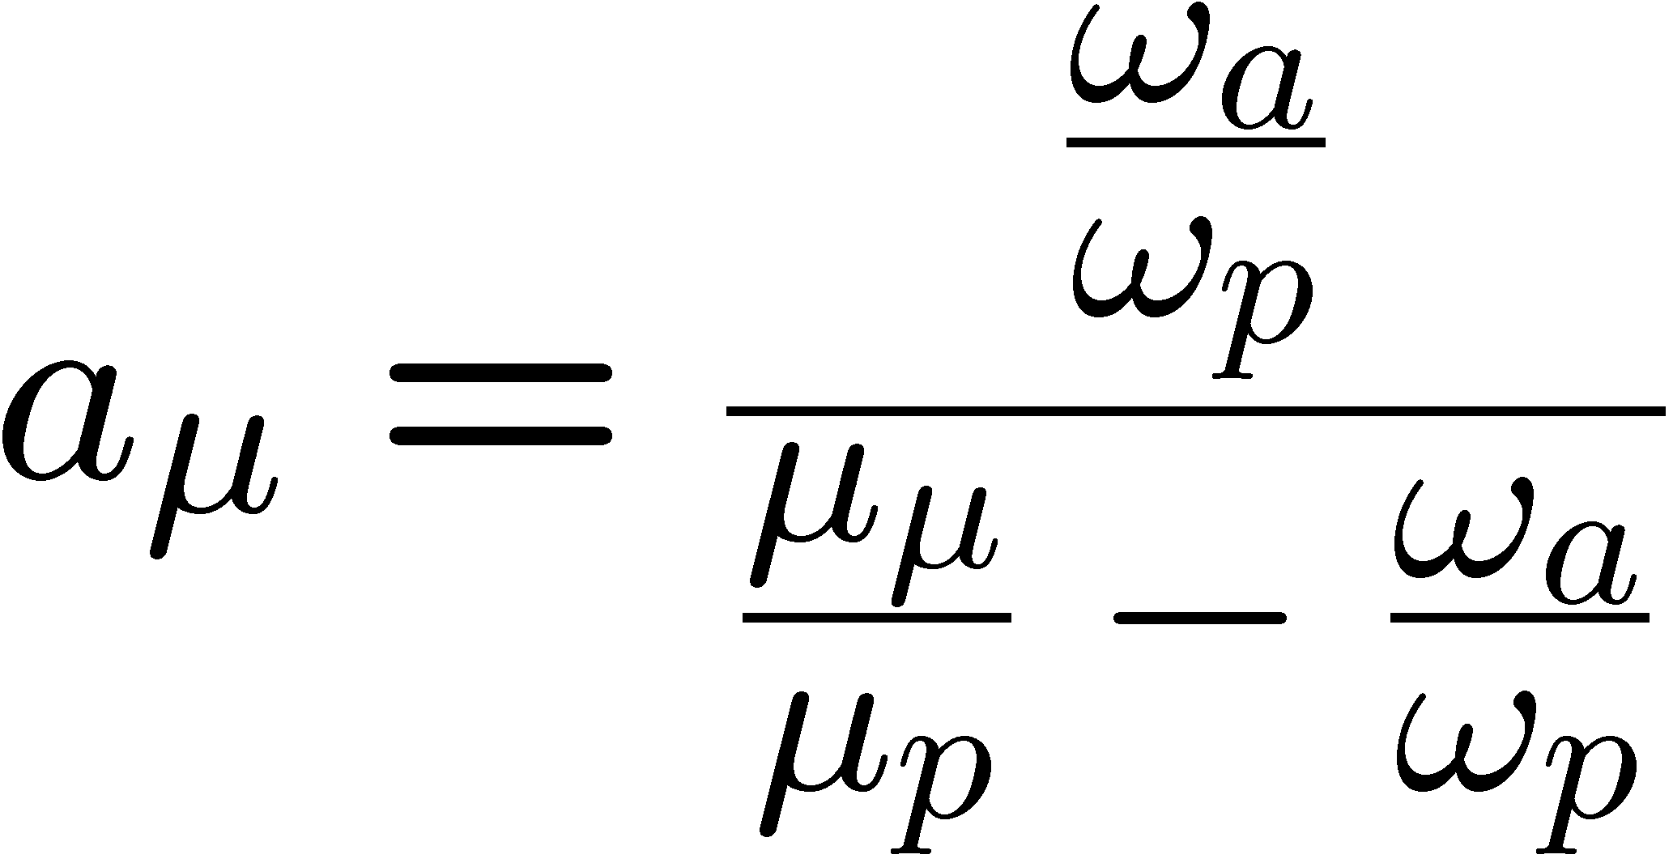
The magnetic field is measured and controlled using pulsed NMR and the free-induction decay.
ω_{p}
ω_{p}= Larmor frequency of the free p
We measure ω_{a} and ω_{p} independently
Use λ = μ_{μ} /μ_{p} as the
“fundamental constant”
Blind analysis
Systematic uncertainty on ω_{p} expected to be reduced by a factor 2 thanks to better shimming (uniformity of B), relocations of critical NMR probes, and other incremental changes

Slide 16
Why Fermilab?
The existence of many storage rings that are interlinked permits us to make the “ideal” beam structure.
  proton bunch structure:
    BNL 4 X 10¹² p/fill: repetition rate 4.4 Hz
    FNAL 10¹² p/fill: repetition rate 15 Hz
  using antiproton rings as an 900m pion decay line
    20 times less pion flash at injection than BNL
  0º muons
    ~5-10x increase μ/p over BNL
  Can run parasitic to main injector experiments (e.g. to NOVA) or take all the booster cycles
Expected data taking in 2016

Slide 17
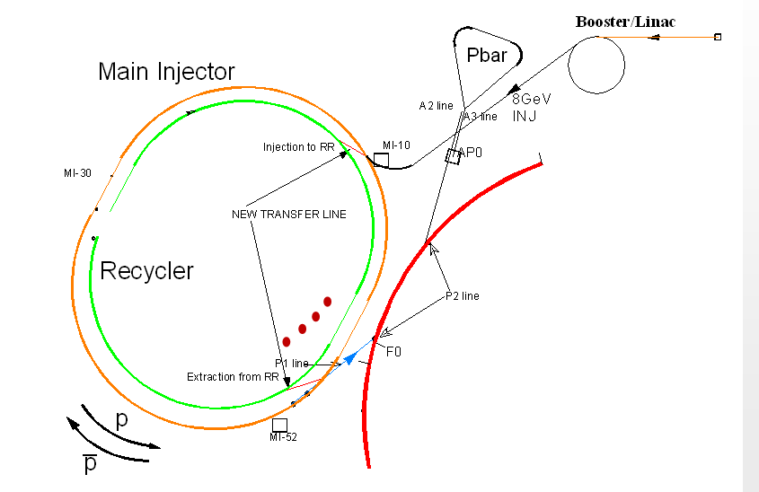
Polarized muons delivered and stored in the ring at the magic momentum, 3.094 GeV/c
beam rebunched in Recycler
4 x (1 x 10¹²) p
Uses 6/20 batches*
  parasitic to ν program
Proton plan up to AP0 target is almost the same as for Mu2e
Modified AP2 line (+ quads)
New beam stub into ring
*Can use all 20 if MI program is off

Slide 18
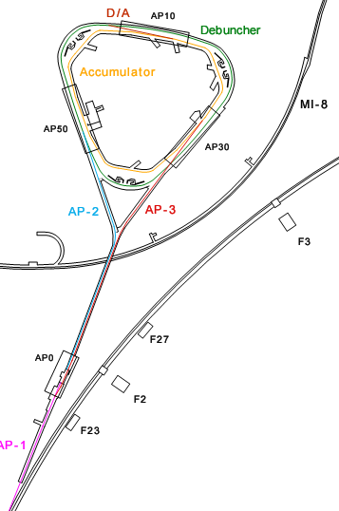
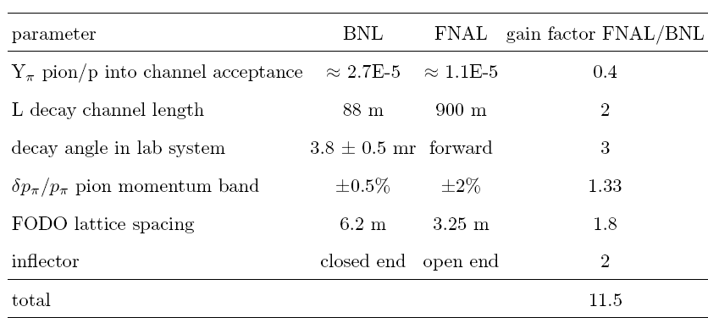
The 900-m long decay beam reduces the pion “flash” by x20 and leads to 6 – 12 times more stored muons per proton (compared to BNL)
Flash compared to BNL
parameter | FNAL/BNL
p / fill | 0.25
π / p | 0.4
π survive to ring | 0.01
π at magic P | 50
Net | 0.05
Stored Muons / POT

Slide 19
Upgrades at Fermilab
New segmented detectors to reduce pileup
  W-scifi prototype under study X₀ = 0.7 cm
  NIM A602 :396-402 (2009).
New electronics
  500 MHz 12-bit WFDs, with deep memories
Improvements in the magnetic field calibration, measurement and monitoring.
- p. 19/57

Slide 20

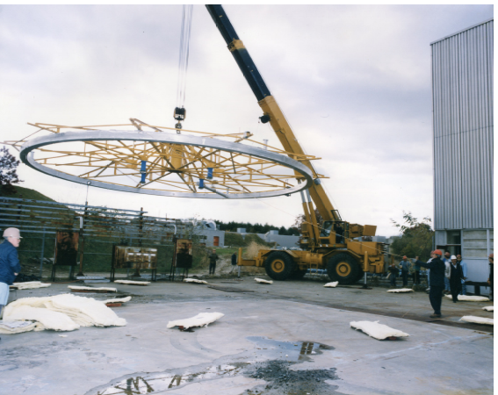
Sikorsky S64F 12.5 T hook weight (Outer coil 8T)
Muon (g-2) storage ring to be relocated to FNAL

Slide 21
Conclusion
During the last ten years the muon (g-2) provided one of the strongest tests of the SM, thanks to the impressive accuracy of BNL experiment (δa_{μ}^{EXP} = 0.54 ppm). Important interplay with LHC!
The SM prediction has steadily improved thanks to precise e⁺e⁻ data (worldwide effort): δa_{μ}SM = 0.43 ppm
At present a discrepancy of more than 3 “standard deviations” between SM and Experiment; uncertainty dominated by BNL experiment
New (g-2)_{μ} experiment at Fermilab with a fourfold reduction δa_{μ}^{EXP} = 0.14 ppm . First results could be available around 2017/18
Theoretical uncertainty will improve thanks to current and planned experimental activities (as well as theoretical ones)
Stay Tuned!
Notes:
Ccorreggere extract fpi …

Slide 22
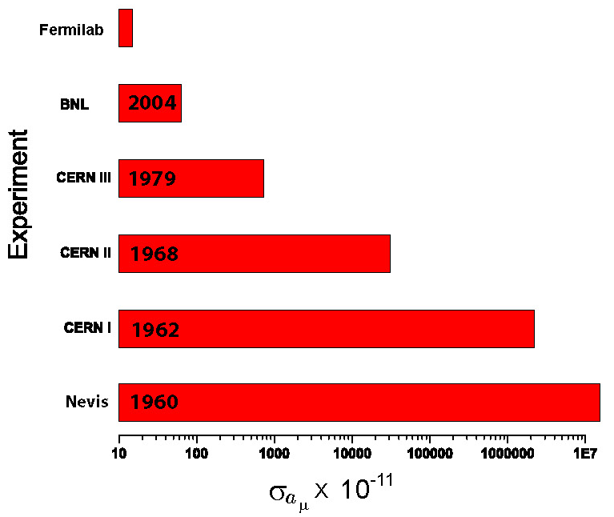
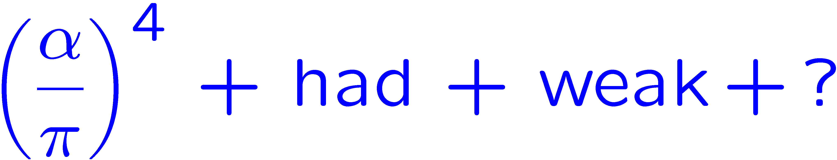
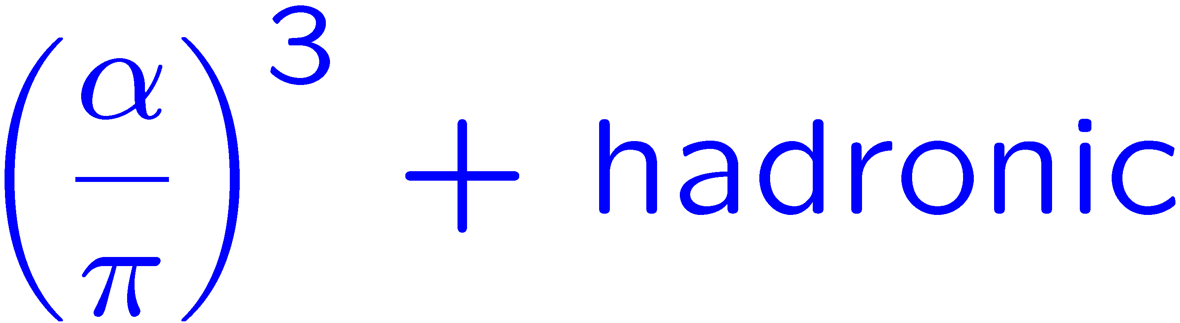
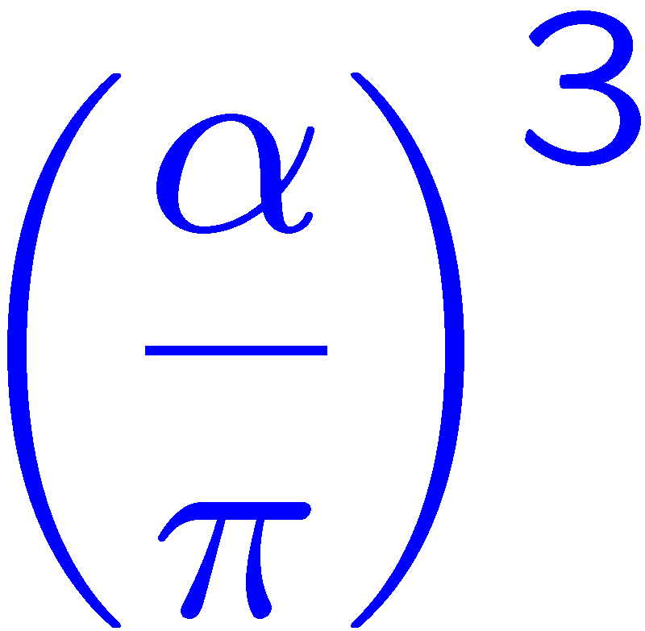
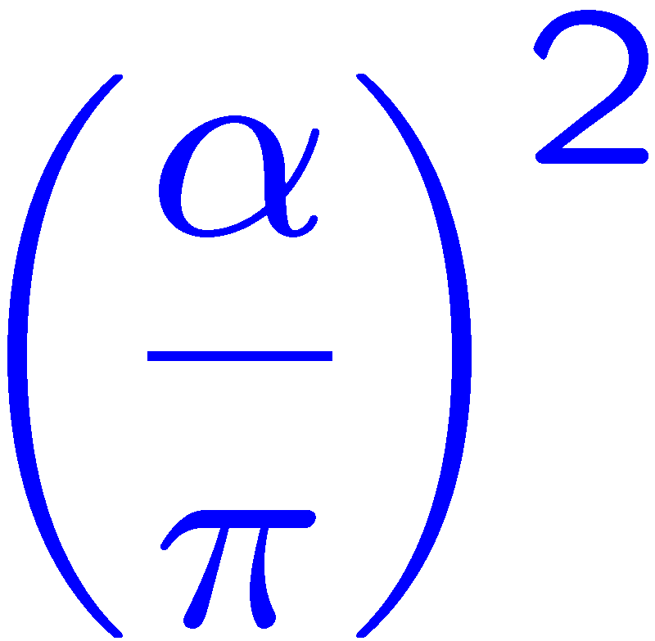
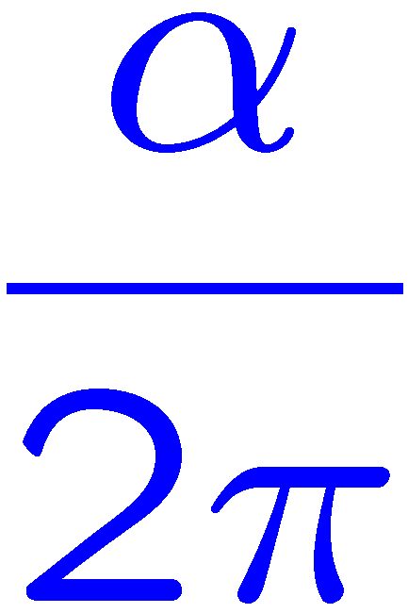
Thank you for your attention!

Slide 23
SPARES

Slide 24
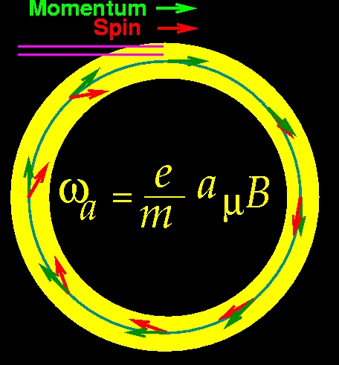
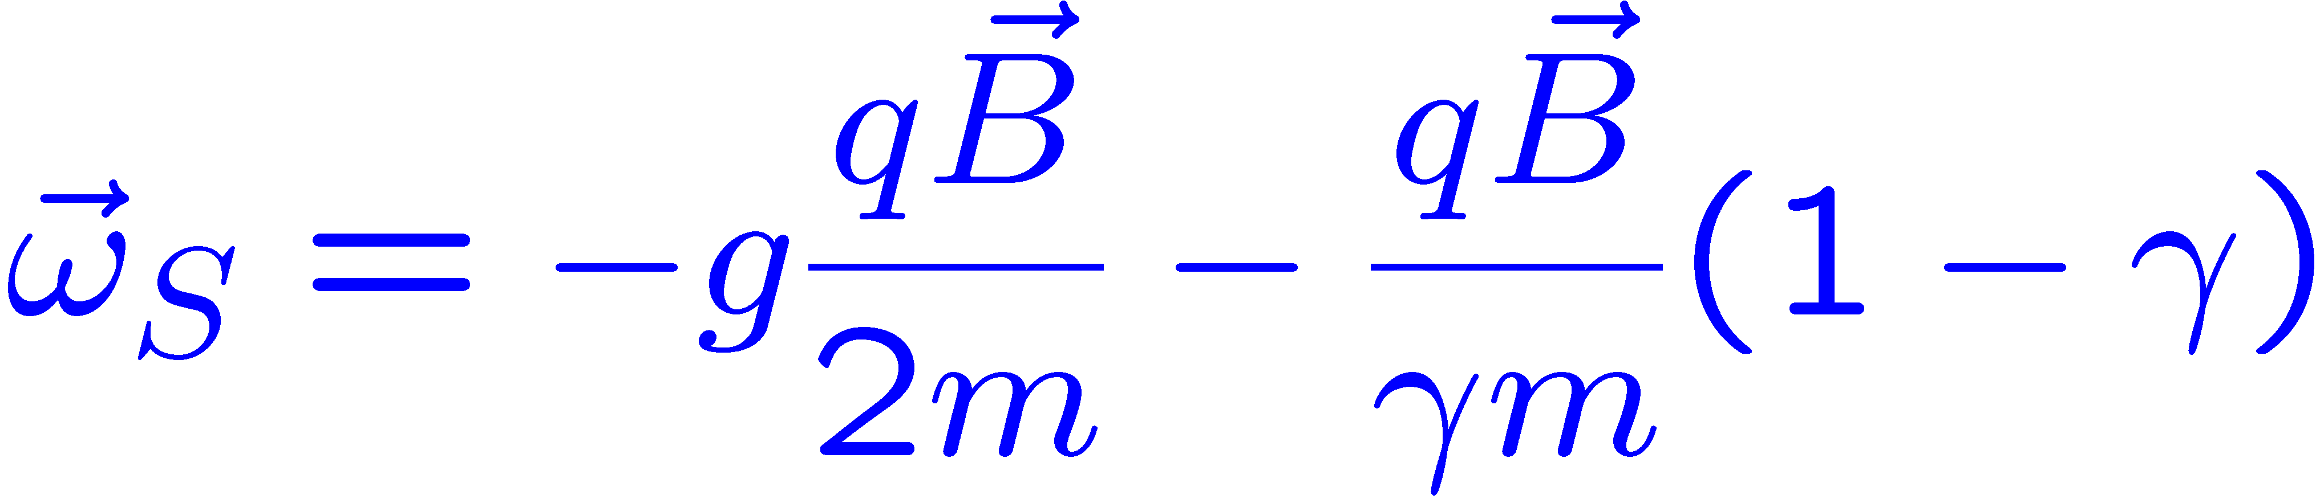
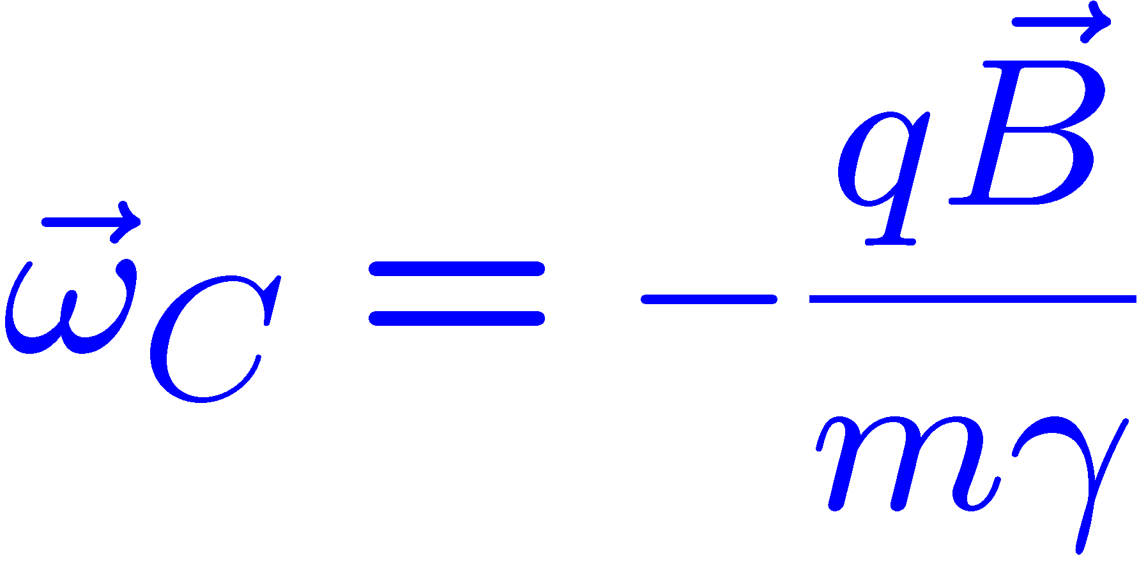


The a_{μ} Experiments:
Place polarized muons in a B field
  spin precession frequency (q = ± e)
  cyclotron frequency
Since g > 2, the spin gets ahead of the momentum

Slide 25


Spin Motion: Use Electric Field for Vertical Focusing
0
Electrostatic quadrupoles cover 43% of ring
Small (< 1ppm) correction for muons not at the magic γ.

Slide 26

Muon (g-2) storage ring to be relocated to FNAL

Slide 27
The error budget for a new experiment represents a continuation of improvements already made during E821
Systematic uncertainty (ppm) | 1998 | 1999 | 2000 | 2001 | E821 final | P989 Goal
Magnetic field – w_{p} | 0.5 | 0.4 | 0.24 | 0.17 |  | 0.07
Anomalous precession – w_{a} | 0.8 | 0.3 | 0.31 | 0.21 |  | 0.07
Statistical uncertainty (ppm) | 4.9 | 1.3 | 0.62 | 0.66 | 0.46 | 0.1
Systematic uncertainty (ppm) | 0.9 | 0.5 | 0.39 | 0.28 | 0.28 | 0.1
Total Uncertainty (ppm) | 5.0 | 1.3 | 0.73 | 0.72 | 0.54 | 0.14

Slide 28
Summary (g-2)
The measurements of e ± and μ± magnetic dipole moments have been important benchmarks for the development of QED and the Standard Model.
At present there appears to be a > 3 σ difference between a_{μ} and the SM prediction.
  if confirmed it would fit well with SUSY expectations, but LHC data will play a role in the interpretation.
A worldwide effort continues to improve the SM value.
a_{μ} has been particularly valuable in restricting physics beyond the standard model. It will continue that role in guiding the interpretation of the LHC data.
The Fermilab experiment, E989, will improve the error on a_{μ} by a factor of ≥4.
First results could be available around 2017/18

Slide 29
Goal is to be ready for data in 2016 with the magnet shimmed
  We expect CD0 this fall/Winter
  Conceptual Design Report being prepared
FY2011 Funding began this June
FY12 and beyond is being discussed between DOE and Fermilab

Slide 30
G. Venanzoni for the New G-2 Collaboration,

Slide 31
G. Venanzoni for the New G-2 Collaboration,

Slide 32


What could a Δa_{μ} ≈ 30×10^{–10} Deviation Tell Us?
Amount of discrepancy in ballpark of SUSY with mass scale of several 100 GeV
Proposals for new experiments E989 at FNAL (similar technique as E821) and at J-PARC (new: ultra-slow muons) with target of σ ~ 1.6 ·10^{–10}
Final E989 proposall:
http://gm2.fnal.gov/public_docs/proposals/Proposal-APR5-Final.pdf
But strong m_{SUSY} limits from LHC require large tanβ
LOI: KEK_J-PARC-PAC2009-06
See also, e.g., Naohito SAITO (KEK), Seminar at DESY 2011

Slide 33


Slide 34


a_{μ} is sensitive to a wide range of new physics, e.g.SUSY
difficult to measure at LHC
Related processes in SUSY

Slide 35



Ring relocation to Fermilab
Heavy-lift helicopters bring coils to a barge
Rest of magnet is a “kit” that can be trucked to and from the barge

Slide 36

Complementary ways to collect data
“t” method – time and energy of each event - pileup
“q” method – integrate the energy - no pileup
Geant simulation using new detector schemes
Event Method
Same GEANT simulation
Energy Method
B. Lee Roberts, University of Sussex – 8 July 2011
- p. 36/57

Slide 37
a_{μ}^{HLO}:
L.O. Hadronic contribution to a_{μ} can be estimated by means of a dispersion integral:
H
1 / s² makes low
energy contributions
especially important:
in the range < 1 GeV
contributes to 70% !
- K(s) = analytic kernel-function
- above sufficiently high energy value, typically 2…5 GeV, use pQCD
Input:
a) hadronic electron-positron cross section data
b) hadronic τ- decays, which can be used with the help of the CVC-theorem
and an isospin rotation (plus isospin breaking corrections)
(G.dR 69, E.J.95, A.D.H.’97,….)
(A., D., H. ’97)
Notes:
Mettere le referenze

Slide 38
Measured Cross section for e⁺e⁻ →π⁺ π⁻
08

Slide 39
What about the lattice?
At the INT Workshop on the Hadronic Light-by-Light contribution in February, Karl Jansen presented a new 2-3% lattice result for the lowest-order hadronic (u,d quarks only)contribution:
We can look forward to results from the other lattice groups!
Feng, Jansen, Petschlies, Renner, arXiv:1103.4818v1 [hep-lat]

Slide 40

Other Models
Technicolor
  small Δa_{μ}
Littlest Higgs with T-parity
  small Δa_{μ}
Universal Extra Dimensions
  small Δa_{μ}
Randall Sundrum
  could accommodate large Δa_{μ}
Two Higgs doublets, shadow Higgs
  small Δa_{μ}
Additional light bosons that can affect EM interactions (difficult to study at LHC)
  secluded U(1),etc., could have significant Δa_{μ}
g - 2
Natalia Toro, Aspen 2011

Slide 41
The error budget for a new experiment represents a continuation of improvements already made during E821
Systematic uncertainty (ppm) | 1998 | 1999 | 2000 | 2001 | E821 final | P989 Goal
Magnetic field – w_{p} | 0.5 | 0.4 | 0.24 | 0.17 |  | 0.07
Anomalous precession – w_{a} | 0.8 | 0.3 | 0.31 | 0.21 |  | 0.07
Statistical uncertainty (ppm) | 4.9 | 1.3 | 0.62 | 0.66 | 0.46 | 0.1
Systematic uncertainty (ppm) | 0.9 | 0.5 | 0.39 | 0.28 | 0.28 | 0.1
Total Uncertainty (ppm) | 5.0 | 1.3 | 0.73 | 0.72 | 0.54 | 0.14

Slide 42
Systematic errors on ω_{a} (ppm)
σ_{systematic} | 1999 | 2000 | 2001 | Future
Pile-up | 0.13 | 0.13 | 0.08 | 0.04
AGS Background | 0.10 | 0.10 | 0.015*
Lost Muons | 0.10 | 0.10 | 0.09 | 0.02
Timing Shifts | 0.10 | 0.02 | 0.02
E-Field, Pitch | 0.08 | 0.03 | 0.06* | 0.03
Fitting/Binning | 0.07 | 0.06 | 0.06*
CBO | 0.05 | 0.21 | 0.07 | 0.04
Beam Debunching | 0.04 | 0.04 | 0.04*
Gain Change | 0.02 | 0.13 | 0.13 | 0.02
total | 0.3 | 0.31 | 0.21 | ~0.07
better with Fermilab beam structure and improved detectors/electronics
Σ* = 0.11

Slide 43

The Precision Field: Systematic errors
Why is the error 0.11 ppm?
  That’s with existing knowledge and experience
    with R&D defined in proposal, it will get better
Next
(g-2)

Slide 44

Hadronic Light-by-Light Contribution
see: http://www.int.washington.edu/PROGRAMS/11-47w/

Slide 45







arXiv:0901.0306v1
Dynamical models with QCD behavior
Note, with Δa_{μ} = 295 x 10⁻¹¹ … If HLBL is the source of the difference with SM, it would need to increase by 11 σ ....

Slide 46





The π⁰ (Goldstone) contribution fixes sign of the contribution From χpt and large N_{c} QCD
Examples of other 3-loop hadronic contributions:
The magnitude of the HLBL is about the same as the magnitude of the 3-loop HVP which can be calculated from the dispersion relation.
It’s hard to believe that the HLBL would be huge compared to the other 3-loop contributions.

Slide 47




EDMs in Storage Rings: E821@ BNL
ω_{edm} <<<<<< ω_{a}

Slide 48

Muon EDM in the BNL E821 Storage Ring
E821 Data
EDM
(g-2)
Vertical Oscillation out of phase with ω_{a}

Slide 49


How do we get rid of the (g - 2) signal?
Y. Semertzidis idea of the “frozen spin”
  Use a radial E field to turn off the ω_{a} precession
0

Slide 50



a_{μ} implications for the muon EDM assuming same New Physics participates (recall that (Δ^{today}=255(80) X10⁻¹¹ )
Assuming that
Either d_{µ} is of order 10^{–22} e cm, or the CP phase is strongly suppressed!

Slide 51

Typical CMSSM 2D space showing g-2 effect
(note: NOT an exclusion plot)
Present:
Δaμ = 295 ± 88 x 10⁻¹¹
Here, neutralino accounts for the WMAP implied dark matter density
scalar mass
2σ
Excluded for neutral dark matter
courtesy Keith Olive
gaugino mass
This CMSSM calculation: Ellis, Olive, Santoso, Spanos. Plot update: K. Olive

Slide 52

Typical CMSSM 2D space showing g-2 effect
(note: NOT an exclusion plot)
Back
Future
Δa_{μ} = 295 ± 34 x 10⁻¹¹
Here, neutralino accounts for the WMAP implied dark matter density
Historically muon (g-2) has played an important role in restricting models of new physics.
It provides constraints that are independent and complementary to high-energy experiments.
scalar mass
Excluded for neutral dark matter
gaugino mass
This CMSSM calculation: Ellis, Olive, Santoso, Spanos. Plot update: K. Olive
With new experimental and theoretical precision and same Δaμ
courtesy Keith Olive

Slide 53
₅₃
Cross section data:
At low energies (< 2 GeV) only measurements of exclusive channels, two approaches:
Energy scan (CMD2, SND):
energy of colliding beams is changed to the desired value
“direct” measurement of cross sections
needs dedicated accelerator/physics program
needs to measure luminosity and beam energy for every data point
Radiative return (KLOE, BABAR, BELLE):
runs at fixed-energy machines (meson factories)
use initial state radiation process to access lower lying energies or
resonances
data come as by-product of standard physics program
requires precise theoretical calculation of the radiator function
luminosity and beam energy enter only once for all energy points
needs larger integrated luminosity

Slide 54




KLOE-2 contribution to F_{π0γ∗γ}(q₁²,0) and a_{μ}^{LbL,π0}
By including KLOE-2→a reduction of a factor 2 in the error of a_{μ}^{π0} !
(D. Babusci et al. to be submitted to journal)
q²= -2EE’(1-cosθ)
6% for each point KLOE2 with 5 fb⁻¹
See the talk of Ivashin
In addition the measurement of Γ(π⁰→γγ) will constrain F_{π0}(q²=0) (which is now obtained by WZW model 1/4πf_{π} w/o error)

Slide 55


Muon g-2 is a powerful discriminator between models; chiral-changing, flavor and CP conserving interaction.
tan b sensitivity
Future
Sfitter
2s
1s
e.g. Super Symmetry
SPS1a; LHC 100 fb-1 at 14 TeV
Snowmass points and slopes (SUSY)
from D. Stöckinger

Slide 56


Slide 57

Yoke fully assembled
January 2009

Slide 59

E821 achieved 0.54 ppm; e⁺e⁻ based theory 0.49 ppm Hint is 3.2 – 3.6 σ
Theory: Davier, et al., Eur. Phys. J. C (2011) 71: 1515
e⁺e⁻ theory
~3.5 “standard deviations”
Hint of new physics?

Slide 60
Systematic errors on ω_{a} (ppm)
σ_{systematic} | 1999 | 2000 | 2001 | Future
Pile-up | 0.13 | 0.13 | 0.08 | 0.04
AGS Background | 0.10 | 0.10 | 0.015*
Lost Muons | 0.10 | 0.10 | 0.09 | 0.02
Timing Shifts | 0.10 | 0.02 | 0.02
E-Field, Pitch | 0.08 | 0.03 | 0.06* | 0.03
Fitting/Binning | 0.07 | 0.06 | 0.06*
CBO | 0.05 | 0.21 | 0.07 | 0.04
Beam Debunching | 0.04 | 0.04 | 0.04*
Gain Change | 0.02 | 0.13 | 0.13 | 0.02
total | 0.3 | 0.31 | 0.21 | ~0.07
better with Fermilab beam structure and improved detectors/electronics
Σ* = 0.11

Slide 61
Systematic errors on ω_{p} (ppm)
Why is the error 0.11 ppm?
  That’s with existing knowledge and experience
    with R&D defined in proposal, it will get better
Next
(g-2)

