Slide 1


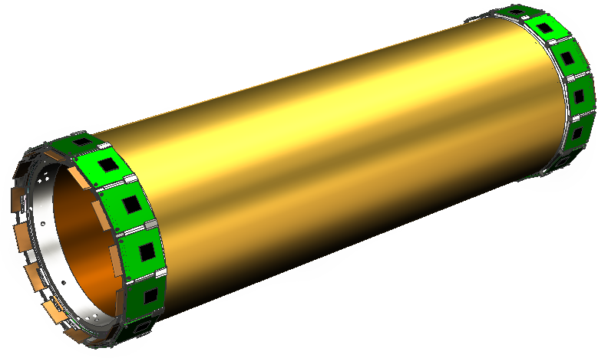
CGEM-IT project and beam test program
G. Felici for the FE-LNF-TO team
Partially supported by the Italian Ministry of Foreign Affairs under the Program of Great Relevance PGR-00136

Slide 2
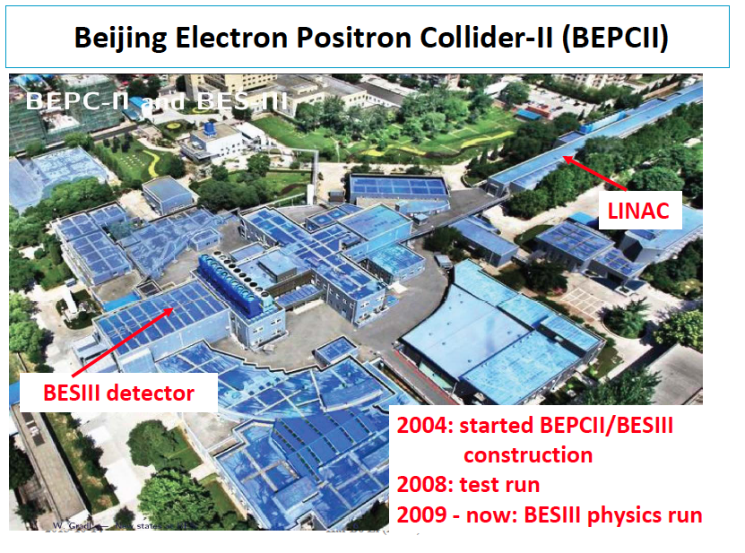

Slide 3

The BESIII Collaboration

Slide 4
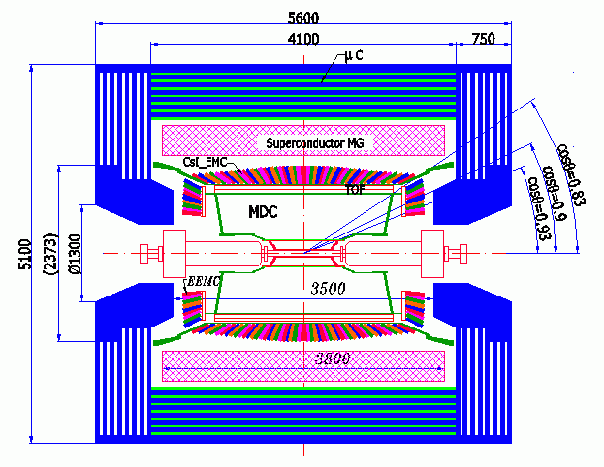
CSI calorimeter
Precision tracking
Time-of-flight + dE/dx PID
BESIII Detector
Magnet: 1 T Super conducting
MDC: small cell & Gas: He/C₃H₈ (60/40), 43 layers
σ_{xy}=130 μm
σ_{p}/p = 0.5% @1GeV
dE/dx=6%
Zero Degree Detector
new (2011)
ZDD
TOF:
σ_{T} = 100 ps Barrel
110 ps Endcap
Muon ID: 9 layers RPC
8 layers for endcap
EMC: CsI crystal, 28 cm
ΔE/E = 2.5% @1 GeV
σz = 0.6 cm/√E
Data Acquisition:
Event rate = 4 kHz
Total data volume ~ 50 MB/s
The detector is hermetic for neutral and charged particle
with excellent resolution, PID, and large coverage.
4
Notes:
consist of a MDC to measure charged track,
Helium and Propane

Slide 5
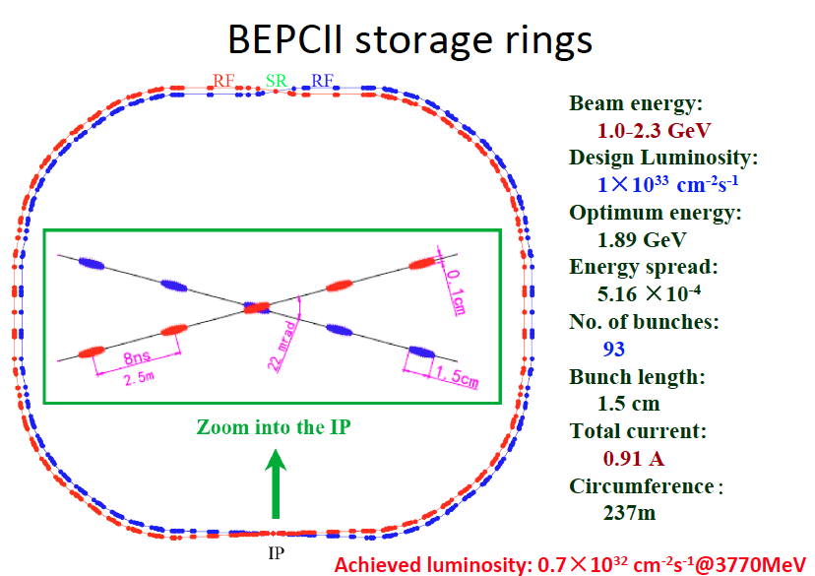

Slide 6
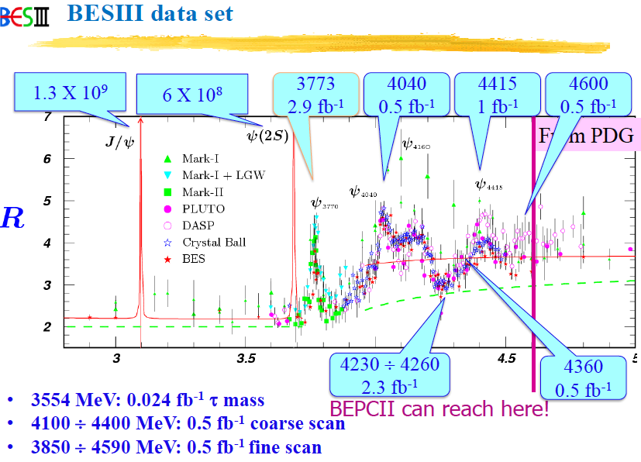
BESIII data set

Slide 7
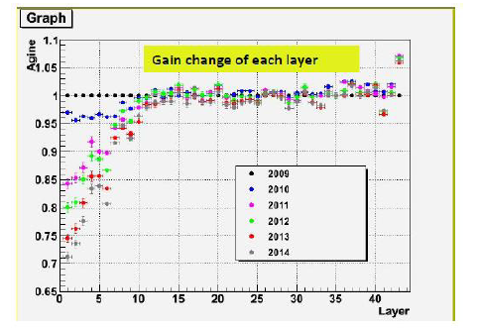
BESIII Inner Tracker: MDC aging problems
Gain change from 2009-2014 with Bhabha events
Compared with 2009, now the gas gains of first 5 layers decrease about 29% —14%
The gains of the first 10 layers have an obvious decrease
The gains of the layers in the outer chamber have nearly no change

Slide 8
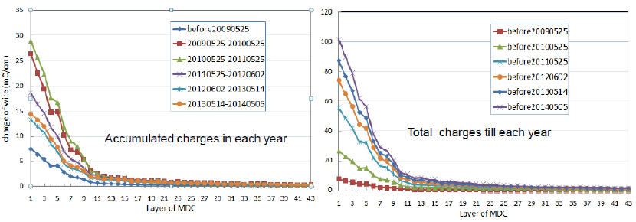
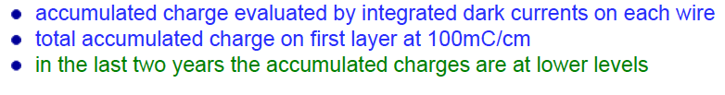
BESIII Inner Tracker: MDC aging problems
Charge accumulation on INNER MDC

Slide 9
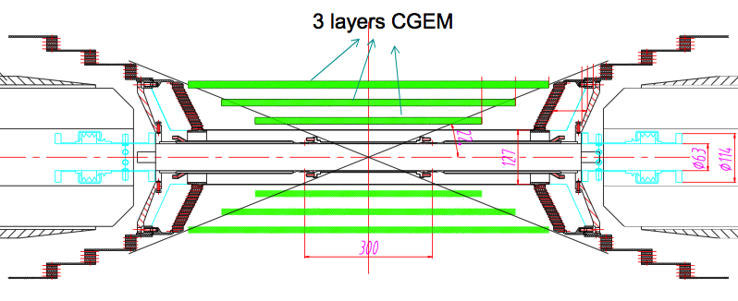
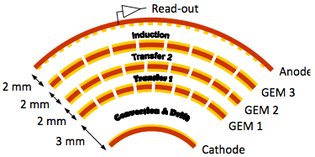
CGEM detector for BESIII
Three active layers
Active area
  L1 length 532 mm
  L2 length: 690 mm
  L3 length: 847 mm
Inner radius: 78 mm
Outer radius: 178 mm
Requirements
Rate capability: ~10⁴ Hz/cm²
Spatial resolution: σ_{xy} =~100μm : σ_{z}=~1mm
Momentum resolution:: σ_{pt}/P_{t} =~0.5% @1GeV
Efficiency = ~98%
Material budget ≤ 1.5% all layers
Coverage: 93% 4π
Operation duration ~ 5 years

Slide 10
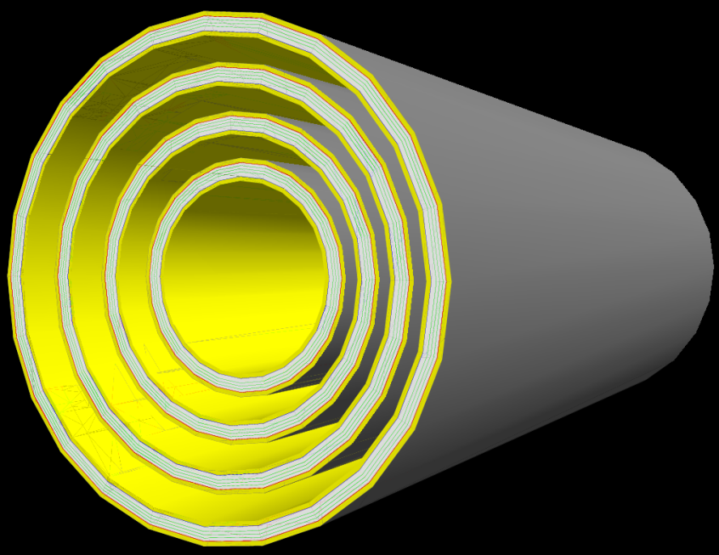
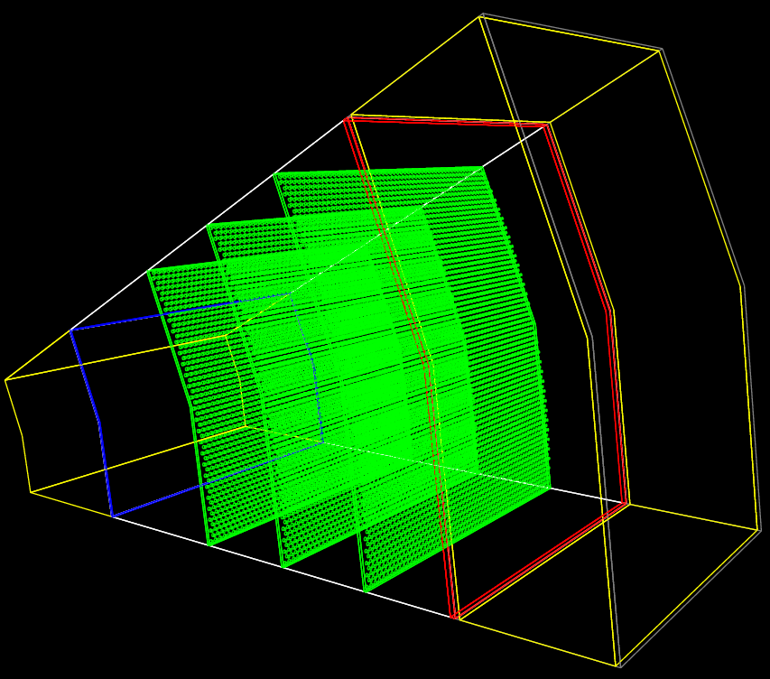

GEANT4 simulation
A CGEM detector has been added to the BESIII simulation in order to preliminary evaluate its possible performance.
A lot of details in the simulation.
Reconstruction code needs to be developed to fully evaluate the impact on the physics.

Slide 11
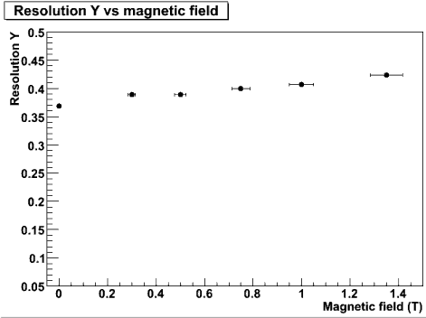
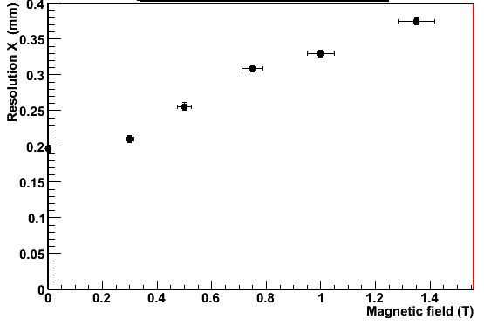
CGEM expected performance
σ_{rφ}
σ_{z}
BESIII B-Field σ_{rφ} = 330 μm
BESIII B-Field σ_{z} = 400 μm
Readout | σ_{rφ} (μm) | σ_{z} (μm)
Digital readout (Beam test @2009) | 330 | 400
Analog readout (magnetic field effect avoided)* | 80 | 150
* Taken as expected spatial resolution

Slide 12
Purpose of beam test(s) …
Validate GEM analog readout in magnetic field.
Validate Garfield simulation and extract useful information for hit digitization.
Validate the BESIII anode structure.
Spatial resolution as function of the magnetic field
Cluster size as function of the magnetic field
Perform the same measurements at different gain
Other measurements:
  efficiency
  different gas mixture
… & Some possible measurement to perform

Slide 13
BESIII beam test setup
BESIII test chamber
APV 25 analog readout
forward trigger
(scintillators+SiPM)
backward trigger
(scintillators+SiPM)
muon/pion
beam
Forward Tracking
two Kloe-2 chamber
with APV 25 readout
Backward Tracking
two Kloe-2 chamber
with APV 25 readout

Slide 14
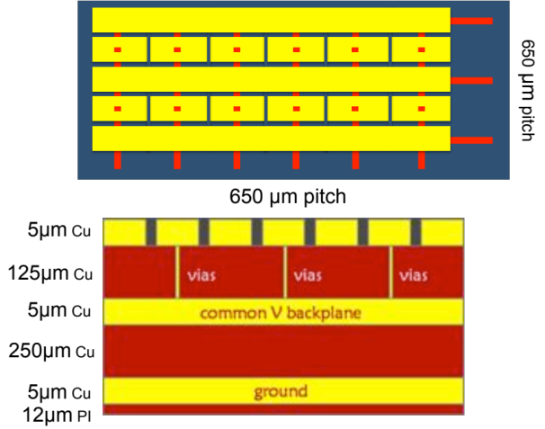
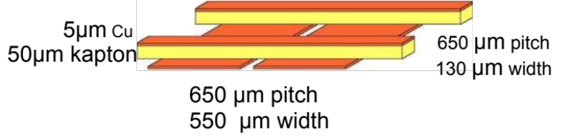
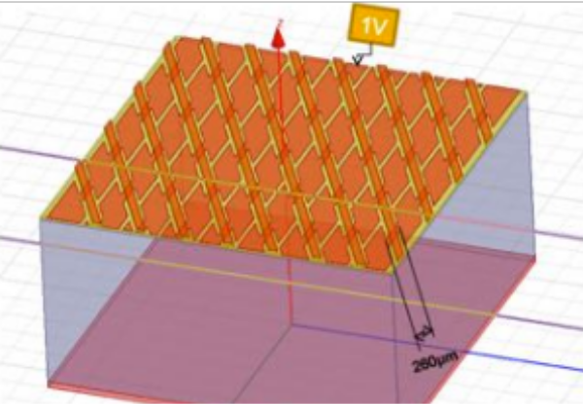
BESIII beam test - readout anode design
KLOE strips design
TRACKING CHAMBERS
BES strips design – rel1 COMPASS LIKE
BES strips design – rel2
Tilted Angle + Jagged design to decrease parasitic capacitance (-30% from simulations)

Slide 15
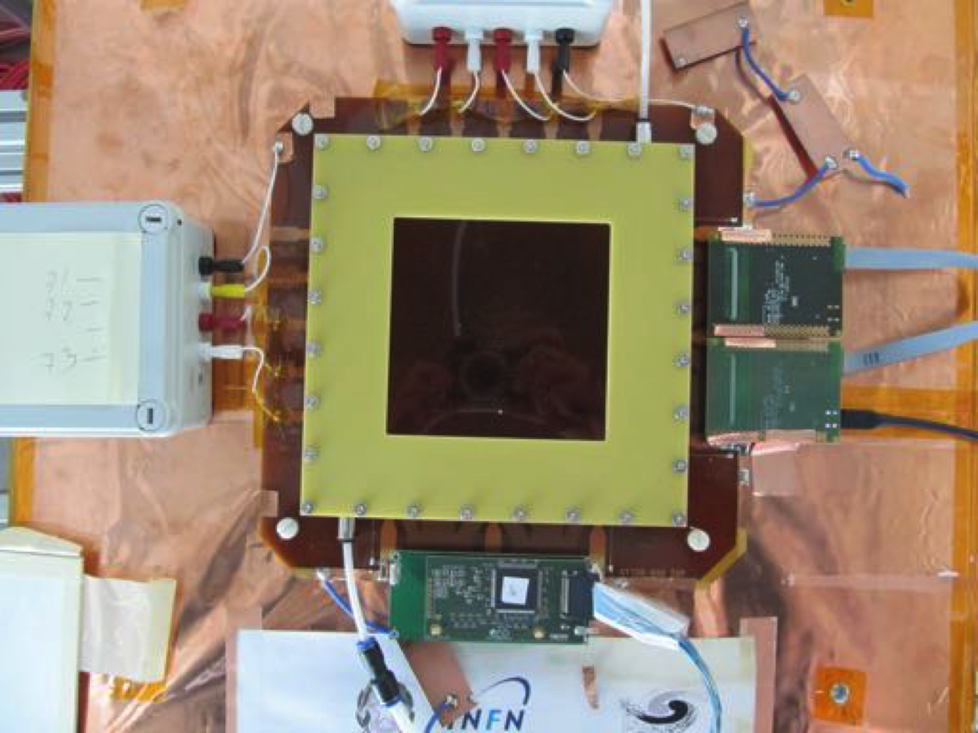
BESIII beam test – Readout
DATA ACQUISITION SUPPORTS FULLY ANALOG, FULLY DIGITAL AS WELL AS MIXED MODE READOUT
APV25
(ANALOG – 128 chs)
GASTONE
(DIGITAL – 128 chs)

Slide 16
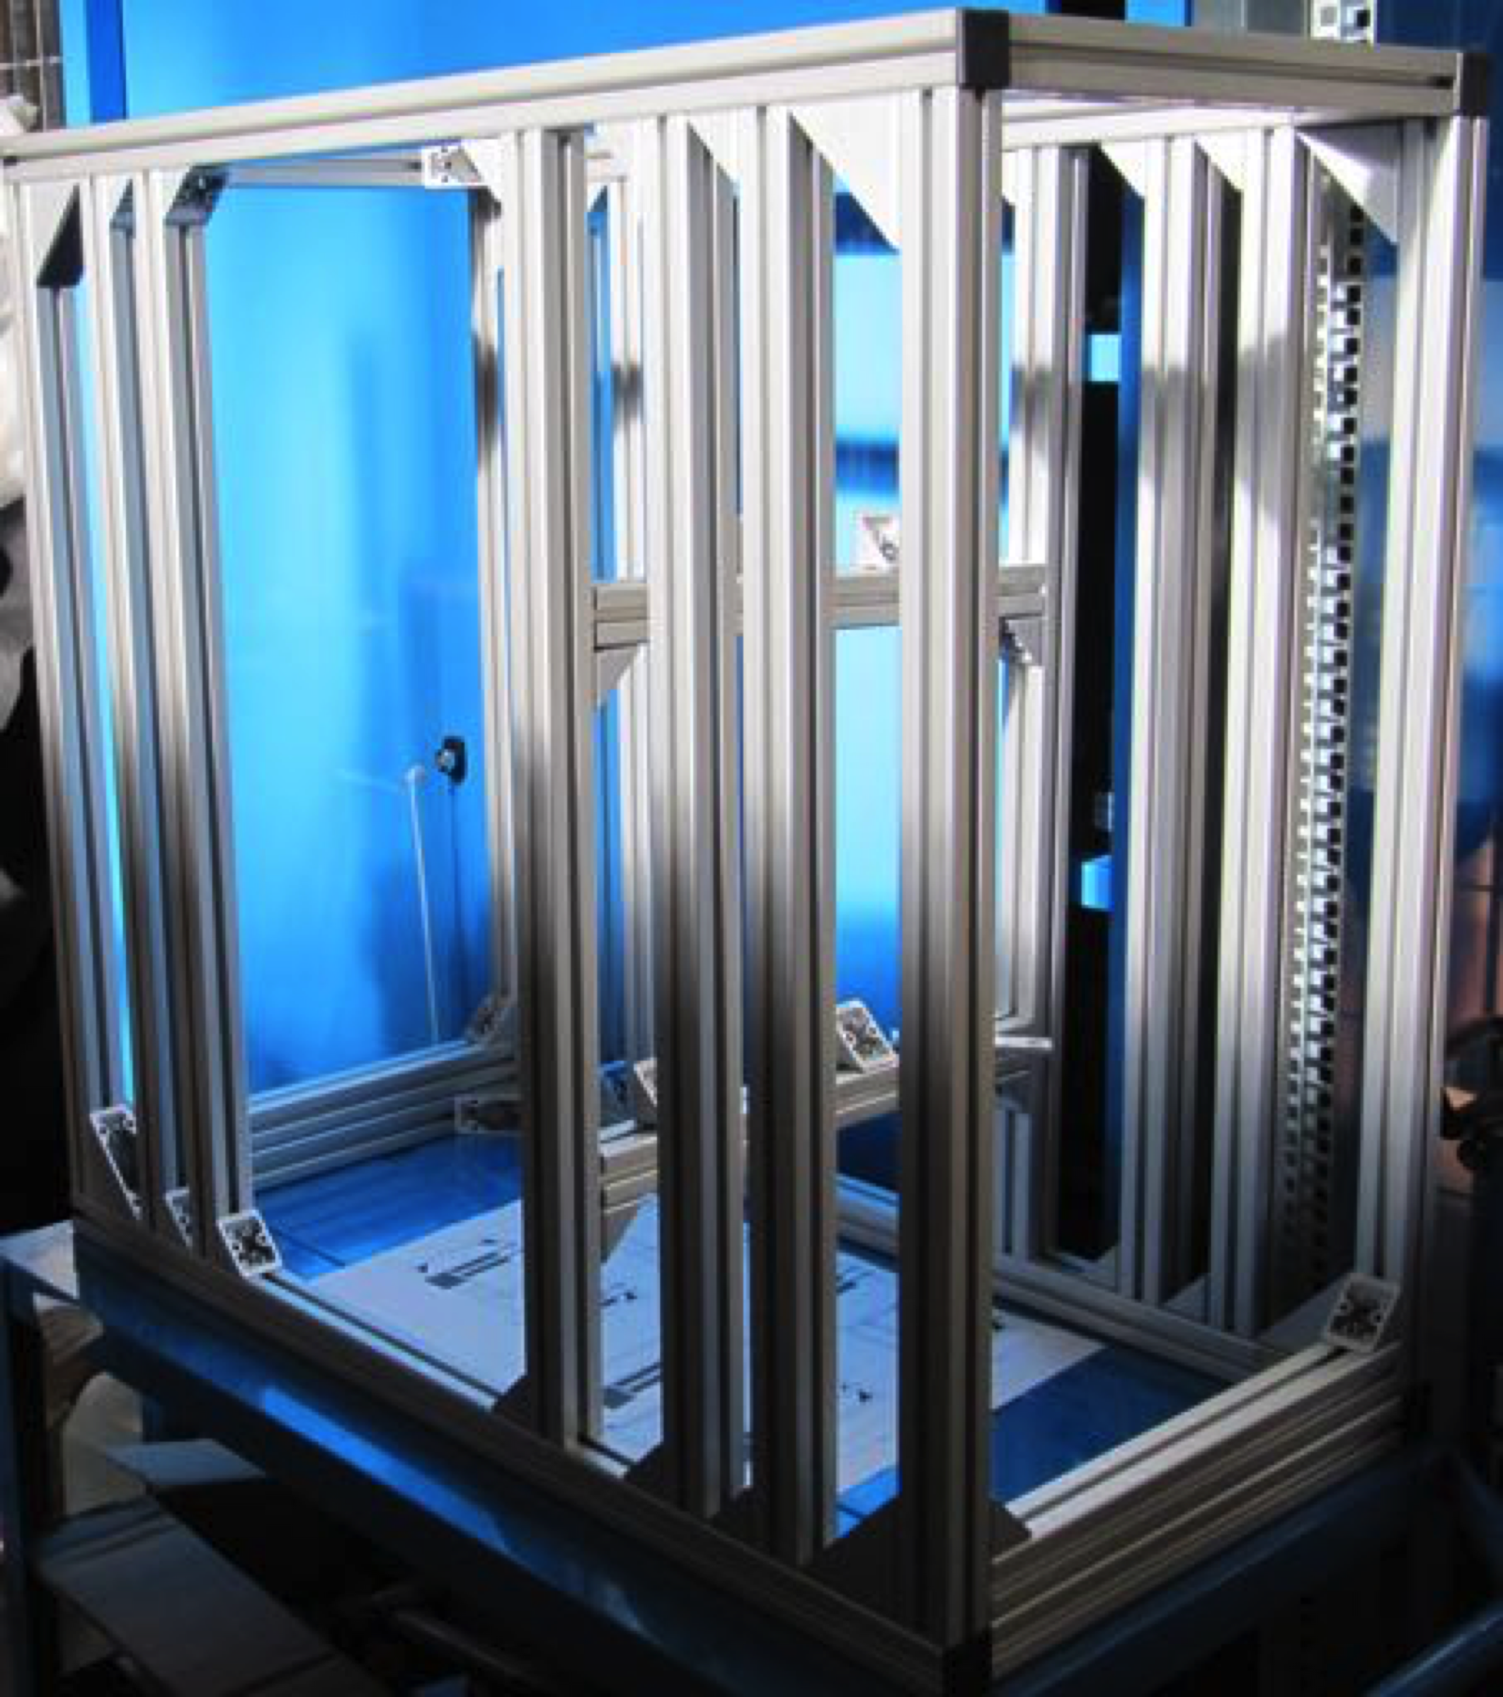
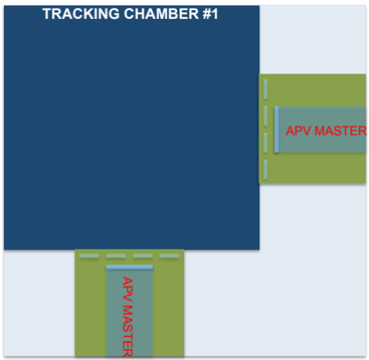
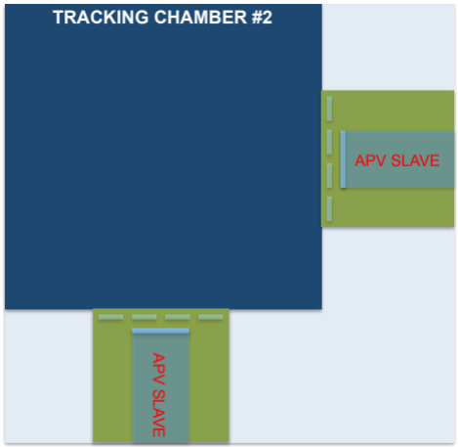
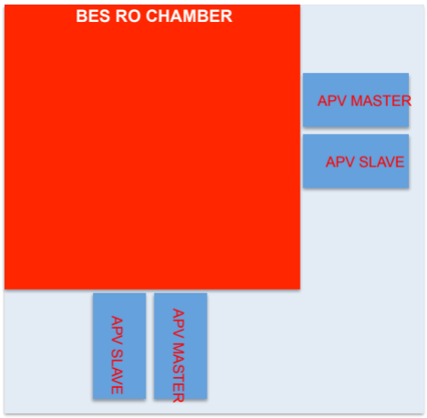
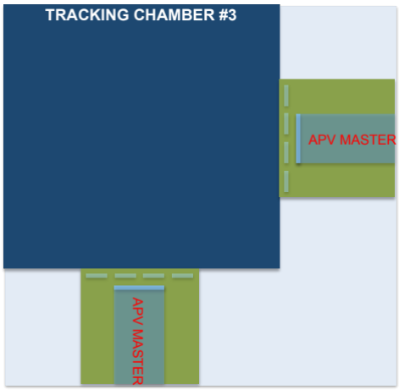
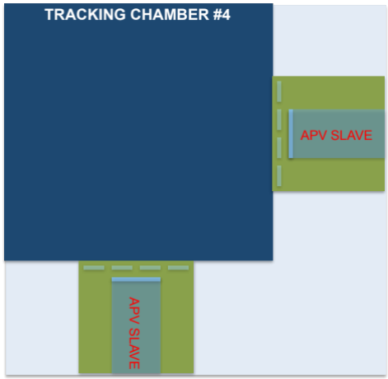
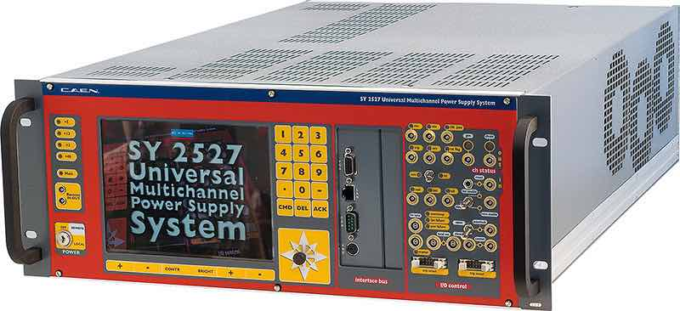
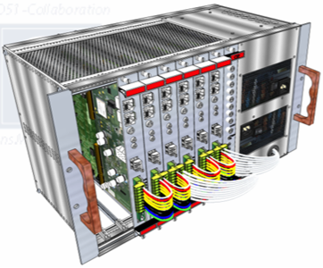
BESIII beam test – Setup
CHAMBERS SUPPORT
MAGNET
≈71 cm
≈ 1300 ANALOG RO channels
≈76 cm
≈39 cm
BEAM AREA

Slide 17
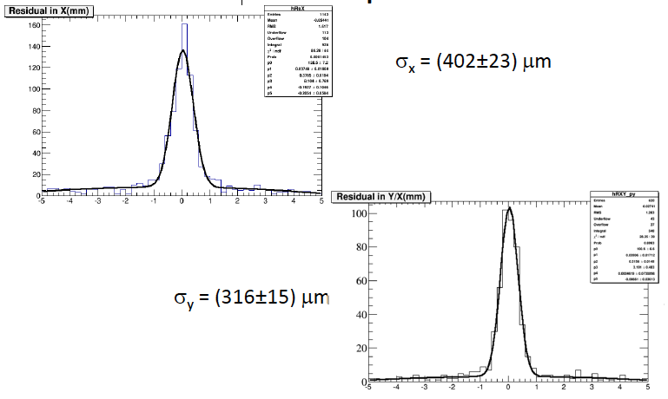
Cosmic data: Spatial resolution
with digital readout
courtesy of Sandro Calcaterra

Slide 18
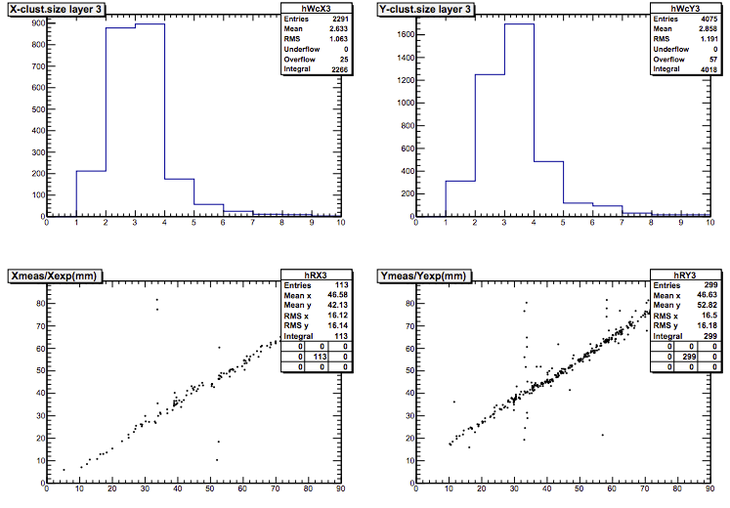
Cosmic data: Cluster size
courtesy of Sandro Calcaterra

Slide 19
Summary
Data acquisition based on APV25 system run smoothly (ATLAS parameters setup and DAQ system).
Integration of tracking chambers, BES proto and mechanical structure is going on
Setup details have been already discussed with RD51 collaboration.
Beam test will start on Nov 26 and end on Dec 14

