Slide 1
The Zero Degree Detector for BES3: status and outlook
A. Calcaterra, for the
LNF-IHEP ZDD group
IHEP 2015-01-21

Slide 2
Talk outline
Introduction
ZDD hardware
  The detector
  The electronics
ZDD firmware and online
  The raw data
ZDD offline software
ZDD Data Quality Monitor

Slide 3
Introduction
The ZDD was designed in Frascati in the year 2010, built, tested and installed in 2011
  Not ready for integration in BESIII DAQ in 2011-2012
Start of real BESIII data taking in 2012-2013
  DAQ errors! Data compression buggy, and also too slow
An upgrade was designed, built and installed in 2013
  New preamps in VME instead of NIM, “segmentation” strips
  DAQ problems persisted also in 2013-2014
  Data taking window too large for processor speed wrt L1* rate
  Latest CAEN firmware not buggy but still too slow
ZDD signal finally identified in spring-summer 2014
  Data taking window halved, data compression algorithm runs fast enough
  More reduction still possible

Slide 4
Part I
ZDD hardware and electronics

Slide 5
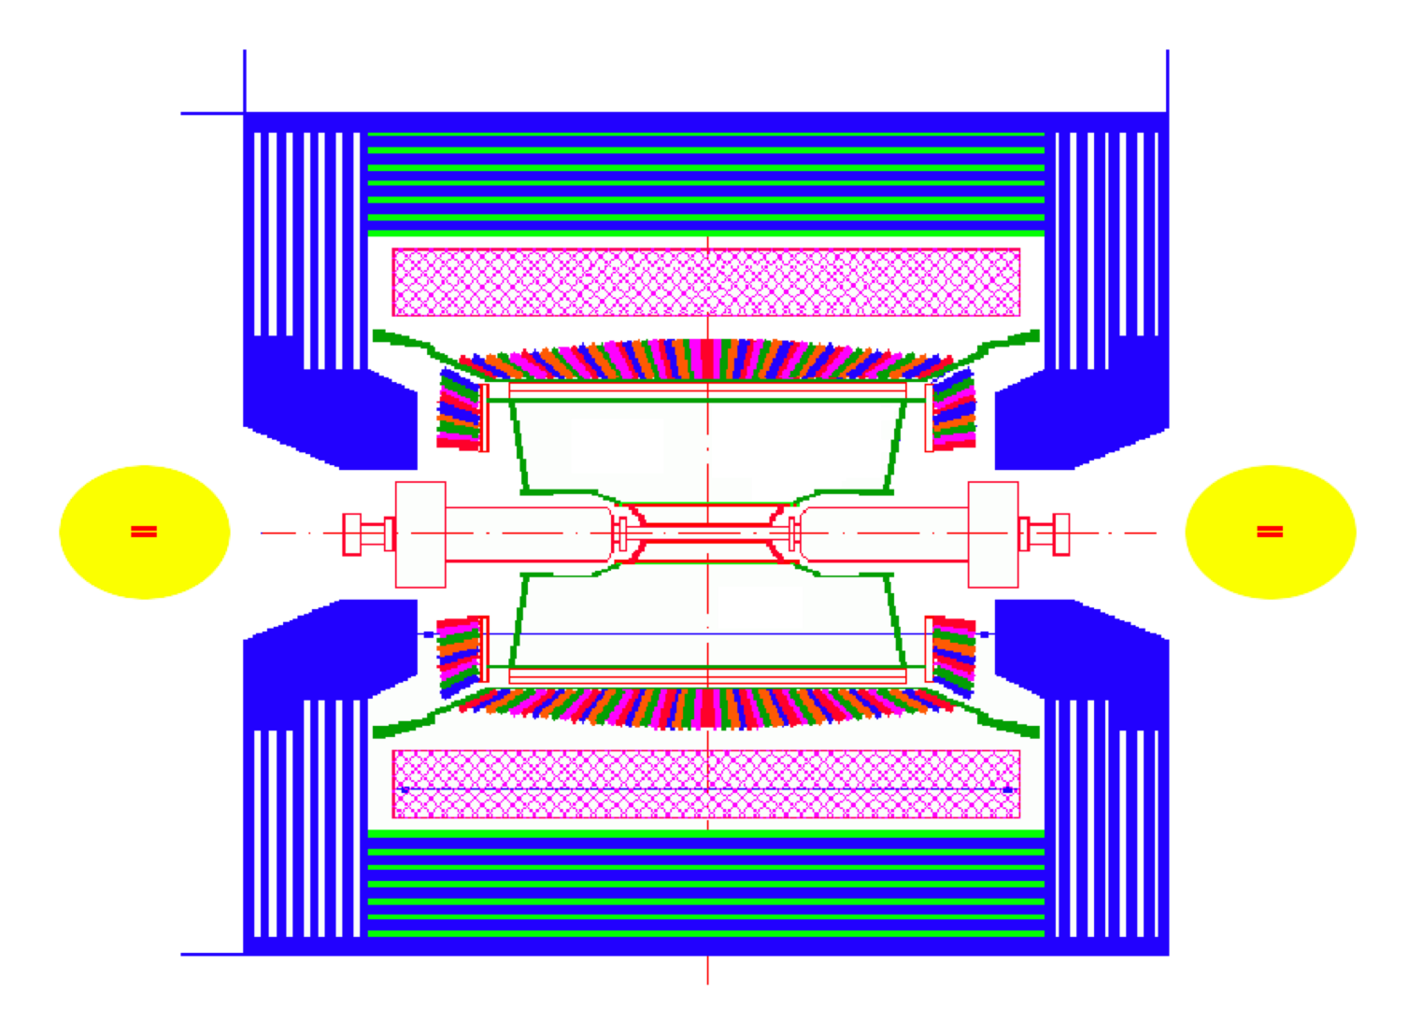
ZDD (Zero Degree Detector) @ BESIII
ZDD_{B}
ZDD_{F}
349cm
Proposal accepted by INFN: substitution of one BESIII luminometer with a mini-calorimeter based on the KLOE Pb/Scintillating fibers technique

Slide 6
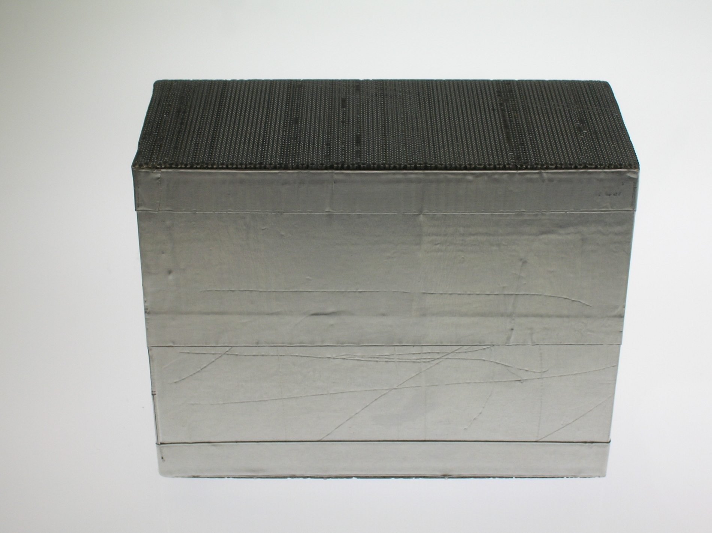
1° prototype (courtesy of P326 – thanks!), machined in early September 2010
5 cm
Weight approx. 5 kg
11 cm
15cm

Slide 7
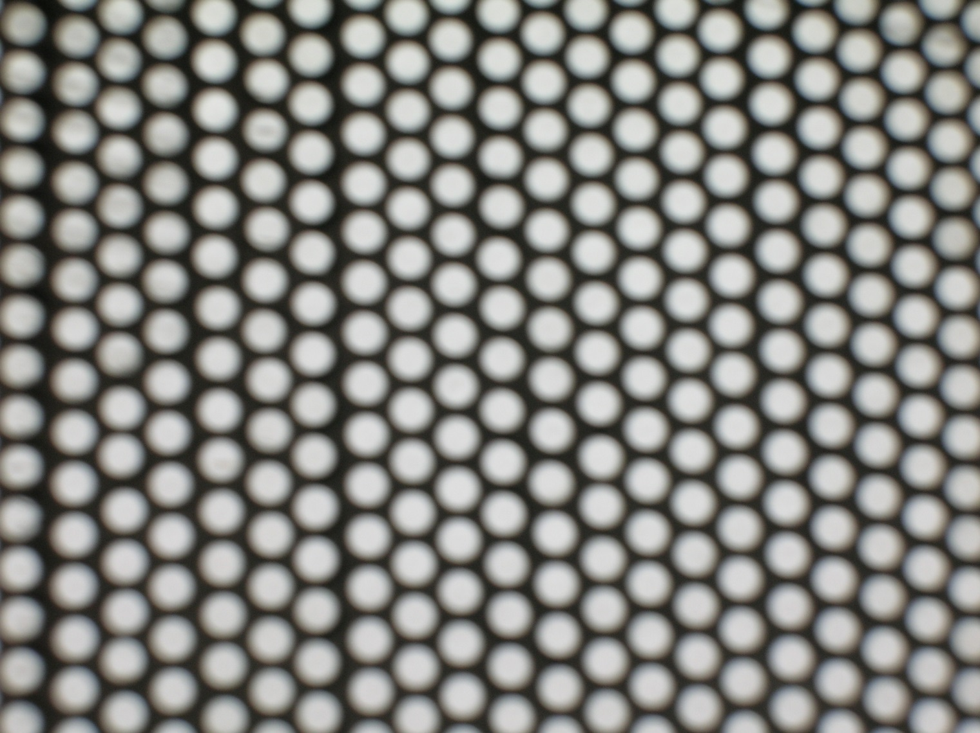
Picture of Pb/Sci.Fi. Array, scintillating material 60% of total (in volume)

Slide 8
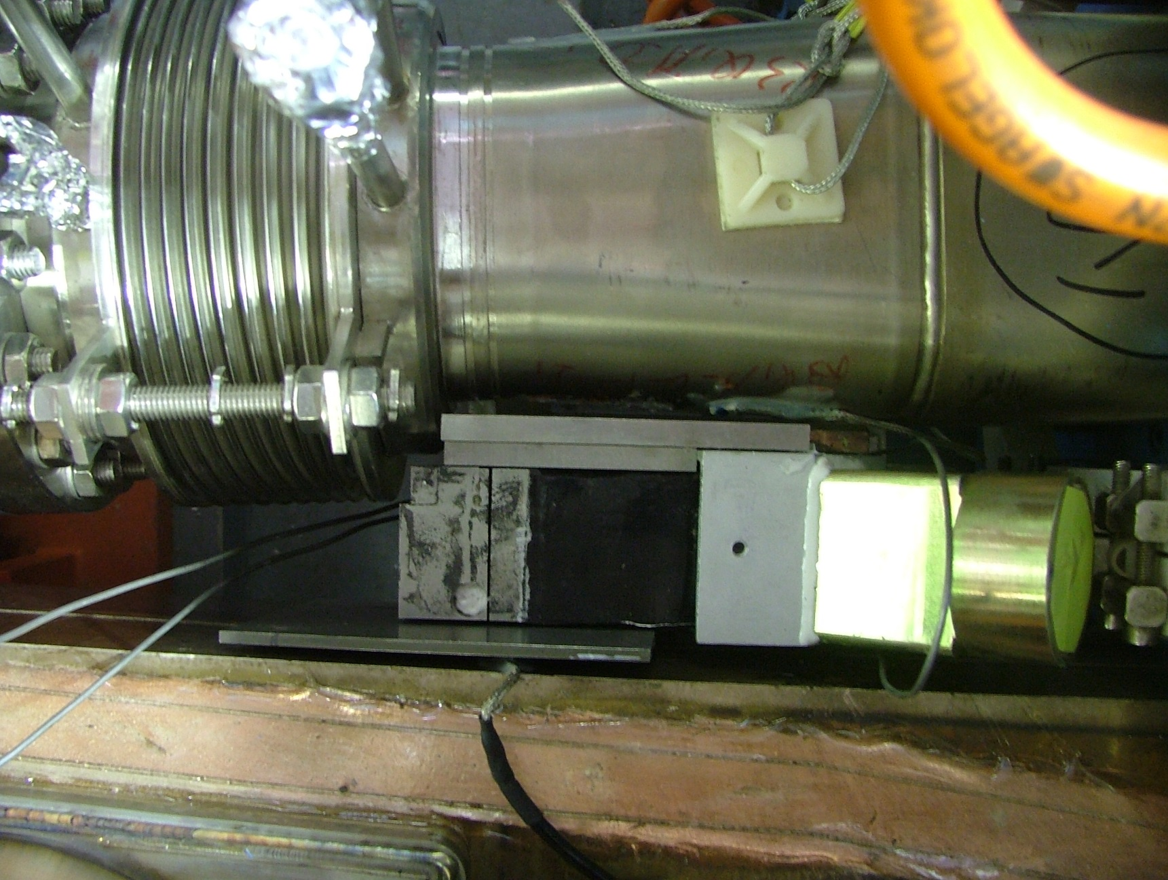
Previous BESIII Lumi detector in the East region
Notes:
visto dall’alto
8

Slide 9
ZDD simplified view
We consider 4 sectors: Top Left, Top Right, Bottom Left and Bottom Right. There are 4 PMs in each sector
Top Left and Right sectors
Upper calorimeter block
γ (e⁺e⁻) direction from IP
Bottom Left and Right sectors
Lower calorimeter block

Slide 10
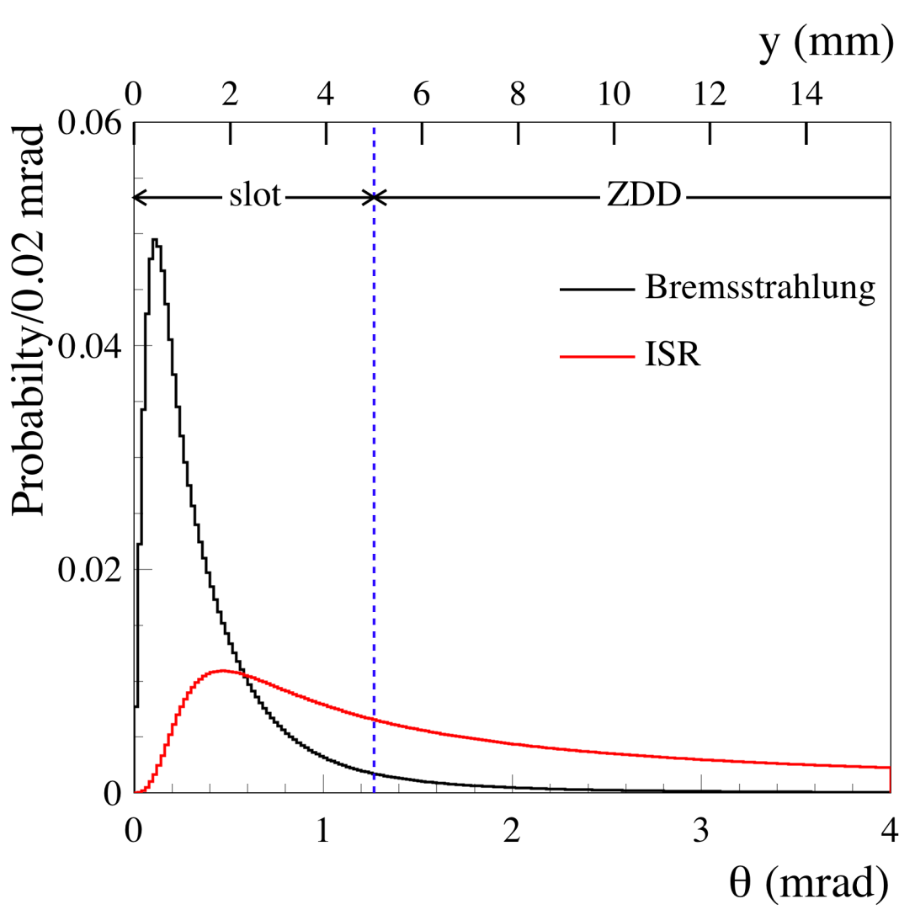
θ distribution of radiation from IP
The θ from ISR radiation peaks somewhat at 0 degrees
The θ from Bremsstrahlung (background) also does it, but much more strongly
Keeping the ZDD away from the θ =0 region reduces background much

Slide 11
ZDD simplified view
One block has 8 channels, 2 cm wide: the “front” 2 channels have depth 2 cm, the “back” 6 are 4 cm deep
2 blocks have 16 channels in all
γ (or e⁺e⁻) direction from IP
Bottom Left and Right sectors
Lower calorimeter block

Slide 12
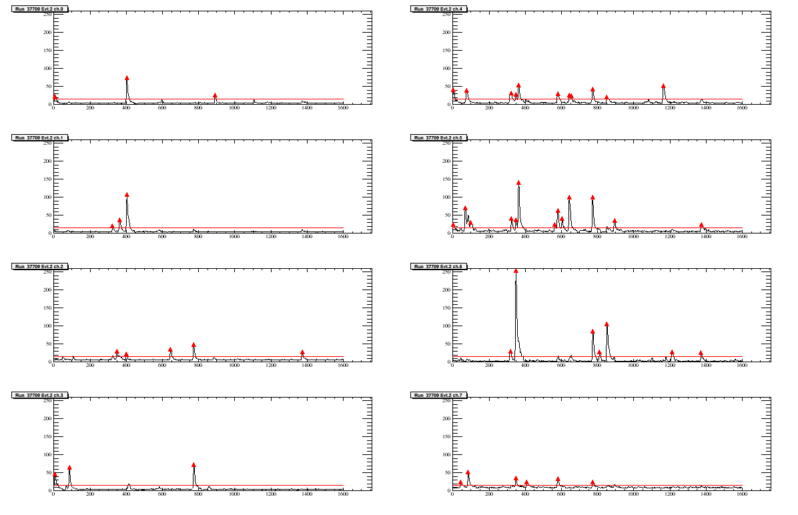
ZDD event (peak width ∼ 6÷10 ns)
8 channels in one calorimeter block share a common timeline within 2 ns

Slide 13
ZDD “reconstruction”
Find the “peaks”
  Mark the maximum height
  Mark the time of this maximum
  Select “good” peaks using BESIII time info
Match peaks between individual channels
Sum “peaks” over 4 channels in a row
  Shower energy sharing, leaking corrections
Compute energy
  Applying calibration(s)

Slide 14
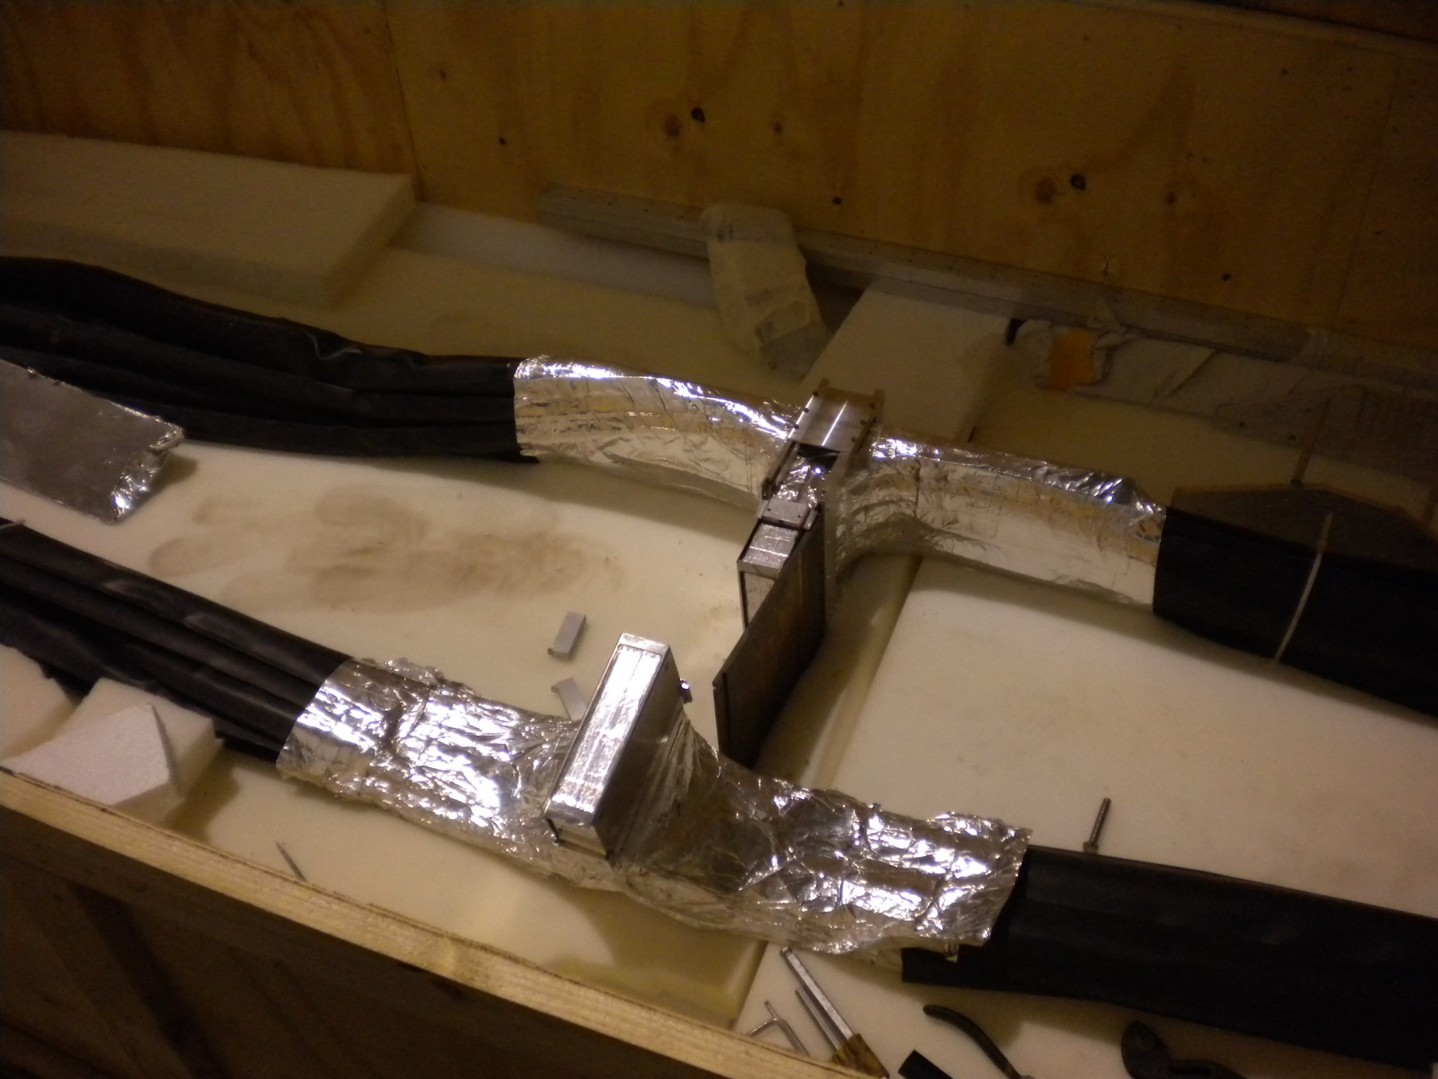
The “naked” ZDD
One Tungsten screen
Pb-SciFi blocks
Readout fiber bundles

Slide 15
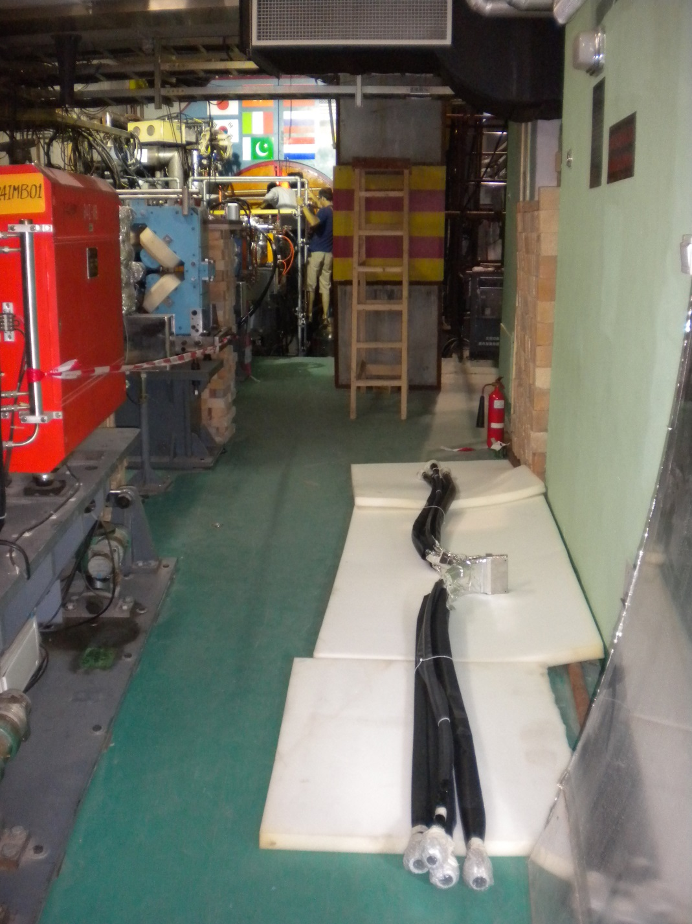
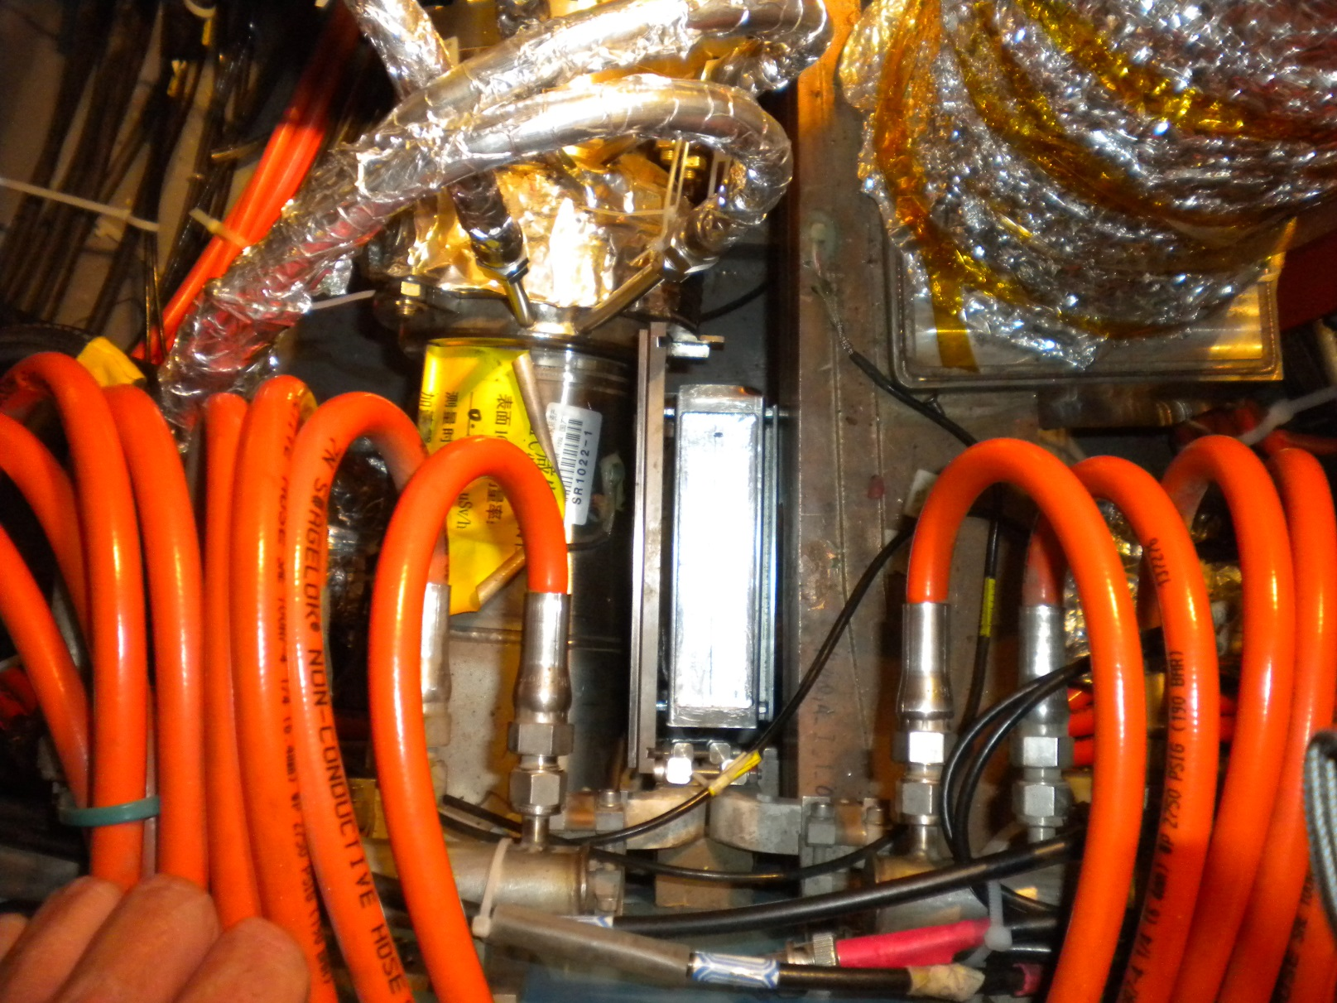

Slide 16
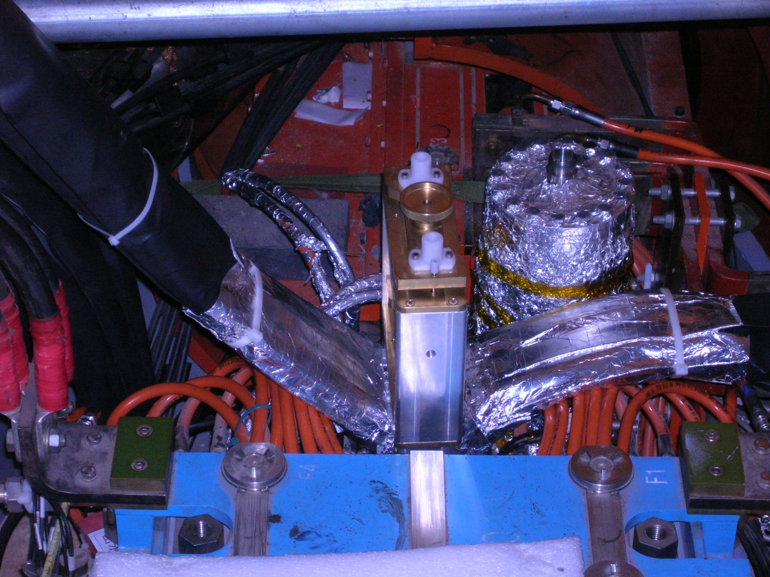
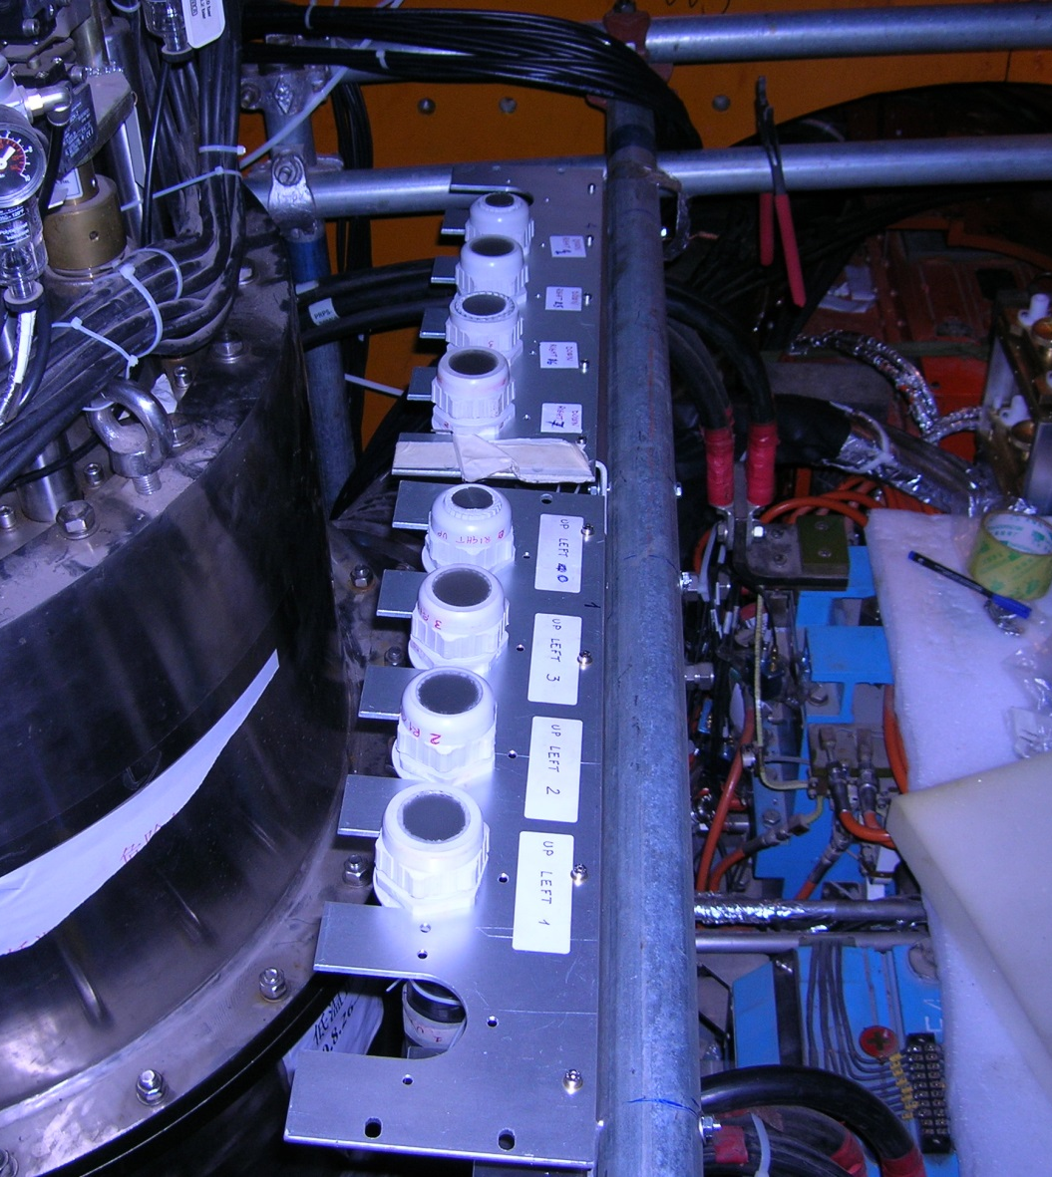

Slide 17
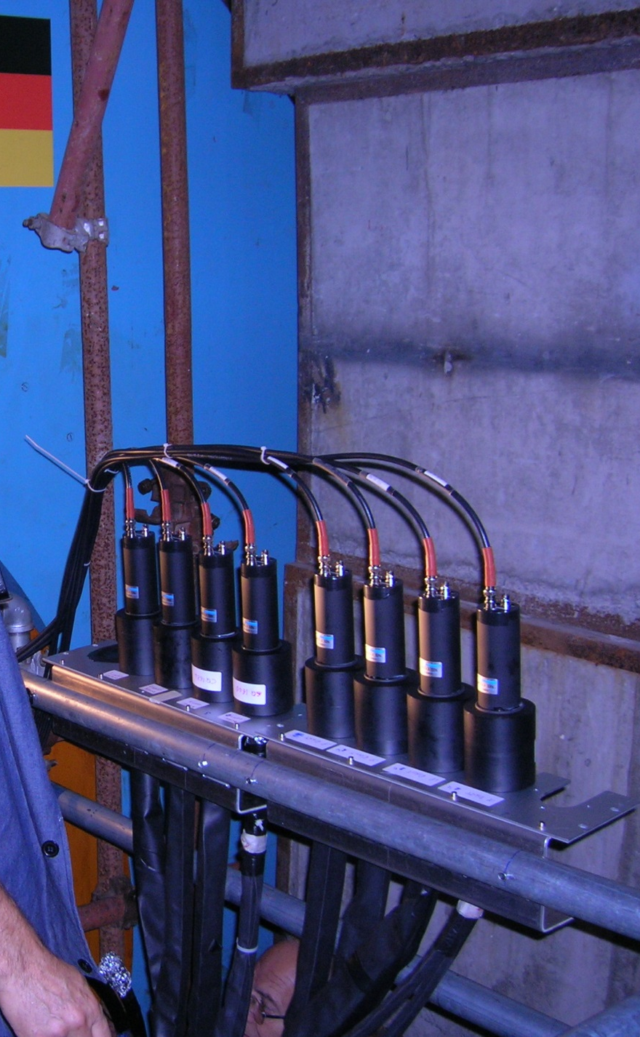

The “final” result:
a huge amount of work
mostly made by Mario Anelli
in Frascati, with much help
by Zhen Xue at IHEP, and Zhu Kejun

Slide 18
ZDD electronics (“front end”)
The electric signals from 16 phototube reach the “Yellow box” (or “happy box”)
The “yellow box” has 16 preamplifiers (x2) and shapers, to drive the signals on ~18m of 50Ω RG136 cable to the ZDD VME crate
The VME crate has two 8-channel FlashADC made by CAEN, model V1721

Slide 19
The CAEN V1721
A V1721 really is an 8-line oscilloscope with one vertical scale of 1V_{pp} (8-bit samples) and a common timescale of 2 ns/sample
N_{samples}/event (or window width) may be programmed
It must be ≥ 8 μs, the L1* trigger latency
Total required memory per event = 64kb
  …a big problem for VME bandwidth and storage!
  “natural width” of one ZDD event is ≈100 ns

Slide 20
V1721 firmware
Help from CAEN was obtained
  read out only the beginning of this window
  reduction of data from 64kb/evt to 26kb/evt
  …still too much
The V1721 can run a compression algorithm on the data buffer (ZeroLengthEncoding, ZLE)
  this reduced data size by a factor ~10
  …but took time!
  many DAQ errors “ZDD not ready”

Slide 21

The ZDD data structure
This time is relative to the start of the ZDD data buffer, so (indirectly) to L1*, that closes the buffer
Only the first part of the buffer, 1600 ns, is analyzed. The second part is thrown away.
L1*-8200ns
One line of samples/channel, times 16 channels
L1*

Slide 22
Before ZLE
The complete waveform is read out, including the baseline

Slide 23
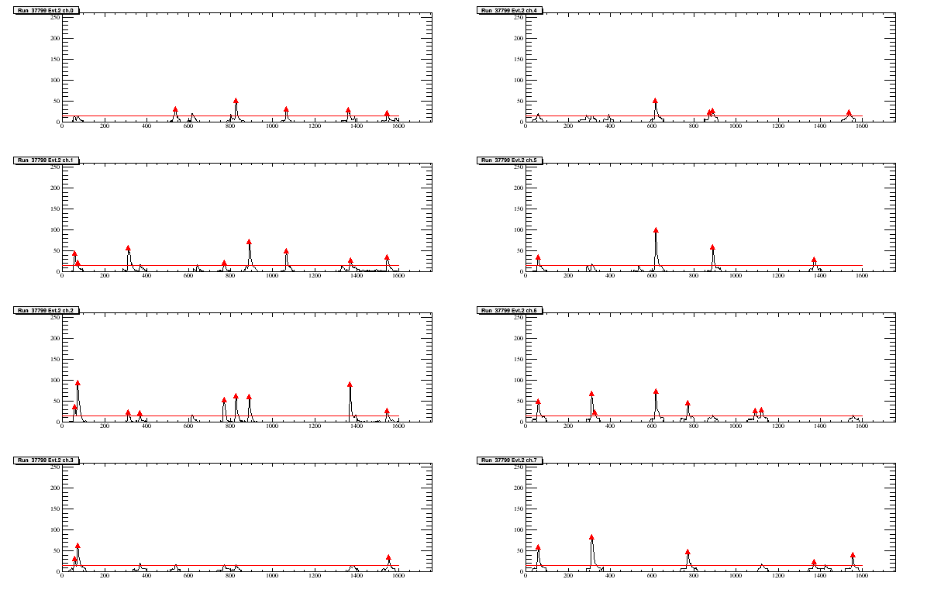
After ZLE
The fADC removes all portions of the baseline below a certain threshold.
Only data for “fragments” are read out

Slide 24
The ZLE algorithm
Advantage: data reduction of 10x
  Depends very much on ZDD HV
Disadvantage: baseline is lost
Disadvantage: the “fragment” width is a multiple of 16 ns
  More than one peak may be “captured” in the picture, which is the good one?
ZLE “undone” in offline reconstruction and redone “right” (more about this later)

Slide 25
Status in 2013
The ZDD could not run regularly.
Needed to reduce the ZDD data window
  But first one needed to find the ZDD timing
The ZDD sees everything!
  Also signals having no relation to L1*
  Conversely, L1* events have very rarely photons in the ZDD (solid angle very small!)
If we plot “everything” there is no ZDD signal, and cannot reduce the window length

Slide 26
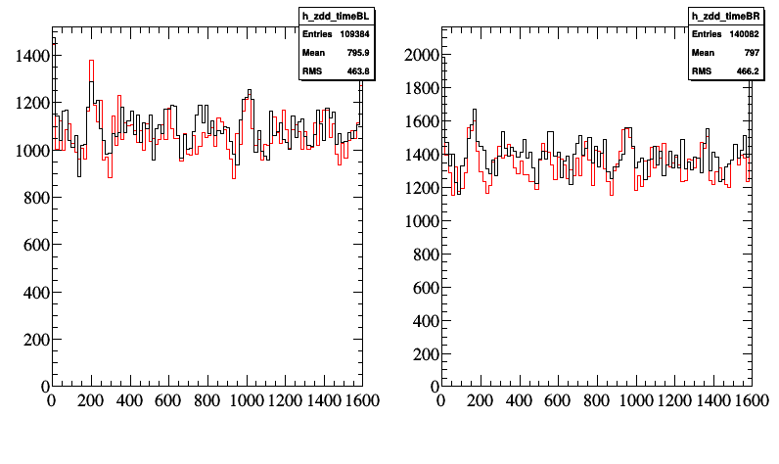
Typical “inclusive” ZDD plots of peak times (ns)

Slide 27
Many thanks!
…to Liu Zhenan for trigger discussion, and one memorable lesson!
…to Jing Dapeng, Zhao Jingzhou, and the Frascati SELF service, for interfacing the BESIII trigger and protocols to our boards
…to Li Fei and Ji Xiaolu for writing the online code and reading out the VME
…to Maura Pieracci from CAEN, for fixing and modifying the CAEN firmware
…to Cai Xiao, Niu Shunli and many others for much help

Slide 28
Part II
ZDD offline code
Present performance and status

Slide 29
Searching for the ZDD signal
Plot “selected data”: e⁺e⁻γ events
Yadi Wang in Frascati did the selection:
  2 charged tracks, total charge 0
  Less than 10 neutrals
  E(e⁺) > 0.6 GeV/c² and E(e⁻) > 0.6 GeV/c²
  A successful vertex fit
  A “strong” missing photon: E_{miss}>0.4 GeV
  A low polar emission angle: |cos(θ_{γ})| > 0.98

Slide 30
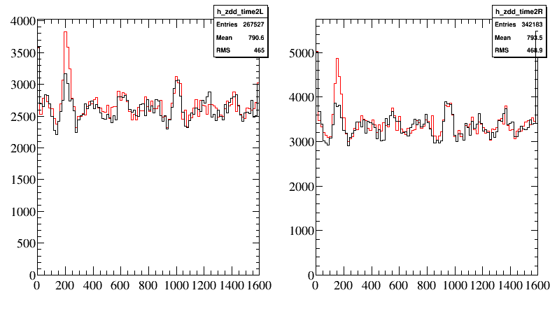
ZDD bottom block
ZDD top block
The red histogram shows ZDD “fragment times” (16 ns/bin) when the missing photon points to the ZDD side (cos(θ_{γ}) > 0.98)
The black histogram shows ZDD “fragment times” when the missing photon points to the other side (cos(θ_{γ}) <- 0.98)
There is a clear accumulation around +200 ns in both plots, FWHM ∼40-50 ns wide

Slide 31
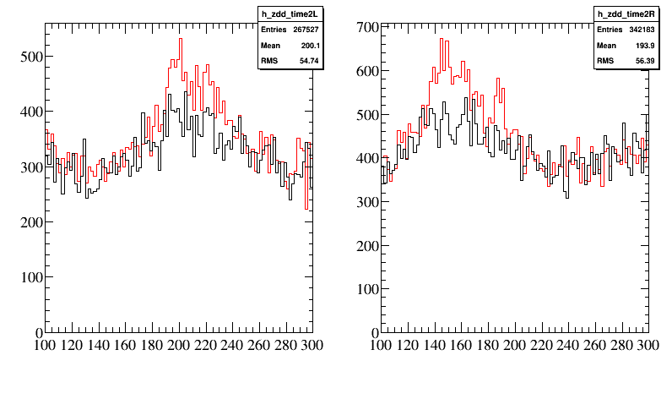
ZDD bottom block
ZDD top block
The same plot, zoomed (2ns/bin) on the interesting region.

Slide 32
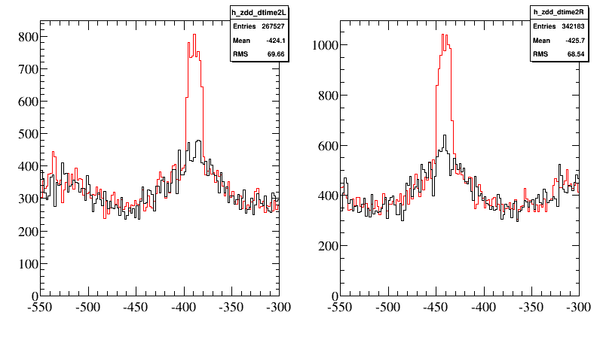
ZDD bottom block
ZDD top block
Here we correct the timing by subtracting the BESIII “Event start time”, the time scale is 2ns/bin as before
The event-to-event variation of the L1* latency is removed
Both peaks are much narrower, and the time shift is because the L1* trigger cable enters the ZDD “bottom” FADC first
The widths (not gaussian, ∼16ns) are due to the FADCs “trigger sensing” granularity

Slide 33
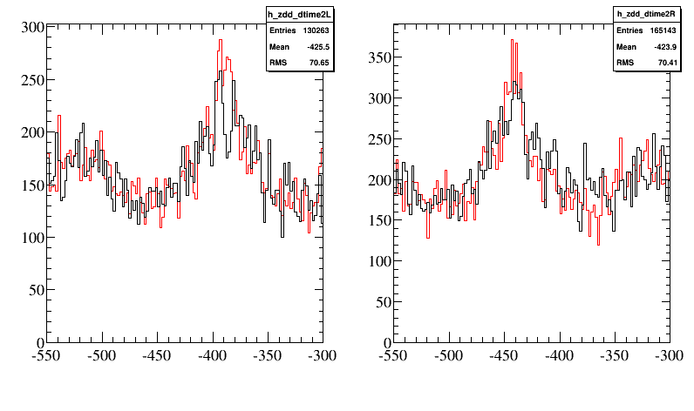
Countercheck 1
The same plot, for the “bad” control sample
0.8 < |cos(θ_{γ})| < 0.97

Slide 34
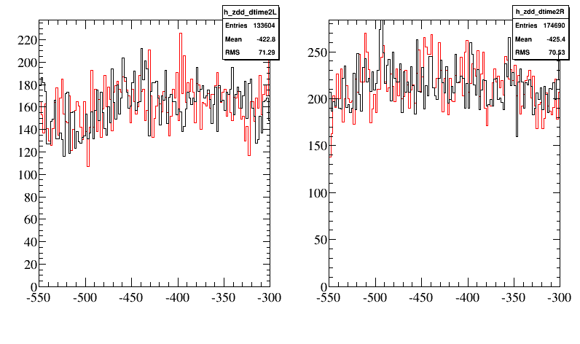
Countercheck 2
The same plot, for a “bad” FADC time window, starting at -7200ns before L1*

Slide 35
Results of analysis
We have demonstrated that accumulations of ZDD hits correlate strongly with 2 BESIII subsystems:
  The MDC because the accumulation depends on the polar angle of the missing photon
  The TOF because the timing is made more precise by using the event t₀
Also, we have shown that if we shift the trigger window, the correlation vanishes

Slide 36
Present ZDD status
The time window has been halved: 800 ns
  ZLE algorithm (still necessary!) runs faster
  No more “ZDD not ready” DAQ crashes
  More reduction is possible
ZDD timing histograms routinely produced in DQM
  Must make sure that L1* timing does not change

Slide 37
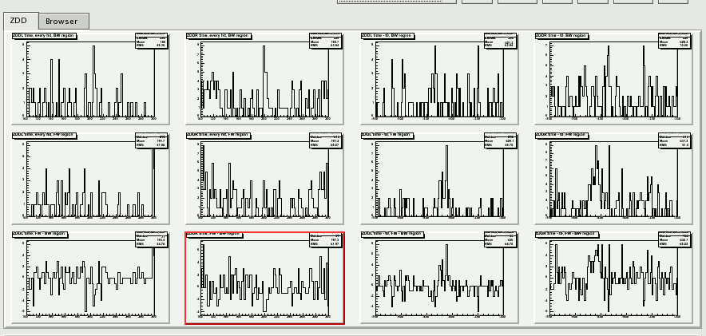
image from today’s DQM
ZDD signals from left and right sectors

Slide 38
ZDD software
All in package ZddReconAlg, written by Zou Jaheng
  Preliminary checks, make sure ZDD event is good
  Get event t₀ from TOF system
  “Undo” ZLE and find again peaks
  Correct peak time using t₀

Slide 39
Next (“simple”) steps
Implement “simultaneity” (1)
  Different channels in one fADC (one ZDD block) have the same timing
  Consider, for summing, only peaks synchronous in different channels
Find and subtract baselines
  Special runs (no ZLE, short window, no data)?
  Baselines depend much on HV
First version already written by Wang Yadi as a ROOT macro, soon to be moved to the offline code

Slide 40
Status of energy calibrations
Data from the 2010 tests in Frascati
From the Beam Test Facility (1):
  No fADC, we used a common ADC (CAEN V786)
  450 MeV ≈ 300pC ( Σ on PM channels)
  Shower profile distribution among layers
From cosmic data (2)
  FADC conversion value = 10÷15 mV/pC
  Happy Box gain: about factor 2
  www.lnf.infn.it/esperimenti/bes3/_doc/Instrumentation/CalibrationData.pdf
  www.lnf.infn.it/esperimenti/bes3/_doc/Instrumentation/QDCvsADC.pdf

Slide 41
How to re-calibrate energy
Radiative Bhabha was the key to ZDD timing
We plan to use it also for E calibration
  Identify and “clean” events a maximum
  Compute “ZDD energy” (Σ over channels)
  Energy of missing photon from BESIII event
  Once events are “clean enough” BESIII energy must correlate with “ZDD energy”
  Sharing of shower energy between channels is known at 450 MeV from BTF test runs

Slide 42
Part III
The ZDD upgrade
What can it accomplish?

Slide 43
The problem
ISR (converted) γ’s hit the ZDD closer to the edge than to the center
  ZDD face (top half)
  Photon expected impact region
Showers are not fully contained, and energy resolution will be worse than expected

Slide 44
What can be done?
Unfortunately this effect can not always be corrected, the γ impact point is unknown
Some γ‘s (1/3 → 1/2) will convert in the beam pipe window
The (narrow opening angle) resulting e⁺e⁻ pair could be detected by an array of small scintillators

Slide 45
The array
Mario Anelli in Frascati built 2 arrays of 8 small scintillators each, of size (5 x 6 x 100) mm³, read by green scintillating fibers
These fibers are connected to a multianode Hamamatsu PM, H7546-200, with 64 channels (gains equal within ~20%)
The 16 channels with most similar gains are chosen, 8 for the bottom ZDD and 8 for the top ZDD

Slide 46
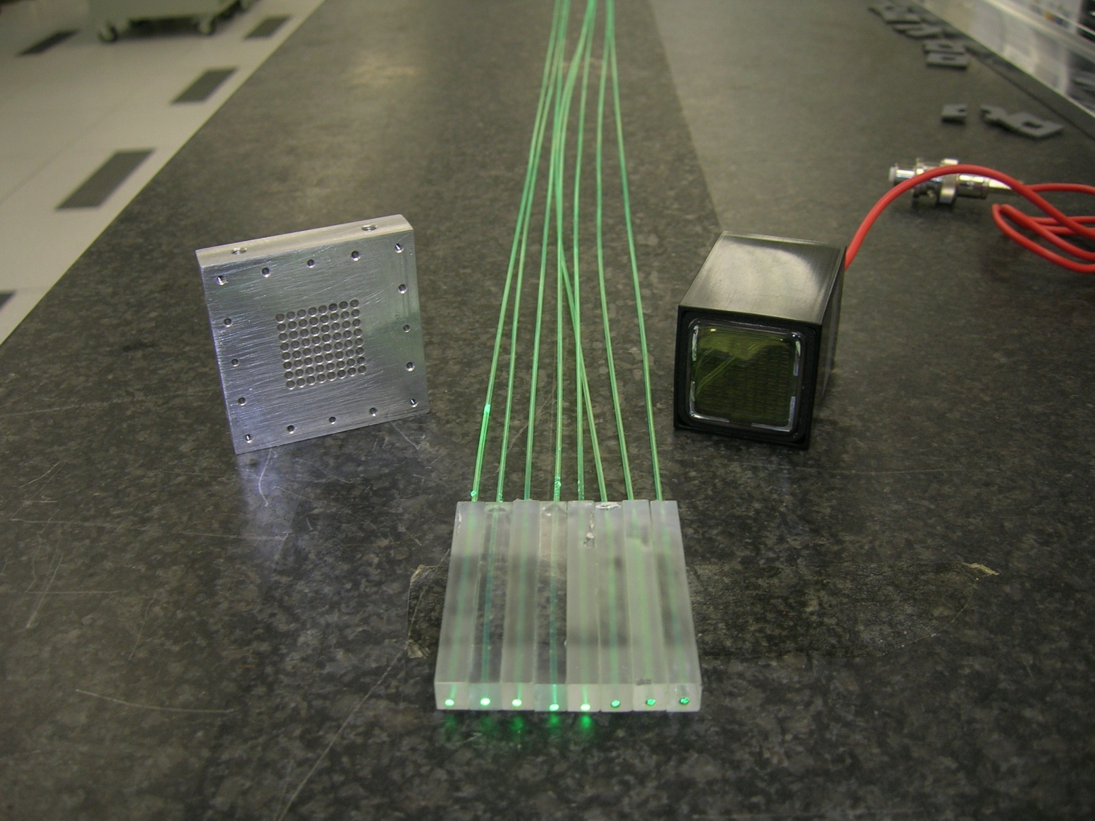
The scintillators

Slide 47
The frontend
The multianode PM is connected to a local group of electronic boards made and tested in Frascati, for amplifying and CF-discriminating signals
Tests were successfully made with a β source looking at LVDS signals on a scope: all channels working
In July 2013 at the LNF BTF discriminated signals from the frontend were sent, via a 20m twisted-pairs cable, to a TDC CAEN V1190

Slide 48
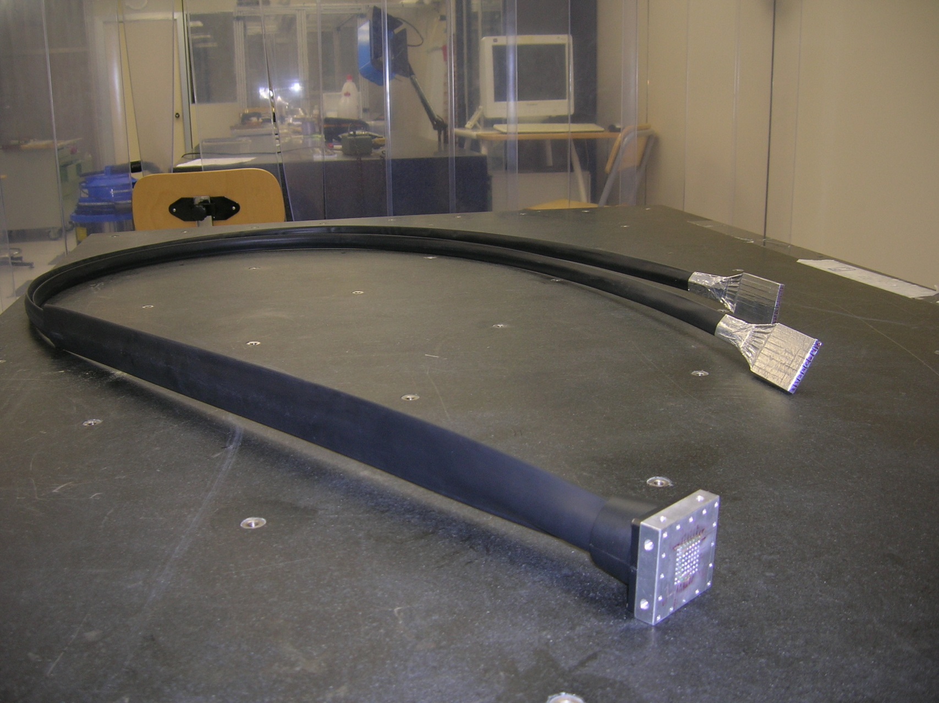
The scintillator arrays

Slide 49
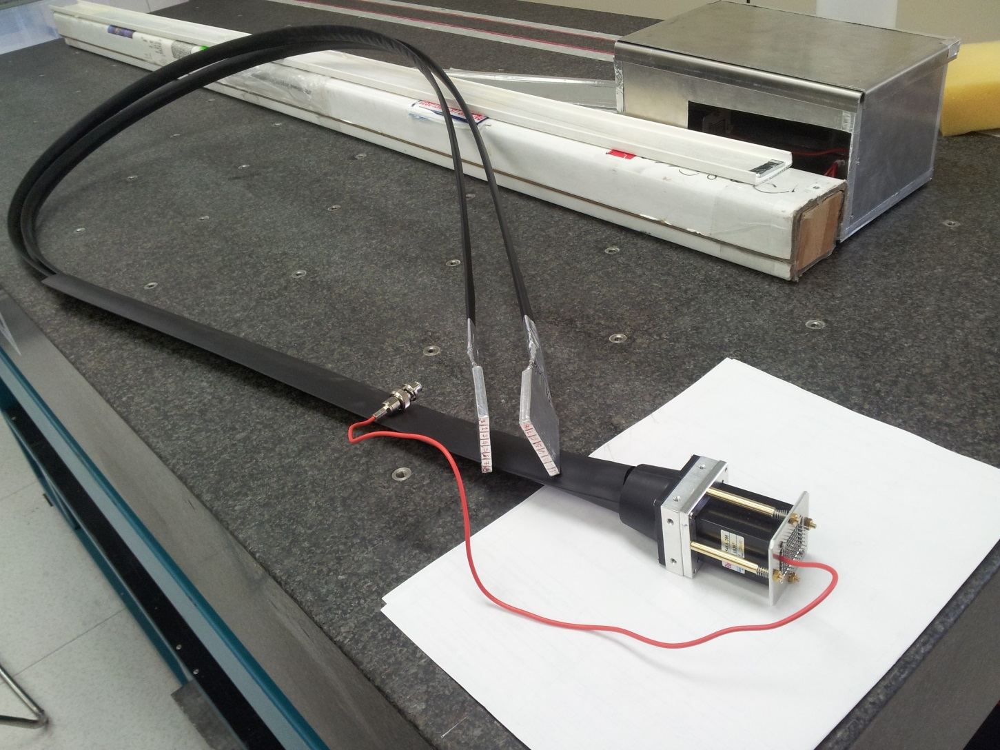
The completed device

Slide 50
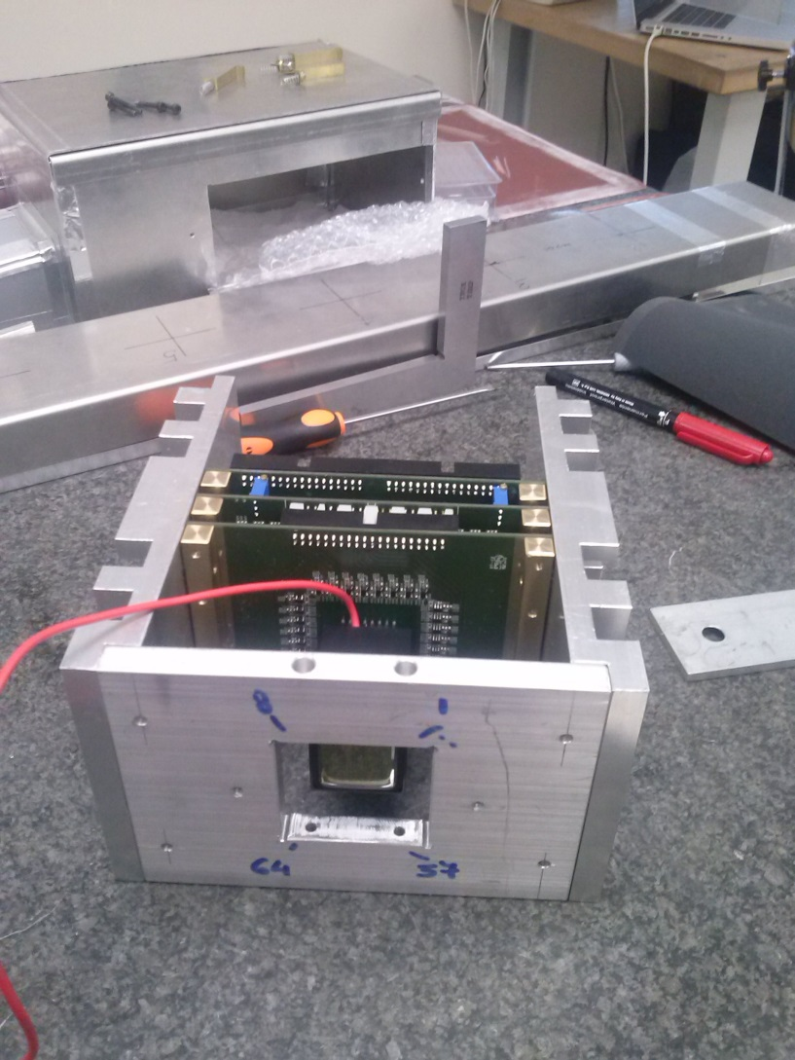
The readout

Slide 51
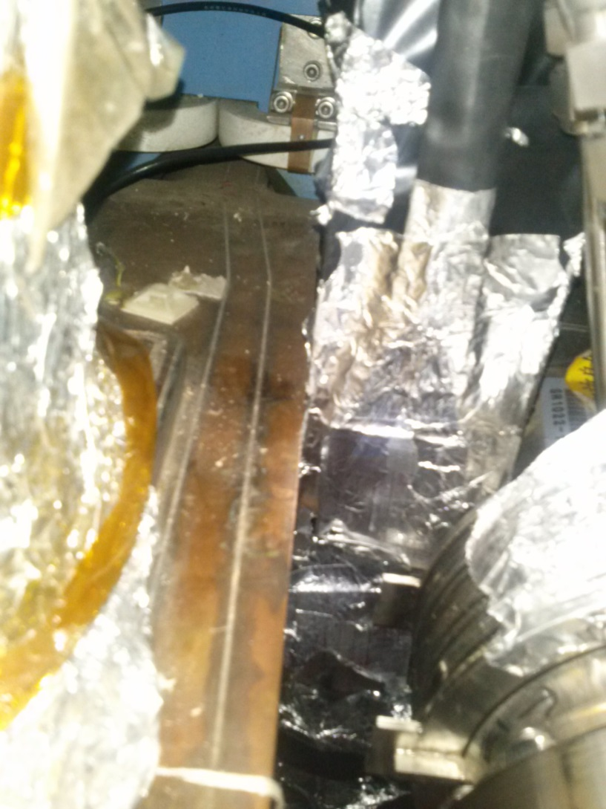

In the East BESIII area
ZDD
ZDD Upgrade

Slide 52
Next steps…
Insert the ZDD in the BESIII simulation
Verify that the “strips” ZDD upgrade works
Check that the MAPM can be read by the V1190
Check that the V1190 can be read by DAQ without problems
Check that the timing is correct
Write the offline code
...finally use the strip info to correct the energy measurement

Slide 53
Conclusions
The ZDD with 2014 has finally entered the BESIII world
It has been used as a luminosity monitor since 3 years
…it is time to start using it also as a calorimeter
  … but it will take much effort.
  Everybody is welcome to enjoy the results!

Slide 54
More thanks!
…to Yadi Wang for writing the radiative Bhabha selection, and teaching me how to read the data
…to Zou Jaheng for writing the ZDD reconstruction code, and showing me how to change it
…to Guan Yinghui and Sun Shengsen for useful discussion about the BESIII t₀ value
…to Yuan Wenlong and Ji Xiaobin for doing the ZDD DQM code and page
…and to all other people missing from this list, and the previous ones

Slide 55
Spares

Slide 56
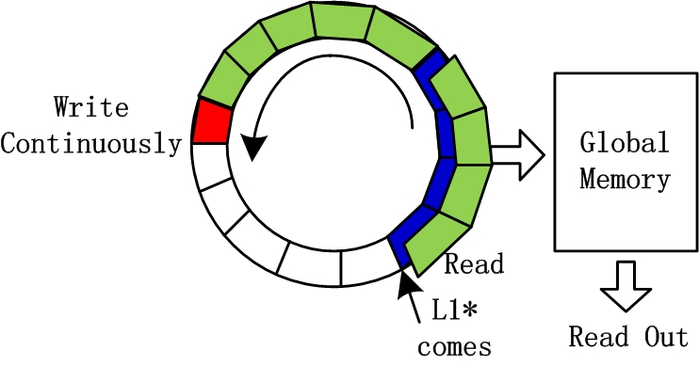
BESIII world
We must locate t₀ in this region for each event with TOF trigger
-8500ns
-8160 ns
-6560 ns
ZDD world
L1* comes
Global Memory
Read Out

