Slide 1
The ZDD data structure
Each ZDD channel produces a positive “waveform”, one 8-bit sample every 2 ns
This waveform is then splitted in “fragments”: a sequence of contiguous data samples, each one above a given threshold
Each “cluster” gives a maximum (biggest sample, for calorimetric analysis to come) and a time for this maximum (used in this analysis)

Slide 2
The ZDD data structure
This time is relative to the start of the ZDD data buffer, so (indirectly) to L1*, that closes the buffer
Only the first part of the buffer, 1600 ns, is analyzed. The second part is thrown away.
L1*-8200ns
L1*

Slide 3
Finding the ZDD signal timing
The ZDD is sensitive to most of the BEPCII beam crossings. There is much background!
We must maximize the probability of a hit in the ZDD
In addition to the radiative Bhabha selection we require:
  A “strong” missing photon: E_{miss}>0.4 GeV
  A low emission angle: |cos(θ_{γ})| > 0.98

Slide 4
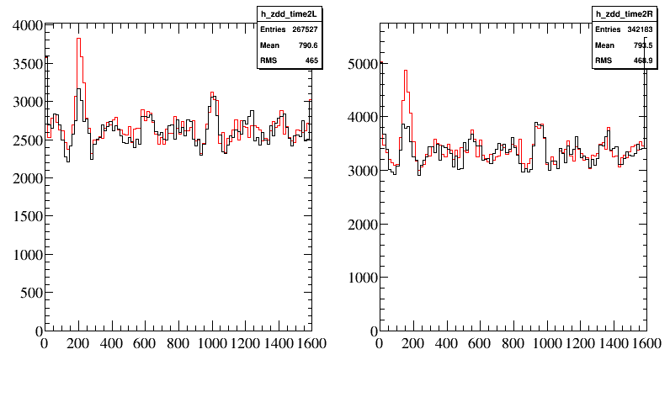
ZDD bottom half
ZDD top half
The red histogram shows ZDD “fragment times” (16 ns/bin) when the missing photon points to the ZDD side (cos(θ_{γ}) > 0.98)
The black histogram shows ZDD “fragment times” when the missing photon points to the other side (cos(θ_{γ}) <- 0.98)
There is a clear accumulation around +200 ns in both plots, FWHM ∼40-50 ns wide

Slide 5
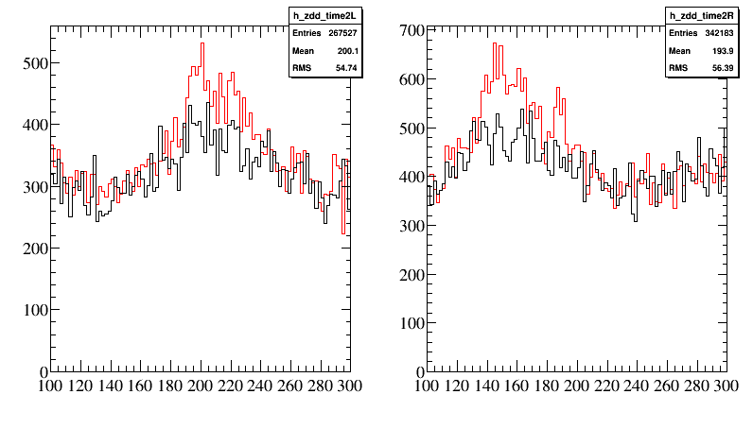
ZDD bottom half
ZDD top half
The same plot, zoomed (2ns/bin) on the interesting region.

Slide 6
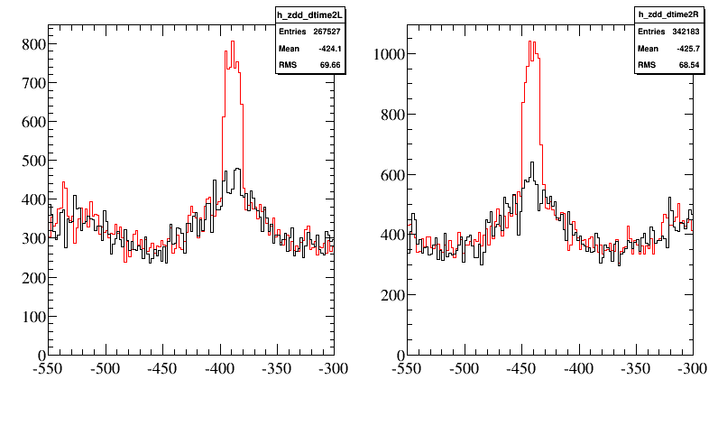
ZDD bottom half
ZDD top half
Here we correct the timing by subtracting the BESIII “Event start time”, the time scale is again 2ns/bin
The event-to-event variation of the L1* latency is removed
Both peaks are much narrower, and the time shift is because the L1* trigger cable enters the ZDD “bottom” FADC first
The widths (not gaussian, ∼16ns) are due to the FADCs “trigger sensing” granularity

Slide 7
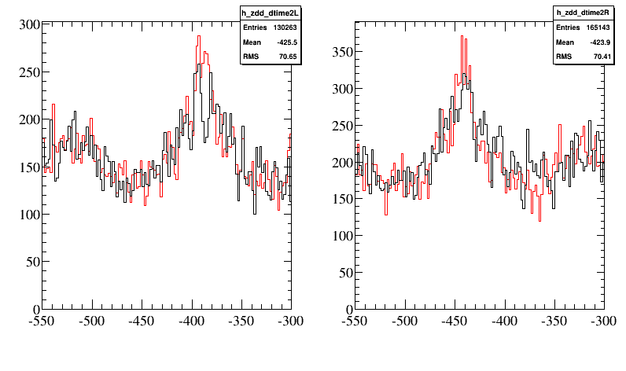
Countercheck 1
The same plot, for the “bad” control sample
0.8 < |cos(θ_{γ})| < 0.97

Slide 8
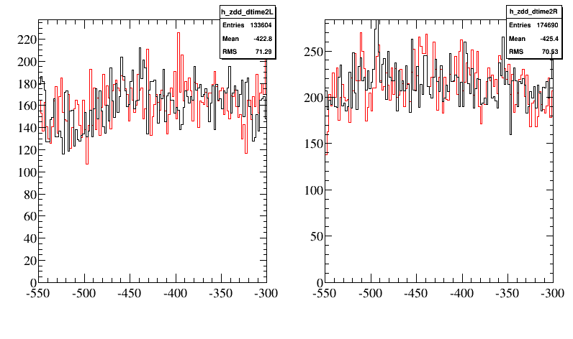
Countercheck 2
The same plot, for a “bad” FADC time window, starting at -7200ns before L1*

Slide 9
Conclusions
We have demonstrated that accumulations of ZDD hits correlate strongly with 2 BESIII subsystems:
  The MDC because the accumulation depends on the polar angle of the missing photon
  The TOF because the timing is made more precise by using the event t₀
Also, we have shown that if we shift the trigger window, the correlation vanishes

Slide 10
Outlook for the 2014-2015 run
The ZDD start of the time window appears correct
The time window will be shortened to 400 ns from 1600→much more tolerable for DAQ
The ZDD signal will become part of the BESIII DQM, and will be monitored by ZDD people to make sure that it does not move

