Slide 1
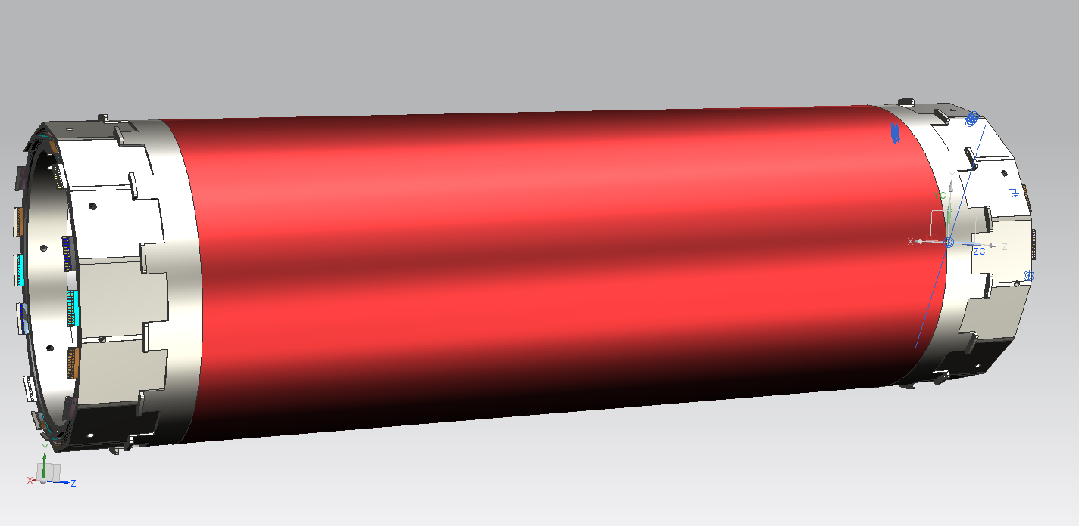

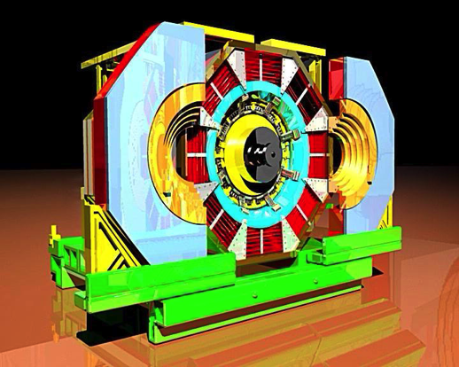
CGEM-IT project update
Project Co-financed by the Italian Ministry for Foreign Affairs (MAE)
The BESIII Winter Collaboration Meeting
Huangshang University - November 23-27, 2013
Gianluigi Cibinetto
(INFN Ferrara)
on behalf of the CGEM group

Slide 2
Outline
Introduction
Mechanics of the detector
  Mechanical constraint
  Test cathode construction
  Layer-2 final design
Cosmic ray setup for a planar prototype
Plans for the frontend electronics
Budget, CDR and schedule

Slide 3
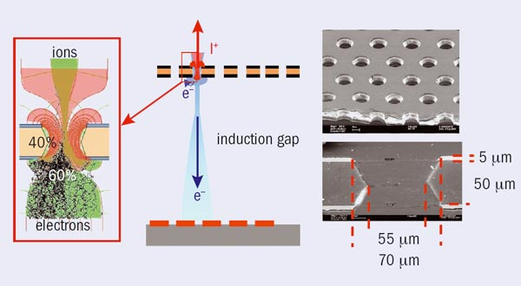
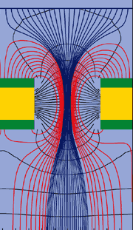
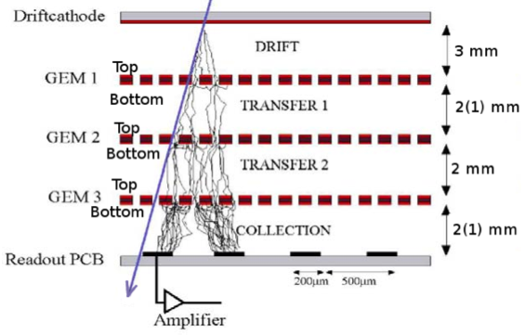
GEM in a nutshell
A thin polymer foil, metal-coated on both sides, is chemically pierced by a high density of holes.
On application of a voltage gradient, electrons released on the top side drift into the hole, multiply in avalanche and transfer the other side.
Proportional gains above 10³ are obtained in most common gases.
Cascaded GEMs permit to obtain larger gains
Spatial resolution determined by chamber and readout electrode geometries

Slide 4
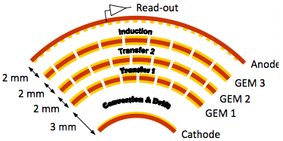
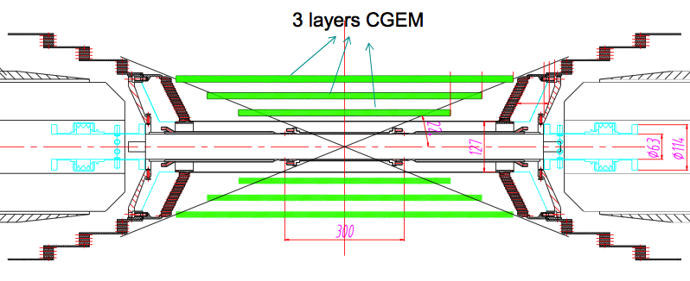
A CGEM based Inner Tracker
A cylindrical triple GEM
Requirements
Rate capability: ~10⁴ Hz/cm²
Spatial resolution: σ_{xy} =~100μm : σ_{z}=~1mm
Momentum resolution:: σ_{pt}/P_{t} =~0.5% @1GeV
Efficiency = ~98%
Material budget ≤ 1.5% all layers
Coverage: 93% 4π
Operation duration ~ 5 years
Three active layers
Active area
  L1 length 532 mm
  L2 length: 690 mm
  L3 length: 847 mm
Inner radius: 78 mm
Outer radius: 178 mm

Slide 5
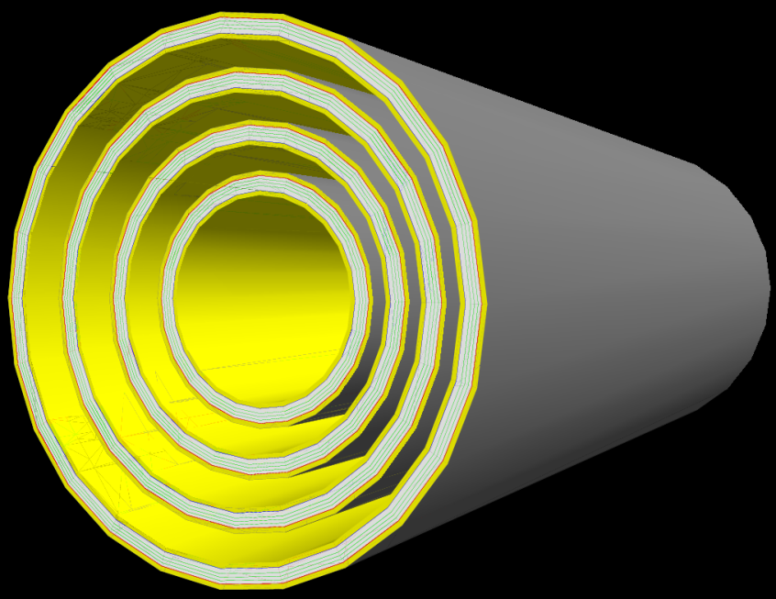
CGEM expected performance
From GEANT4 simulation
CGEM inner detector (wrt MDC inner detector)
Improves dz resolution significantly
(by a factor of 2.6~6)
Comparable dr resolution
(~5% poorer for low momentum tracks )
Comparable momentum resolution
(~5% better for high momentum tracks)
From KLOE beam test
Readout | σ_{rf} (μm) | σ_{z} (μm)
Digital readout (Beam test @2009) | 330 | 400
Analog readout (magnetic field effect avoided)* | 80 | 150
* Taken as expected spatial resolution

Slide 6
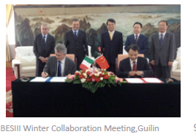
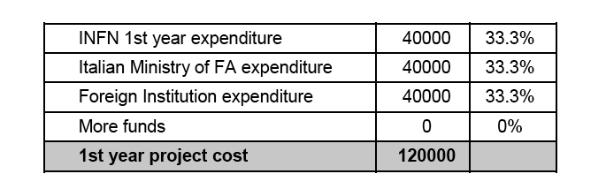
The MAE project
Design, construction and test of a CGEM prototype and readout electronics funded by the Foreign Affairs Ministry agreement of scientific cooperation for a Joint laboratory “INFN-IHEP”.
360,000 euros in three years!
Status of the project
2013 budget almost exhausted (see next slide)
February 2014: relation to MAE concerning 1st year activities
March-April 2014: MAE approval of relation, and reimbursement to INFN (40 kEuros)
April-June: expect 2014 budget available

Slide 7
Status of MAE budget
Two budgets have been allocated in 2013 by INFN
  INFN own financing (40 kE) in July
  MAE contribution (40 kE) in November, advanced by INFN, to be recovered next spring from MAE and immediately re-advanced for 2014
One extra-budget (20 kE) procured as Ferrara “startup” extra-help
almost exhausted:
lab setup and R&D,
electrodes for construction of the first layer of CGEM
exhausted:
material and tooling for test cathode construction
molds and tooling for first layer construction

Slide 8
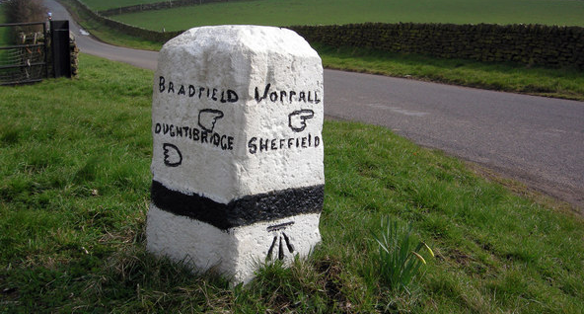
The path toward a CGEM-IT
To go from one layer to the complete IT there’s a long way to walk
R&D program (Jun 2013 – Jun 2014)
First layer funded under the MAE agreement
  design (Sep-Nov 2013)
  construction (May 2014 – Jul 2015)
Review of the project and CDR approval by the BESIII collaboration (June 2014)
Second layer
  design (Dec 2013 – Mar 2014)
  construction (Feb-Nov 2015)
Third layer
  design
  construction (Jul 2015 – Mar 2016)
Test and integration (Jan-May 2016)
Ready for installation (Jan 1st 2017)
in progres…
completed!

Slide 9
Activities update

Slide 10
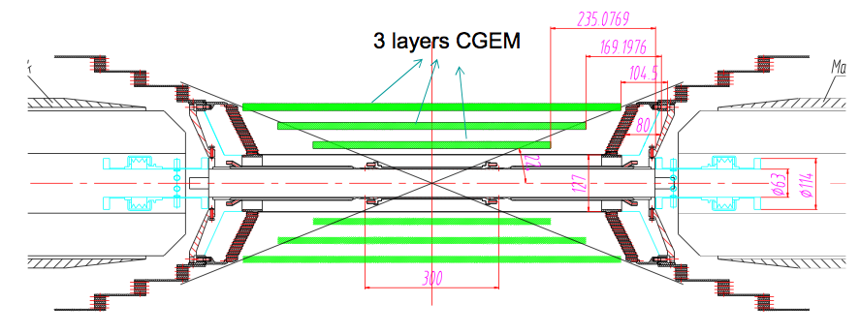
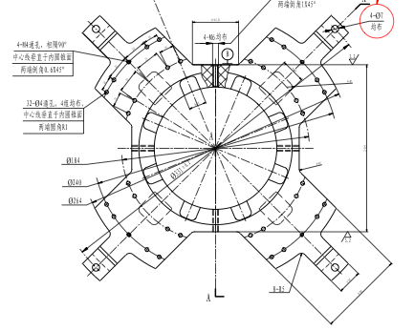
Mechanical constraints
We had meeting @ IHEP in September where we discussed many integration and installation details.
Very limited space to play with: the beam pipe supports close most of the space in z direction.
The outcome of the discussion drove few detector design modifications.

Slide 11
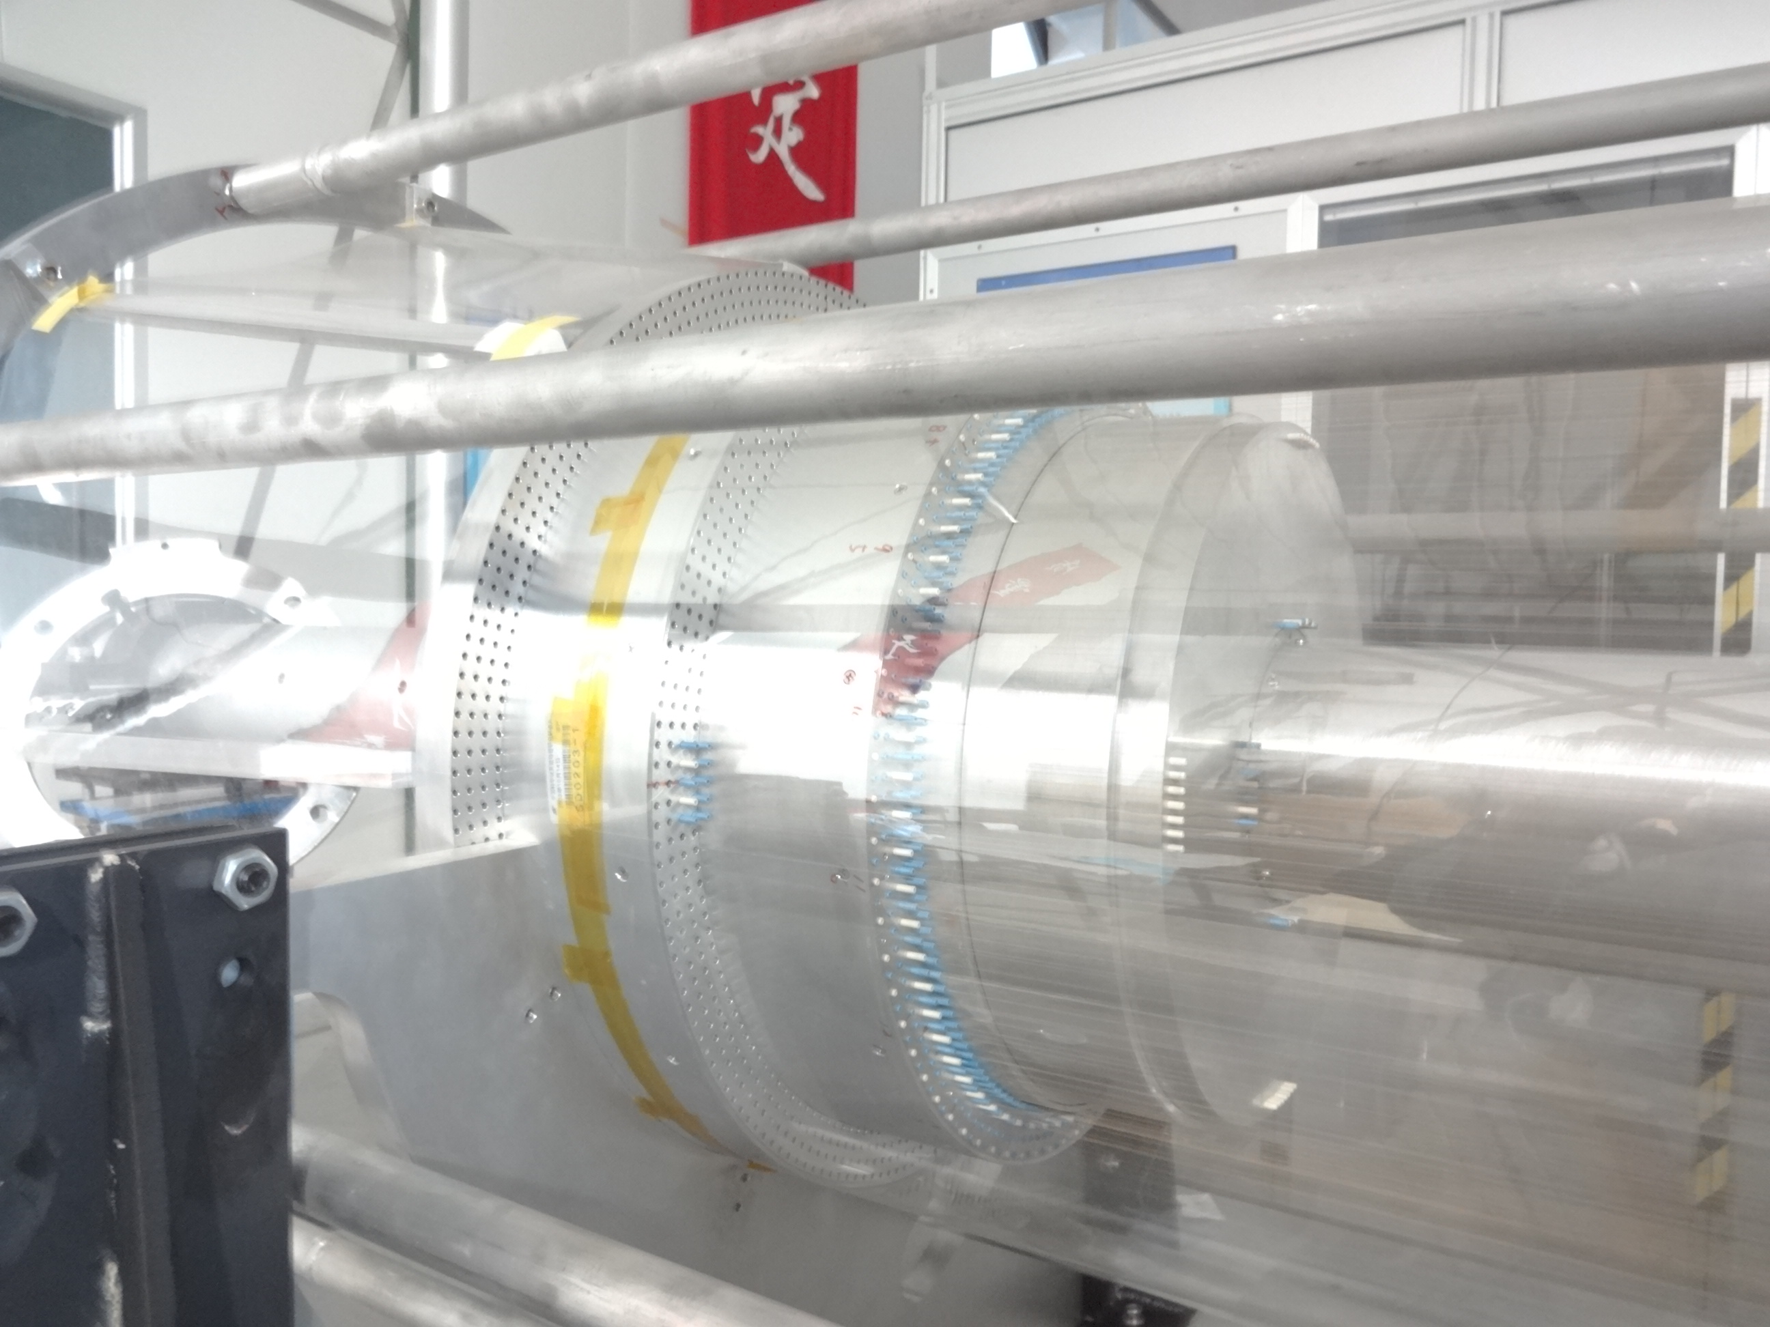
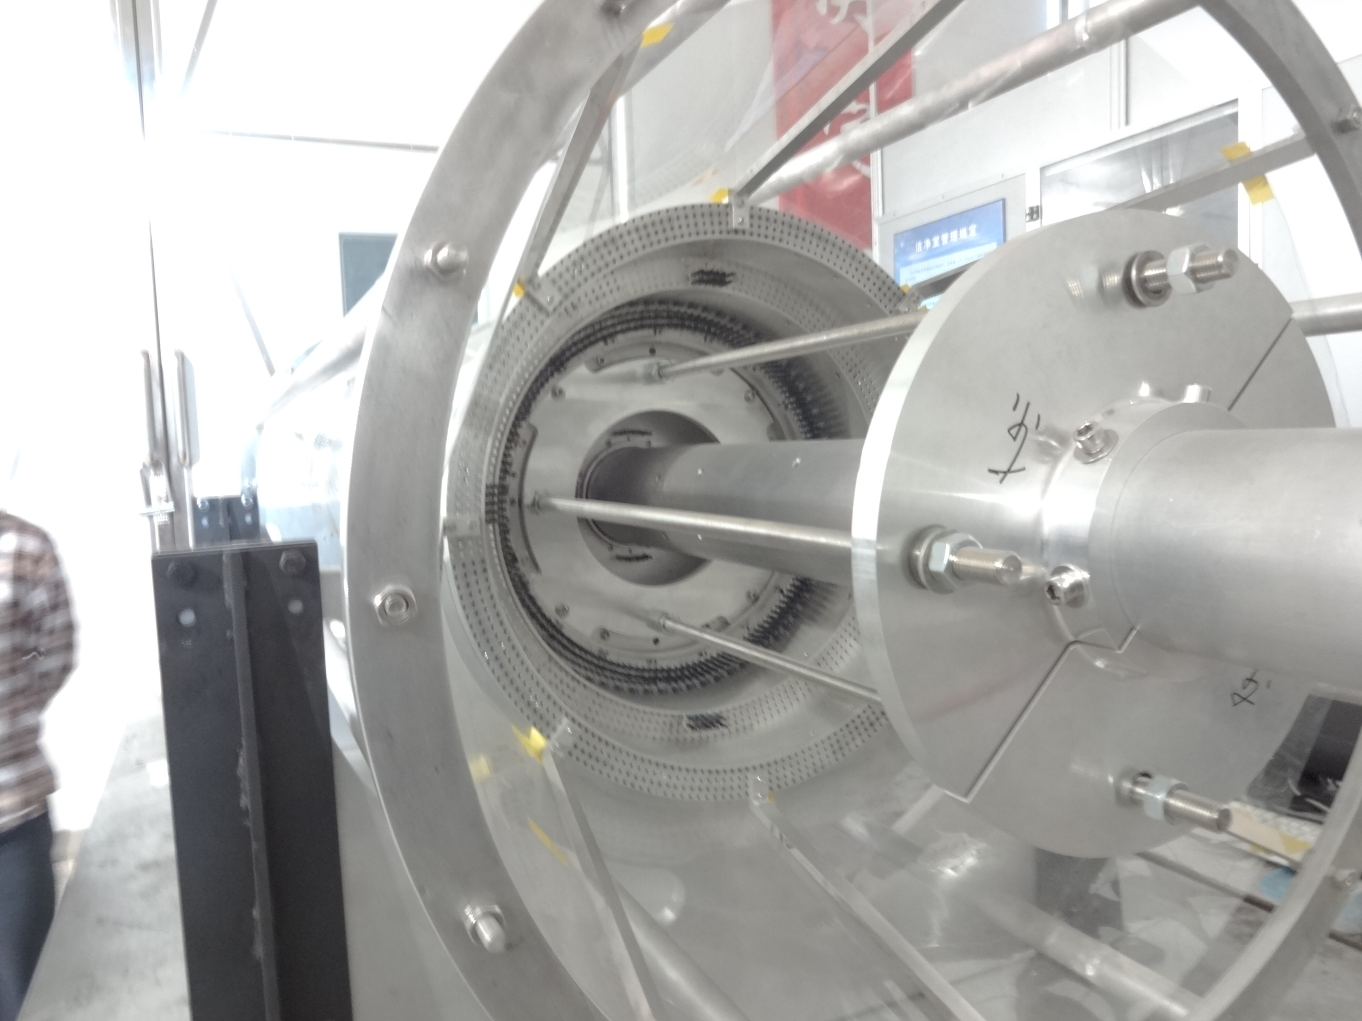
Mechanical integration
A carbon fiber cylinder is needed to close the outer drift chamber.
New supporting flanges to install the CGEM-IT and the carbon fiber cylinder will be designed by Ferrara engineers.
The drift chamber mockup @ IHEP will be used to test the new supporting flanges and the installation procedure.

Slide 12

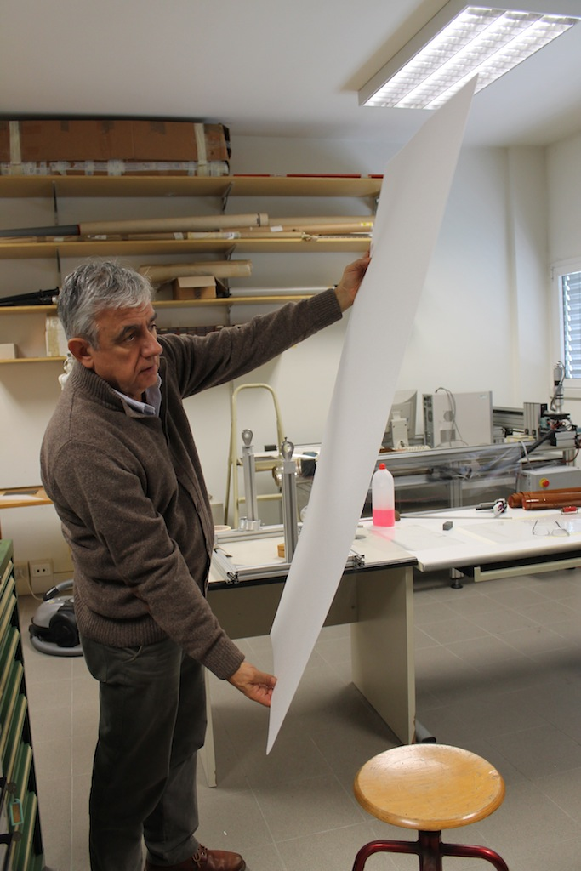
A Rohacell based cathode (and anode)
Read-out
cathode layout
Induction
Transfer 2
Anode
2 mm
Transfer 1
GEM 3
2 mm
GEM 2
2 mm
Conversion & Drift
GEM 1
3 mm
25 μm Kapton
Cathode
Copper cladded 50 (or 25) μm Kapton
1 mm Rohacell 31
Rohacell is a very light material that will be replace the honeycomb in the cathode and anode construction with substantial reduction of the thickness of the detector
 | Rohacell | Honeycomb
# of X₀ for 1 layer | 0.24 | 0.39
# of X₀ for 3 layers | 0.72 | 1.17
This technique has been successfully tested in Ferrara

Slide 13
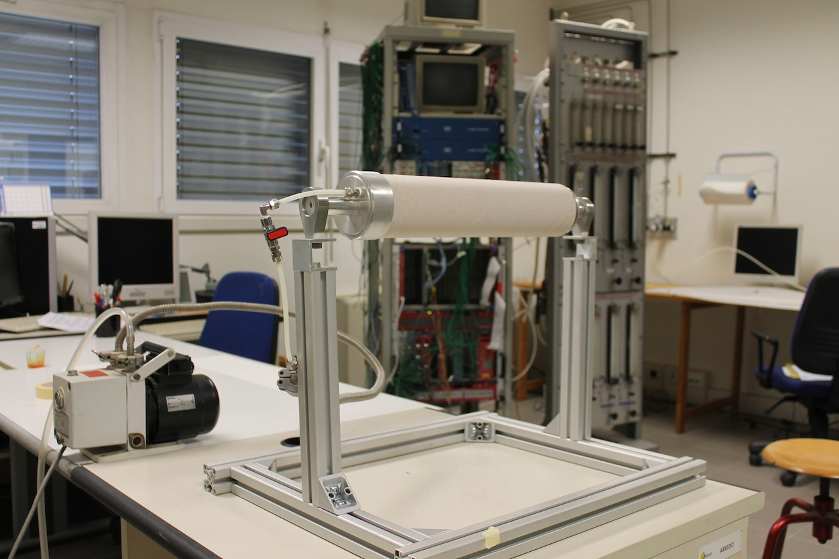
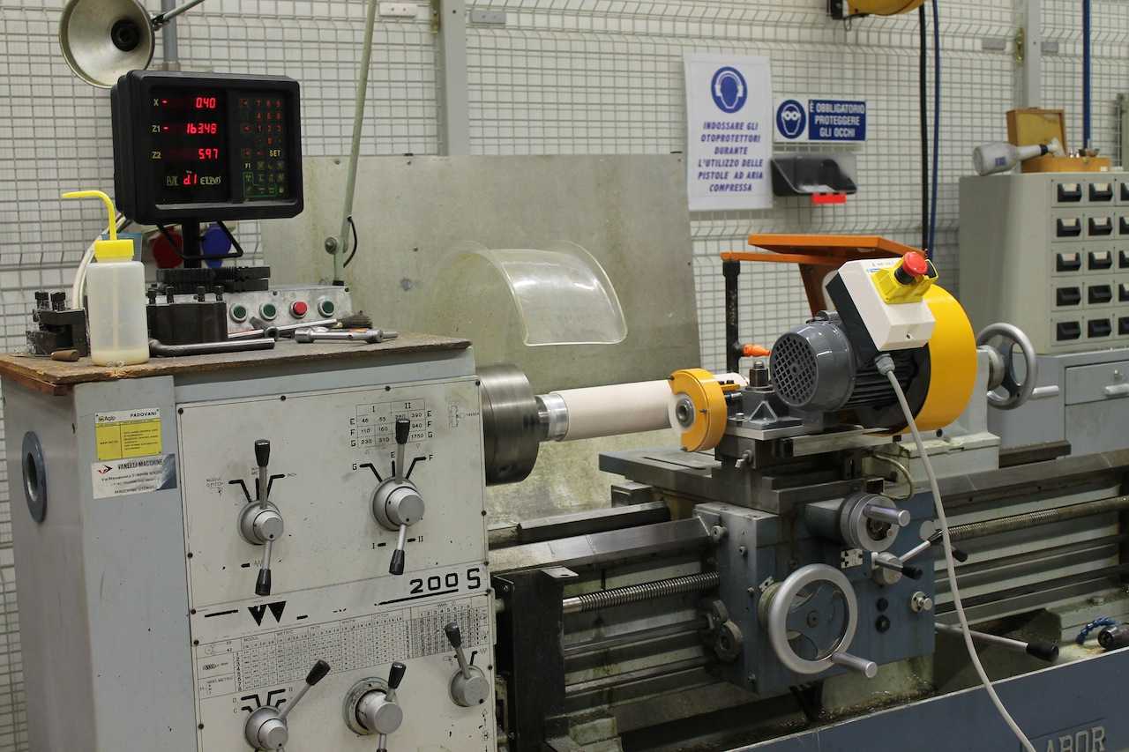
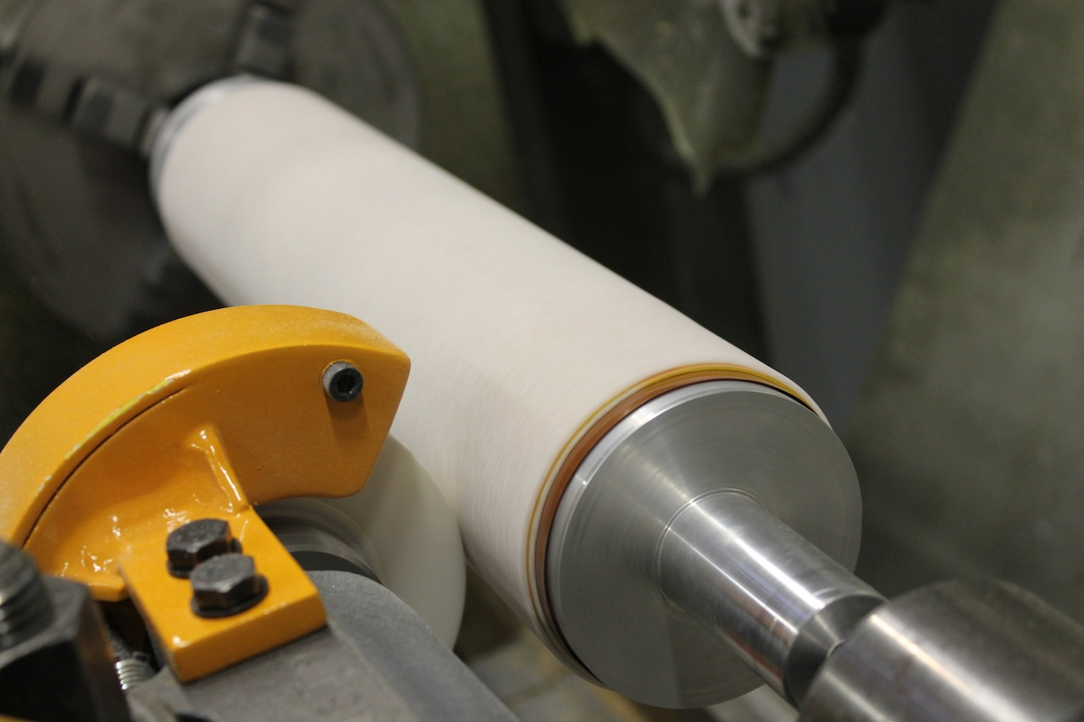
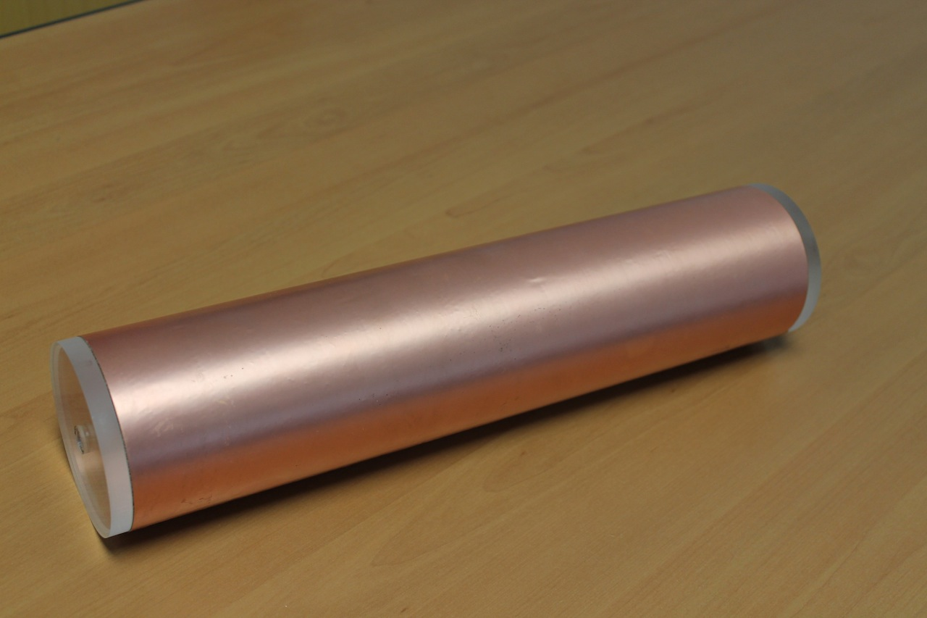
Rohacell technique tested on a fake cathode
rohacell wrapped around the mold
rohacell machined
cathode foil wrapped on the rohacell
impressive robustness

Slide 14


Detector design
Several months of ideas, sketches, discussions, designs, assembly simulations, drawing reviews led us very close to the completion of the first layer design (will be layer number 2, the middle one).
The mechanics (except for the anode design) has been validated last week.
The tooling for construction and assembly is ready to be manufactured: orders will be placed next week.
A large area has been allocated in Ferrara for the cathode and anode production that will take place next year.
The clean room used for Kloe CGEM detector construction in Frascati has been refurbished and adapted for the BESIII detector assembly.

Slide 15
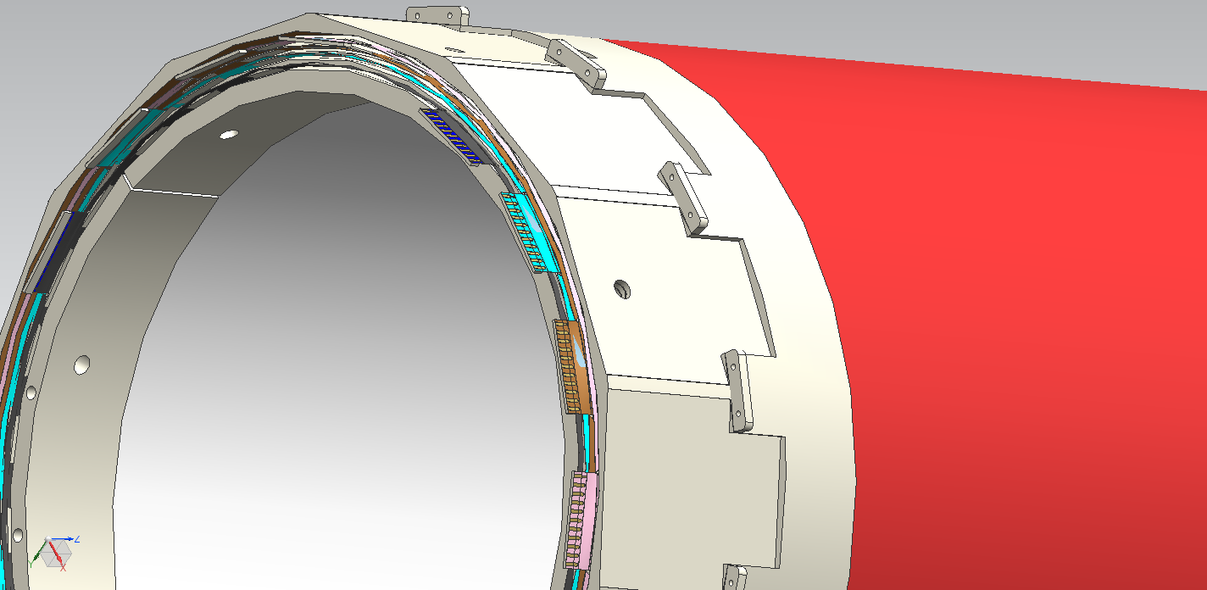
Layer 2 mechanical design
Assembly of the layer composed by a cathode, 3 GEM foils and the anode, each independently pre-assembled.
Durostone rings for detector support
Anode external shield
HV connectors
Frontend card
location
Cathode internal shield
Gas inlets

Slide 16
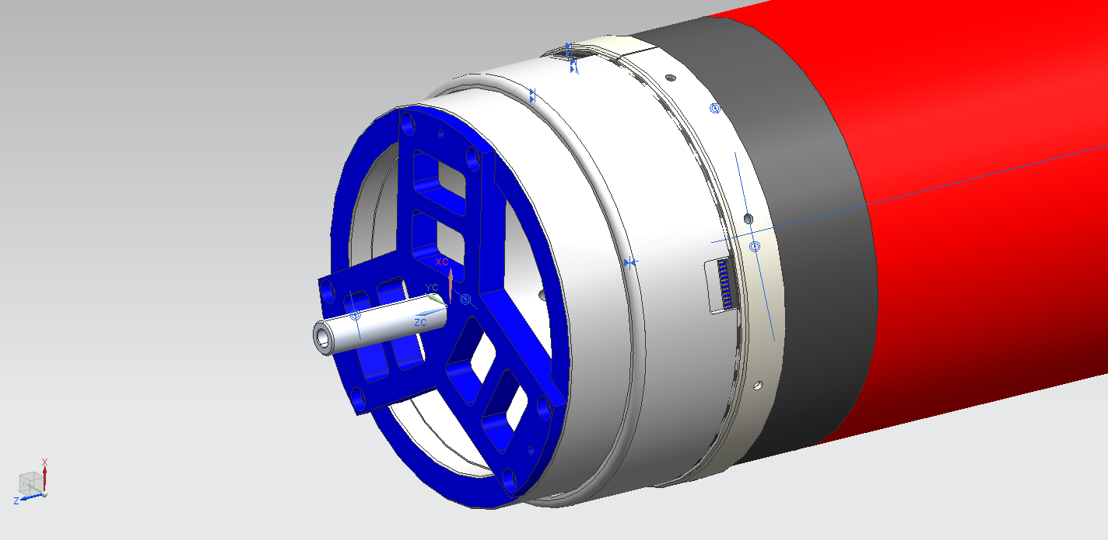
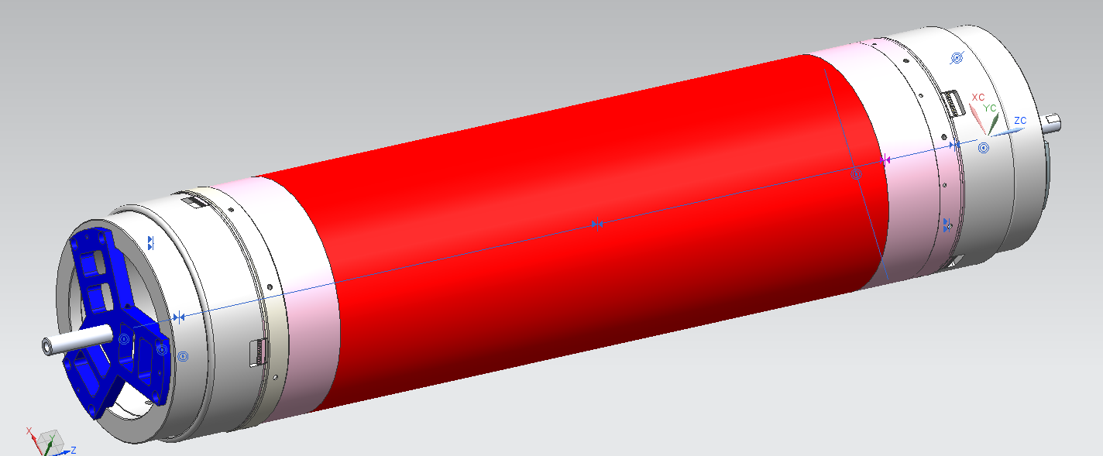
Molds for layer 2 construction
Cathode mold
Each of the five detector skins (cathode + 3 GEMs + anode) is pre-assembled on an aluminum mold.
Each skin has its own mold
Cathode foil
Aluminum ring for assembly
Durostone rings for detector support
Aluminum rings for correct positioning during assembly
GEM foil
Molds and aluminum ring design ready!
GEM mold

Slide 17
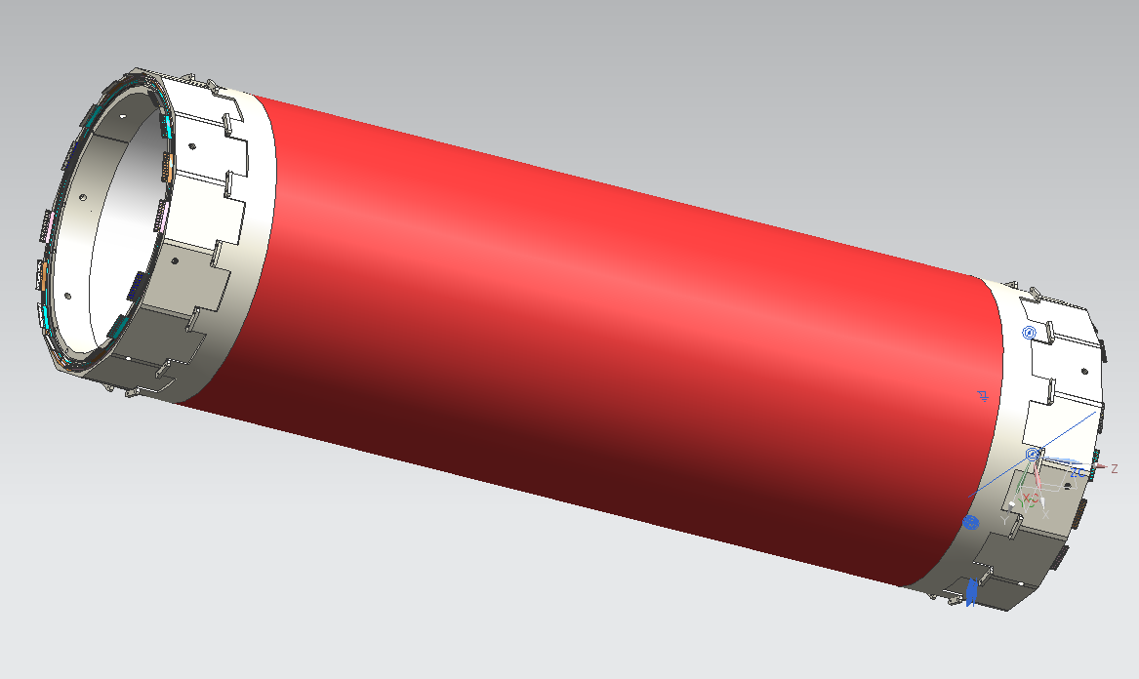
How the complete layer will look like

Slide 18
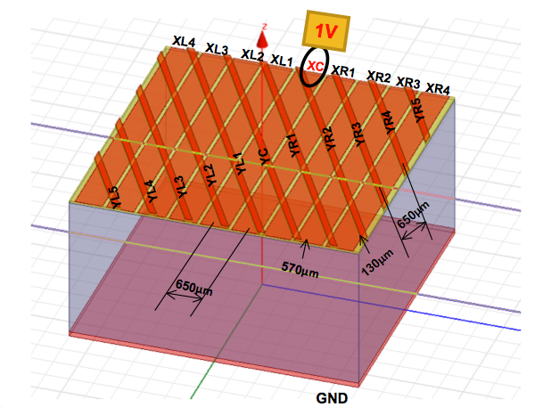
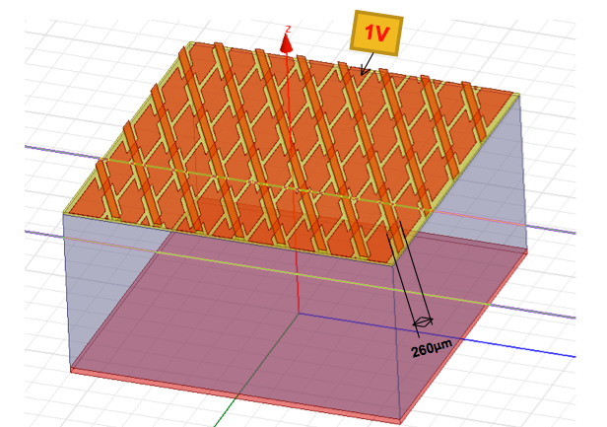
Anode simulation
The simulation of readout circuit has just started in Ferrara and Frascati in order to study the coupling effects of the strips and ground planes.
Two different anode design have been taken into account for comparison.
Linear design
Jagged design
Preliminary results show a ~30% reduction in the coupling capacitance for the jagged design.

Slide 19
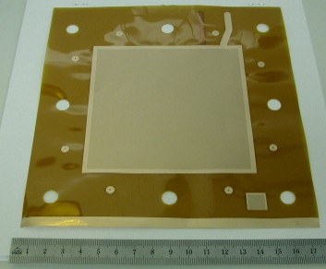
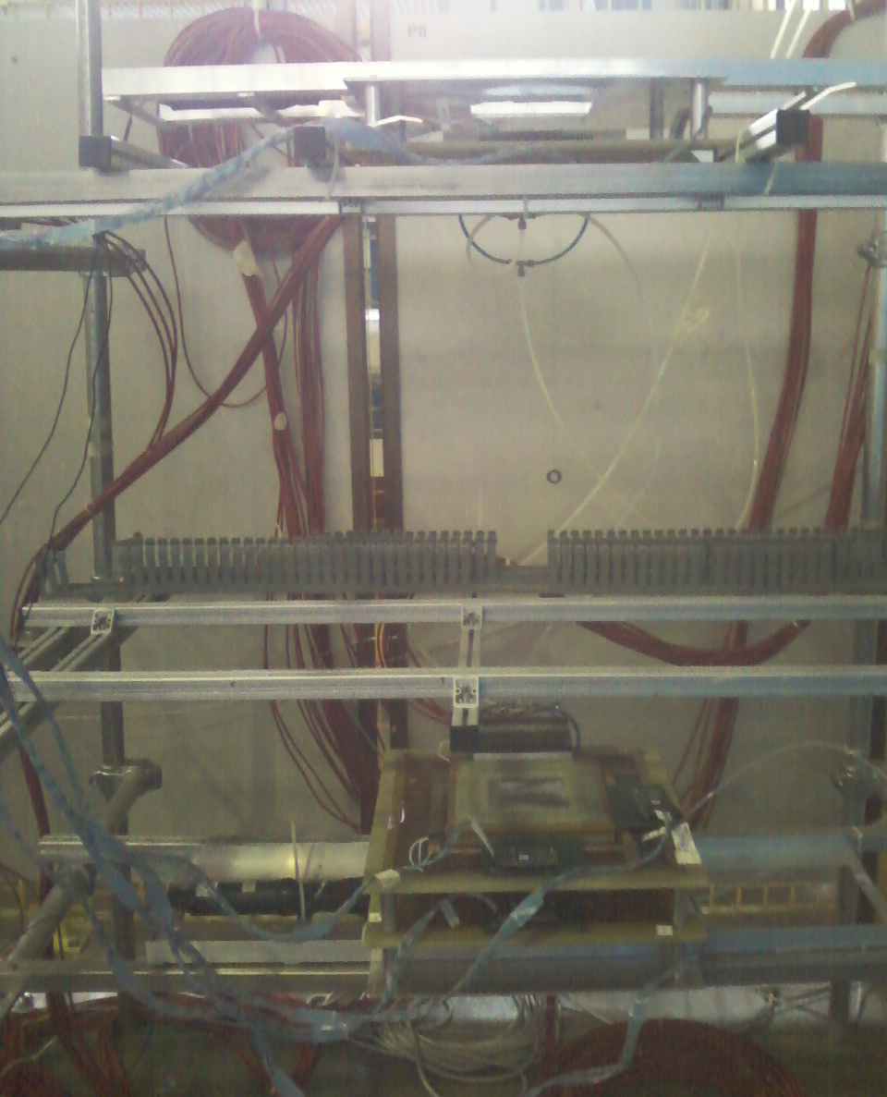
The planar prototype
10x10 cm² planar GEM
The BESIII readout will be substantially different from the KLOE2 one:
  it must be tested on a small scale prototype (10x10 cm² planar GEM chamber).
Frascati cosmic ray telescope
Top tracking chamber
Top counter
Space free for
test chamber
Two bottom tracking
chambers
Bottom counter
Cosmic telescope is in place @ LNF
HV and gas system are ready
Trigger system ready
Telescope DAQ sw tested in Ferrara
Analysis software under way
GEM foils for test chamber purchased from CERN
Waiting for the readout plane and electronics

Slide 20
CGEM IT FrontEnd electronics
Readout ASIC for CGEM:
  Modify/adapt the existing TOF-PET ASIC
  (Rolo, Rivetti et al. [INFN Turin] http://iopscience.iop.org/1748-0221/8/02/C02050)
  in IBM 130nm for PET applications
Re-design a new analogue FE (suited for CGEM signals)
Use of the same BackEnd of TOF-PET
Migration to a newer and cheaper technology:
IBM 130nm → UMC 110 nm
should be exportable to China (implemented in Italy)
Integration and development of the new ASIC for CGEM

Slide 21
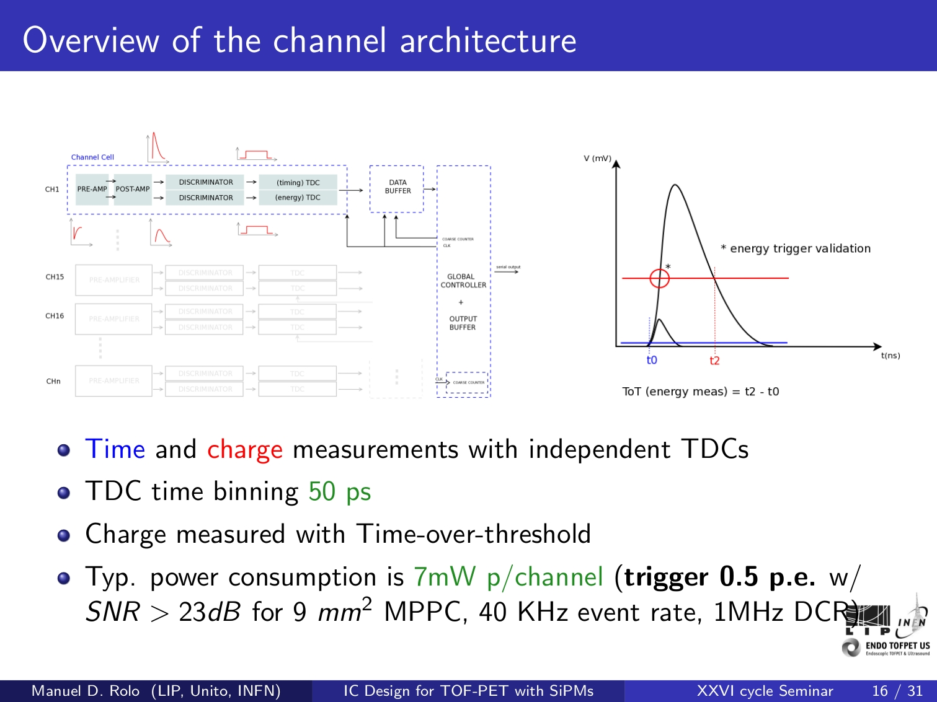
From TOFPET to the New CGEM ASIC
New
FrontEnd
64 Channels
but New Pad geometry
Same BackEnd
Input stage
+ Linear ToT
but SEU
Protection

Slide 22
NEW CGEM ASIC : Basic Features
UMC 110 nm technology
(limited power consumption, to be tested for radiation tolerance)
  Input charge: 3-50 fC
  Sensor capacitance 100-150 pF
  Input rate (single strip): 7-15 kHz
  Time and Charge measurements by independent TDCs
  TDC time binning > 50 ps
  Double threshold discrimination
  Time over Threshold (ToT) to measure the charge
  Power consumption < 7 mW p/channel ⇒ 4 mW p/channel feasible
⇒ CGEM needed time resolution ~ 1 ns
⇒ CGEM: Linear ToT

Slide 23
Budget and schedule

Slide 24
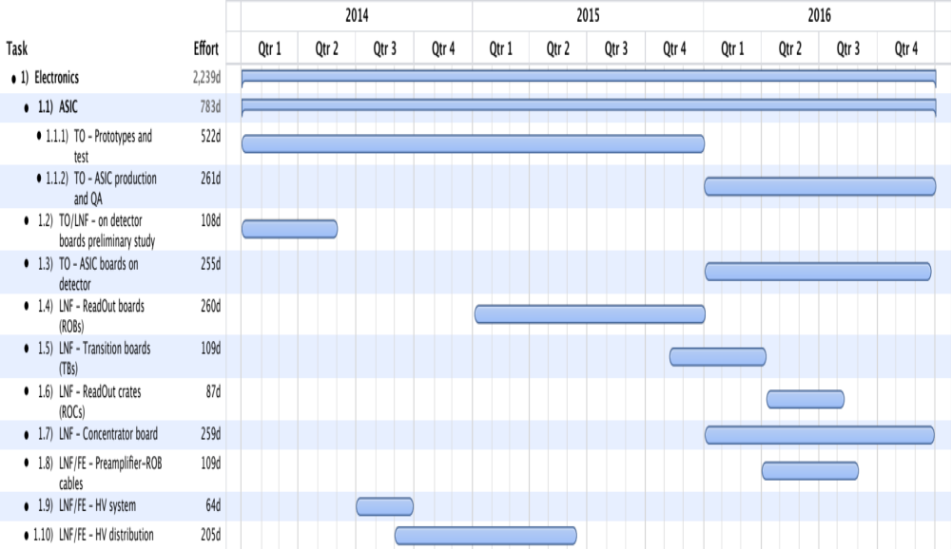
Schedule for electronics

Slide 25
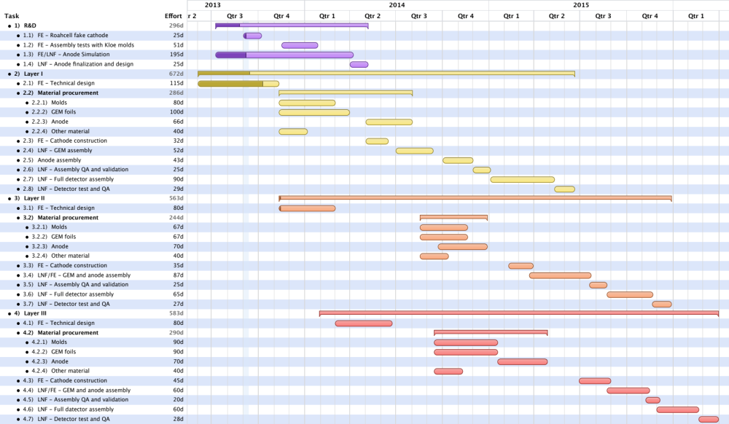
Schedule for detector construction
R&D
first layer
second layer
third layer
CDR approval by the BESIII collaboration

Slide 26
Schedule for the CDR
During the last BESIII-Italy meeting (4 and 5 Sep. 2013) we dedicated a full session to the planning of the CDR.
Formal approval for the CGEM based IT is needed by BESIII collaboration.
The CDR will be reviewed during the June 2014 collaboration meeting.
A detailed structure of the CDR has been prepared and discussed with BESIII colleagues.
A repository has been setup at IHEP.

Slide 27


Sharing the effort
Introduction
  The present BESIII Inner Tracker
  Luminosity Issues
    Present and expected backgrounds
  Inner Tracker Upgrade Requirements
Detector design
  Operating principle of a triple Cylindrical GEM detector
    The KLOE2 Inner Tracker: know-how and first results
  BESIII CGEM innovations
    Rohacell
    Anode design
    Analog vs. digital, expectations and measurements
The BESIII CGEM-IT
  CGEM-IT vs DC-IT
  Mechanical Design
  Tooling and Construction
Simulation of Cylindrical GEM Inner Tracker
  Parametric Simulations (Liang)
  CGEM-IT full Offline Reconstruction
    Pattern Recognition
    Tracking
    Acceptance, Resolutions and Reconstruction Efficiencies
  Monte Carlo simulation results
    Physics Benchmark
Front End Electronics
  Requirements
    Power Consumption
  System Block Description
  On-Detector Electronics
    ASIC
  Off-Detector Electronics
DAQ and Trigger
  Requirements
  Dead time and bandwidth
  Possible second level trigger future upgrades
  Storage
Integration of the CGEM-IT with the Spectrometer
  Mechanical design
    Interfacing with beam pipe
    Interfacing with Outer DC
  Power Dissipation and Cooling
  Gas Systems
  HV Systems
  Slow Controls
Money, manpower, schedule, task subdivision…..

Slide 28
Preliminary spending profile
The full construction cost for 3 CGEM layers is about 940 kEuros (not including manpower, integration and installation). INFN has requested an external contribution of ~150 kEuros.
+ Exec. Prog. 120 kEuros from IHEP for manpower
Total 117 217 333.5 294

Slide 29
Summary and outlook
Many updates, since the last meeting, have been presented here
  integration, fake cathode, mechanics and planar prototype
Substantial improvements have been done in the detector design
  The first big step toward the construction of a layer will be done next week when we’ll place the order for the tooling
We are facing a very intense 2014 with the CDR preparation, the construction of the first layer and the development of the frontend electronics.
The schedule is very tight but we’ll make it; come and join the fun!

Slide 30


Slide 31
Preliminary spending profile
 | 2013 | 2014 | 2015 | 2016 | 2017 | Total
Clean room preparation | 20 | 0 | 0 | 0 | 0 | 20
Planar prototype | 49 | 8 | 10 | 0 | 0 | 67
Layer 1 | 38 | 68 |  | 0 | 0 | 106
Layer 2 | 0 | 48 | 20 | 0 | 0 | 68
Layer 3 | 0 | 21 | 47 | 0 | 0 | 68
Off-det electronics | 0 | 0 | 146 | 0 | 0 | 146
On-det electronics | 0 | 0 | 43 | 28 | 0 | 71
ASIC | 0 | 45 | 0 | 236 | 0 | 281
Integration | 0 | 0 | 0 | 30 | 0 | 30
Total | 107 | 190 | 266 | 294 | 0 | 857

