Slide 1

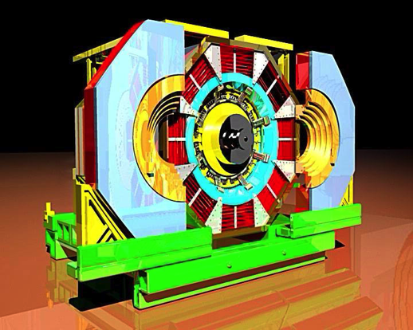
BESIII Cylindrical GEM IT
Project for BESIII
Project Co-financed by the Italian Ministry for Foreign Affairs (MAE)
BESIII Physics Workshop
IHEP, 2013-09-22
Sandro Calcaterra
(LNF-INFN)

Slide 2
Outline
Purpose of this work
Mechanics issues
Cosmic ray setup
Plans for the frontend electronics
Writing a Conceptual Design Report

Slide 3
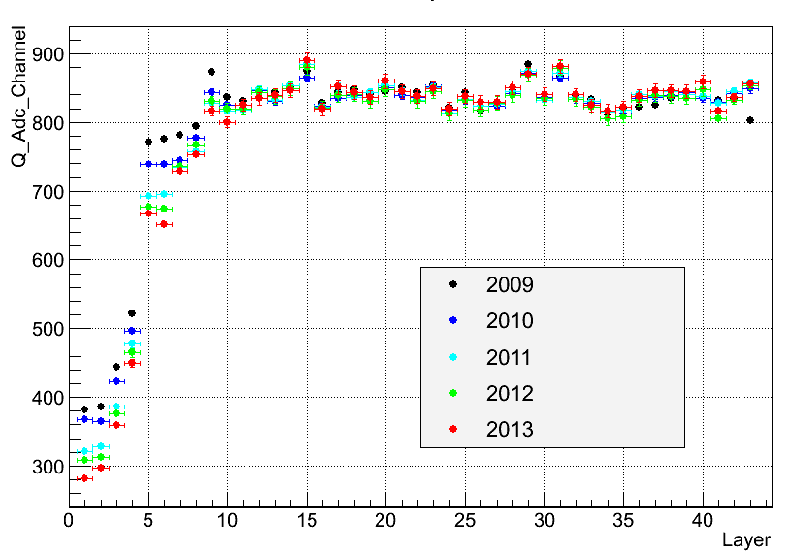
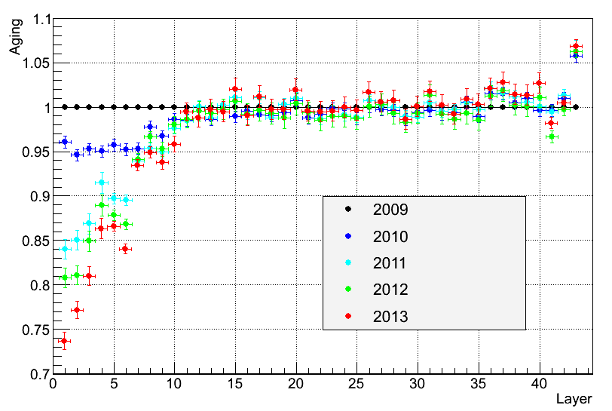
Present Drift Chamber
Gain change over 2009-2013 with Bhabha events
Gain change of each layer
Q value of each layer
Compared with 2009, now the gas gains of first 5 layers decrease about 26% —14%
The gains of the first 10 layers show an obvious decrease
The gains of the layers in the outer chamber show no change

Slide 4
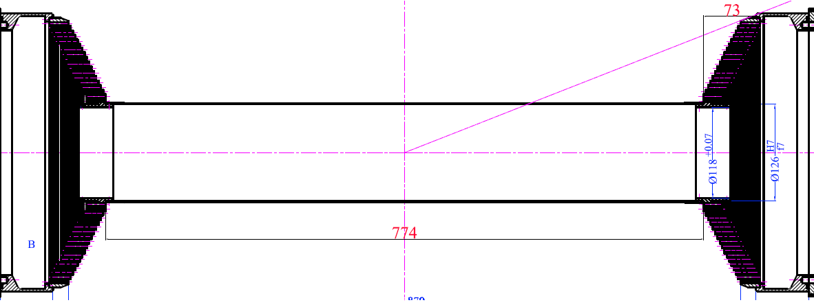
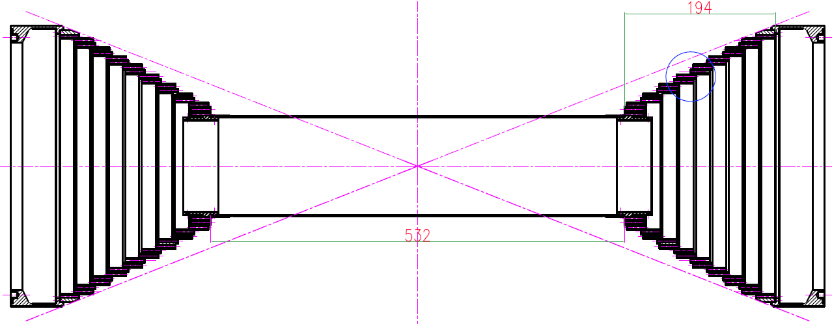
Replacement of the inner drift chamber
A new inner drift chamber is under construction, and will be finished in next April
A different end plate is used, to shorten the wire length and reduce backgrounds
The new inner drift chamber will be installed in 2015 but an expected luminosity doubling jeopardizes its lifetime.
Old inner chamber
New inner chamber

Slide 5
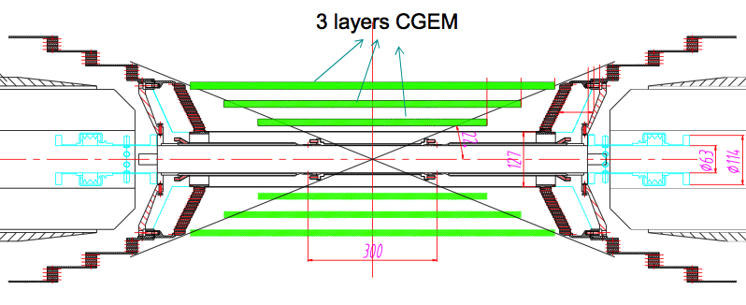
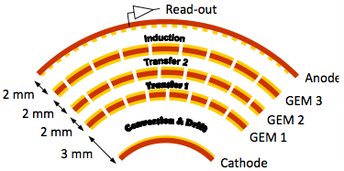
CGEM detector for BESIII
Three active layers
Active area
  L1 length 532 mm
  L2 length: 690 mm
  L3 length: 847 mm
Inner radius: 78 mm
Outer radius: 178 mm
Requirements
Rate capability: ~10⁴ Hz/cm²
Spatial resolution: s_{xy} =~100μm : s_{z}=~1mm
Momentum resolution:: s_{pt}/P_{t} =~0.5% @1GeV
Efficiency=~98%
Material budget <= 1.5% all layers
Coverage: 93% 4π
Operation duration~ 5 years

Slide 6
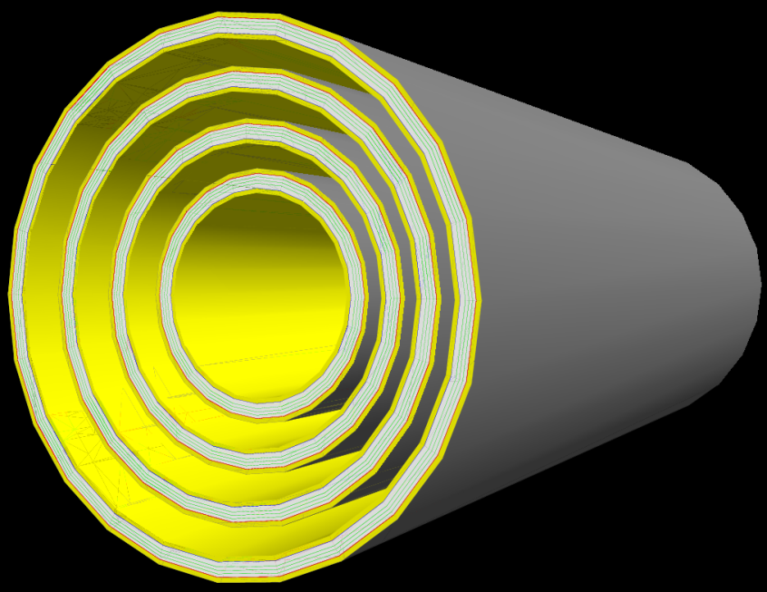
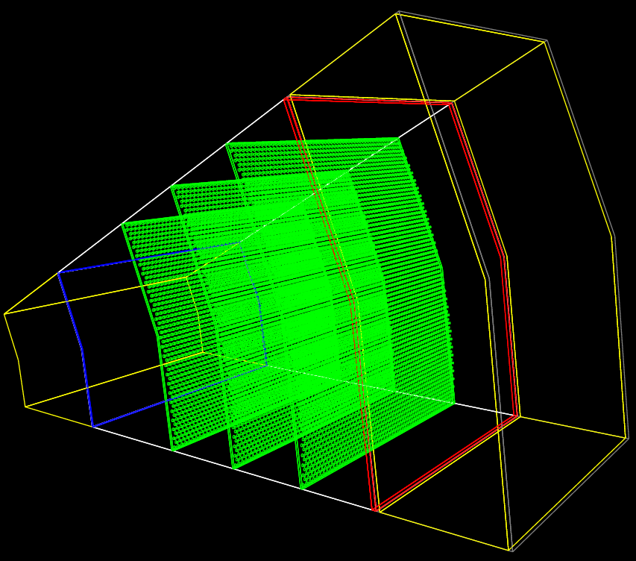

GEANT4 simulation
A CGEM detector has been added to the BESIII simulation in order to preliminary evaluate its possible performance.
A lot of details in the simulation.
Reconstruction code needs to be developed to fully evaluate the impact on the physics.

Slide 7
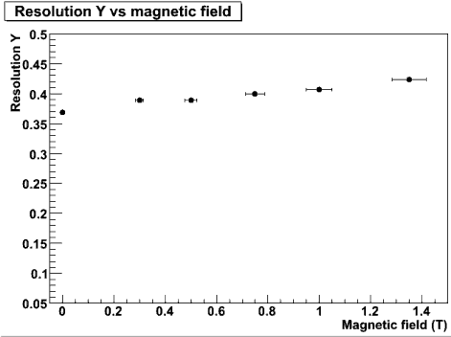
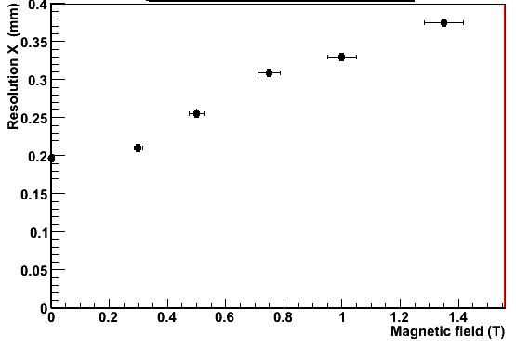
CGEM point resolution vs. B
σ_{rφ}
σ_{z}
BESIII B-Field σ_{rφ} = 330 μm
BESIII B-Field σ_{z} = 400 μm
Readout | σ_{rφ} (μm) | σ_{z} (μm)
Digital readout (KLOE Beam test in 2009) | 330 | 400
Analog readout (magnetic field effect avoided)* | 80 | 150
* Taken as expected spatial resolution

Slide 8
CGEM expected performance
CGEM inner detector (Vs MDC inner detector)
Improves dz resolution significantly
(by a factor of 2.6~6)
Comparable dr resolution
(~5% poorer for low momentum tracks )
Comparable momentum resolution
(~5% better for high momentum tracks)

Slide 9
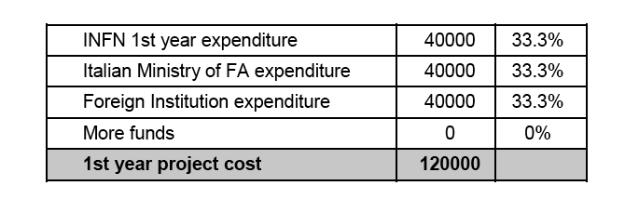
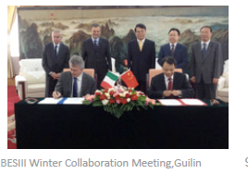
First layer: construction goals
Design, construction and test of a CGEM prototype, in case first layer of a new CGEM Inner Tracking
Design, construction and test of an analog readout system to achieve < 100 μm xy and < 200 μm z resolutions
Budget (euros) requested to Foreign Affairs Ministry, following the Agreement of scientific cooperation for a Joint laboratory “INFN-IHEP”

Slide 10
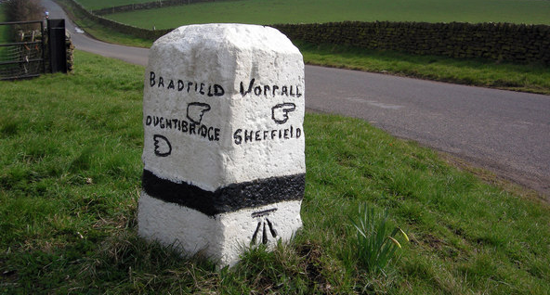
The path toward a CGEM-IT
Much effort needed to go from one layer to the complete IT
R&D program (Jun 2013 – Jun 2014)
First layer funded under the MAE agreement
  design (Sep-Nov 2013)
  construction (May 2014 – Jul 2015)
Write a Conceptual Design Report (CDR)
(winter 2013/spring 2014)
Submission of the CDR to BESIII for approval
(June 2014).
Second layer
  design (Dec 2013 – Mar 2014)
  construction (Feb-Nov 2015)
Third layer
  design
  construction (Jul 2015 – Mar 2016)
Test and integration (Jan-May 2016)
Ready for installation (Jan 1st 2017)

Slide 11
First mechanical drawings (Fe)

Slide 12
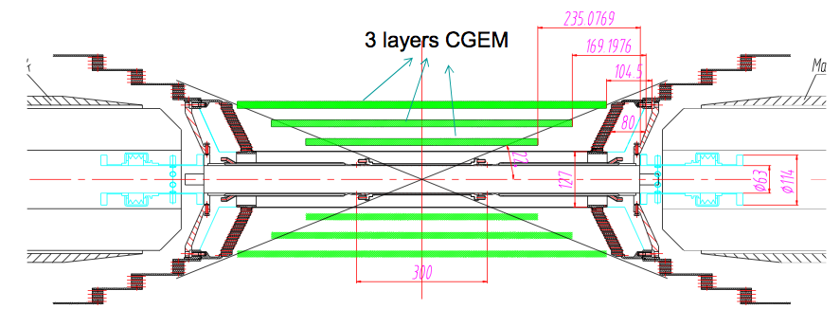
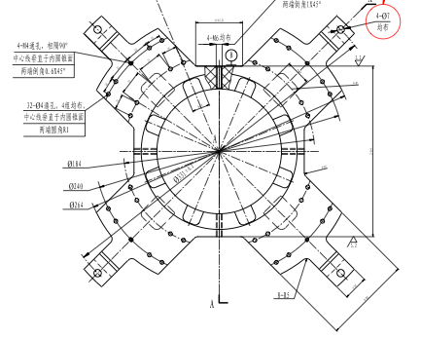
Constraints!
We had a first interaction with Chinese engineers to understand the mechanical constrains for the inner tracker.
Doable but very limited space.
The beam pipe support closes most of the space in z direction.
The KLOE2 design needs modification

Slide 13
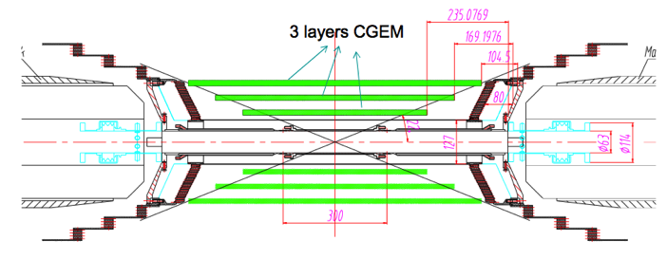
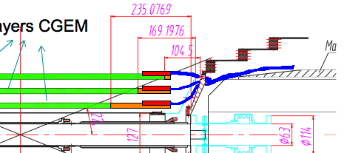
CGEM conceptual design
About 10 cm outside the active area.
We plan to use three layers of the same length in order to facilitate the mechanics of the installation and the robustness of the structure.
For the two innermost layers the electronics will be placed inside the gaps between the chambers.
The design for the outermost layer will be evaluated after a meeting with BESIII people scheduled tomorrow.

Slide 14
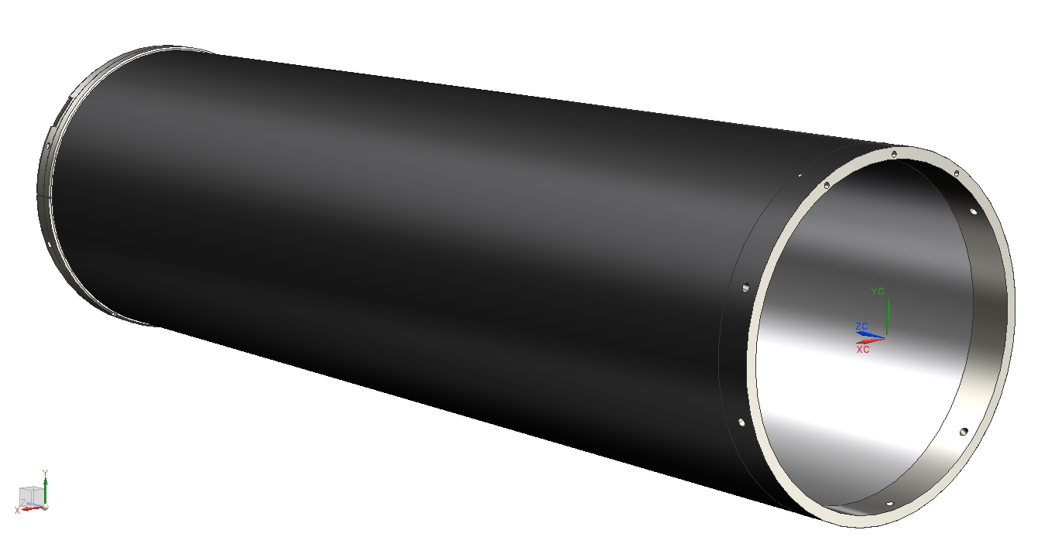
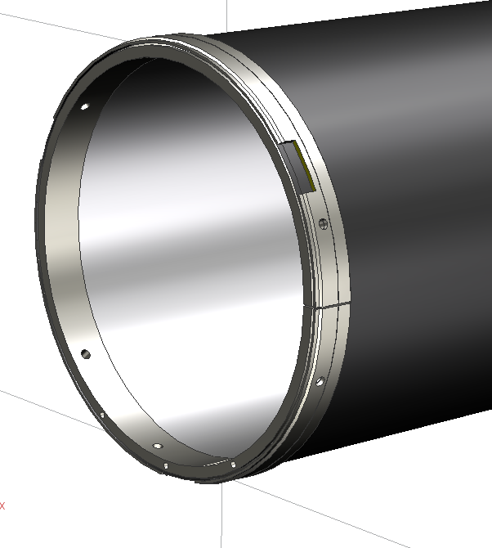
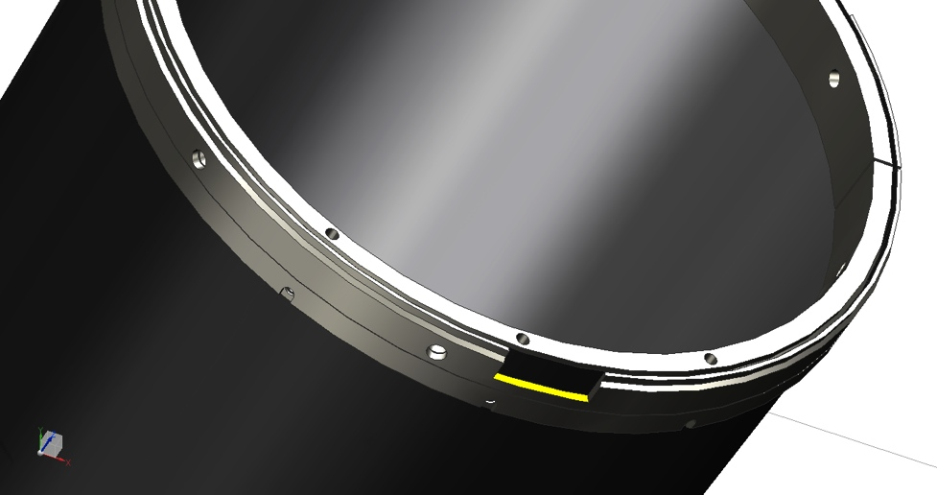
The cathode design
Preliminary solid model of the cathode has been done and it is currently under discussion within the collaboration.
Space for housing the HV connectors
positioning holes

Slide 15
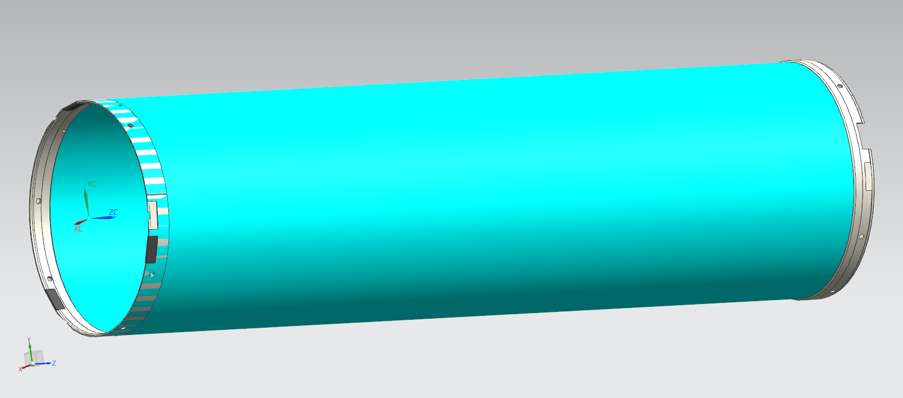
CGEM layer design
3D model of the one of the cylindrical GEM layer showing the internal and external rings.
outer ring on the other side
inner ring on one side

Slide 16
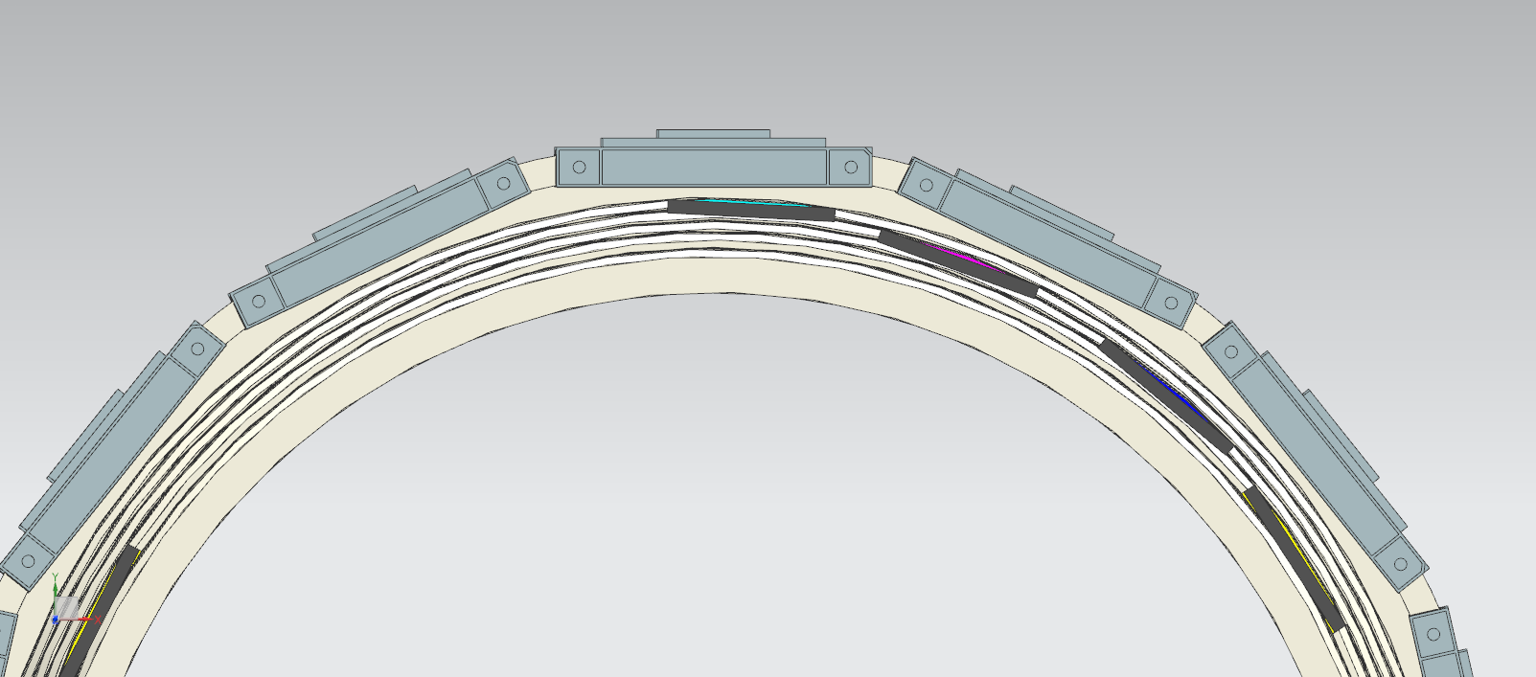
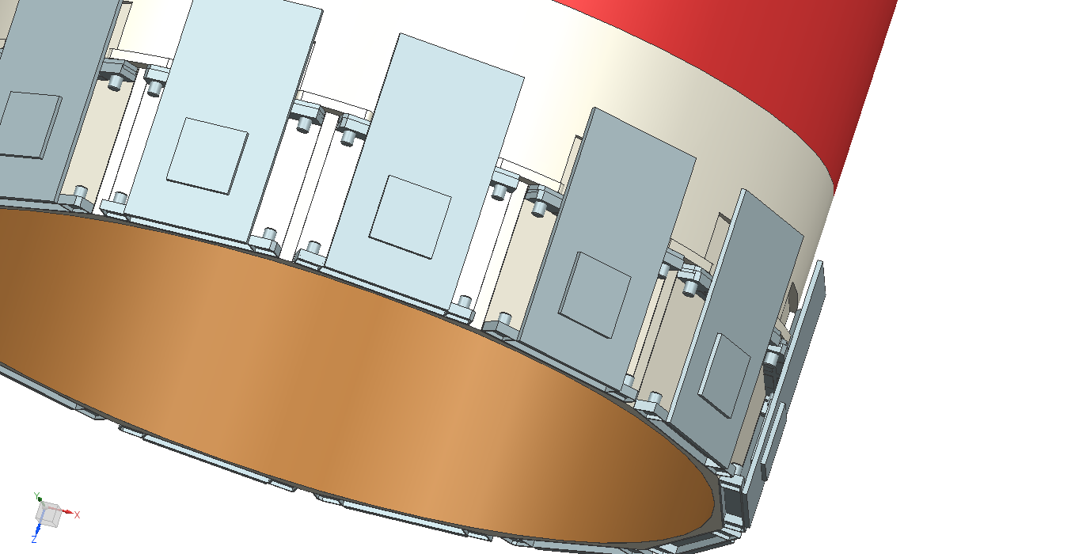
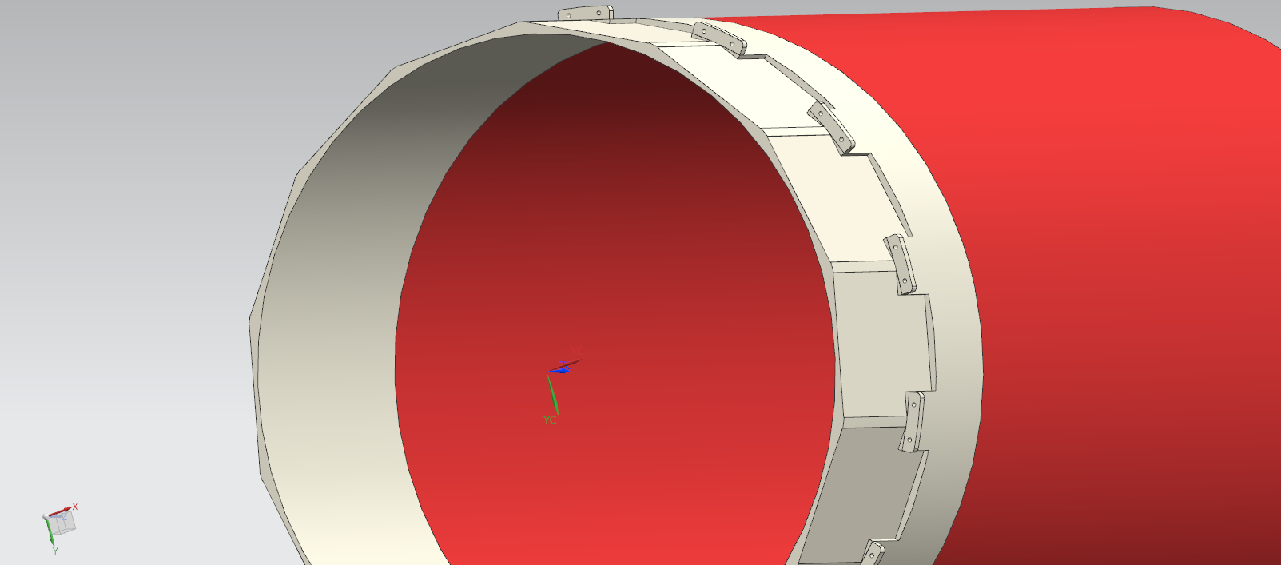
The anode conceptual design
The anode design will be finalized once the studies with simulations and planar prototype will be finished (May 2014).
Nevertheless we need to address many mechanical constraints now to be sure that our design will match perfectly other parts of the detector.

Slide 17
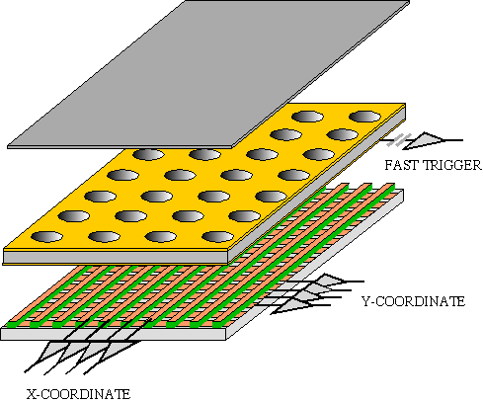
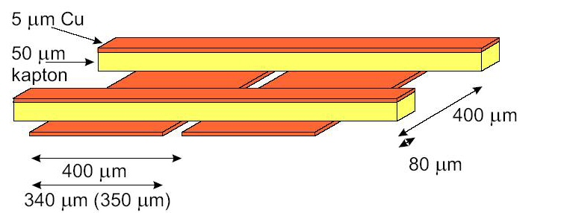
Anode simulation
Pitch X strips: 650 μm
Width X strips: 350 μm
Width V strips: 80 μm
Kapton: 50 μm
Cu: 5 μm
Due to diffusion the charge cloud collected on the readout board is bigger than the strip width and a weighting method is used for calculate the exact track position in two dimensions
A simulation (performed with ANSYS Maxwell) is under way to study the couplings both between the strip planes and between a strip plane and ground.
Any chance to reduce the capacitance will be investigated.
The deadline for this task is May 1st 2014.

Slide 18
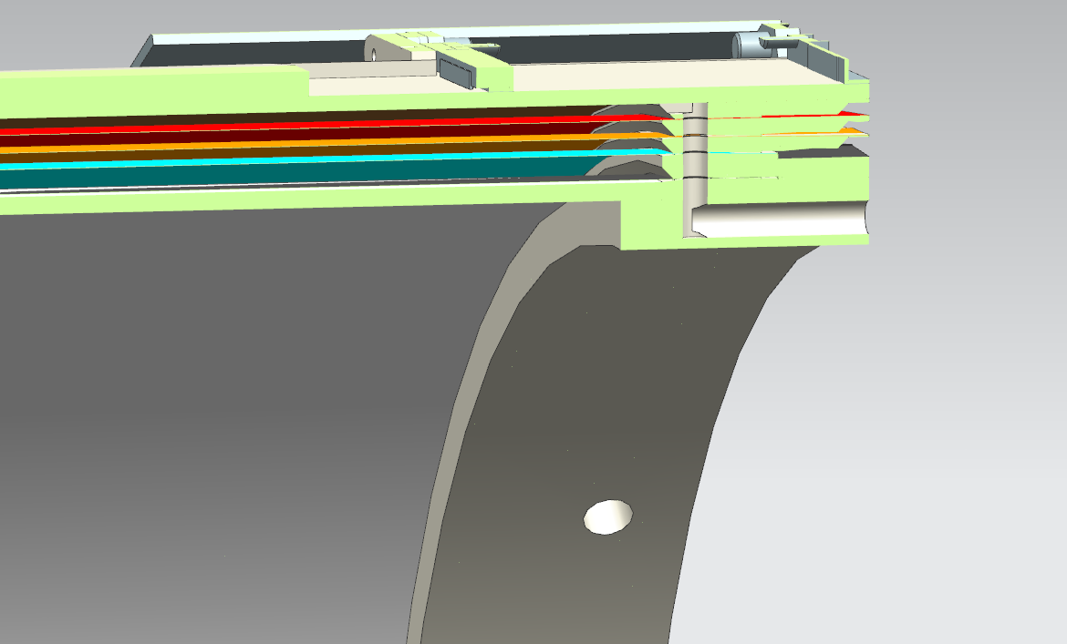
Section of the assembly
the gas path

Slide 19
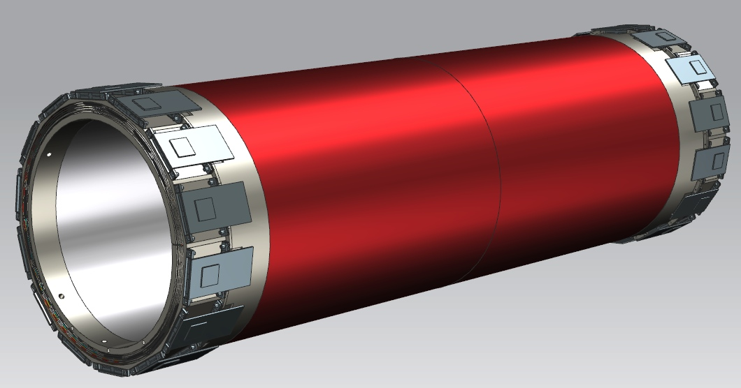
One-layer assembly

Slide 20
Before freezing the design
Rohacell based fake cathode to be done in Ferrara (end of September).
Discuss mechanical constraints with Chinese engineers (we have two days of meetings at IHEP on the 25th-26th ).
Evaluate the space needed the HV, signal and gas connectors, and cooling tubes.
Evaluate FE board dimensions, concurrently with final anode design (will be done in 2014).

Slide 21
Tooling for detector construction
The proper tooling for cathode and GEM layers construction has been designed.
Assembly procedures have been discussed.
Manpower needed for construction and assembly has been evaluated.
We will reuse as much as possible the tooling and the expertise from KLOE2.
Careful review of the tooling design is under way (very important since the procurement of the material will start soon).

Slide 22
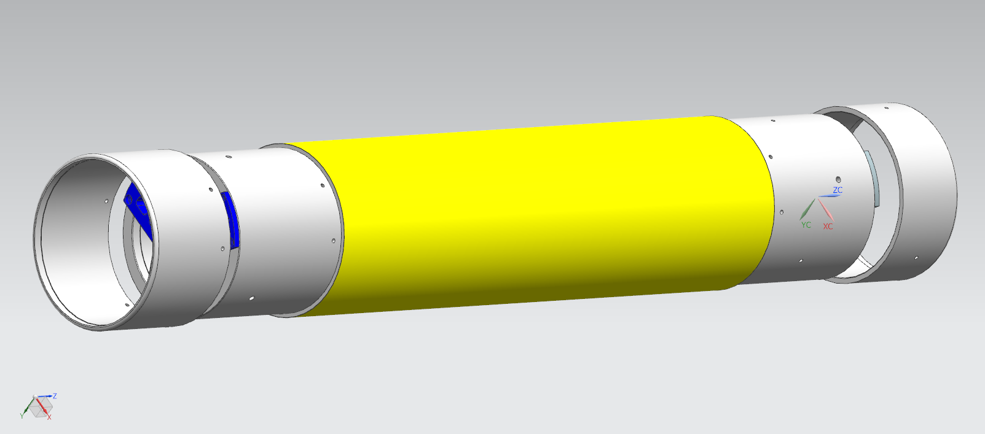
The cathode assembly tooling and procedure
Mold positioning

Slide 23
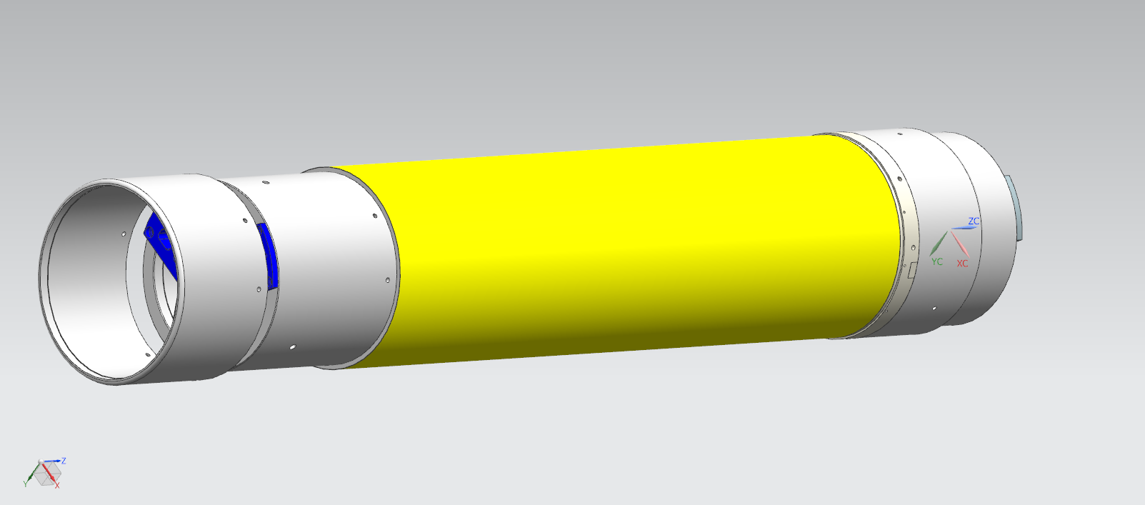
The cathode assembly tooling and procedure
Position vetronite rings

Slide 24
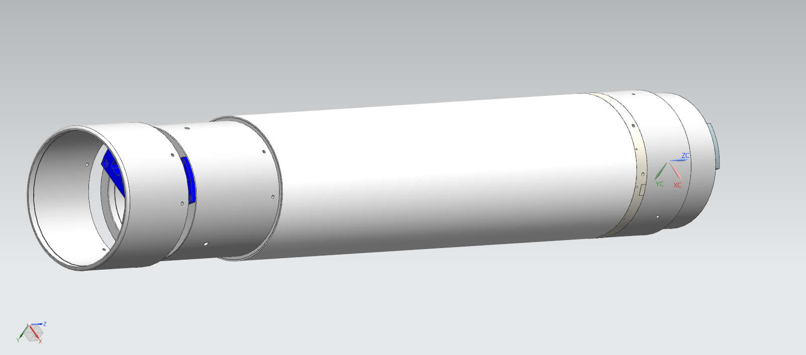
The cathode assembly tooling and procedure
Glue and machine the Rohacell structure

Slide 25
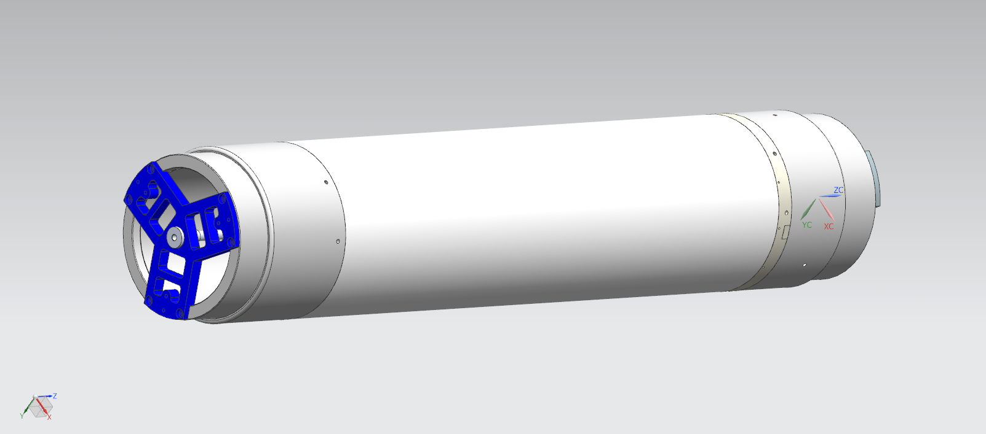
The cathode assembly tooling and procedure
Complete support structure

Slide 26
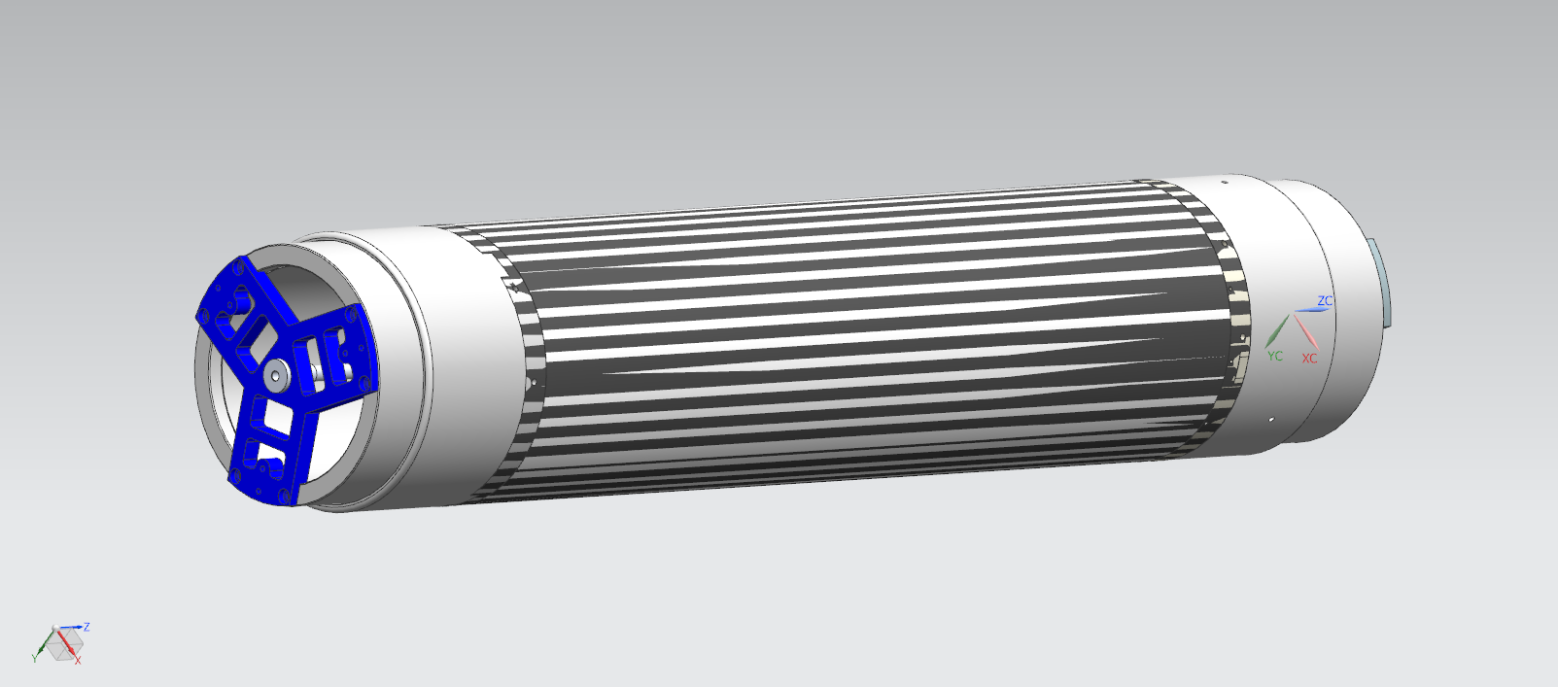
The cathode assembly tooling and procedure
Glue the cathode sheet

Slide 27
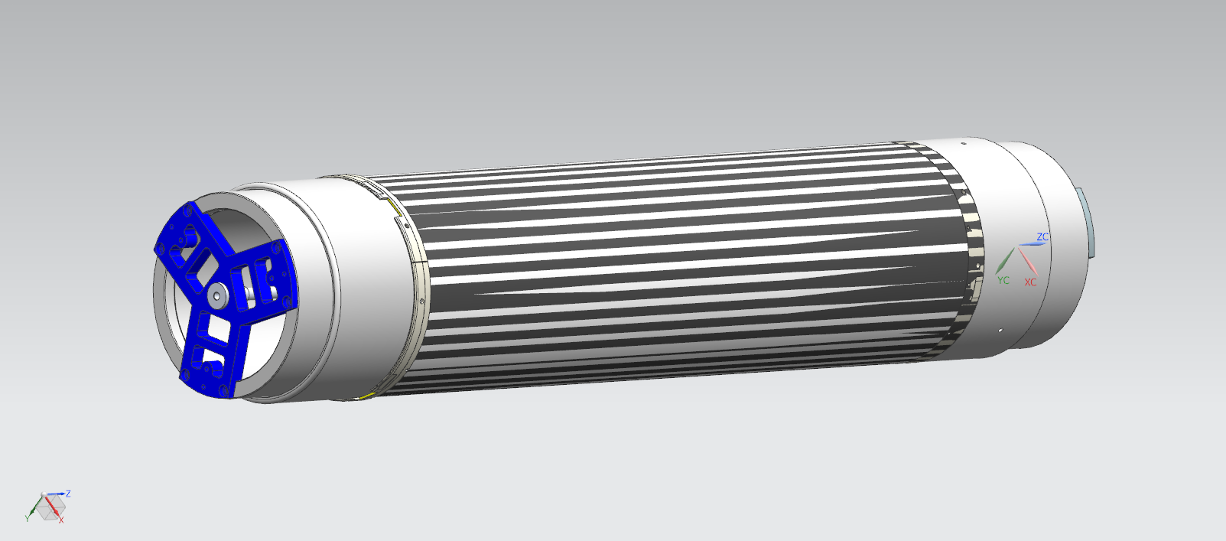
The cathode assembly tooling and procedure
Glue the GEM 1 supporting ring

Slide 28
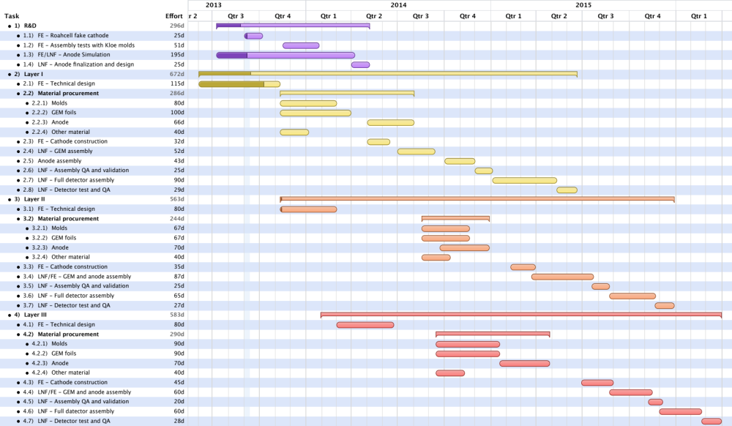
Schedule for detector construction
R&D
first layer
second layer
third layer
CDR approval by the BESIII collaboration

Slide 29

Zoom to the first layer

Slide 30
The planar prototype

Slide 31
CGEM first layer: cosmic test setup (LNF-FE-TO)
The COMPASS-type readout layer is substantially different from the KLOE2 one
It must be tested, before employ in a full-scale cylindrical prototype
KLOE2 cosmic-ray telescope borrowed
(3 complete and working planar GEM chambers of KLOE2 type)
To these we will add a small (10x10 cm²) planar chamber with GEMs, and a COMPASS-type readout layer
Planar GEM chamber kit from CERN ordered and arrived in LNF
Build, test and operate setup, to characterize COMPASS-type readout
Start taking cosmic data, beam if possible
Small rate if few channels: will take time

Slide 32
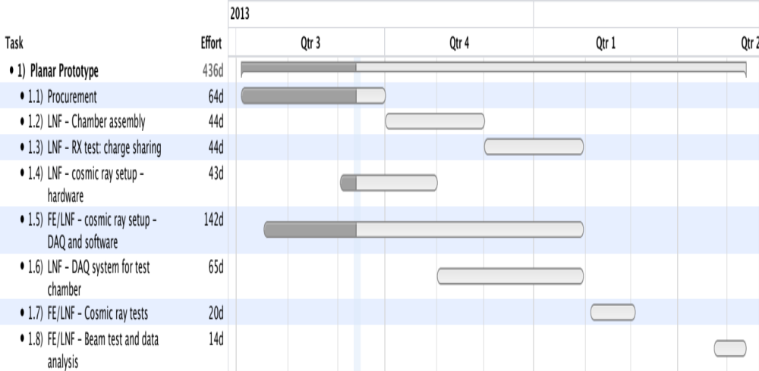
Schedule for planar prototype

Slide 33
Plans for electronics design

Slide 34
CGEM IT FrontEnd electronics
Readout ASIC for CGEM:
  Modify/adapt the existing TOF-PET ASIC
  (Rolo, Rivetti et al. http://iopscience.iop.org/1748-0221/8/02/C02050)
  in IBM 130nm for PET applications
Re-design a new analogue FE (suited for CGEM signals)
Use of the same BackEnd of TOF-PET
Migration to a newer and cheaper technology:
IBM 130nm → UMC 110 nm
should be exportable in China (implemented in Italy)
Integration and Development of the new ASIC for CGEM

Slide 35
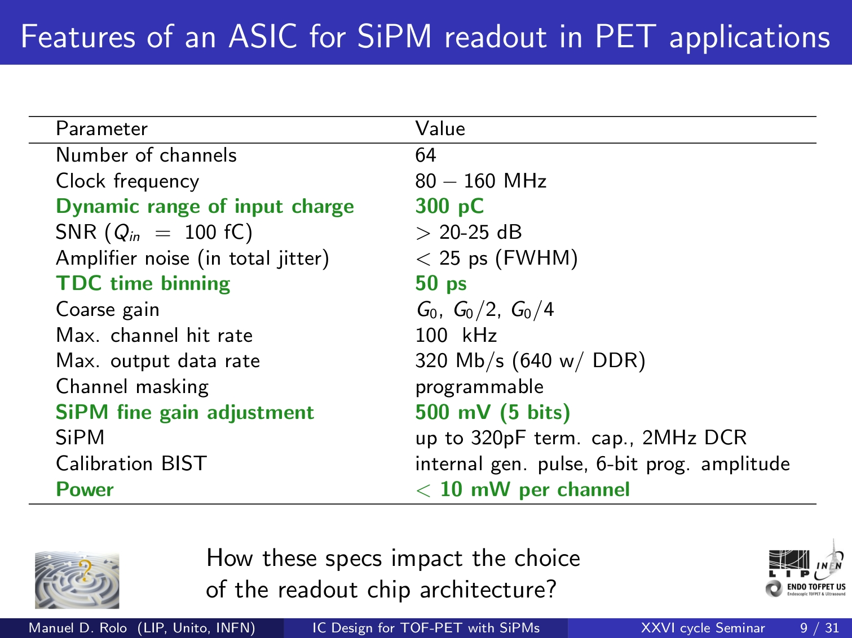
TOF-PET: Basic Features
⇒ GEM Input charge : 5 - 20 fC
⇒ CGEM needed time resolution ~ 1 ns
⇒ GEM Capacitance: 100-150 pF
⇒ GEM Power cons. < 7 mW
Front End not suited for GEM signals

Slide 36
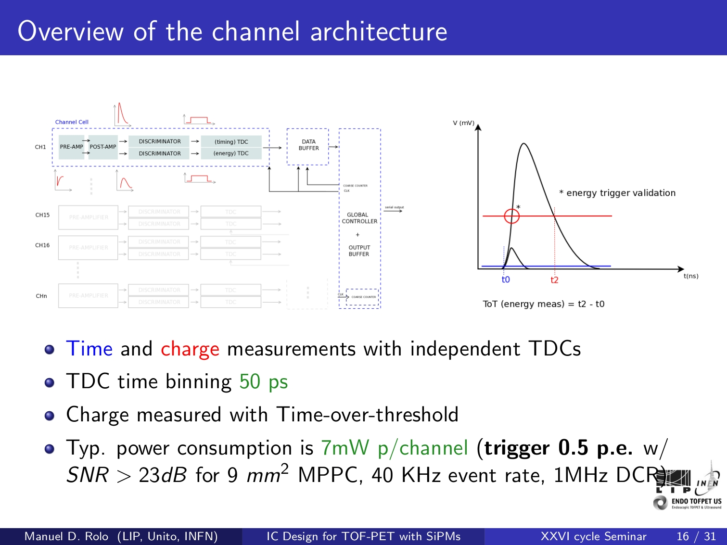
From TOFPET to the New CGEM ASIC
New
FrontEnd
64 Channels
but New Pad geometry
Same BackEnd
Input stage
+ Linear ToT
but SEU
Protection

Slide 37
NEW CGEM ASIC : Basic Features
UMC 110 nm technology
(limited power consumption, to be tested for radiation tolerance)
  Input charge: 5-20 fC
  Sensor capacitance 100-150 pF
  Input rate (single strip): 7-15 kHz
  Time and Charge measurements by independent TDCs
  TDC time binning > 50 ps
  Double threshold discrimination
  Time over Threshold (ToT) to measure the charge
  Power consumption < 7 mW /channel ⇒ 4 mW /channel feasible
⇒ CGEM needed time resolution ~ 1 ns
⇒ CGEM: Linear ToT

Slide 38
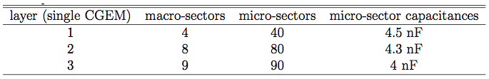
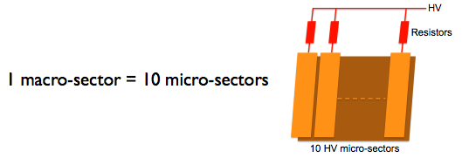
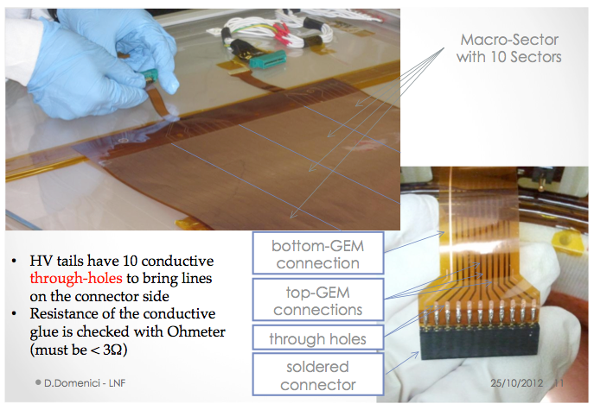
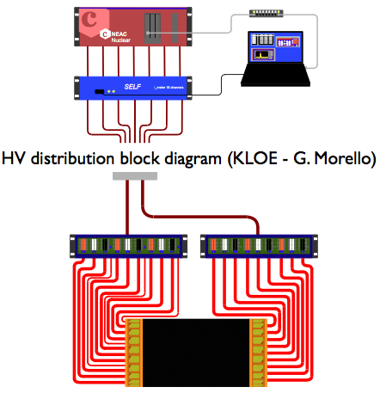
High Voltage distribution

Slide 39
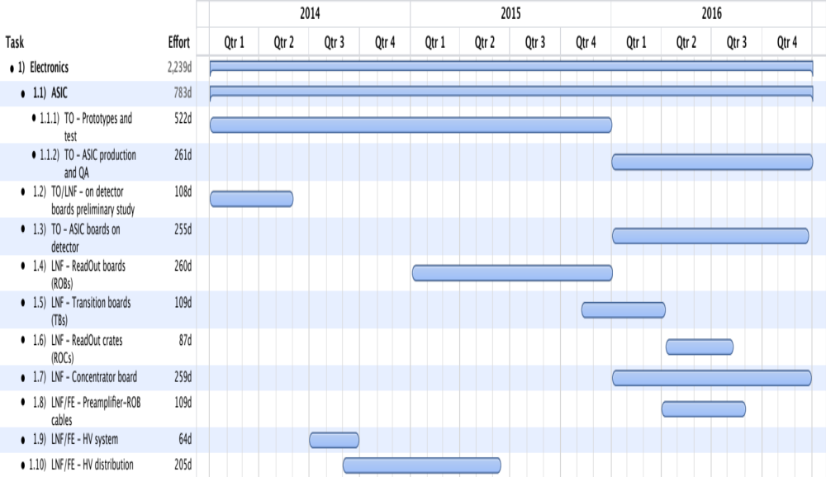
Schedule for electronics

Slide 40
The Conceptual Design Report

Slide 41
Plan for the CDR
During the last BESIII-Italy meeting (4 and 5 Sep. 2013) we dedicated a full session to the planning of the CDR.
The CDR will be submitted to BESIII some time before the June 2014 Collaboration Meeting
We expect from that Meeting the final go-ahead to proceed with the construction plan
A detailed Table of Content has been prepared, discussed with Chinese colleagues and approved.

Slide 42


Sharing the effort
Introduction
  The present BESIII Inner Tracker
  Luminosity Issues
    Present and expected backgrounds
  Inner Tracker Upgrade Requirements
Detector design
  Operating principle of a triple Cylindrical GEM detector
    The KLOE2 Inner Tracker: know-how and first results
  BESIII CGEM innovations
    Rohacell
    Anode design
    Analog vs. digital, expectations and measurements
The BESIII CGEM-IT
  CGEM-IT vs DC-IT
  Mechanical Design
  Tooling and Construction
Simulation of Cylindrical GEM Inner Tracker
  Parametric Simulations (Liang)
  CGEM-IT full Offline Reconstruction
    Pattern Recognition
    Tracking
    Acceptance, Resolutions and Reconstruction Efficiencies
  Monte Carlo simulation results
    Physics Benchmark
Front End Electronics
  Requirements
    Power Consumption
  System Block Description
  On-Detector Electronics
    ASIC
  Off-Detector Electronics
DAQ and Trigger
  Requirements
  Dead time and bandwidth
  Possible second level trigger future upgrades
  Storage
Integration of the CGEM-IT with the Spectrometer
  Mechanical design
    Interfacing with beam pipe
    Interfacing with Outer DC
  Power Dissipation and Cooling
  Gas Systems
  HV Systems
  Slow Controls
Money, manpower, schedule, task subdivision…..

Slide 43
Acknowledgements
Thanks to BESIII authors of talks at the April Workshop in Frascati!
  Dong Mingyi
  Wang Liangliang
  Xiu Qinglei
  Ye Mei
Thanks to Qun Ouyang for help in preparing the CDR!
Thanks to G. Morello (KLOE2)
  KLOE2 beam test data
Thanks to Gigi Cibinetto (FE)!
  Author of the remaining of these slides

Slide 44
Spares

Slide 45
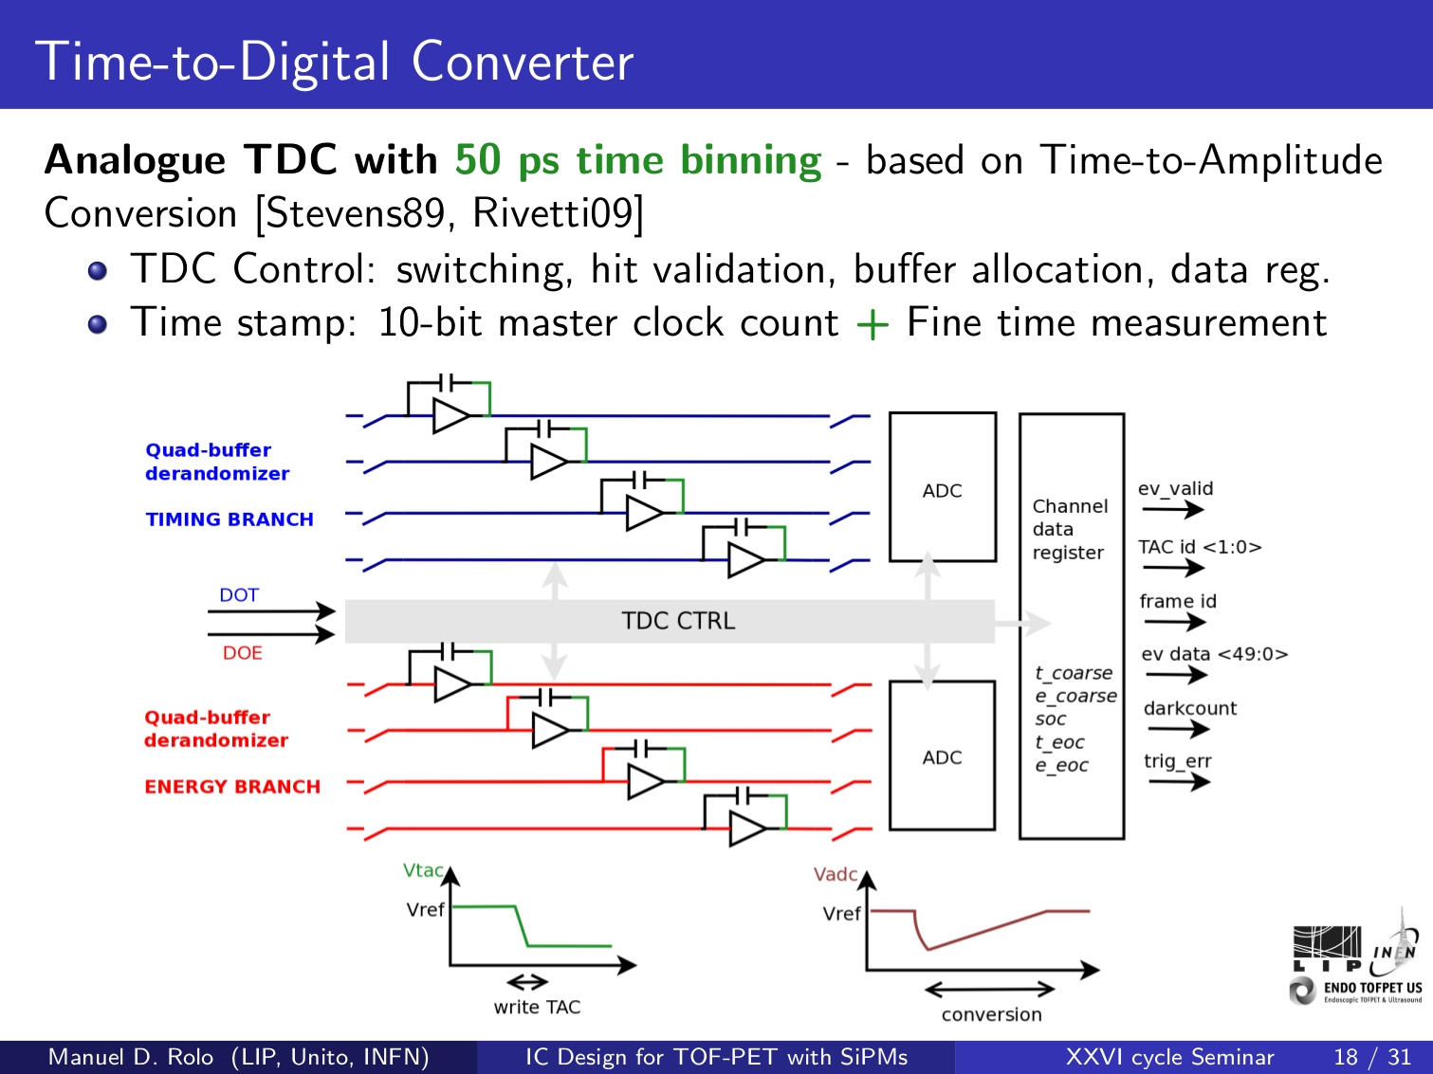
Current TOFPET

Slide 46
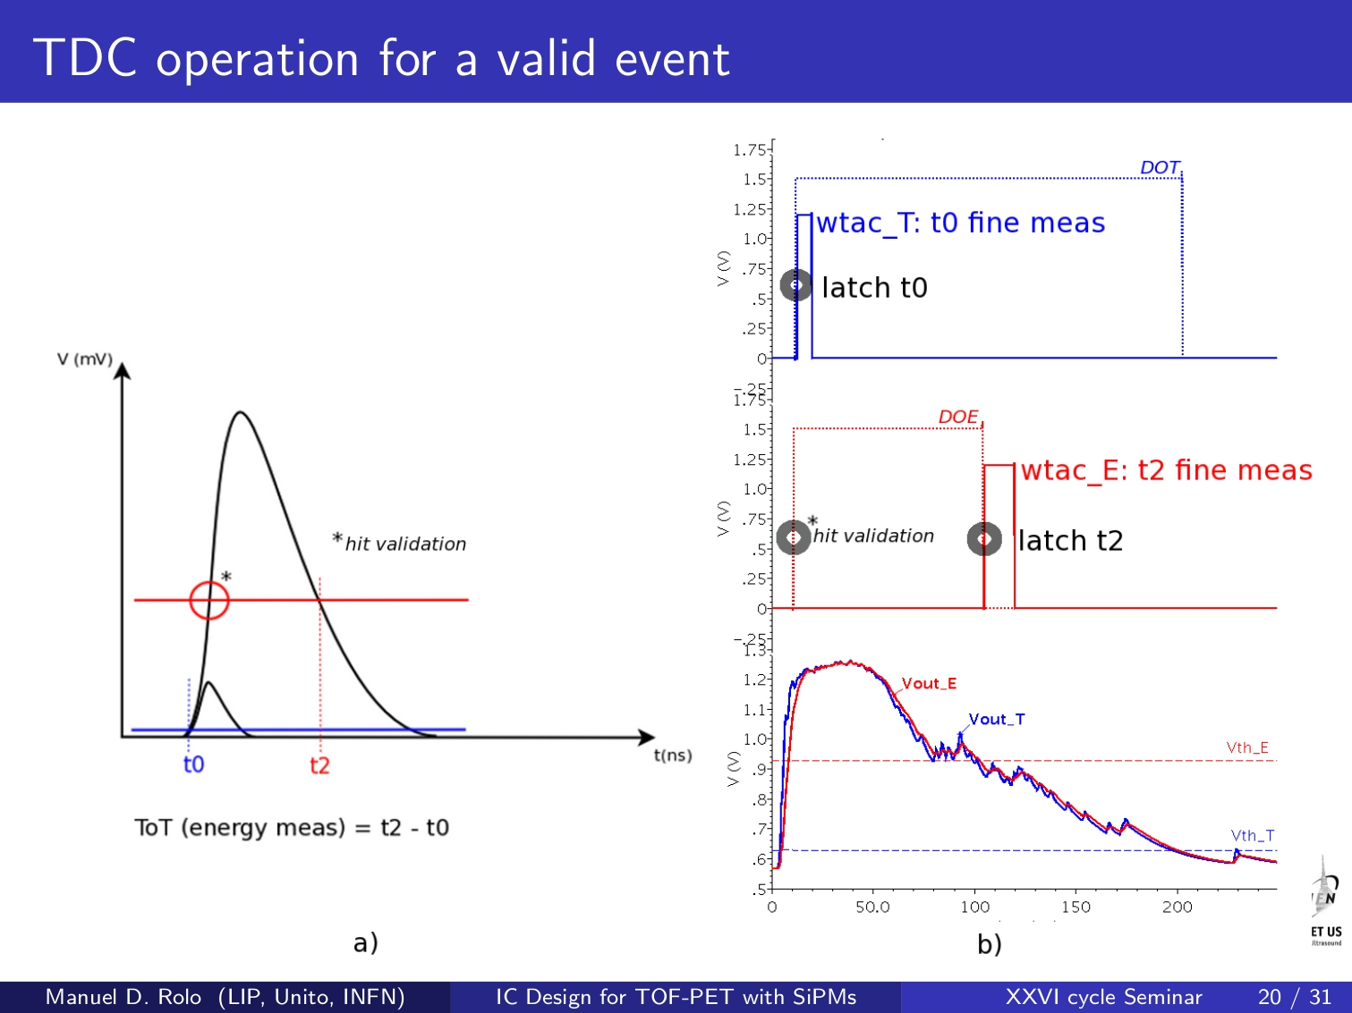
Current TOFPET

Slide 47
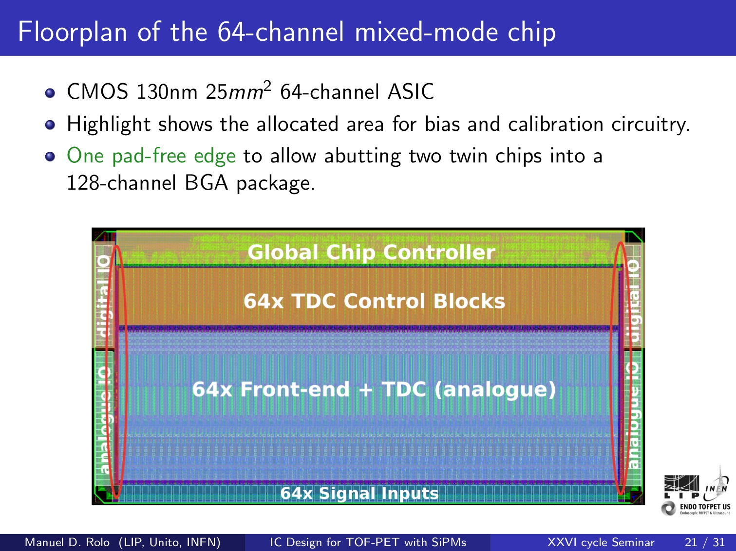
Current TOFPET
Pad-free edge

Slide 48
CGEM Specifications
Input charge: 5-20 fC
Cstrip 100-150 pF
Input rate (single strip): 7-15 kHz
Trigger latency: 8-9 μs - Dead time. 4 μs
Trigger rate: 1-2 kHz
Input impedance 120-300 Ω
Charge sensitivity 20-40 mV/fC
Shaping time: 50-100 ns
ENC : 400e+40e/pF to 600e+60e/pF
Charge meas resolution: 7-8 bits
Time meas resolution: 10-20 ns
  Power consumption < 7 mW p/channel ⇒ 4 mW p/channel feasible
Detector Spec
Readout section
Input section (pre+shaper)
Data conversion section

Slide 49
Manpower for the construction of one layer
From KLOE and our own evaluations
GEM foils test (@ LNF): 1 physicist and/or 1 technician for 1 week – full time.
GEM gluing on the molds (@ LNF): 2 or 3 phys/techs + 1 supervisor for 2 months – full time
Cathode and anode construction (in Ferrara): 2 or 3 phys/techs + 1 supervisor for 2 months – full time
Assembly of the detector (@ LNF): 2 or 3 phys/techs + 1 supervisor for 2 weeks – full time.

