Slide 1
The search for the dark light
Fabio Bossi
INFN-LNF

Slide 2
Talking about «dark light» may seem an oximore. We naturally connect the idea of darkness with that of absence of light.
In our macroscopic everyday’s world this is in fact correct, not only from the point of view of our instinctive perception but also from that of a rigorous physical description of reality.
Darkness is equivalent to absence of communication with the outside world, communication that can be performed only by means of electromagnetic waves catched by our «antennas» (including our eyes) i.e. by means of light
If we switch however to the microscopic world of Particle Physics this relation is not anymore so obvious and things become more tricky and intriguing

Slide 3
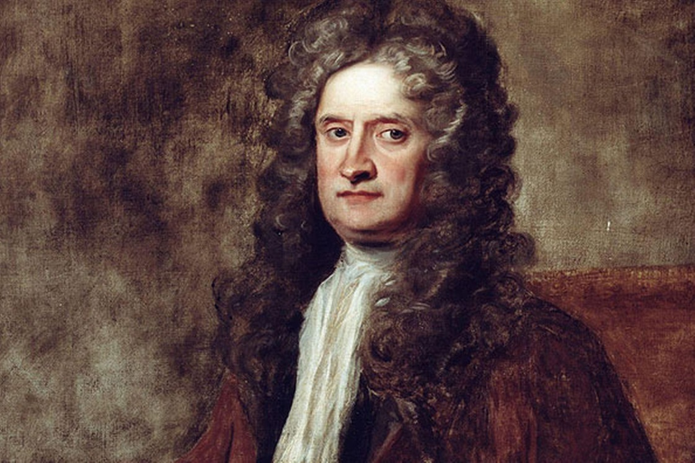
What is light?
The quest for understanding the actual nature of light is as old as mankind
In modern times, Newton himself elaborated a theory according which light is made of minuscule particles, which obey the same laws of physics as other masses, like planets and stars
The fact that we do not observe gravitational effects on light rays is due to the fact that the speed of these particles is so great

Slide 4
As you probably very well know, Newton’s theory had to be surerseded by a different one, due mainly to Maxwell: light is nothing more or different than an electromagnetic wave of given frequency (or the superposition of many of them) produced by the motion of electric charges
An electromagnetic wave is, in turn, an oscillating electromagnetic field which propagates in space at a well defined speed, the speed of light in fact
In the Sun or in a filament of a bulb, the motion of the electrons and protons heated at high temperature (a few thousands Kelvin degrees) produces emission of these waves which we eventually see with our detectors (our eyes for instance)
With the advent of Quantum Mechanics, however, a different description of light has emerged: it is now described as the manifestation of the presence of a specific type of particles, the photons

Slide 5
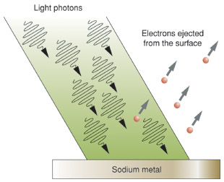
This concept was firstly introduced by Einstein in 1905 to explain the puzzling (at that time) results of the electrons emission from a metallic surface by an incident light beam, the so called «photoelectric effect»
Since electrons are emitted independently of the beam intensity, but depending on whether a frequency threshold is exceeded, Einstein proposed that light may be seen as made of particles each one carrying an energy proportional to the frequency through the Plank’s constant, E = hν. Single electrons can thus acquire the energy of single photons and be emitted out of the metal if this energy is higher than the electron’s binding energy
For the sake of historical rigour, it was in fact this work that laid the foundations for the advent of Quantum Mechanics (and for which Einstein was awarded the Nobel prize)

Slide 6
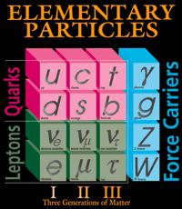
In the zoo of elementary particles known as of today, and described by the Standard Model of particle physics, the photon has its own specific and well defined place, among the so called «force carriers» or «gauge bosons»
The other type of fundamental particles are the «matter particles», leptons and quarks, the basic bricks of which the entire visible world is composed

Slide 7
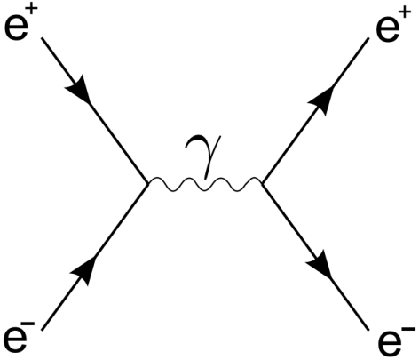
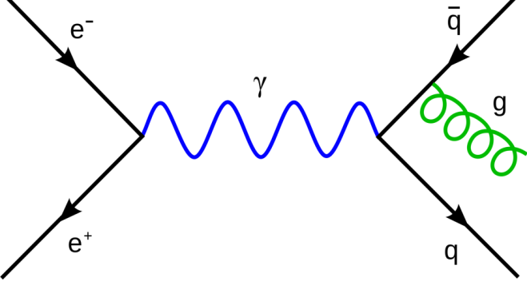
What does actually mean «force carrier»?
It means that it interacts, i.e. exchanges energy and momentum, with any particle which carries electric charge or magnetic momentum according to the (quantum) laws of electromagnetism (QED)
Moreover, any pair of particles with electromagnetic charge, interact between each other by the exchange of a (virtual) photon, according to the same laws
This processes are often pictorially represented by the so called Feynman diagrams, which have a strong visual impact, but also a well defined mathematical meaning

Slide 8
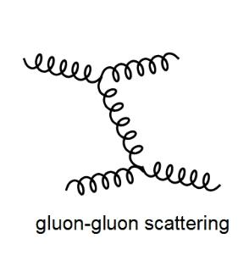
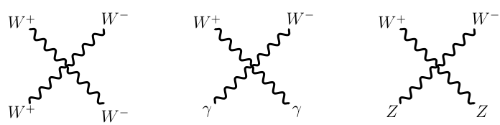
In the Standard Model there are other force carriers besides the photon, each one sensitive to the «charge» related to a specific type of fundamental interaction
The 8 gluons, sensitive to the «colour» charge of the Strong Nuclear Interaction
The W⁺,W⁻ and Z⁰ sensitive to the «weak» charge of the Weak Nuclear Interaction
Differently from the photon that does not have an electromagnetic charge, they instead carry the same charge which they are sensitive to, so they can «autointeract» via diagrams of the type below

Slide 9
The strenght of the coupling for the various interactions (i.e. the strenght of the unit charge of each of these forces) is very different. Approximately one has:
Q_{strong} : Q_{e.m.} : Q_{weak}
1 : 0.01 : 0.000001
which clearly explains the reason of the names «Strong» and «Weak»
All of the force carriers have spin 1 (in the slang they are «vector bosons»).
The photon and the gluons are massless while the carriers of the weak force are rather heavy, approximately 80-90 times the mass of a proton (80-90 GeV)

Slide 10
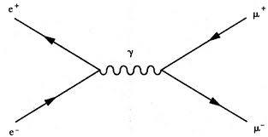
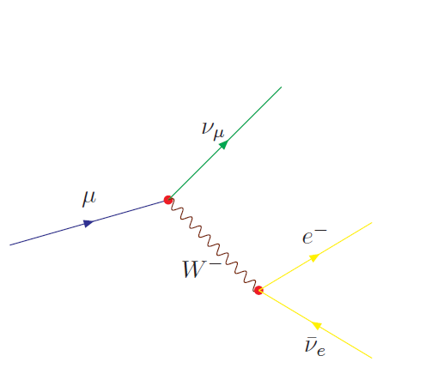
Leptons and quarks can carry more than one type of charge, so they can be sensitive to more than one type of interaction
For instance the muon that can be produced in pairs by Electromagnetic Interactions via a diagram of the type:
Can then decay via Weak Interactions via a diagram of the type:
In fact, among the various types of «matter particles» only the three types of neutrino are sensitive only to the Weak Interaction. This is the reason for they are so elusive

Slide 11
I would like to underline the fact that the existence of photons (as well as of the other vector bosons) is not a mathematical artifact, just useful for our calculations. In our experiments we actually do «see» single photons as products of well understood processes
For instance in the event depicted here, we observe 4 photons producing a signal in the KLOE detector, together with other charged particles called pions. For all of these particles we are able to determine their energies and flight directions, so that we can eventually reconstruct how and when they were produced (from the decay of other two particles called neutral kaons, in fact)

Slide 12

However this is NOT the entire story
In fact it seems that there is A LOT MORE to be understood in our Universe. Something NEW, something DARK

Slide 13
There is astrophysical evidence, which has become nowadays rather solid, about the fact that the vast majority of matter existing in the Universe is not made up of ordinary matter (i.e. by those particles which obey the Standard Model)
This evidence comes from:
Spiral galaxies rotation curves
Velocity dispersion of elliptical galaxies
Gravitational lensing effects
None of the above mentioned phenomena can be correctely described by taking into account only the gravitational forces induced by the matter that we can see

Slide 14
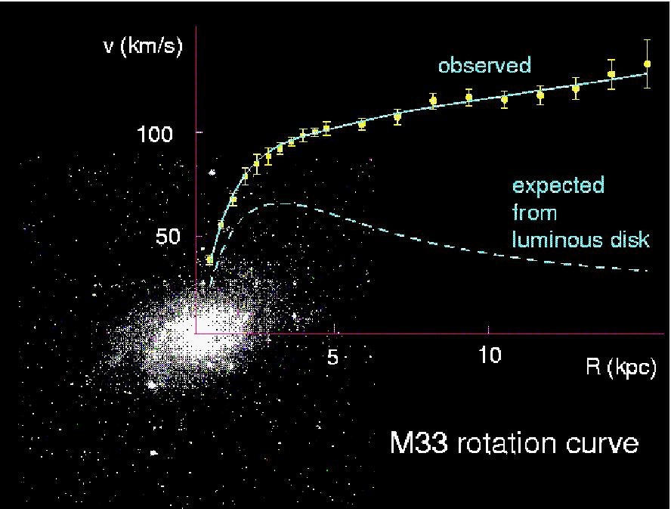

Slide 15
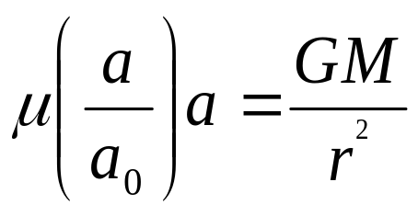
It is obviously possible to try to explain these observations with the hypothesis that the laws of dynamics that we know are not valid anymore at large distances or for specific acceleration values
For instance the so called MOdified Newtonian Dynamics model assumes that in the presence of a gravitational potential Newton’s law is modified as:
Where μ is a not well defined function equal to 1 when a >> a₀ (newtonian limit) which becomes 0 when a → 0, with a₀ ∼ 10⁻⁸ cms⁻²

Slide 16
However the most popular explanation of these phenomena among the physicists is that they are due to a new type of matter particles, which is electrically neutral and stable, and which populates the Universe in a 5:1 ratio with respect to baryonic ordinary matter
There exist several hypothesis on the actual nature of this mysterious Dark Matter, none of which has been experimentally proven to date
For instance, in the so called Supersymmetry framework, a class of models particularly intriguing for a number of theoretical reasons, there exist a natural candidate for the purpose, named Neutralino. However no evidence has been obtained so far on the Neutralino nor on any other kind of supersymmetric particle

Slide 17
One very important constraint imposed on the nature od Dark Matter comes however from Cosmology
In fact, in the early time of the Universe, just after the Big Bang, when its dimensions were much smaller than today, the interactions of the DM with photons and ordinary matter must have been such not to prevent galaxy formation and the correct ordinary/dark matter relic abundances
In other words we cannot have a DM candidate that would have made the presently observed Universe (including ourselves) impossible to exist!
This is a strong constraint. Any time a new DM candidate is hypothesized calculations must prove that it is compatible with cosmological observations

Slide 18
It has been proven that any hypothetical massive particles sensitive to the weak interaction (WIMP) would naturally be able to produce the correct relic abundance, a fact that has been often dubbed as «the WIMP miracle». The above mentioned Neutralino is such a kind of particle in fact
For this reason a lot of attention and experimental efforts have been put in the last two decades in the search for this kind of particles
On the other hand, no clear-cut evidence for WIMPS has been obtained to date, so one may argue whether alternative models of the DM nature and interactions must be taken into consideration
In fact new interactions in the dark sector naturally arise in a variety of theories beyond the SM, and are thus well motivated from a theoretical point of view

Slide 19
This is the most important slide (so please, wake up!)
Before briefly discussing two of these models, let me underline some facts which are worth considering, in my opinion:
The SM accounts for only ∼20% of the matter budget of the Universe , still it is rather rich in particle’s content and interactions
Its actual structure is determined by phenomenology and not by first principles
There is no good reason (but economicity) to believe that the remaining 80% of matter must be composed of a much poorer spectrum of states and forces
On the other hand, since our experiments are sensitive to SM interactions, the key point for us is to understand if and how this dark world interacts with the SM one, besides gravity

Slide 20
In a very famous paper Arkani-Hamed et al. have proposed a model consisting of a (at least) 3-states heavy (∼800 GeV) DM with mass splittings of order 100 keV and 1 MeV
χ₃
∼1MeV
∼800 GeV
χ₂
χ₁
∼100keV
These states are charged under a non-Abelian symmetry with one light ( ∼1 GeV) force carrier, γ’ and at least another ∼10 times heavier, γ’’

Slide 21
So called Asymmetric DM models (ADM) provide a natural way to account for light ( ≤10 GeV) DM particles
In these scenarios, DM particles have antimatter counterparts exactely as our ordinary matter components. Both DM and anti-DM populate the thermal bath in the early Universe; however, exactely as in the case of ordinary matter, a matter-antimatter asymmetry mechanism has left one of the two component only at present times
T. Lin et al., have shown that in the context of these models all cosmological constraints can be satisfied, provided that DM annhilation is mediated by a light force carrier

Slide 22
Besides the details, these two (and also other) models have the common feature to postulate the existence of a new light force carrier, with the same quantum numbers of the photon but with a small but nn zero mass, which from now on we call generically «dark photon» or γ’
It is postulated that ordinary particles can have a very small coupling with the dark photons, allowed by some subtle quantum-mechanical effect
This small coupling is generally labelled by a parameter ε which gives the strenght of the «dark charge» of ordinary matter with respect to its electromagnetic charge
If ε was exactely 0, then the dark and ordinary world would be kept totally separate but for gravitational effects. However there are several puzzling astrophysical measurements that would suggest that it may be in the (rather wide) range 10⁻³ – 10⁻⁸

Slide 23
Can we «see» a Dark Photon?
Well, this depends on the details of the physics model that are behind it.
If one supposes that in the «dark sector» there exists new particles, χ, that couple predominantly with the γ’, then the latter can decay
If m_{γ‘} < m_{χ} only into standard model particles (electrons, muons ecc...) so that the decay will be visible
If m_{γ‘} > m_{χ} only into dark matter particles, so the decay will be invisible
Don’t be pessimistic however: also invisible decays can be seen!

Slide 24
The striking consequence of this, is that if ε is non-zero then dark photons can be produced and observed in laboratory experiments
In fact, any process that produces a photon in the ordinary world can produce a dark photon with probabiity suppressed by a factor ε² (rather small, to be honest)
γ’
e⁻
e⁻
γ’
e⁻
e⁺
γ
N
Radiative production in e⁺e⁻ collisions
γ’ emission in electron-nucleon scattering
Motivated by these arguments, several experiments in the world have started the hunt for the dark photon by studying in detail some «standard» event

Slide 25
The common line of reasoning of them all is the following: if a γ’ has the same quantum numbers of the photon it must appear in all the processes which involve a γ, with two main differences:
It is suppressed by a factor ε² with respect to ordinary electrodynamics
Differently from the QED processes that produce photons of all the allowed energies, the «dark» process must be concentrated at the energy equal to the mass of the γ’
So, the name of the game for all the experiments is the following
Produce as many events as possible to look for very rare phenomena
Be extremely powerful in the measurement of the masses, to discriminate as much as possible «dark» events from QED ones

Slide 26
Here in Frascati we have been performing these searches using data from the KLOE experiment, exploiting two different processes
e⁺e⁻ → γ′γ→μ⁺μ⁻γ
e⁺e⁻ → Φ → ηγ′→ ηe⁺e⁻
In both cases there is a «standard» QED process with exactely the same final state but extremely more likely to occur. However the pair of muons/electrons from QED have an invariant mass which can take a continuum of possible values. Instead that from «dark» events must be concentrated at a single value, equal to the dark photon mass in fact

Slide 27
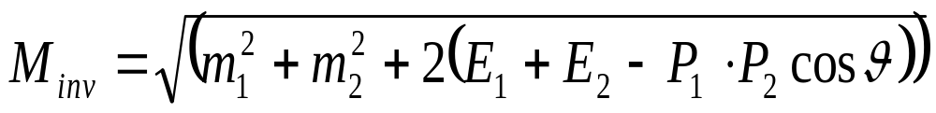
The invariant mass is a quantity which can be computed from the energies, directions and masses of the observed particles, and which corresponds to the mass of the «mother» particle from which they have been produced
Differently from, for instance, lengths and velocities it takes always the same value independently of the observer’s reference frame (hence the name «invariant»).

Slide 28
For instance in case 2., the measurement strategy would be
Select events of the type Φ → ηe⁺e⁻
Build the invariant mass distribution of the e⁺e⁻ pair
In case of absence of signal this distribution would look like the left plot below. In the presence of a positive signal it would show a peak in a well defined position, as in the plot on the right

Slide 29
The width of the bins of the two previous distributions is determined by the resolution with which the invariant mass is measured
This fact is very important. If one would have a resolution worst by a factor of 2, for instance, the right distribution would look like the plot reported below. The peak is much less evident!

Slide 30
Φ mesons are produced by the LNF collider DAΦNE. One looks therefore for the presence of an η meson and e± pair
The η is recognised by its decay products that can be either 6 photons or 2 photons and 2 charged tracks
Every single event with these features is selected and studied to determine if its kinematics is compatible with the searched events (i.e. if their energies/momenta/directions are compatible with the presence of an η and a e± pair)
Some final cleaning is performed to reject particularly nasty instrumental effects...

Slide 31
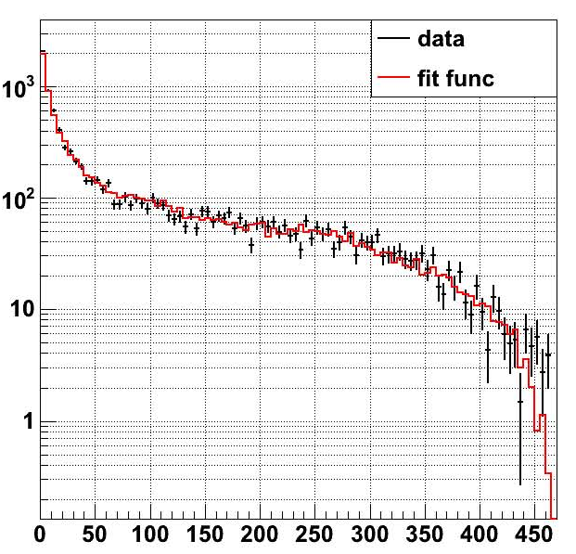
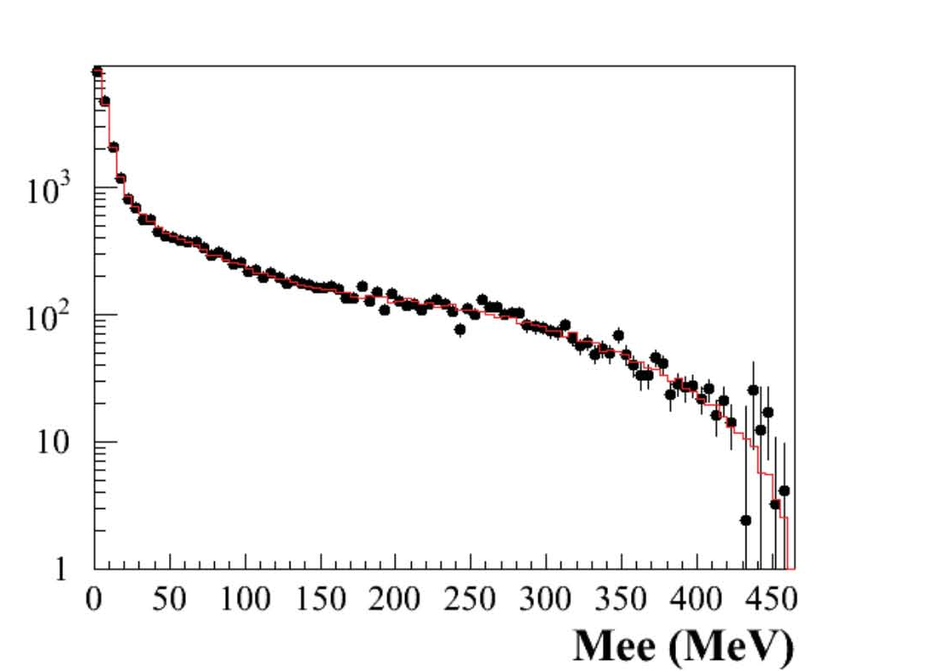
...and finally here there are the two invariant mass distributions
2 photons and 2 tracks events
6 photons events
Damn it! No peaks, no trip to Stockholm!

Slide 32
As for the KLOE case, many other experiments is the world have tried to find evidence for this dark light, all of them without success
Still we keep searching. It may well be that the «dark charge» of SM particles, i.e. the ε parameter, is smaller than what it is possible to observe with our detectors
For this reason new experiments are being designed and built in many laboratories, including this one, to improve our sensitivities to smaller and smaller dark charges
In particular a new line of reseaarch is concentrating upon the possibility of detecting invisible dark photon decays

Slide 33
The idea is to use a positron beam hitting a properly studied target, and precisely measuring the single photon produced by events of the type e⁺e⁻ → γγ’ → γ anything
γ
е⁺
Beam axis
M_{miss}² = (p_{pos} + p_{elec} - p_{γ})²
γ′
By the precise knowledge of the energies and directions of the incoming beam and of the outgoing photon one can reconstruct the missing mass of the event, that (as in the previous case for the visible decays) peaks on the mass value of the dark photon

Slide 34
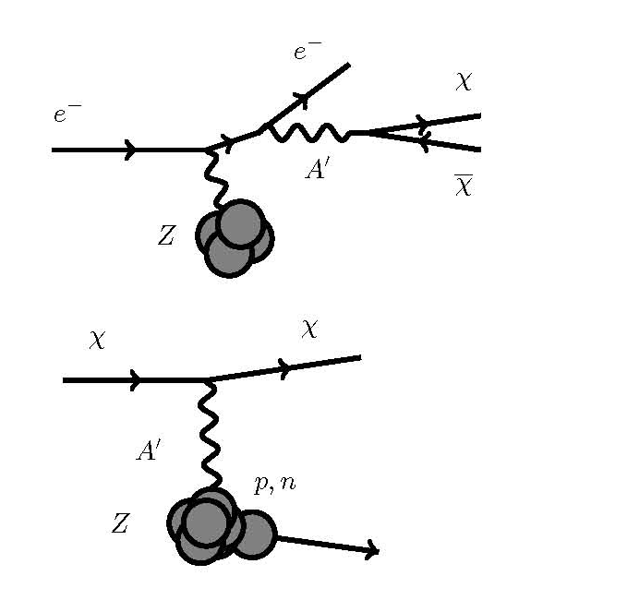
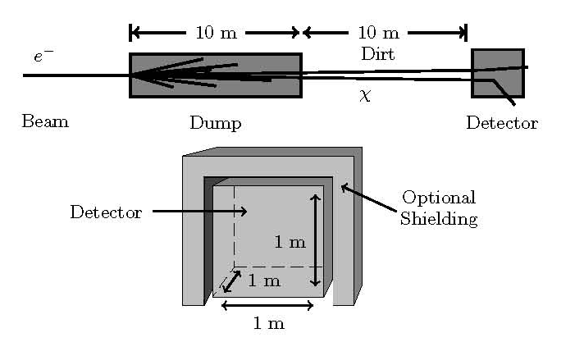
An alternative, ambitious and, in my opinion, very attractive approach is to try to produce and detect light dark matter particles from γ’ decays
This can be done by smashing an electron beam onto a target, filtering the products of this reaction by a large wall of concrete (to stop all the ordinary matter particles) and wait for a signal downstream the wall that can be due only to non standard «dark» particles

Slide 35
In the second case we would catch two birds with one stone: the dark photon AND the light dark matter particles!
Obviously, i make the story very simple, maybe too much simple. There is a large number of technical details that make these experiments rather difficult to be performed
Still, we and our colleagues in Germany, USA, Russia, Japan, Switzerland...are very determined in carrying them out.
Big surprises can come at any moment: be prepared!

Slide 36
Concluding:
Modern Particle Physics teaches us that light is nothing more and nothing less than the manifestation of one specific «carrier» of one specific fundamental force of Nature: the electromagnetic force
Other fundamental forces with their own carriers exist and have been observed and studied in great detail
Astrophysics tells us that this cannot be the end of the story: there is matter, other than the ordinary one, in an unbelievably overwhelming proportion with respect to the one that we know
There might well be therefore new interactions about which we don’t know anything with their own carriers, messangers of a «hidden» and potentially extremely rich world
We have just started the search for this new world. Be prepared to surprises!

