Slide 1
Medical Applications of radiation physics
Riccardo Faccini
Universita’ di Roma “La Sapienza”

Slide 2
Outlook
Introduction to radiation
  which one ?
  how does it interact with matter?
  how is it generated?
Diagnostics and nuclear medicine:
  Diagnostics (radiography, SPECT, PET,…)
  Molecular radiotherapy
  Radio-guided surgery
Particle beams in medicine
  Radiotherapy
  hadrotherapy

Slide 3
Introduction to radiation
Which one ?
How does it interact with matter?
How is it generated?

Slide 4
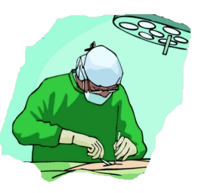
Radiation of interest
Neutral particles:
High penetration before interacting
Gamma rays: produce electrons
Neutrons: produce low energy protons → more “aggressive”
positrons: positrons annihilate with e- and produce 2 photons that escape patient and interact outside
Other charged particles (electrons, protons, ions):
low penetration, short path, depending on energy
Notes:
Perche’ irradia?

Slide 5
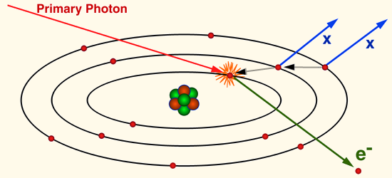
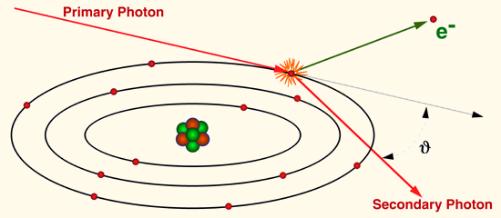
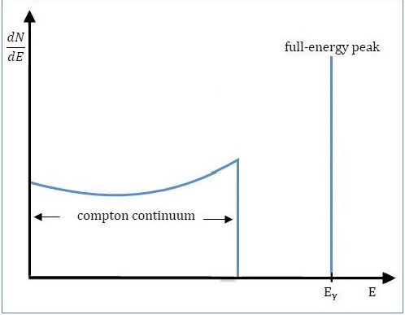
gamma- matter interactions
Gamma rays
  Photoelectric effect
    Emission of electron with same energy as impinging photon
  Compton scattering
    Only part of the energy is transferred to an electron
      → photon “remnant” with lower energy and different direction
  Pair production
  γγ→ e⁻e⁺ (only if E_{γ}>2m_{e})
E_{γ}
E_{e}

Slide 6
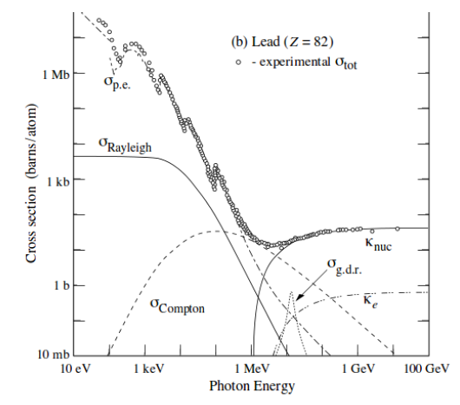
gamma-matter interactions (II)
A photon survives unchanged until it interacts → then it transforms
Photon beam attenuates exponentially
N(x)=N(0)e^{-μx} =N(0)e^{-nσx}
μ=coefficiente di attenuazione
σ=sezione d’urto
n= # atomi per unita’ di volume
σ_{tot}=σ(p.e.)+
σ(compton)+
σ(pair)

Slide 7
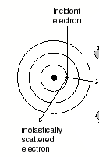
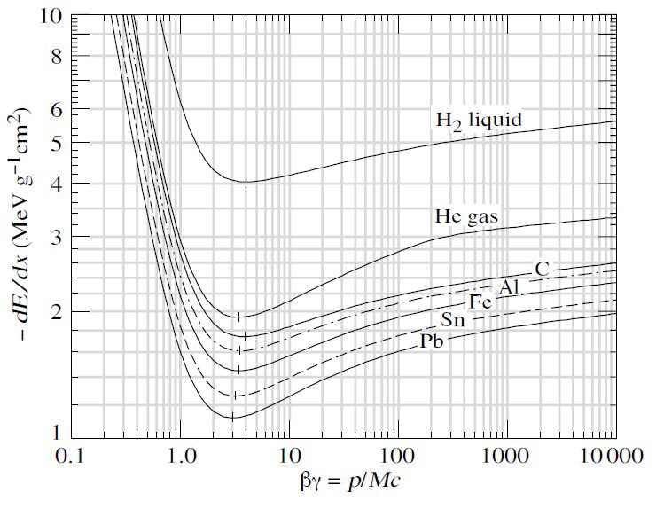
Charge particles-matter interactions
Dominant interaction: ionization
➔ continuous release of energy until particle stops
ionized electron

Slide 8
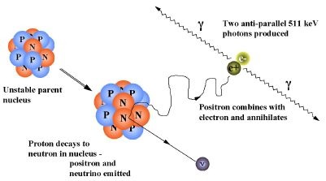
positron-matter interactions
In 80% of the cases there are two back-to-back mono-energetic photons

Slide 9
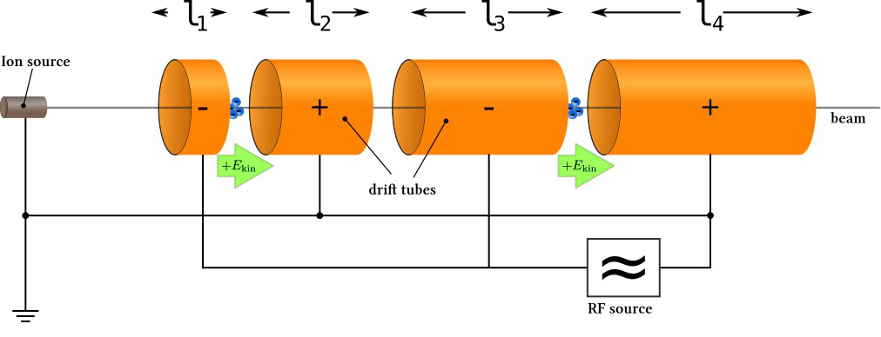
Accelerators: LINAC
Used in medicine for electrons up to few MeV

Slide 10
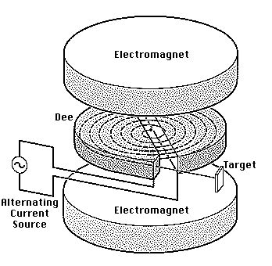
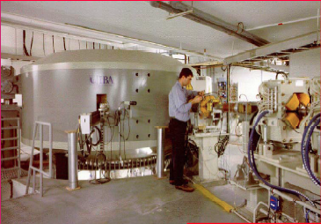
Accelerators: CYCLOTRON
Used to accelerate protons/ions
10-30 MeV for radio-isotope production
Up to 200 MeV for radio-therapy
230 MeV Protons

Slide 11
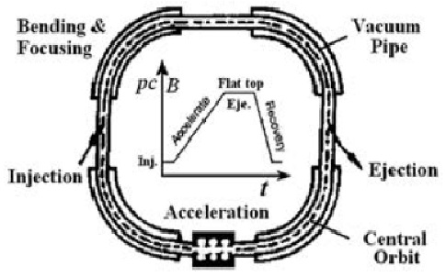
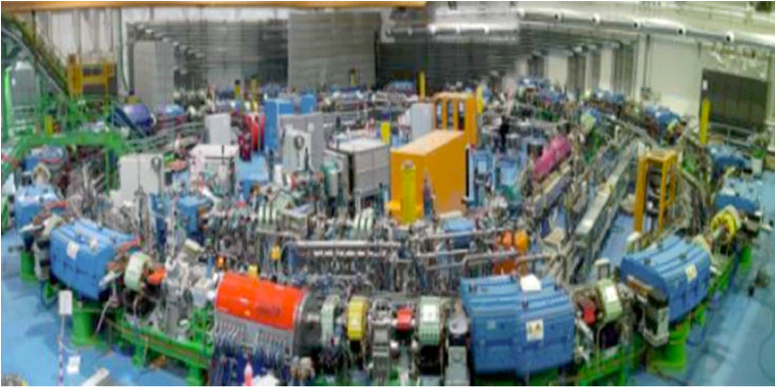
Accelerators: syncrotrons
Accelerate protons/carbons for therapy up to 4800 MeV

Slide 12
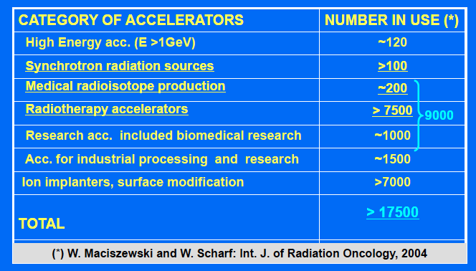
Medical accelerators

Slide 13
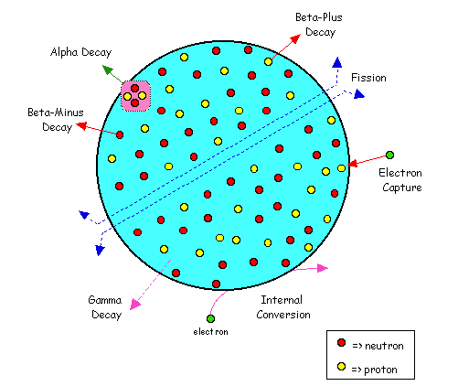
Radio-isotopes
Unstable nuclei that decay with strong interactions
Produced:
by strong reactions (bombardment of stable nuclei with protons)
as remnants from reactors

Slide 14
Diagnostics and Nuclear Medicine
Diagnostics (radiography, SPECT, PET,…)
Molecular radiotherapy
Radio-guided surgery

Slide 15
Diagnostics
Two major categories:
  Morphologic: sensitive only to densities
    Radiography
    TAC
    ultrasound, …
  Functional: sensitive to organ functionalities
    PET
    SPECT
    …

Slide 16
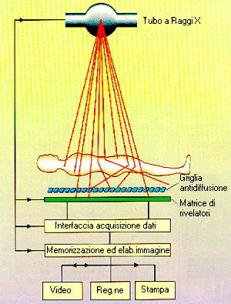
Diagnostics: radiography
X-rays produced with a cathodic tube by Bremsstrahlung
Interaction between matter and patient
X-ray detection
X-rays
Notes:
Pani

Slide 17
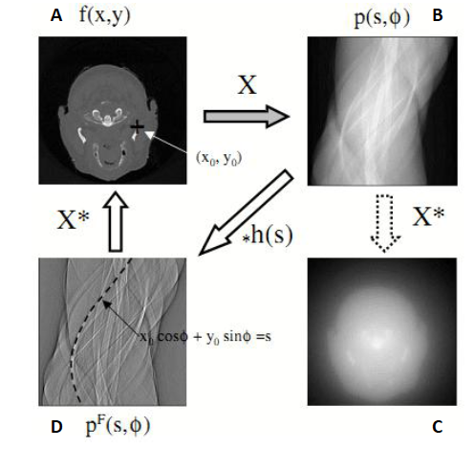
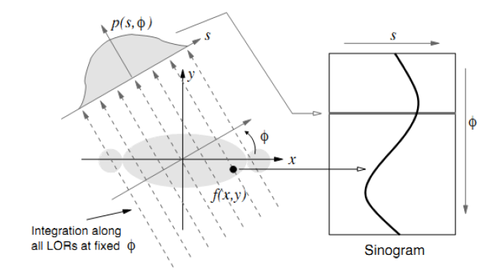
Diagnostics: Tomography
Generic mathematical tool from 1D → 2D
CT with X-rays is most renown
From image to sinogram
Radon transform
Filter

Slide 18
Radio-nuclides for imaging
Administer, to patient (either systemically or locally) a drug which:
  the tumor/organ of interest takes up significantly more than the rest.
  is linked to a radio-nuclide that emits particles via nuclear decay
Wait for the drug to diffuse
Measure the emitted radiation and obtain information

Slide 19
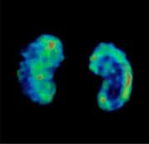
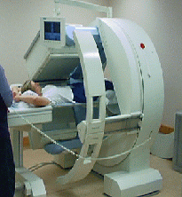
Diagnostics: SPECT
Single Photon Emission Computerized Tomography
Inject radionuclide (typically ⁹⁹Tc but also ¹³¹I)
Decays with single photon
Detection ~50cm from source with anger camera
Gamma decays
Notes:
Pani

Slide 20
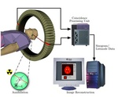
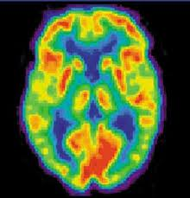
Diagnostics: PET
Positron Emission Tomography
Inject radionuclide (¹⁸F in FDG, FET, 11C in methionine, choline)
β+ decay
Detect the two gammas in coincidence outside patient
Beta+ decays

Slide 21
Radio-guided surgery
Administer, before operation to patient (either systemically or locally) a drug which:
  the tumor takes up significantly more than the healthy tissue.
  is linked to a radio-nuclide that emits particles via nuclear decay
Wait for the drug to diffuse to the margins of the tumor
Start operation
  Remove the bulk of the tumor
  Verify with a probe that detects the emitted particles the presence of:
    Residuals
    Infected lymph nodes

Slide 22
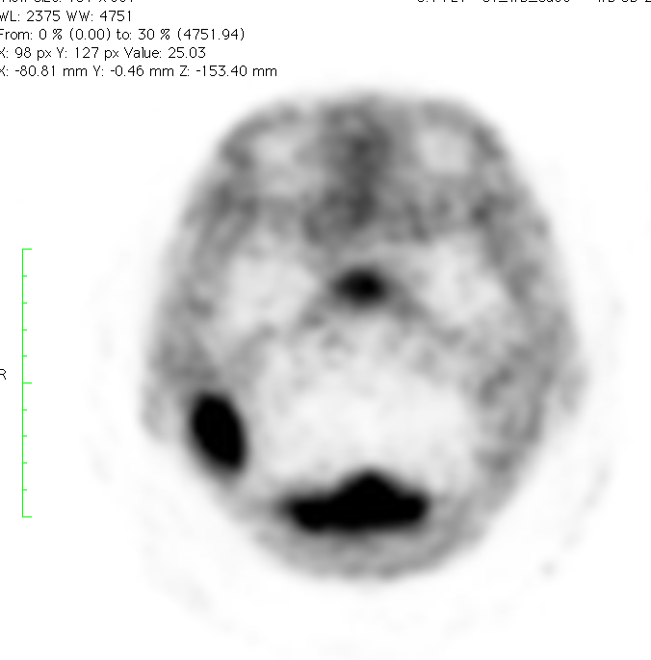
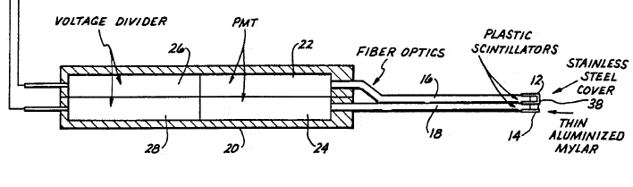
Radioguided surgery
Three approaches
Gamma: well established, e.g. sentinel lymph-node
Beta+: based on the dual probe approach
Beta-: future fronteer
probe

Slide 23
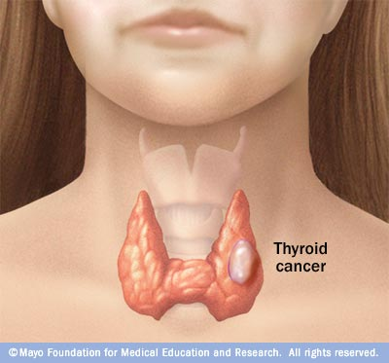
radiomethabolic/Brachitherapy
Inject/ position radionuclide (e.g. 131I)
Beta- decays
Electrons release energy in tumor locally
Beta- decays

Slide 24
Physics Building Blocks of Diagnostics
Nuclear decays
Production of radiation source:
  X rays
  Radio-nuclides → nuclear reactions/accelerators
Dosimetry
Detectors for photons and electrons

Slide 25
Radiotherapy
From conventional to Hadrotherapy

Slide 26
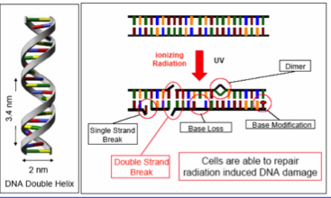
Radiotherapy
Goal:
Deliver energy on tumor cells in order to break them in an irreparable way
Large dE/dx
➔ DNA breaks irreparably
Moderate dE/dX
➔ chemical reaction due to free radicals

Slide 27
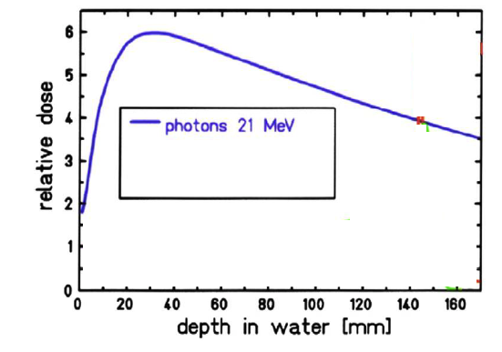
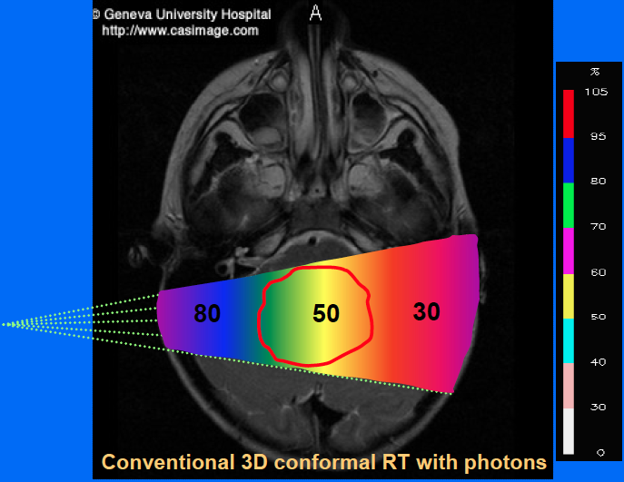
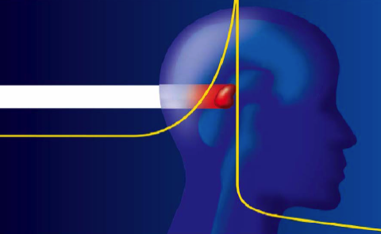
Conventional radiotherapy
Photon beams on patient
Large release of energy outside tumor
Healthy brain
Beam
Depth[mm]
beam
Depth
tumor

Slide 28
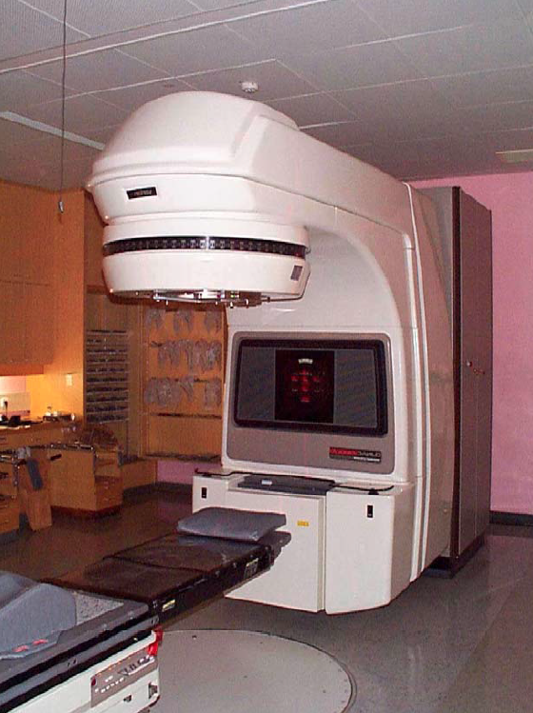
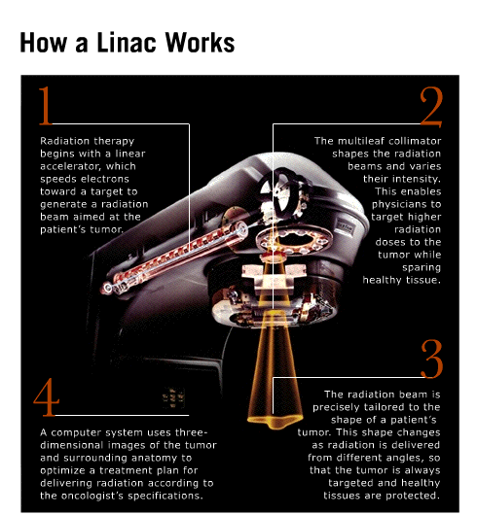
Radiotherapy LINAC

Slide 29
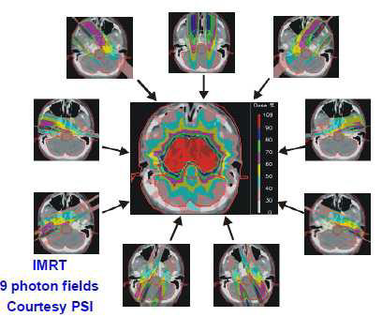
Conventional radiotherapy
Photon beams on patient
Large release of energy outside tumor
Multiple beams each of smaller energy (IMRT)
Beam
Depth[mm]
beam
Depth
Notes:
Spiegare meglio IMRT

Slide 30
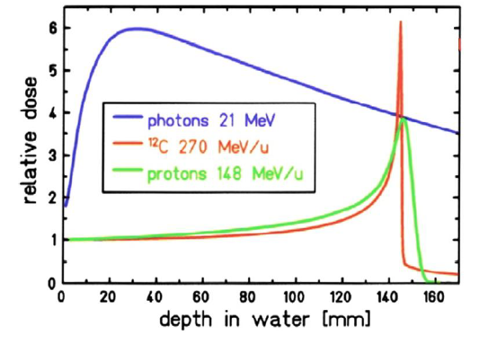
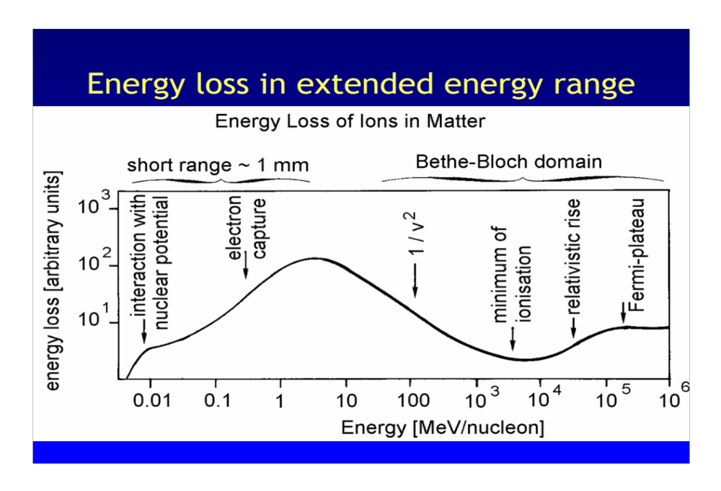
Hadrontherapy
Proton/ion beams on patient
Concentrate release of energy inside tumor due to release of energy in ionization.
Beam
Depth[mm]
beam
Depth

Slide 31
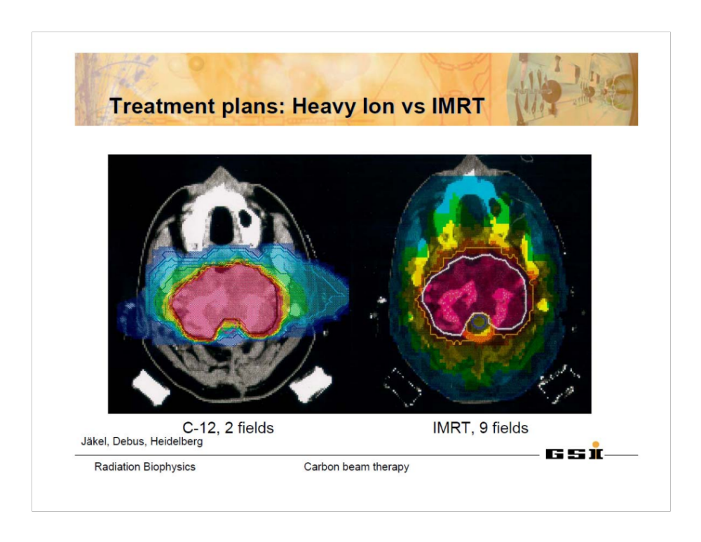
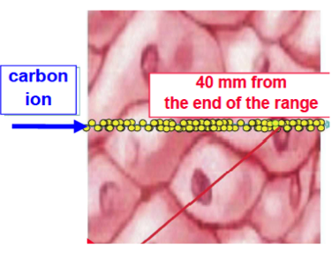
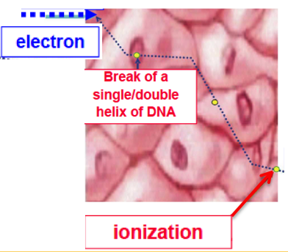
Comparison ¹²C vs IMRT
Better confinement of energy release
More effectiveness in killing cells

Slide 32
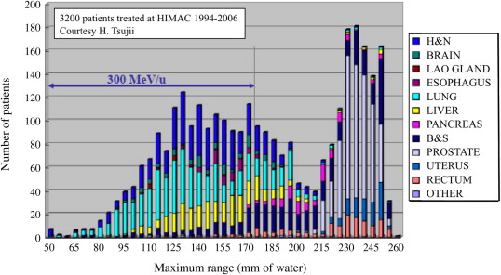
Accelerators
p/C Energy(MeV/u)
190/350
Required proton/Carbon energy
160/300
100/200
Bragg Peak depth (mm)
Proton Kinetic Energy between 100-250 MeV
Carbon Kinetic Energy between 200-400 MeV/u
Notes:
Manca GSI

Slide 33
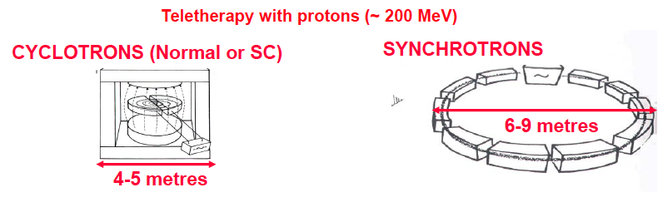
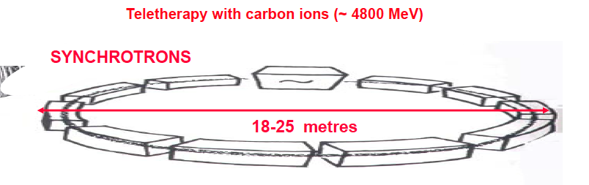
Accelerators for hadrotherapy

Slide 34
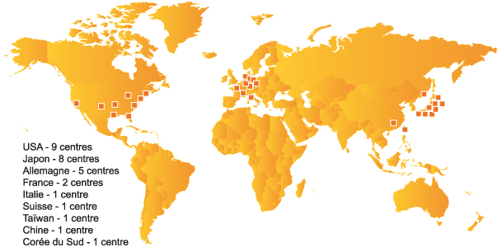
Present of hadrotherapy

Slide 35
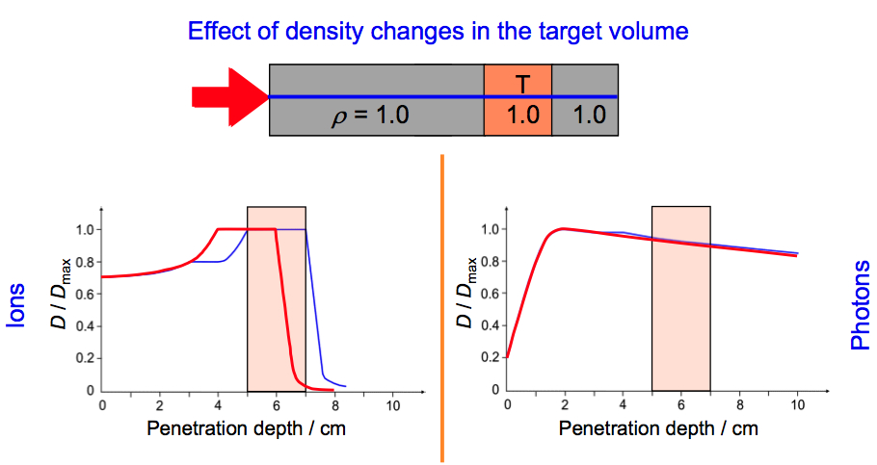
HT:Monitoring the dose
Why is so crucial to monitor the dose in hadrontherapy ? Is like firing with machine-gun or using a precision rifle..
A little mismatch in density by CT ➔sensible change in dose release

Slide 36
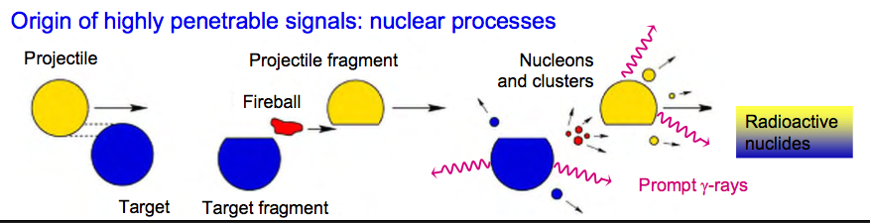
Measuring the dose
Based on nuclear reactions between the projectile and the patient
Reactions of interest
β+ decays
Prompt γ
Charged products
Don’t exit patient
No detectable signal
Possible nuclear reactions
Notes:
Mechanism for charged production?

Slide 37
Physics in Medicine
Nuclear decays
Particle-matter interactions
Radio Isotopes
Radiation detection
Particle accelerators

Slide 38
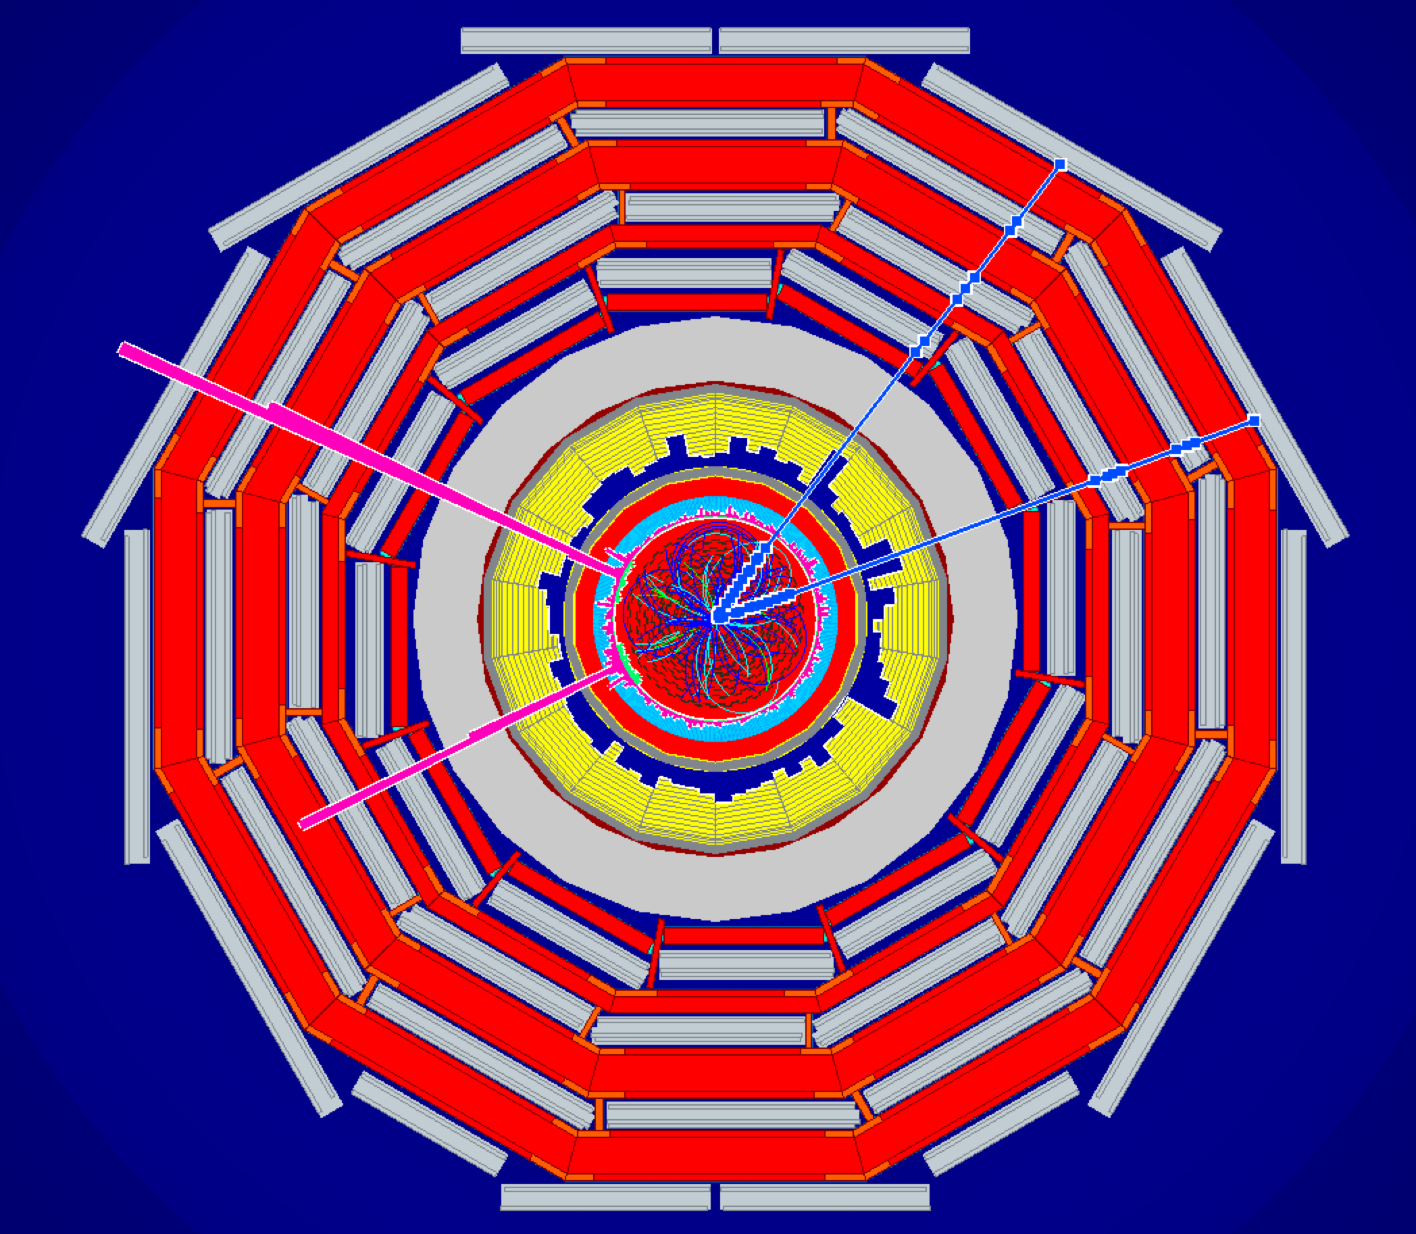
PHYSICS IS BEAUTIFUL …
… AND USEFUL
(U. Amaldi)

