Slide 1
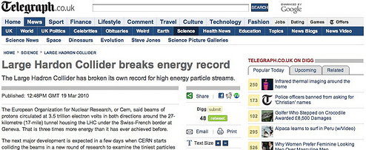
I blogs e la comunicazione scientifica: alcuni spunti per la discussione
Incontri di Fisica 2011 – Frascati, 7 ottobre
Forse voleva dire “hadron” ?
Tommaso Dorigo, INFN Padova

Slide 2
Un punto sospeso da l’altroieri
I problemi legati al fare divulgazione scientifica da “dentro”
  “blogging rules” delle collaborazioni scientifiche
  Pressioni dall’employer
  Questioni personali con i colleghi

Slide 3
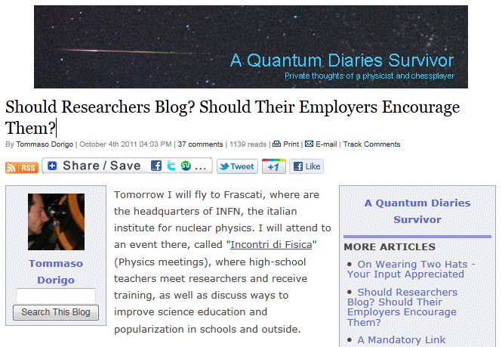
Alcune domande
Mercoledì e giovedì ho scritto due articoli nel blog, dove ho posto alcune domande ai miei lettori, per ricevere un input e discuterne con voi oggi.
L’idea non era tanto di avere un valido feedback, quanto di mostrare come funziona il canale di comunicazione.
I nostri datori di lavoro
dovrebbero incentivare o reprimere le iniziative di divulgazione scientifica ? Quali sono i pericoli e quali le soluzioni ?
2. Chi divulga risultati già pubblici ma che i principali autori non hanno ancora potuto presentare a una conferenza fa un’operazione scorretta?

Slide 4
Alcune risposte dei lettori
La massima parte degli interventi ha sottolineato l’importanza dei blogs per la divulgazione, esprimendo addirittura fastidio per gli ostacoli e i problemi che si incontrano nel processo
  Non si tratta di una platea di yes-men – in rete I commenti, anche anonimi, sono del tutto impietosi e chi interagisce non ha alcun ritegno a darti dell’imbecille. Quindi non c’è un “bias” (i.e. chi risponde non è necessariamente in accordo con quanto espresso nell’articolo)
  Piuttosto, la platea è fatta di persone che usano il mezzo e lo apprezzano: la maggior resistenza all’uso di internet, ai blogs, e in generale ai mezzi di comunicazione “estesa” del XXI secolo viene da chi non è familiare con il mezzo.
Bente Lilya Bye (geologa e scrittrice):
  I would argue that science outreach is a field in its own right. And for that reason alone it should be considered as part of the merits of a scientist. Before outreach work merits (good outreach work meaning higher salary), it will not be fully accepted and respected
  Stealing 'spotlight' is different than stealing credit. In your case I have a feeling it is more like you actually creating light and pointing it in the direction of your co-workers.

Slide 5
“OneIdeaFurther”:
  I think that your employer should reserve some of your working time to your blog and see it as a part of his public relations. The average published collaboration paper is nearly impossible to understand for a mortal like me. You are someone, who can be contacted personally, who provides explanations and answers readers' questions.
  In my opinion, your blog can actually increase the interest in the conference paper. Having "independent" analysis prior the conference may allow attendees to take broader view angle to the topic and prepare some questions or comments. Maybe the best solution would be some coordination with the main author, just not to spoil his punchline, if he or she prepared one for the conference.

Slide 6
“Philip”:
  Regarding 2), I think it has a negligible negative effect on the official presentation. The people highly interested in the field will still attend it and I don't think that such blogs are "stealing" any attention. If anything, they 'create' more attention from those who are especially interested and are not satisfied with what they're served in the daily newspaper.
  As for 1), I don't think we can expect scientists to be paid for blogging about their science, but I definitely don't see why it should be frowned upon. The complicated part with being paid for such work is that it's hard to tell how much is "enough". In the end, you might end up having a hundred scientists blogging about that one thing, but nobody actually working anymore :) Instead, I could imagine a more encouraging atmosphere in which you don't have to be afraid of what you blog about.

Slide 7
Hamish Johnston:
  I think the idea of blogging as part of the job description of a scientist is a good one, especially one who is paid from the public purse...but there are several issues that would have to be resolved.
  -Not all researchers would want to blog (or be any good at it), and therefore I don't think blogging could be added to a standard job description of a scientist.
  -There would have to be some sort of quality control. If a scientist is being paid to write for the public, they shouldn't be producing drivel and people should be actually be reading the blog. How quality is measured would, of course, be a tricky and very political issue.

Slide 8
Anonymous:
  I think this kind of issue is related to the increasingly outdated idea of the conference. Thanks to the internet, all the world's researchers are only a few clicks away from an interesting experiment. Results can come out almost instantly and questions can be asked online. The idea of building suspense by waiting for a big conference to properly present one's work is an exercise in showmanship, not science communication.
  I feel that people trying to censor the distribution of their work to preserve the traditional drama, and prestige, of a ground-breaking conference presentation are fighting a losing battle.

Slide 9
“Anonymous” #2:
  - it should be defined, who is the audience, how many people have to read and understand it to call it a successful outreach project. Actually I guess as public outreach project for lay people in general, I doubt that a blog is very successful, but one could try it out.
  - the blog isn't the prime medium for publication, so if you ask one of the prime authors, if you can blog about a result, and they don't want it, you should give them indeed the time to present their result at least once at a conference. For lay people it doesn't matter, if they get know a few days earlier or later of some result.
  - the blog should be written in the official language of the country, which pays you - in your case Italian.

Slide 10
Hank Campbell (owner of Ion Publications inc.):
  Blogging was successful because it was outside corporate and government rules. The moment this becomes a formal outreach project, the person picked to do it will be a product of politics and the corporate agenda and not someone organically best suited to it and so it will be a failure.

Slide 11
Stefano Machera (IT consulting, degree in physics)
  1) Yes, blogging could be a recognized work activity. However, in this case, it should be managed as such:
  - only selected people should be considered a "professional blogger"
  - those people should be given goals and tasks, just as for any other job
  - outside of this, you may still blog, but not for a salary
  2) This is a bit tricky. Let's say in general that if the result is public, you can discuss it, without being formally reprehensible. However, if the result is likely to make the news, and it is coming from your collaboration, or from someone who you are in some way related to, I would expect you to give the author(s) of the research some advance notice that you are going to blog on the subject. Blogs like yours are not supposed to be a newsstand: you explain to a larger and less educated public what otherwise would be restricted to the professional audience of physicists. You do not need to be first on the headlines, to provide value to the public.

Slide 12
Gerhard Adam:
  As for the disclosure of public results, one will always have egos to contend with, but it is highly unlikely that any scientific endeavor will suffer because of exposure and discussion.

Slide 13
“Anonymous” #3:
  Why not do your blogging while at work, and do your "real" work while at home? -- then there's no issue with whether to claim blogging as work-at-home-time?

Slide 14
“PhilG”:
  It is obvious that scientists should be encouraged in any outreach effort. I don't understand why blogging would not be valued by your employers. I don't really get this "envy" stuff. Anyone can blog if they want a little public recognition.
  Once something is public as a paper or public conference note it is silly not to let someone like you blog about it. If you don't then those of us who blog from outside will probably report it anyway. If they want the lead author to get the glory by revealing all at a conference then they should keep the conference notes offline until the talk has been given.
  Why should they hold a blogger back from explaining it to thousands online just so that a speaker can announce it first to a hundred or so people at a conference?

Slide 15
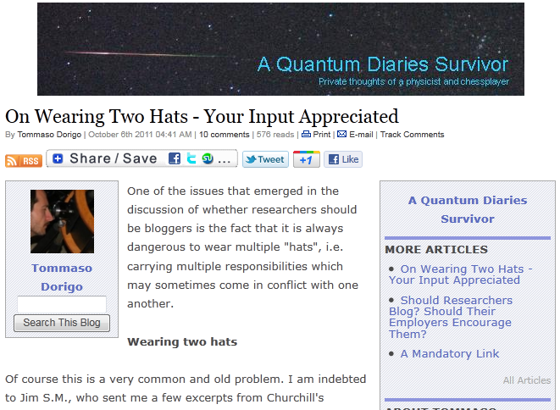
2. Il problema dei multipli ruoli: un blogger che ha anche un altro lavoro “istituzionale” corre il rischio di venire identificato come una voce ufficiale del suo employer

Slide 16
Peter Krahulik:
  From my personal experience, the biggest challenge for my knowledge (or lack of it) is to explain something (trivial!) to my daughter. To find all pieces she needs to understand some advanced topic makes me find all dark spots in my mind I was not aware of.
  This way even your main job takes profit from your blogging, even if it goes unnoticed by others. If I would be a manager of a big scientific collaboration, I would make educational activities, as blogging for example, mandatory for scientific researchers just to make sure that they regularly make some basic idea cleanup in their heads.

Slide 17
“Marco”:
  Is it acceptable for a researcher to act as a science reporter?
  Absolutely. Especially if she reports on the science she's making, or is expert of.
  What negative impact may this have on his or her research activity?
  Science reporting and blogging is time consuming, everyone doing it knows that. It can easily eat time to research, if one is not very careful to properly confine these activities.
  Does the early release of non-official results damage science, or create "media fatigue" (people getting fed up of announcements of new physics discoveries)?
  IMHO, yes, definitively. And the real question is: what are these "early release" worth, to the scientific community (that might be already aware, and you say) and especially to the public? Are they doing any good, other then bringing visibility to the early reporter?

Slide 18
Mike Taylor:
  Damaging science is perhaps a little ambitious. What you could conceivably damage is the reputation - or "brand" - of the projects with which you are associated. Publicly funded research must be as pure as Caesar''s wife - not only pure in fact but, as importantly, seen to be pure - as a necessary condition for public trust and long term funding and you must bear that in mind. Having said which, openness and transparency are also essential to that trust. Your blogging can (and does) make a significant contribution in this respect, with much more credibility than carefully coiffed and manicured press releases - and may even help your research in that there is nothing better than explaining things to others for seeing the weaknesses in one's own thinking. --

Slide 19
Philip:
  I'm absolutely certain that you won't find a better informed person than the researcher himself, and it's quite likely that only he or she will be able to put newly released research in the right context.
  As for the problem of media fatigue, I don't think that this is the case here. At least in my case, I rather feel that I learn to judge the significance of research that is published. More importantly, a science-oriented blog, or even more so a HEP-oriented blog (or any other very focused blog), is bound to attract only HEP-oriented readers. Those readers aren't prone to media fatigue, as they're actually more interested in it and thrive for more information.
  I don't think that this is just "bringing visibility to the early reporter". Instead, this can be very useful information that the reporter can use to better write his or her article, compressing and filtering yet again. Unfortunately, it's too often that science which is reported in mainstream media has a rather low quality and is error-ridden. Blogs can build the bridge between incomprehensible papers and dumbed down press-releases.

Slide 20
Hank Campbell (owner, Ion Publishing):
  Politicians have taken to leaking their own stories about their own candidates to manipulate the press and, in a sense, the OPERA group did that also. The press conference got a lot more attention than it otherwise would have because the result was leaked in advance, despite the fact that most researchers regard it is as systematic error.

Slide 21
Blogs di fisica consigliabili
In italiano:
  Marco Del Mastro, “I borborigmi di un fisico renitente” (http://www.borborigmi.org/)
  Peppe Liberti, “Rangle”
  (http://peppe-liberti.blogspot.com/)
  Amedeo Balbi, “Keplero” (http://www.keplero.org/)

Slide 22
In inglese:
  Tommaso Dorigo, A Quantum Diaries Survivor
    4/2009-presente:
    http://www.science20.com/quantum_diaries_survivor
    2006-2009: http://dorigo.wordpress.com
    2005: http://qd.typepad.com/6/
  Peter Woit, Not Even Wrong
    http://www.math.columbia.edu/~woit/wordpress/
  Sabine Hossenfelder, Backreaction:
    http://backreaction.blogspot.com/
  Questi blogs hanno links a molti altri
In greco:
  Tommaso Dorigo, Ένας Επιζών των Quantum Diaries
    http://qdepizwn.wordpress.com/

