Slide 1
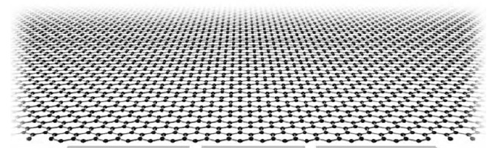
Order parameters and their topological defects in Dirac systems
Igor Herbut (Simon Fraser, Vancouver)
arXiv:1109.0577 (Tuesday)
Bitan Roy (Tallahassee)
Chi-Ken Lu (SFU)
Kelly Chang (SFU)
Vladimir Juricic (Leiden)
Quantum Field Theory aspects of Condensed Matter Physics, Frascati/Rome 2011

Slide 2
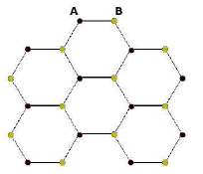
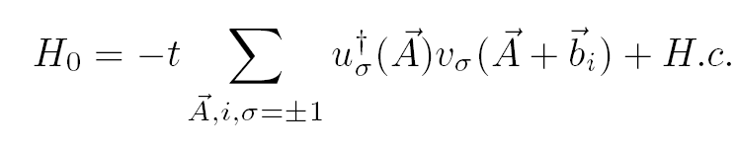


Paradigmatic Dirac system in 2D: graphene
Two triangular sublattices: A and B; one electron per site (half filling)
Tight-binding model ( t = 2.5 eV ):
(Wallace, PR 1947)
The sum is complex => two equations for two variables for zero energy
=> Dirac points (no Fermi surface)

Slide 3
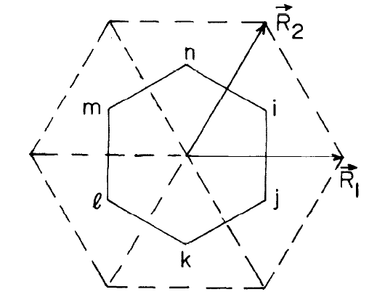
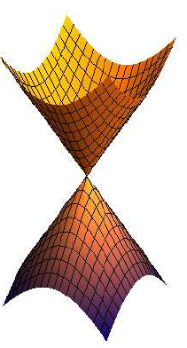





Brillouin zone:
Two inequivalent (Dirac) points at :
+K and -K
Dirac fermion: 4 components (2^d with time-reversal, IH, PRB 2011)
“Low - energy” Hamiltonian:
i=1,2
,
(isotropic, v = c/300 = 1, in our units)

Slide 4




Symmetries: exact and emergent
Lorentz
(microscopically, only rotations by 120 degrees and reflections: C3v)
2) Valley :
=
,
Generators commute with the Dirac Hamiltonian (in 2D). Only two are emergent!
3) Time-reversal :
( + K <-> - K and complex conjugation )
(IH, Juricic, Roy, PRB 2009)

Slide 5





Chiral symmetry: anticommute with Dirac Hamiltonian
,
= >
and so map zero-modes, when they exist, into each other!
Zero-energy subspace is invariant under both commuting and anticommuting operators!!

Slide 6







“Masses” = p-h symmetries
1) Broken valley symmetry, preserved time reversal
→
+
2) Broken time-reversal symmetry, preserved valley
→
+
In either case the spectrum becomes gapped:
,
=
,

Slide 7


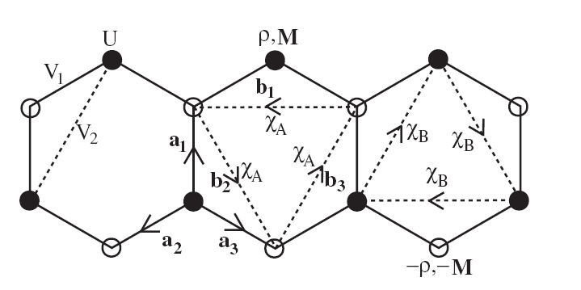
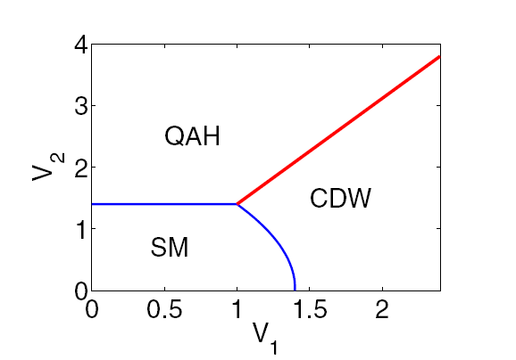
On lattice?
1) m
staggered density, or Neel (with spin); preserves translations (Semenoff, PRL 1984)
2)
topological insulator (circulating currents, Haldane PRL 1988, Kane-Mele PRL 2005)
( Raghu et al, PRL 2008, generic phase diagram IH, PRL 2006 )

Slide 8




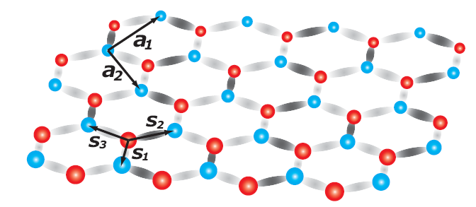
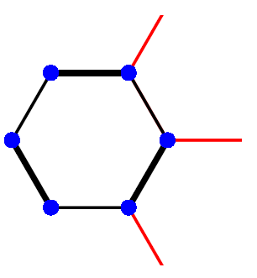
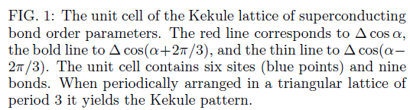
+
Kekule bond-density-wave
3)
(Hou,Chamon, Mudry, PRL 2007)
(Roy and IH, PRB 2010, Lieb and Frank, PRL 2011)

Slide 9





All Dirac masses in 2D: with electron spin included, 2 X 2 X 4 = 16
16 X 16 Dirac-Bogoliubov-deGenness representation:
Dirac-BdG Hamiltonian is now:
So there are 8 different types of masses:
1) 4 insulating masses (CDW, two BDWs, TI: singlet and triplet): 4 x 4 =16
2) 4 superconducting order parameters ( s-wave (singlet), f-wave (triplet), 2 Kekule
(triplet)): 2 + 3 x ( 2 x 3) = 20 (Roy and IH, PRB 2010)
Altogether: 36 masses in 2D! (Ryu, Mudry, Hou, Chamon, PRB 2009)

Slide 10







Dirac-BdG Hamiltonian
Dirac Hamiltonian, 8 x 8:
Dirac-BdG Hamiltonian, 16 x 16:
where
and the (Hermitian) mass satisfies Altland-Zirnbauer constraint:

Slide 11








Mass-vortex:
with masses insulating and/or superconducting, but always anticommuting
and, of course,
The problem: what are other masses
that satisfy

Slide 12
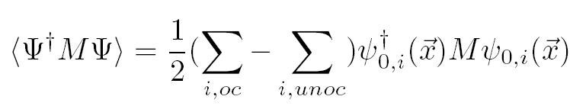
Why?
For any traceless matrix M which anticommutes with the Hamiltonian the expectation value comes entirely from zero-energy states: (IH, PRL 2007)
Dirac-BdG Hamiltonian is 16 x 16, and therefore has four zero-modes! (Jackiw, Rossi, NPB 1981)
Internal structure !

Slide 13



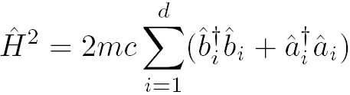

Digression: zero-modes of Jackiw-Rossi-Dirac Hamiltonian in ``harmonic approximation” (IH and C-K Lu, PRB 2011)
Introduce bosonic and fermionic operators a la Dirac :
so that

Slide 14
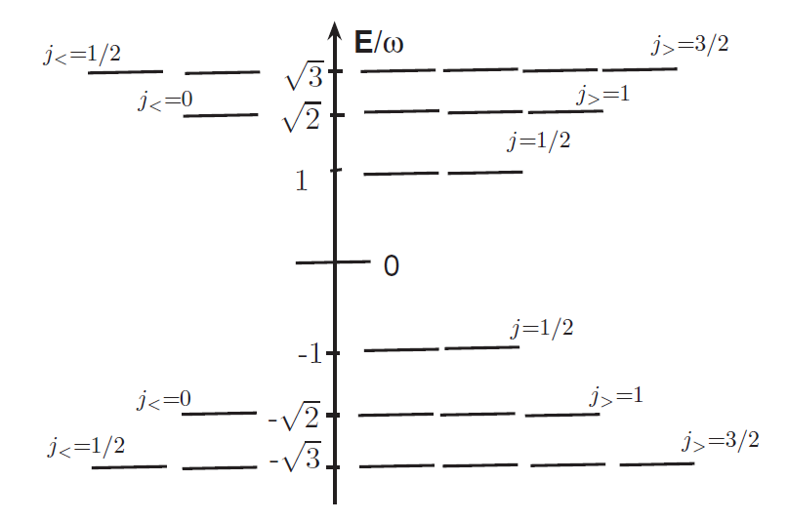
The vortex-core spectrum: (IH and C-K Lu, PRB 2011)

Slide 15






AZ constraint: unitary transformation
so that
and purely imaginary!
Here:
and
and it exists!

Slide 16


At the same time, the kinetic energy
and,
so that after the transformation,
with the two 16 x 16 matrices
as real! The transformed Hamiltonian is purely imaginary, and the (antilinear) particle-hole symmetry is just complex conjugation!
How many matrices X do then mutually anticommute?

Slide 17
Clifford algebra C(p,q):
p+q mutually anticommuting generators
p of them square to +1
q of them square to -1
Vortex Hamiltonian: given, 16 X 16 representation of
2 real Gamma matrices
2 imaginary masses (when mutliplied by ``i” become real and square to -1)
The question: what is the maximal value of q for p=2 (or p>2) for which a real 16X16 representation of C(p,q) exists?

Slide 18
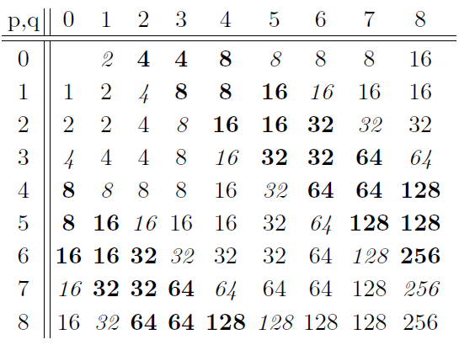
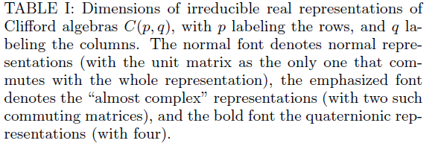
Real representations of C(p,q): (IH, arXiv:1109.0577, Okubo, JMP 1991)

Slide 19






So there exist three more mutually anticommuting masses:
and
form an irreducible real representation of the Clifford algebra
Quaternionic representation: there are three nontrivial real ``Casimirs”
Define instead the imaginary

Slide 20









We then find three more solutions:
which satisfy the desired relations
and commute with the old solutions:
In summary:
and true in d=1 (for domain wall) and d=3 (for hedgehog) (IH, arXiv:1109.0577)

Slide 21









Order in the defect’s ``core” : two (pseudo) spins-1/2
In the four dimensional zero-energy subspace in some basis:
Perturbed (chem. potential, magnetic field, lattice…) Dirac-BdG Hamiltonian:
with small, and matrix obeying AZ constraint.

Slide 22





Splitting of the zero modes: p-h symmetry is like time-reversal in
If
is the eigenstate with energy +E, then its time reversed copy
is the eigenstate with energy –E, and thus orthogonal to it:
Product state!

Slide 23









Two possibilities:
E
0
Single finite pseudospin-1/2!

Slide 24
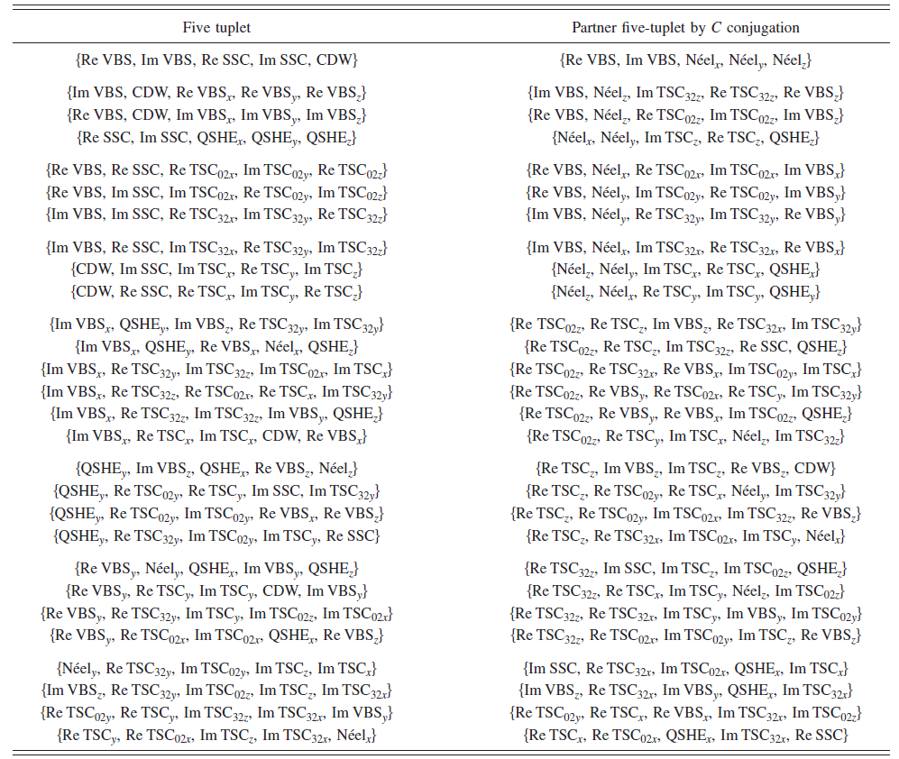

Slide 25
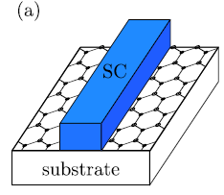


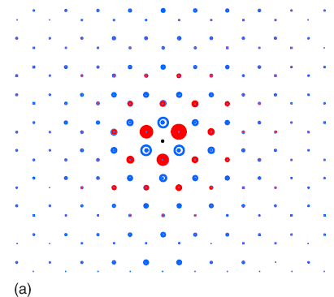
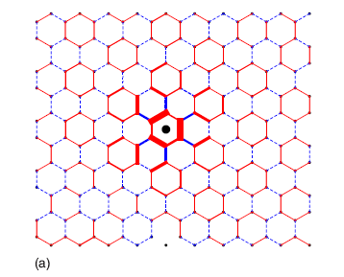
Example: superconducting vortex (s-wave, singlet) (IH, PRL 2010)
: {CDW, Kekule BDW1, Kekule BDW2}
: { Haldane-Kane-Mele TI (triplet)}
Lattice: 2K component
External staggered potential
Core is insulating ! (Ghaemi, Ryu, Lee, PRB 2010)

Slide 26
Example: insulating vortex
1) Kekule BDW {Neelx, Neely, Neelz} (insulating)
{CDW, sSC1, sSC2} (mixed)
2) Neel, x-y {Neelz, KekuleBDW1, KekuleBDW2} (insulating)
{QSHz, fSCz1, fSCz2} (mixed)
E3 is the number operator
M’4 and M’5 are superconducting.

Slide 27


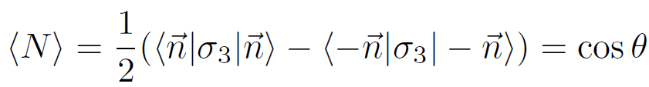
The electric charge: Q
Insulating core Q=0 sharp
Mixed core
Q =
and continuous, but not sharp!

Slide 28
Summary and open questions:
1) Defect’s cores are never normal; there is always some other order inside:
Clifford algebra C(3,0) X C(3,0)
3) One pseudospin is finite; the other is zero
4) Pseudospin can be manipulated (pseudospintronics?)
5) Defect proliferation: Landau-forbidden transition?
6) Electric charge: 0 or 1 when sharp, in between when not
7) Other defects (skyrmions …) : non-trivial quantum numbers? (Grover, Senthil, PRL 2009)

