Slide 1
Perspectives in High-Energy Physics
First lecture: The need for precision and energy
  The theoretical and experimental landscape today
    Arising from 50 years of high-energy physics
  A strategy for the future, towards precision and energy frontiers
  The short-term perspectives (2020-2030)
Second lecture: The quest for precision
  Precision measurements: The why and the how.
    A few highlights with LEP and SLC
  The medium-term perspectives (2030-2045)
    Linear or circular ?
Third lecture: The energy frontier
  The long-term perspectives (2045-2060)
    Leptons or hadrons ?
  Thinking out of the box
    Muon collider, plasma acceleration, …

Slide 2
Lecture 2
High-energy physics
The quest for precision

Slide 3
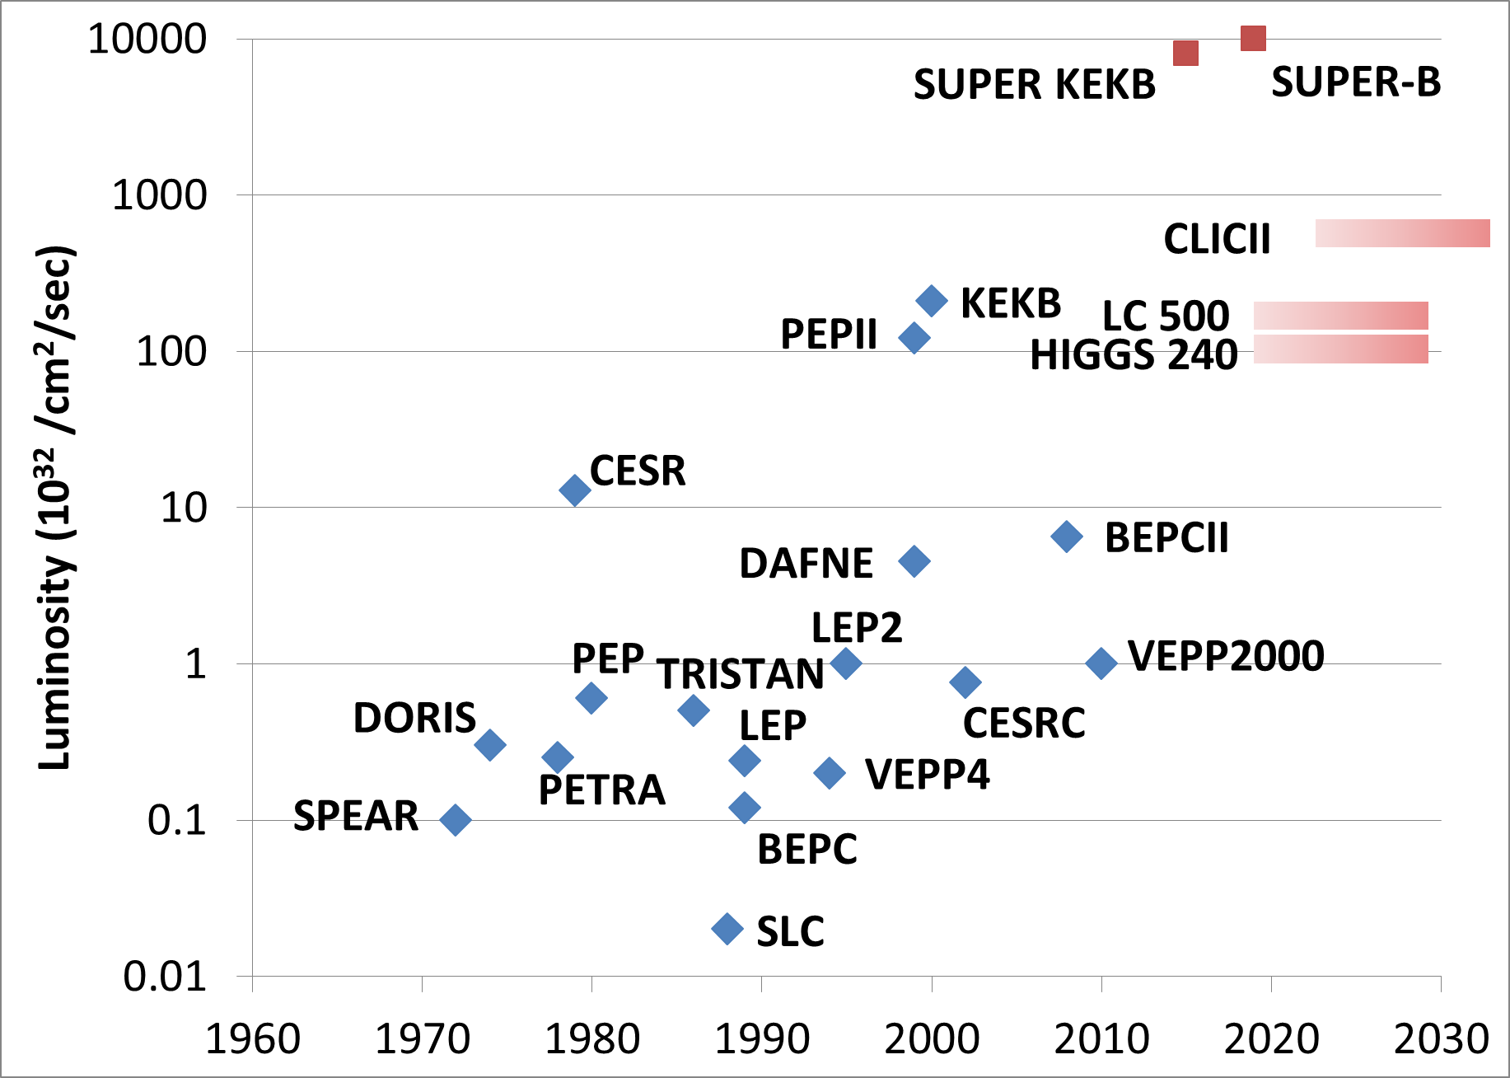
A tiny bit of history over 50 years (1)
Historically, e⁺e⁻ colliders have been used for precision measurements
  The accuracy of e⁺e⁻ colliders led to predictions at higher scales (m_{top} , m_{H} , limits on NP)
    And to unexpected discoveries (e.g., c quark, gluon, tau lepton, …)
Circular ?
Linear ?

Slide 4
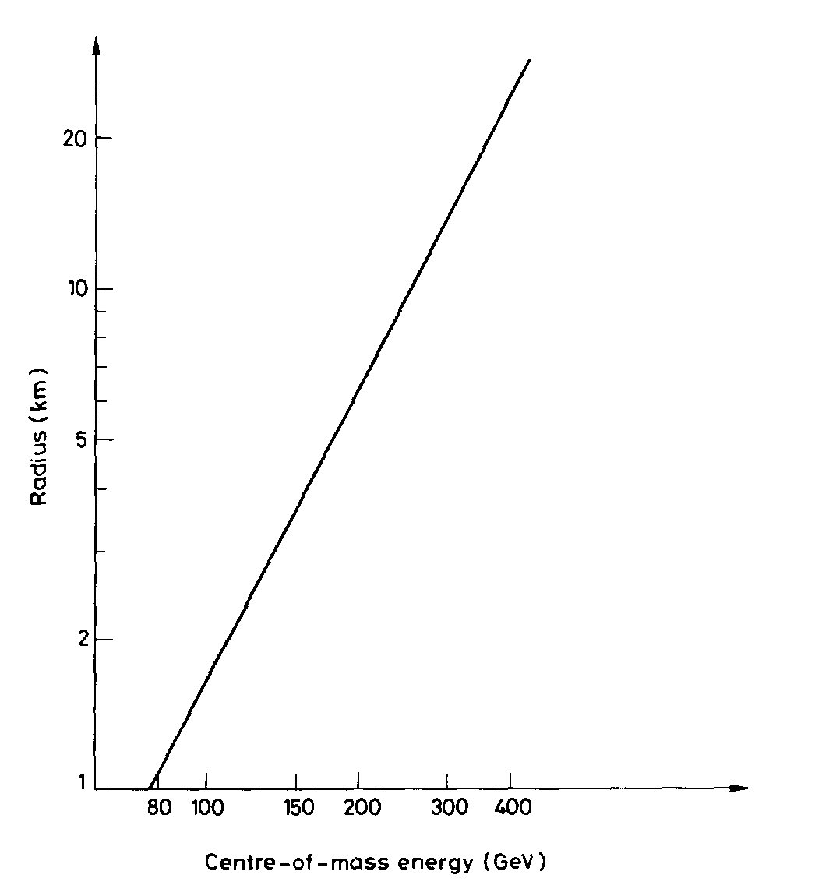
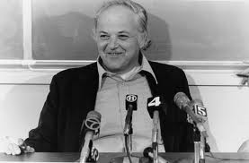
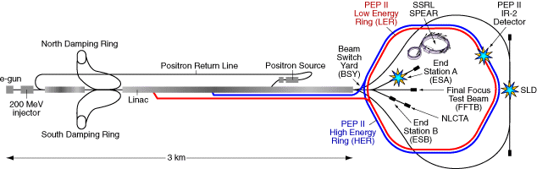
A tiny bit of history over 50 years (2)
The dilemma is not really new
  “An e⁺e⁻ storage ring in the range of a few hundred GeV in the centre-of-mass can be built with present technologies […] would seem to be […] the most useful project on the horizon”
Original LEP proposal, 1976
NIM 136 (1976) 47-60
B. Richter
(1976)
200 GeV 30 km
400 GeV 90 km
  B. Richter, “The SLAC Linear Collider”, 11th Conf. on High-Energy Accelerators (1980)

Slide 5
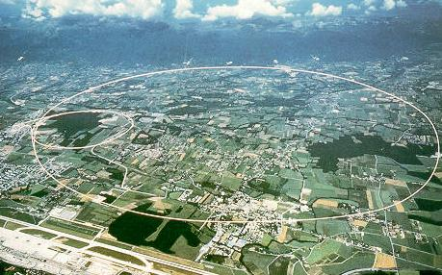
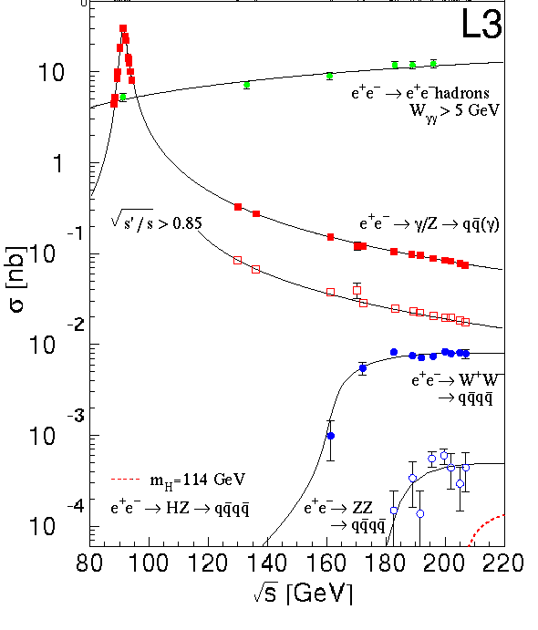
A tiny bit of history over 50 years (3)
LEP: Largest circular e⁺e⁻ collider so far
  26.7 km circumference
  1 fb⁻¹ delivered at each IP from 1989 to 2000
  √s upgraded from 88 to 209 GeV
  Four detectors (ALEPH, DELPHI, L3, OPAL)
    20 million Z decays and 40K WW events
  Precise beam energy measurement (±2 MeV)

Slide 6
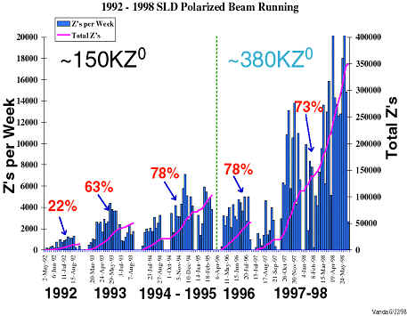
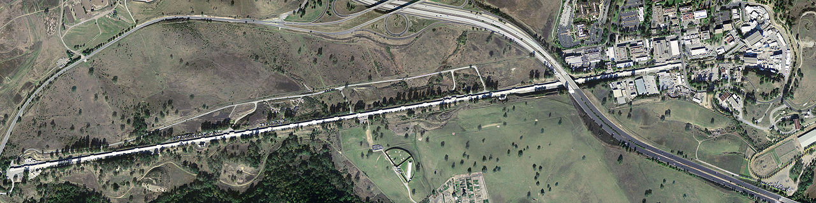
A tiny bit of history over 50 years (4)
SLC: The first high-energy e⁺e⁻ linear collider
  2 miles long
  0.01 fb⁻¹ delivered to one IP
    From 1988 to 1998
  √s at the Z pole (91 GeV)
  Polarized electron beam (up to 80%)
  One detector (MarkII, then SLD)
    400,000 Z decays

Slide 7
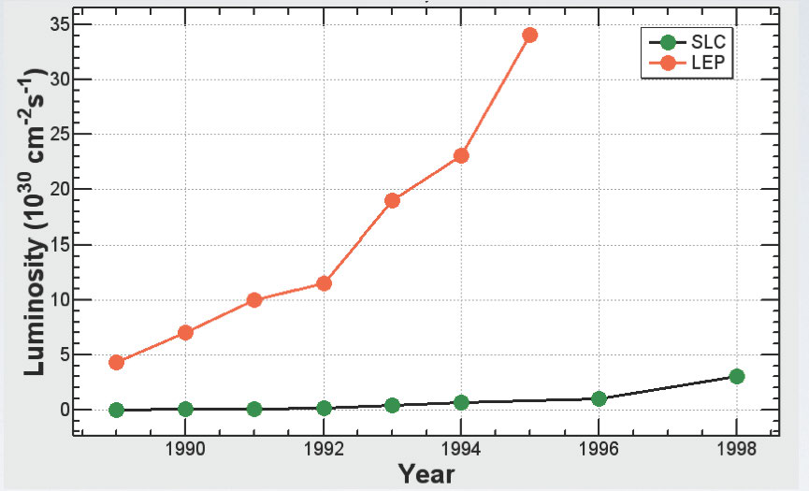
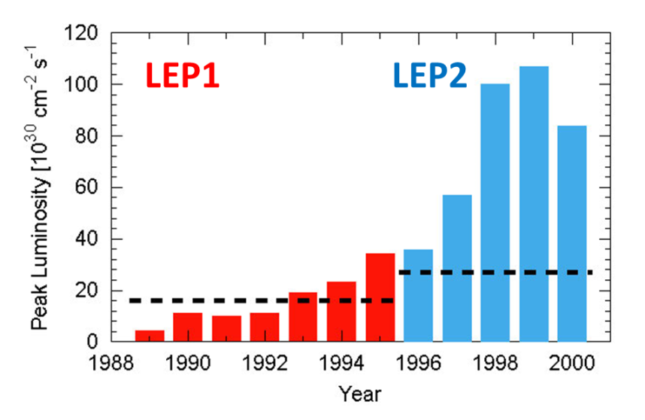
A tiny bit of history over 50 years (5)
Commissioning time and performance
  LEP1 reached the design luminosity after three years, and ended a factor 2 above design
  LEP2 exceeded the design luminosity at startup, and ended a factor 3 above design
  SLC never reached the design luminosity after 11 years of commissioning
    And ended a factor 2 below design
      Lesson #1 : Linear colliders are difficult machines, even at low luminosities
LEP1
(per IP)
LEP1 design
SLC design
SLC

Slide 8
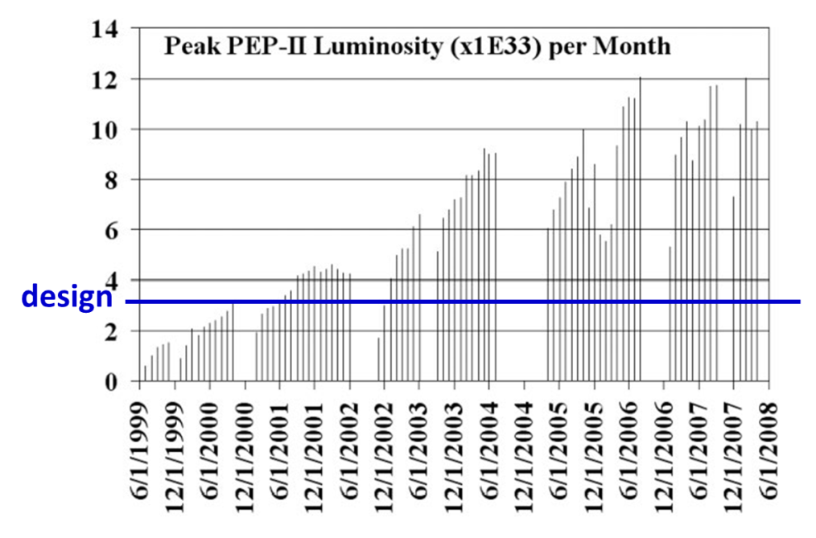
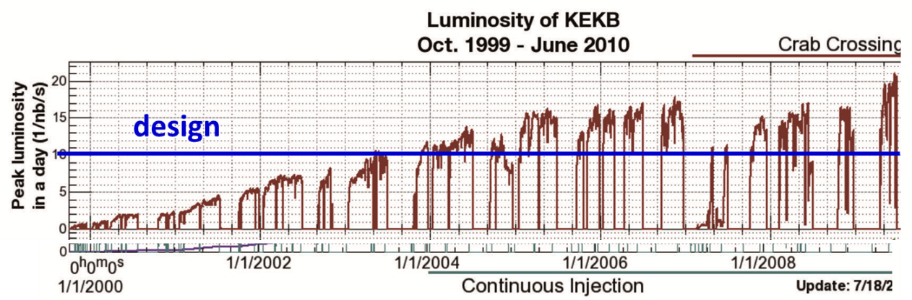
A tiny bit of history over 50 years (6)
Commissioning time and performance (cont’d)
  Lesson #2: Circular colliders are reliable machines, up to highest luminosities
PEP-II
KEK-B
 | E_{beam} [GeV] | Design Lumi [10³² cm⁻²s⁻¹] | Peak lumi / design | Time to achieve design [year]
LEP1 | 45 | 0.13 | 2 | 3.5
SLC | 45 | 0.06 | 0.5 | – (> 11)
LEP2 | 60 – 104.5 | 0.26 | 4 | < 0.5
PEP-II | 9 , 3.1 | 30 | 4 | 1.5
KEK-B | 8 , 3.5 | 100 | 2 | 3.5

Slide 9
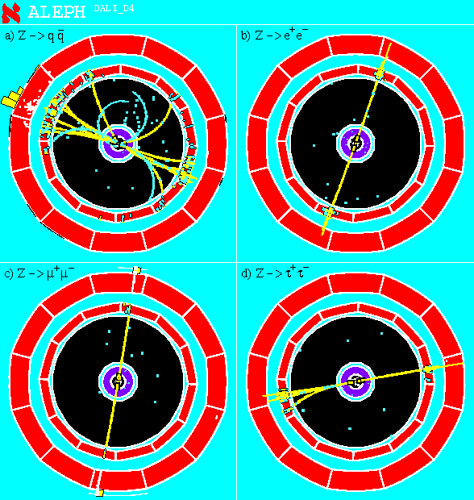
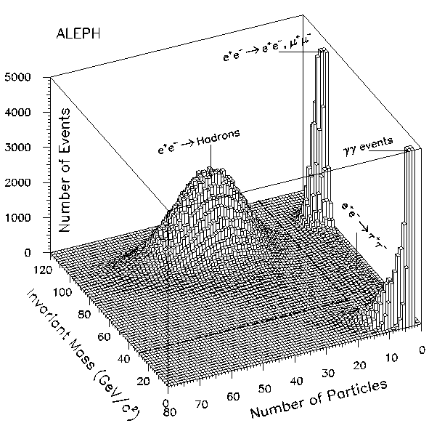
LEP and SLC: A few highlights (1)
Remember LHC ?
Why are e⁺e⁻ colliders the tool of choice for precision anyway ?
  Electrons are not protons, i.e., do not interact strongly: no pile-up collisions
    Corollary #1: Final state is clean and cosy, triggering is easy (100% efficient)
      Analysis is a waking dream
    Corollary #2: No huge QCD cross section: All events are signal.
-
High efficiency
High purity

Slide 10
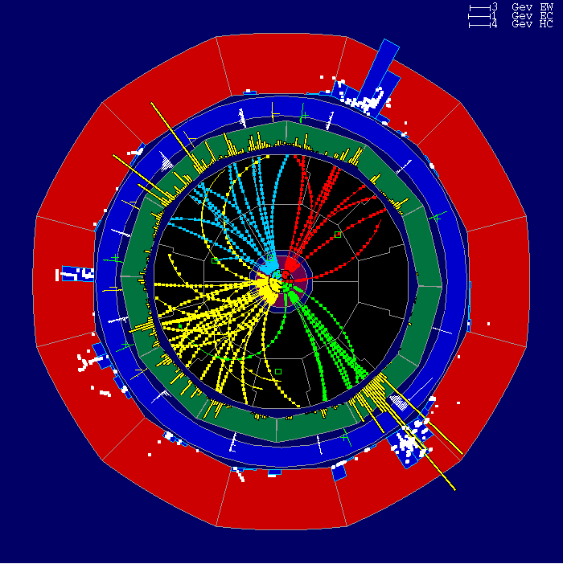
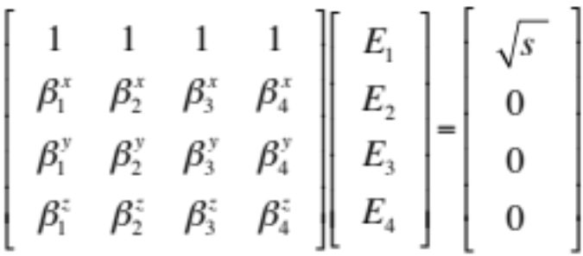
LEP and SLC: A few highlights (2)
Why are e⁺e⁻ colliders the tool of choice for precision anyway ? (cont’d)
  Electrons are leptons, i.e., elementary particles: no underlying event
    Corollary: Final state has known energy and momentum: (√s, 0, 0, 0)
-
-
  Example: an e⁺e⁻ → W⁺W⁻ → qqqq candidate
    Jets are detected in colours !
    Total energy and momentum are conserved
      E₁ + E₂ + E₃ + E₄ = √s
      P₁^{x,y,z} + p₂^{x,y,z} + p₃^{x,y,z} + p₄^{x,y,z} = 0
    Jet directions (β_{i} = p_{i}/E_{i}) are very well measured
    Jet energies (or di-jet masses: m_{W}) determined analytically by inverting the matrix
      No systematic uncertainty related to jet energy calibration
        A lot of Z are available anyway to calibrate and align everything

Slide 11
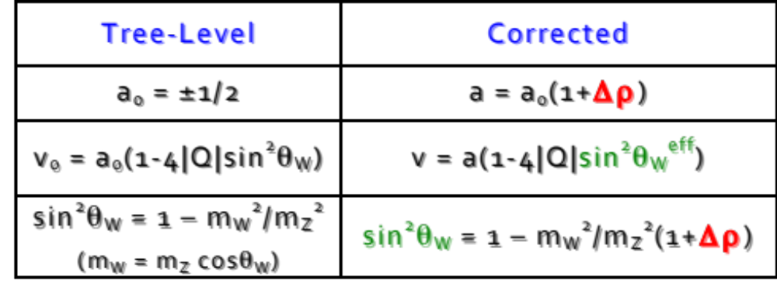
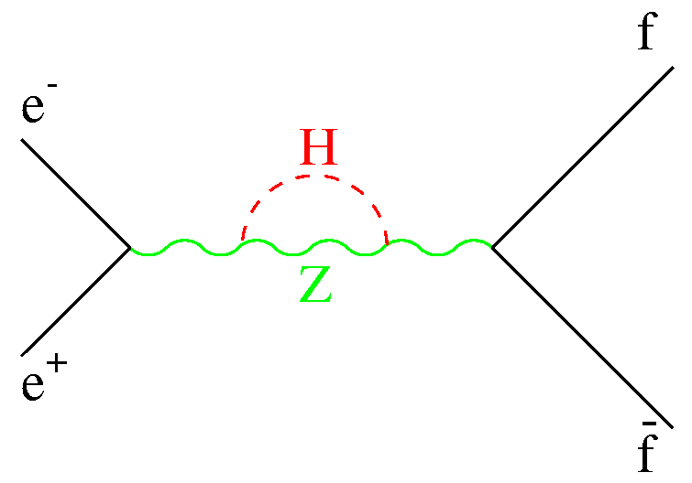
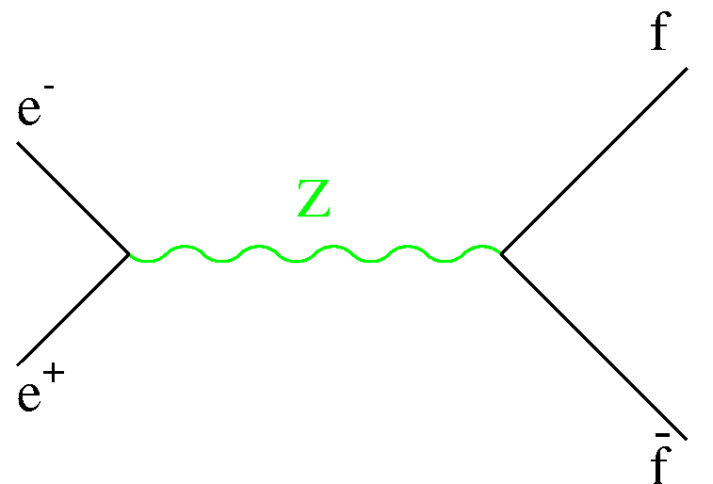
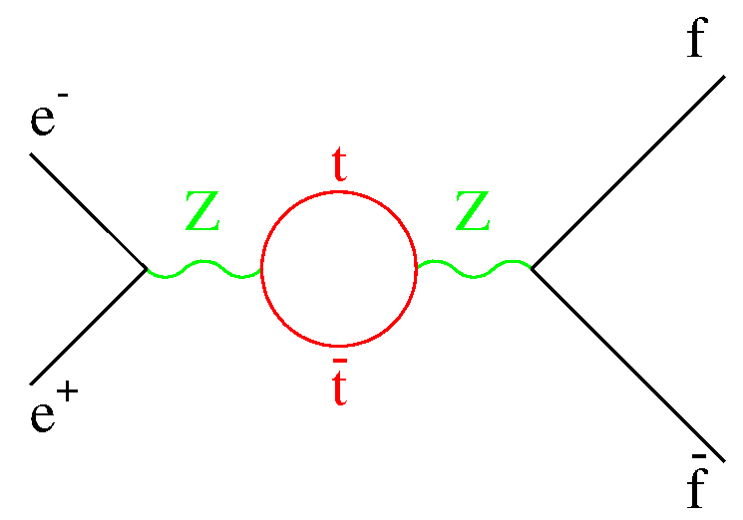
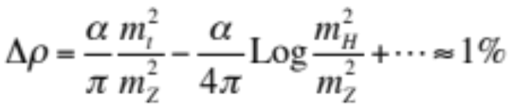
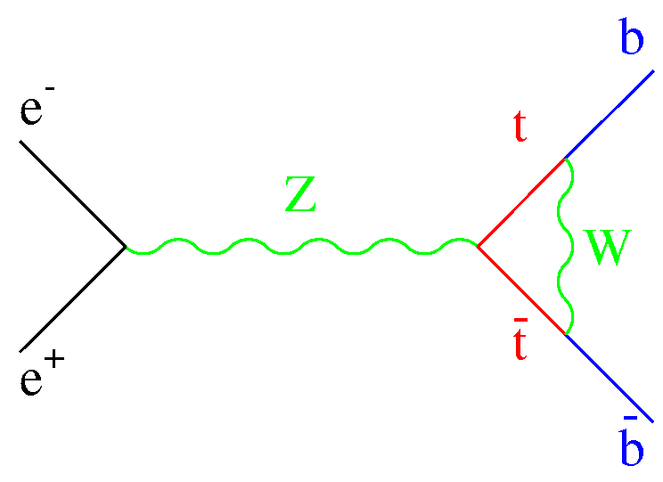
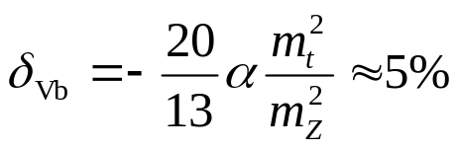
LEP and SLC: A few highlights (3)
Why are e⁺e⁻ colliders the tool of choice for precision anyway ? (cont’d)
  Electroweak observables can be calculated/predicted with precision
    And are sensitive to heavier particles through quantum corrections
      At the Z pole
      Specific correction for Rb
        R_{b} = Γ(Z→ bb)/Γ(Z→ hadrons)
L Couplings (v+a)
≠
R Couplings (v-a)
-
R_{b} → R_{b}×(1 + δ_{vb})
No m_{H} !

Slide 12
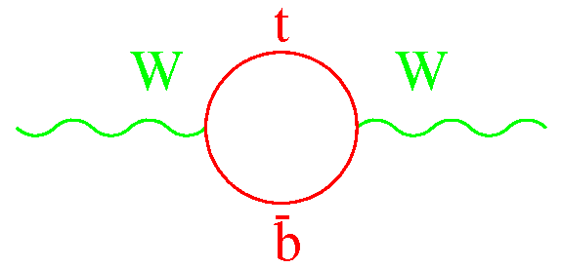
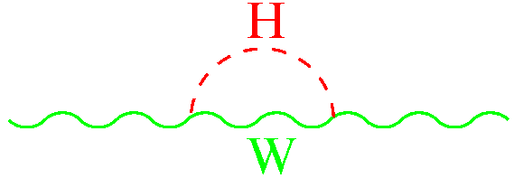
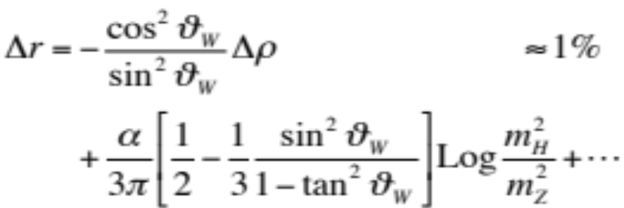
LEP and SLC: A few highlights (4)
Why are e⁺e⁻ colliders the tool of choice for precision anyway ? (cont’d)
  Electroweak observables can be calculated/predicted with precision
    And are sensitive to heavier particles through quantum corrections
      W mass
      Prediction of m_{top} and m_{H}
220
200
180
160
140
m_{top} (GeV/c²)
m_{W}
(m_{W}/m_{Z})² → (m_{W} /m_{Z})² ×(1 + Δr)
R_{b}
Δρ
Combined
10 10² 10³
m_{H} (GeV/c²)

Slide 13
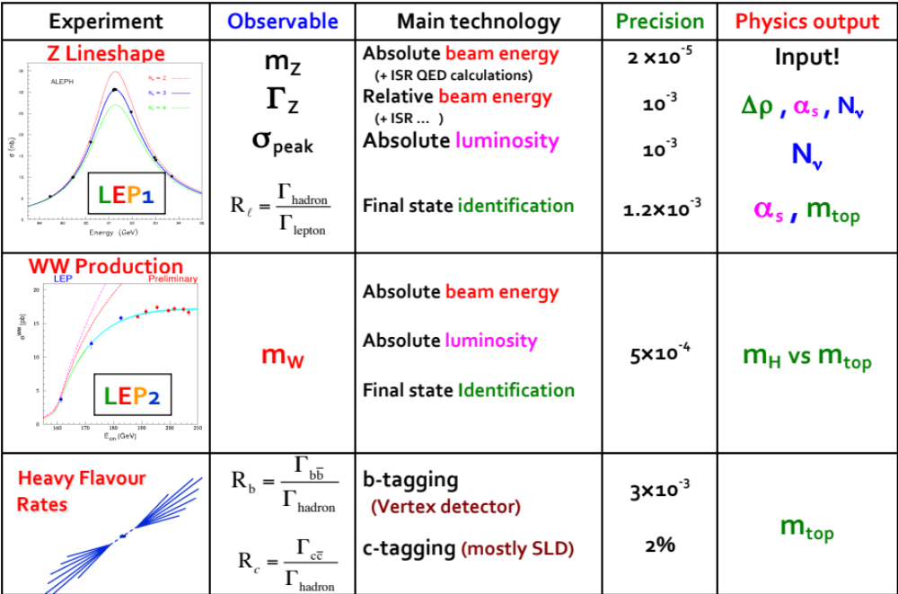
LEP and SLC: Electroweak Observables (1)
Electroweak observables

Slide 14
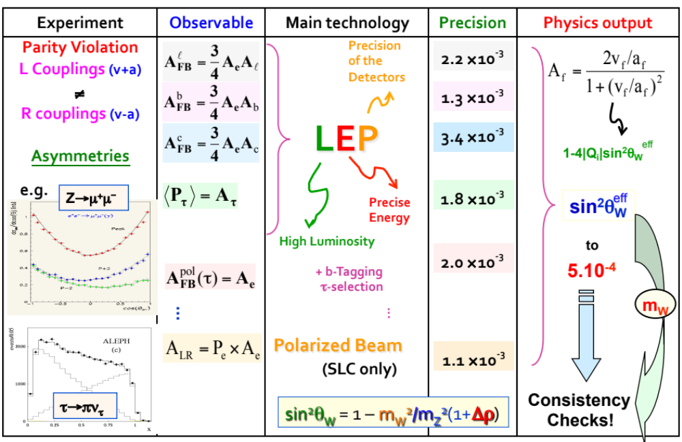
LEP and SLC: Electroweak Observables (2)
liui

Slide 15
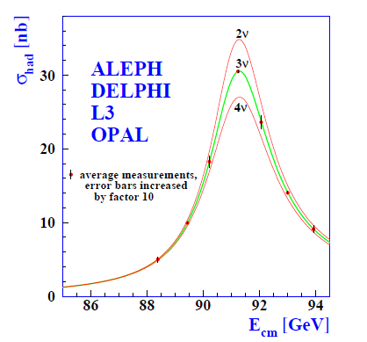
LEP and SLC: A few highlights (5)
The Z line-shape measurement at LEP
  Mostly a statistically-limited counting experiment
    Count e⁺e⁻ → Z → hadrons/leptons events, and e⁺e⁻ → e⁺e⁻ at low angle (lumi)
  After 5 years :
    N_{ν} = 2.984 ± 0.008
    Γ_{Z} = 2495.2 ± 2.3 MeV
    m_{Z} = 91187.5 ± 2.1 MeV
    R_{l} = 20.767 ± 0.025
    α_{S} = 0.1190 ± 0.0025
  NB. The beam energy must be measured
  with ~1 MeV precision, and the luminosity
  with ~0.1% precision
√s ~ 91 GeV
(Note the 2σ deficit)

Slide 16
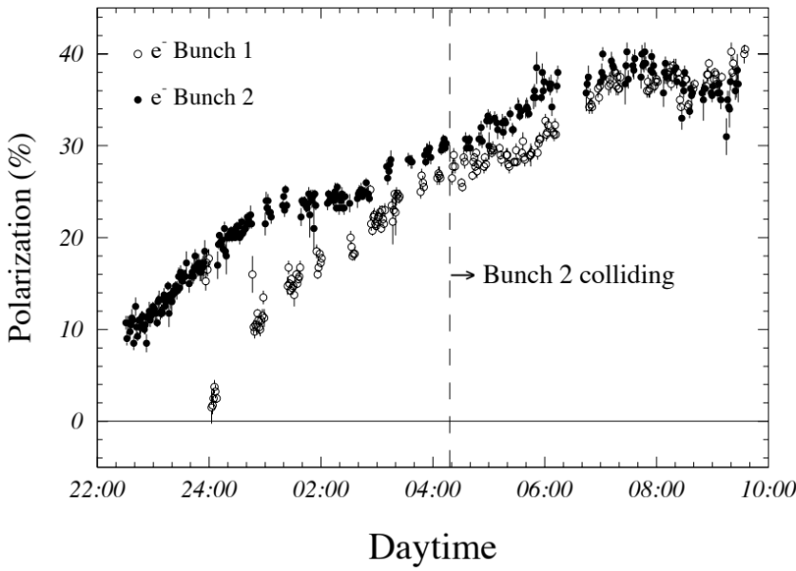
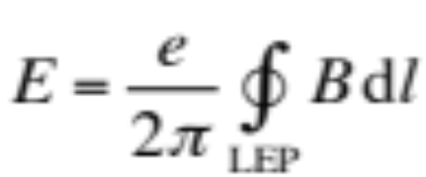
LEP and SLC: A few highlights (6)
Measurement of the beam energy at LEP
  Ultra-precise measurement unique to circular colliders (crucial for m_{Z}, Γ_{Z})
Electron with momentum p in a uniform vertical magnetic field B:
In real life, B non uniform, LEP ring not circular
The electrons get transversally polarized (i.e., their spin tends to align with B)
Slow process (~ 1 hour to get 10% polarization)
NB. Polarization can be kept in collision (was tried only once at LEP).
B_{dipole}
→
p
e⁻
R
LEP
L = 2πR = 27km
E ∼ p = e B R = (e/2π) B L
To be
measured

Slide 17
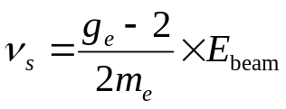
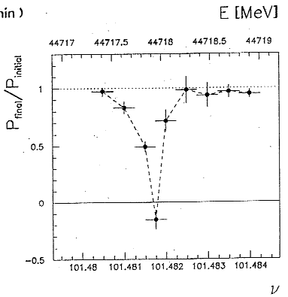
LEP and SLC: A few highlights (7)
Measurement of the beam energy at LEP (cont’d)
  The spin precesses around B with a frequency proportional to B (Larmor precession)
    Hence, the number of revolutions ν_{S} for each LEP turn is proportional to BL (or ∫Bdl)
  Resonant intrinsic precision of the method ΔE_{beam}<100 keV !
    However, m_{Z} and Γ_{Z} measured at LEP with a precision of 2.2 MeV …
      Why ?
Resonant depolarization:
B_{dipole}
0
1
2
→
p
3
-B_{x}
e⁻
B_{x}
B_{x}: oscillating field with frequency ν
in one point of the ring
Vary ν until Pol = 0 (ν=ν_{S})

Slide 18
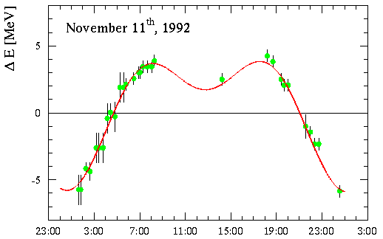
LEP and SLC: A few highlights (8)
Measurement of the beam energy at LEP (cont’d)
  Measurement with polarization take hours
    Usually performed with a single e⁻ bunch (no collisions)
      Observed dispersion over 24 hours : 10 MeV !
        100 times larger than the intrinsic precision of resonant depolarization…

Slide 19
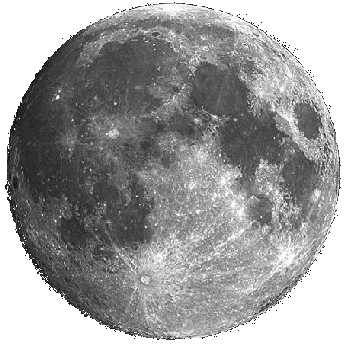

LEP and SLC: A few highlights (9)
Measurement of the beam energy at LEP (cont’d)
  Dispersion explained by the effect of the moon
    Ring circumference varies according to tides
LEP at midnight
Longer by 300 μm
LEP at noon
Shorter by 300 μm
So what ?
→ S
→ U
→ N

Slide 20
B_{dipole}
RF frequency:
352 254 170 Hz
(±1 Hz)
Electron orbit length fixed by RF

Slide 21
QUAD
Dipole
Dipole
QUAD
⊗
⊗
B_{dipole}
Beam Orbit
Monitors (BOM)
⊗
⊗
QUAD
QUAD

Slide 22
6:00 am
⊗
⊗
B_{dipole}
⊗
⊗

Slide 23
Midnight
⊗
⊗
Larger ring circumference
Smaller B field seen by the beam
Beam energy smaller
B_{dipole}
⊗
⊗

Slide 24
6:00 pm
⊗
⊗
B_{dipole}
⊗
⊗

Slide 25
Noon
⊗
⊗
Smaller ring circumference
Larger B field seen by the beam
Beam energy larger
B_{dipole}
Prediction and data
fit perfectly …
⊗
⊗
Extrapolation to collision conditions and other time-dependent effects
limit the uncertainty on the beam energy to ~1.5 MeV

Slide 26
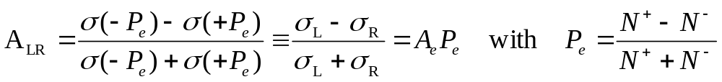
LEP and SLC: A few highlights (10)
Measurement of A_{LR} (Left-Right asymmetry) at SLC
  “Just” a counting experiment at the Z pole with a longitudinally polarized e⁻ beam
  Many advantages
    A_{LR} = A_{e} ~ 14% for a 100% polarized electron beam (P_{e} = 1)
      i.e., almost 10 times more sensitive to sin²θ_{W} than A_{FB}^{leptons} = ¾ A_{e}A_{l} ~ 1.5%
    A_{LR} is independent of the final state
      Use all Z decays into hadrons, τ⁺τ⁻, μ⁺μ⁻, e⁺e⁻
    A_{LR} is independent of the detector acceptance
      Cancels in the ratio: just count the events with neg’ve and pos’ve P_{e}
    Most theoretical uncertainties cancel in the A_{LR} ratio
Can achieve the same sin²θ_{W} precision with 100 times less statistics

Slide 27
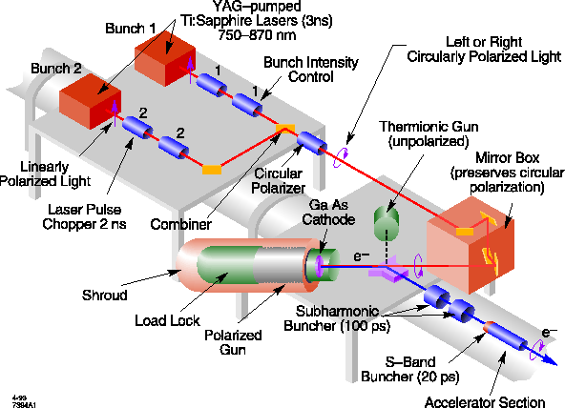
LEP and SLC: A few highlights (11)
Measurement of A_{LR} at SLC (cont’d)
  Getting longitudinally polarized electrons is quite “easy”
    Illuminate a photo-cathode with circularly polarized LASER light
      80% longitudinal polarization was achieved routinely
  Keeping longitudinal polarization in a linear accelerator is natural
    No depolarizing effects
  Keeping longitudinal polarization is impossible in a ring
    Spin flips by synchrotron radiation
      Kills longitudinal polarization in a few turns
  Could have used the natural transverse polarization at LEP
    As well as spin rotators before and after one or several interaction points
      To transform transverse polarization to longitudinal polarization
  Experiment was proposed in 1995 but was turn down (LEP2 was the priority)

Slide 28
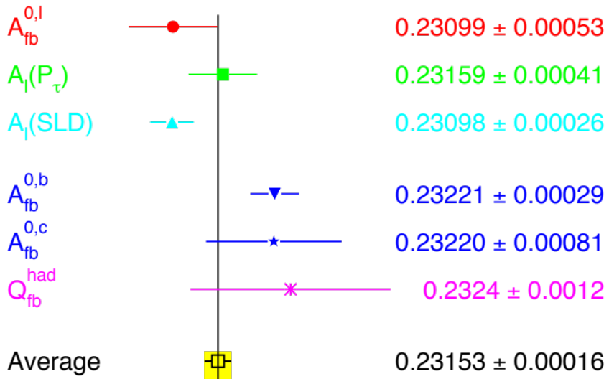
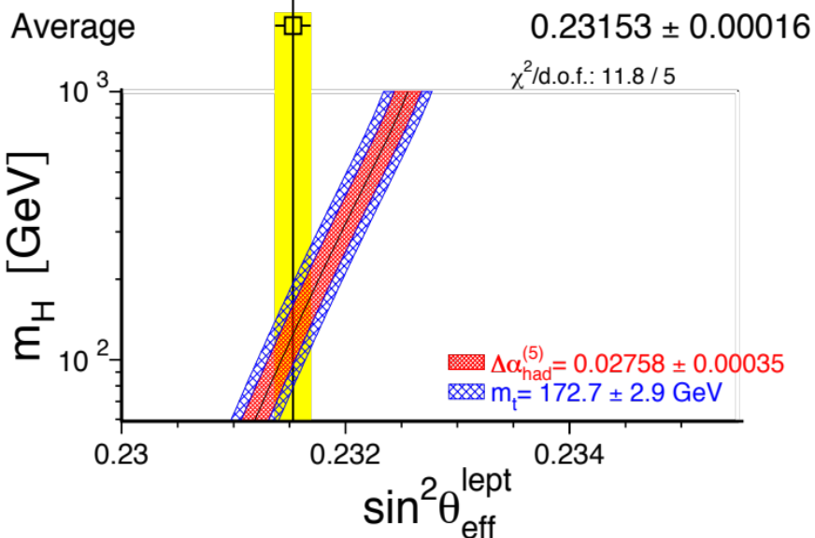
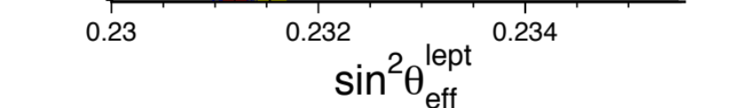
LEP and SLC: A few highlights (11)
Measurement of A_{LR} at SLC (cont’d)
  As anticipated, single most precise measurement of sin²θ_{W}
    Similar precision as the combined value from many measurements at LEP
  Combined relative precision (LEP+SLC) of 5×10⁻⁴
    Enough to be sensitive to m_{H}
All EW measurements
LEP+SLC+m_{top} at 95% CL
114 GeV < m_{H} < 152 GeV

Slide 29
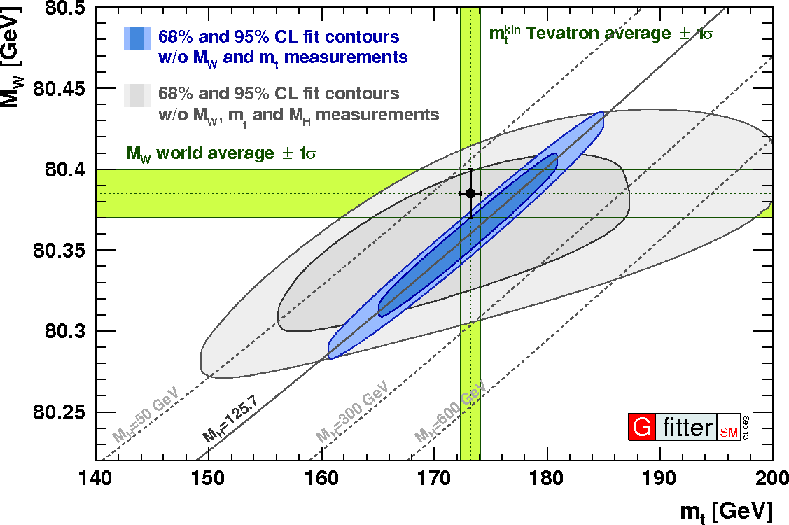
LEP and SLC: A few highlights (12)
Current status of precision measurements
  With m_{top}, m_{W} and m_{H} known, the standard model has nowhere to go
    Strong incentive to significantly improve the precision of all measurements
      Towards being sensitive to 100 TeV new physics through quantum corrections

Slide 30
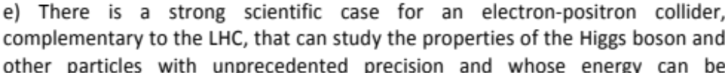

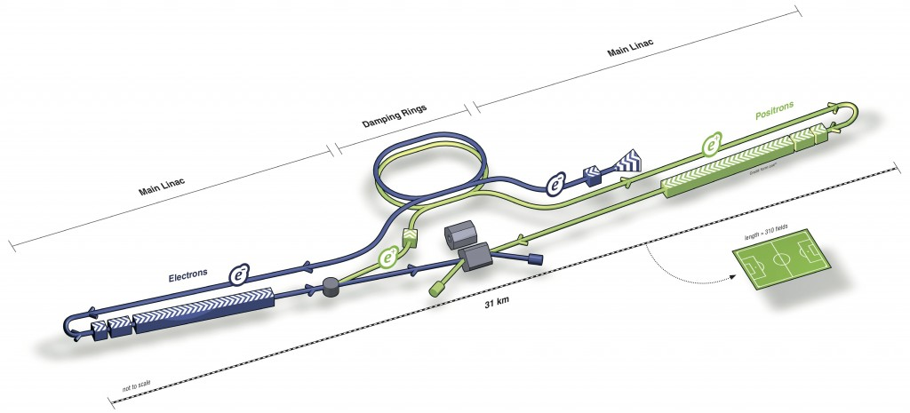
Future prospects for precision e⁺e⁻ colliders (1)
The European Strategy update in 2013 does not say otherwise
  For 20 years, there was only one such project on the market
    A 500 GeV e⁺e⁻ linear collider, now called “ILC”, proposed in the early 1990’s
Total length: 31 km

Slide 31
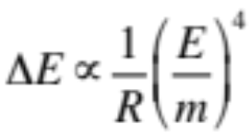
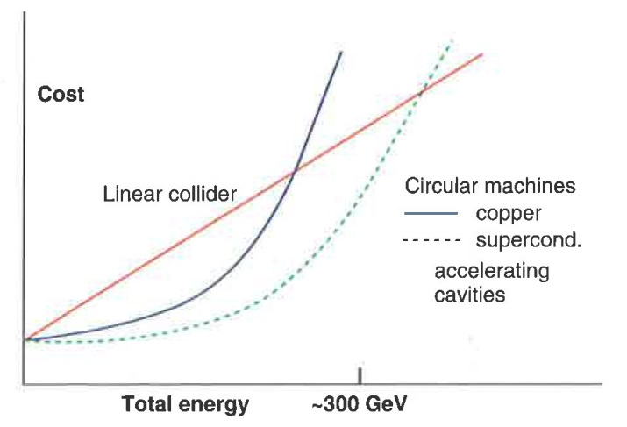
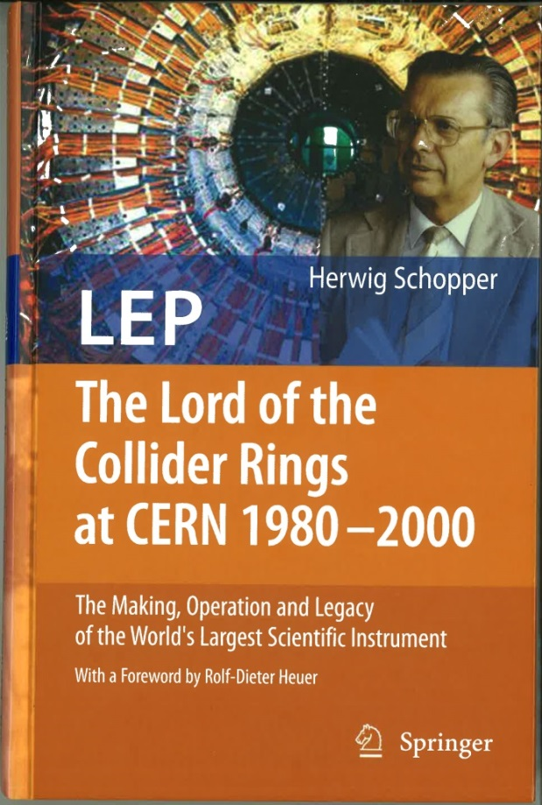
Future prospects for precision e⁺e⁻ colliders (2)
Why linear and not circular ?
  Synchrotron radiation in circular machines
    Energy lost per turn grows like , e.g., 3.5 GeV/turn at LEP2
      Need to compensate with accelerating cavities. Cost increases like E⁴ too.
  A 500+ GeV e⁺e⁻ collider can only be linear. Cost of a circular collider is prohibitive.
    “Up to a centre of mass energy of 350 GeV at least, a circular collider with superconducting accelerating cavities is the cheapest option”
Author: Herwig Schopper
(Former CERN DG)
Foreword: Rolf Heuer
(Current CERN DG)
~500 GeV
H. Schopper, private communication, 2014

Slide 32
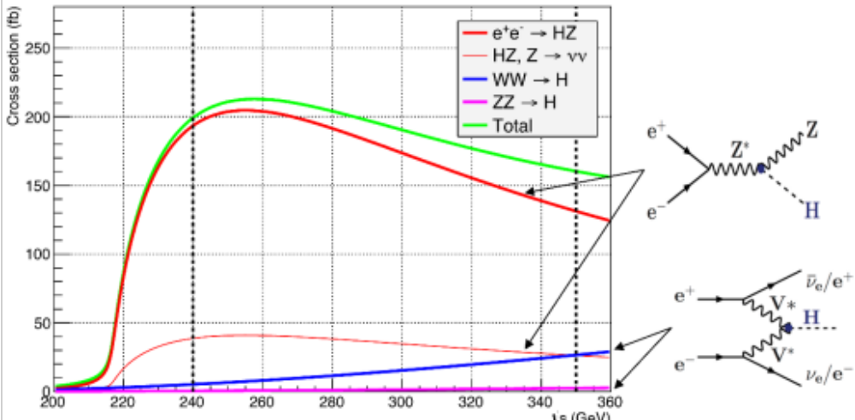
Future prospects for precision e⁺e⁻ colliders (3)
Interest for circular collider projects grew up again after first LHC results
  The Higgs boson is light – LEP2 almost made it: only moderate √s increase needed
    Need to go up to the top-pair threshold (~350 GeV) anyway to study the top quark
  There seems to be no heavy new physics below 500 GeV
    The interest of √s = 500 GeV (and even 1 TeV) is now very much debated
      High luminosity at 90, 160, 240 and 350 GeV to study the Z, W, H and top
        The way to go for precision physics: Linear or Circular ?
LEP2

Slide 33
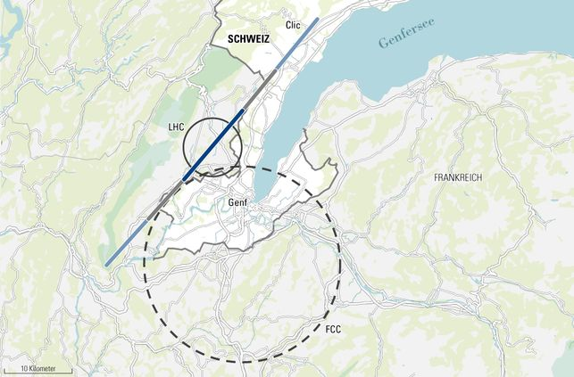
Future prospects for precision e⁺e⁻ colliders (4)
Proposed linear and circular colliders
ex. Geneva basin
LEP3
H and top factory
ILC 0.5 TeV (30km)
ILC 1 TeV (50km)
CLIC 3 TeV (50km)
FCC (100 km)
[Future Circular Colliders]
First step: FCC-ee (90-400 GeV)
[Z, W, H, top factories]
Ultimate goal: FCC-hh (100 TeV)
[Access to highest energies]
High energy

Slide 34
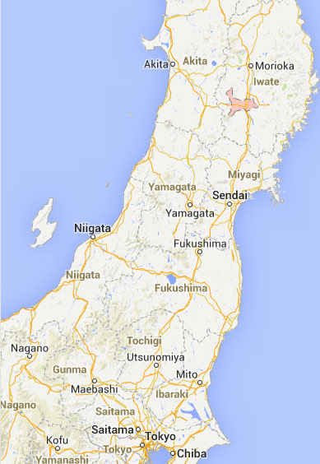
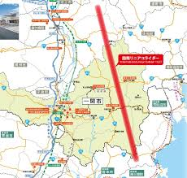

Future prospects for precision e⁺e⁻ colliders (5)
Proposed linear and circular colliders (cont’d)
ex. Japan
ILC
Kitakami site
Tristan-II layout – Tsukuba site (1983)
Tristan-II
94 km
e⁺e⁻, pp and
ep collisions

Slide 35



Future prospects for precision e⁺e⁻ colliders (6)
Proposed linear and circular colliders (cont’d)
  CepC: e⁺e⁻ collisions at 240 GeV
    Higgs factory
  SppC: pp collisions at 50-70 TeV
    Highest energies
ex. China

Slide 36

Future prospects for precision e⁺e⁻ colliders (7)
Most advanced linear collider project: ILC
  R&D for the past 20 years
  Detector designs well underway
  Technical design report delivered in June 2013
  Japan as a possible host ?
Most advanced circular collider project: FCC-ee (formerly TLEP)
  Still very much in its infancy (first proposal end of 2012)
  Conceptual design report expected in 2018, in time for the next strategy update
  50 years of experience with circular colliders
  CERN as a possible host ?
Let’s compare both baseline projects in term of
  Energy (and power), Luminosity, Precision, and Cost
European strategy:

Slide 37

Towards precision: Linear vs Circular (1)
Getting the energy
  ILC: Long sections with RF accelerating cavities
    Both beams are lost after a single collision
    RF must supply the full beam energy for each collision
      Example of a Higgs factory at √s = 250 GeV
        State of the art RF superconducting cavities provide a gradient of 31 MV/m
        Each beam must reach 125 GeV
        Total length : 8 km (actually 12 km when cryo-modules are included)
        Increased to 24 km for √s = 500 GeV (baseline design)
e⁻
e⁺

Slide 38



Towards precision: Linear vs Circular (2)
Getting the energy (cont’d)
  FCC-ee
    Beams collide many times (four times per turn, for hours)
    RF needed only to compensate the energy loss / turn by synchrotron radiation
      2 GeV at √s = 240 GeV, 7.5 GeV at √s = 350 GeV (baseline design)
        For RF superconducting cavities with 15-20 MV/m gradient
        Need less than 600 m of RF cavities (800 m with cryo-modules)
~30 GeV
e⁻
e⁺
  ρ = 3.1 km
  ρ = 11 km
~ 7.5GeV
~ 2.0GeV

Slide 39
Towards precision: Linear vs Circular (3)
Getting the energy (Summary)
    Ten times more RF cavities needed for ILC-H
      It is the cost driver of the project
    FCC-ee wall-plug power designed for 50 MW / beam (Synchrotron radiation)
      It is set to the maximum socially acceptable today
        (Directly proportional to the luminosity)
 | ILC-H | FCC-ee-H and top
RF voltage V_{tot} | 240 GV | 3-10 GV
RF gradient G_{RF} | 31.5 MV/m | 15-20 MV/m
effective RF length | 8 km | <800 m
RF frequency f_{RF} | 1.3 GHz | 400-800 MHz (?)
Q₀: unloaded cavity Q | 10¹⁰ | 2-4x10¹⁰ (higher at lower G_{RF})
D: RF duty factor | 0.75% (pulsed) | 100% (cw)
total cryo power | 16 MW | 10-25 MW
Wall-plug power | 163 MW (500 GeV) | 300 MW (Fcc-ee-top)

Slide 40

Towards precision: Linear vs Circular (4)
Getting the luminosity
  n_{IP} : number of interaction points
    Up to 4 for FCC-ee, one for ILC.
  N : number of electrons/positrons per bunch
  k_{b} : number of bunches per pulse (ILC) or total (FCC-ee)
  f : frequency of collision
  σ∗_{x,y} : transverse beam sizes at interaction point
  F : reduction factor due to beam crossing angle
  H_{D}: pinch effect due to beam-beam interactions (Beamstrahlung)
  4π : you shouldn’t touch that !
× H_{D}

Slide 41
Towards precision: Linear vs Circular (5)
Getting the luminosity (cont’d)
  Remember: σ(e⁺e⁻ → HZ) ~ 200 fb at √s ~ 250 GeV
  For 0.1% precision on the couplings, at least 10⁶ HZ events are required
    Order of magnitude for the total luminosity: 5000 fb⁻¹, e.g. in 5 years
      Corresponds to an instantaneous luminosity of 10³⁵ cm⁻²s⁻¹
        (Prove it as an exercise !)
      LEP2 reached 10³² cm⁻²s⁻¹ : Need three orders of magnitude more
      SLC reached 3 × 10³⁰ cm⁻²s⁻¹ : Need > four orders of magnitude more

Slide 42
Towards precision: Linear vs Circular (6)
Getting the luminosity (cont’d)
  Beam spot size at FCC-ee
    Inspired by B factories (KEK-B, PEP-II) progress
      Final focus optics reduces vertical / horizontal sizes
        By factors of 100 (σ∗_{y}) and 10 (σ∗_{x}) with respect to LEP2
 | σ∗_{x} (μm) | σ∗_{y} (nm)
LEP2 | 182 | 3200
FCC-ee | 22 | 44
ILC | 0.47 | 5.9
  Beam spot size at ILC
    The frequency f of collisions at ILC is 5 Hz (time needed to produce new bunches)
      Compared to 300,000 km/s / 100 km = 3 kHz at FCC-ee
        Need much smaller beam sizes at ILC than at FCC-ee, never achieved so far.
        Need another factor 600 on σ∗_{x} × σ∗_{y} - Design foresees a factor 300.
        It is also a factor 2000 smaller than the SLC beam spot.

Slide 43

Towards precision: Linear vs Circular (7)
Getting the luminosity (cont’d)
reached with
N ~ design and
β∗_{x} ~ 10 x design,
equivalent to ~2%
of design luminosity

Slide 44


Towards precision: Linear vs Circular (8)
Getting the luminosity (cont’d)
  Collateral effect at FCC-ee-H and top : luminosity lifetime ~ 15-20 mins
    Culprit is Bhabha scattering e⁺e⁻→ e⁺e⁻(γ) : large cross section, burns the beam
      Supported by top-up injection (extensively used at PEP-II and KEK-B)
    Requires another 10 GV of RF
      For the accelerator ring
    Also avoids ramping transients
      Eases tuning of the machine
Top-up injection : Schematic cycle
Constant luminosity!

Slide 45



Towards precision: Linear vs Circular (9)
Getting the luminosity (cont’d)
  Collateral effect at ILC: Beamstrahlung
    Synchrotron radiation in the strong field of opposing beam
      A fraction of e± emit a significant part of their energy
  Further degrades beam lifetime in a ring at large √s
    Solved by the top-up injection scheme
      Improved by a large momentum acceptance of the optics (Δp/p ~ 2%)
Degraded luminosity spectrum Additional detector background
FCC-ee,
√s = 240 GeV
ILD TPC
at 500 GeV

Slide 46

Towards precision: Linear vs Circular (10)
Getting the luminosity (cont’d)
  Total beam current
    Limited by positron source at ILC
      Inject 100% of the intensity 5 times per seconds
    Limited by RF power at FCC-ee (synchrotron radiation)
      Only inject 1% of the intensity every 10 seconds
  ILC e⁺ source has no precedent : it requires a e⁻ beam of at least 150 GeV
    Its performance can only be verified after the ILC construction
 | SLC | ILC (H) | LEP2 | FCC-ee (H)
e⁺ / second | 6 x 10¹² | 200 x 10¹² | 0.2 x 10¹² | 0.05 x 10¹²

Slide 47

Towards precision: Linear vs Circular (11)
Getting the luminosity (cont’d)
  Most of the challenging FCC-ee parameter will be commissioned in 2015
    SuperKEK-B will be a FCC-ee demonstrator – we’ll know soon if the concept works
Some SuperKEKB parameters :
  Beam Lifetime : 5 minutes
    FCC-ee (H) : 20 minutes
  β*_{y} : 300 μm
    FCC-ee (H) : 1 mm
  σ_{y} : 50 nm
    FCC-ee (H) : 50 nm
  ε_{y}/ε_{x} : 0.25%
    FCC-ee (H) : 0.2% t0 0.1%
  e⁺ production rate : 2.5 × 10¹² / s
    FCC-ee (H) : < 1 × 10¹¹ / s
  Off-momentum acceptance at IP : ±1.5%
  FCC-ee (H) : ±2.0% to ±2.5%
  Centre-of-mass energy: ~10 GeV
  FCC-ee (H) : 240 GeV
To be commissioned in 2015

Slide 48
Towards precision: Linear vs Circular (12)
To summarize: ILC(H) vs FCC-ee(H)
  FCC-ee (H)
    Larger collision frequency: x 600 (f)
    Larger bunch charge: x 2.5 (N)
    Several IPs: x 4 (n_{IP})
    Better wall-plug power to be efficiency: x 3-4 (Nk_{b})
  ILC (H)
    Smaller beam spot sizes: x 300 (σ∗_{x} × σ∗_{y} )
  For equal wall-plug power, FCC-ee (H) has 12 times more luminosity than ILC (H)
    And a factor 35-40 more luminosity at design wall-plug power (< 2 x ILC500)
Scaling with energy
  FCC-ee
    Synchrotron radiation decreases like E⁴ at smaller √s
      Use the available power to collide more bunches
  ILC
    Beam spot transverse size decreases like 1/E at larger √s
      Because of “adiabatic damping” when the beam gets accelerated
        (Radiation-induced beam size reduction)
[pulsed vs cw]

Slide 49

Towards precision: Linear vs Circular (13)
Getting the precision
  FCC-ee is the ultimate Z, W, Higgs and top factory
    10 to 1000 times the ILC targeted statistics at the same energies
      10⁵ more Z’s and 10⁴ more W’s than LEP1 and LEP2
  [If LHC finds no new physics below ~1.5 TeV,] it is the tool of choice for precision physics
    Higher energy might become useful otherwise (if NP produced in e⁺e⁻ collisions)
Statistics / year
 | FCC-ee | ILC | LEP
Z decays | 10¹² | 10⁹ | 2x10⁷
WW pairs | 10⁸ | 10⁶ | 4x10⁴
HZ events | 5×10⁵ | 2×10⁴ | –
Top pairs | 5×10⁵ | 5×10⁴ | –
Complementarity

Slide 50

Precision electroweak physics at FCC-ee (1)
Tera-Z, Oku-W and Mega-Tops
90-400 GeV e⁺e⁻
(FCC-ee)

Slide 51
Precision electroweak physics at FCC-ee (2)
The FCC-ee in numbers (after commissioning)
      Potential statistical accuracies are mind-boggling !
Parameter | Z | W | H | tt | LEP2
E_{beam} (GeV) | 45 | 80.5 | 120 | 175 | 104
I (mA) | 1400 | 152 | 30 | 7 | 4
No. bunches | 16’700 | 4’490 | 1’330 | 98 | 4
σ*_{y} (μm) | 0.25 | 0.13 | 0.044 | 0.045 | 182
σ*_{x} (μm) | 121 | 26 | 22 | 45 | 3.2
Energy spread (%) | 0.06 | 0.09 | 0.14 | 0.19 | 0.16
Lifetime (min) | 213 | 52 | 21 | 15 | 300
L (10³⁴ cm⁻²s⁻¹) | 28 | 12 | 5.9 | 1.8 | 0.012
√s (GeV) | Running time | FCC-ee Statistics
91 | 1 – 2 years | 10¹² Z decays (Tera Z)
161 | 1 – 2 years | 10⁸ WW pairs (Oku W)
240 | 4 – 5 years | 2×10⁶ HZ events (Mega Higgs)
350 | 4 – 5 years | 2×10⁶ top pairs (Mega Top)
Next Lecture

Slide 52
Precision electroweak physics at FCC-ee (3)
Tera-Z : Get 10¹² Z decays at 15 kHZ/IP
  Repeat the LEP1 programme every 15 minutes
  Bonus: Use ~100 “single” bunches to measure E_{BEAM} with resonant depolarization
    Each measurement gives 100 keV precision, with no extrapolation uncertainty
      Examples of targeted accuracy:
  Predicting accuracies with 250 times smaller statistical precision than at LEP is difficult
    Conservatively used LEP experience for systematics. This is just the start.
Observable | Measurement | Current precision | TLEP stat. | Possible syst. | Challenge
m_{Z} (MeV) | Lineshape | 91187.5 ± 2.1 | 0.005 | < 0.1 | QED corr.
Γ_{Z} (MeV) | Lineshape | 2495.2 ± 2.3 | 0.008 | < 0.1 | QED corr.
R_{l} | Peak | 20.767 ± 0.025 | 0.0001 | < 0.001 | Statistics
R_{b} | Peak | 0.21629 ± 0.00066 | 0.000003 | < 0.00006 | g → bb
N_{ν} | Peak | 2.984 ± 0.008 | 0.00004 | < 0.004 | Lumi meast
α_{s}(m_{Z}) | R_{l} | 0.1190 ± 0.0025 | 0.00001 | 0.0001 | New Physics
m_{Z} to < 100 keV!
+ many asymmetries
for sin²θ_{W} to 10⁻⁵ - 10⁻⁶

Slide 53

Precision electroweak physics at FCC-ee (4)
Longitudinally polarized beams at √s = m_{Z}: A_{LR} measurement ?
  SLC demonstrated the feasibility of longitudinally polarized beams at linear colliders
    ILC design values: P₋ = 80% and P₊ = 30%
  FCC-ee would need a specific setup for this measurement
    Reduced luminosity (~1% of nominal) to avoid top-up injection (depolarizing)
    Wigglers to get transverse polarization faster (natural time: 15h for 5% polarization)
    Spin rotators on both sides of the detector(s) to get longitudinal fragmentation
  With 10¹⁰ Z (1% design, still a factor 10 more than ILC)
    Measurement of sin²θ_{W} to 2×10⁻⁶
      Added value to be weighed with the experimental challenge
Observable | Measurement | Current precision | TLEP stat. | Possible syst. | Challenge
A_{LR} | Z peak, polarized | 0.1514 ± 0.0022 | 0.000015 | < 0.000015 | Design Expt

Slide 54


Precision electroweak physics at FCC-ee (5)
Oku-W: 10⁸ WW events at production threshold
  Measurement of the W mass Measurement of the number of neutrinos
    with cross section at threshold (with single photon events)
  Will bring final answer to the current N_{ν} deficit (sterile neutrinos ?)
-
N_{ν} ~ σ(e⁺e⁻ → ννγ) / 2σ(e⁺e⁻ → μ⁺μ⁻γ)
ν
-
ν
Observable | Measurement | Current precision | TLEP stat. | Possible syst. | Challenge
m_{w} (MeV) | Threshold scan | 80385 ± 15 | 0.3 | < 0.5 | QED Corr.
N_{ν} | Radiative returns e⁺e⁻→γZ, Z→νν, ll | 2.92 ± 0.05 2.984 ± 0.008 | 0.001 | < 0.001 | ?
α_{s}(m_{W}) | B_{had} = (Γ_{had}/Γ_{tot})_{W} | B_{had} = 67.41 ± 0.27 | 0.00018 | < 0.0001 | CKM Matrix
m_{W} to < 500 keV!

Slide 55


Precision electroweak physics at FCC-ee (6)
-
Mega-top: a million tt events at threshold
  Measure top quark mass and width
    From cross section at threshold
      10 x the ILC statistics
      No beamstrahlung systematics
    Watch out the moon
      From 0.1 to 1.5 GeV E_{BEAM} variation !
      Dynamic control of the RF frequency ?
  Measure the top Yukawa coupling
FCC-ee
m_{top} to 10 MeV!
Observable | Measurement | Current precision | TLEP stat. | Possible syst. | Challenge
m_{top} (MeV) | Threshold scan | 173200 ± 900 | 10 | 10 | QCD (~40 MeV)
Γ_{top} (MeV) | Threshold scan | ? | 12 | ? | α_{s}(m_{Z})
λ_{top} | Threshold scan | μ = 2.5 ± 1.05 | 13% | ? | α_{s}(m_{Z})

Slide 56


Precision electroweak physics at FCC-ee (7)
Comparison with ILC precision measurements
  Beam energy measurement (compton back-scattering, spectrometer) to ~10⁻⁴
    m_{Z} and m_{W} not measured to better than 5-10 MeV at ILC
      In absence of new physics, the (m_{top}, m_{W}) plot would look like this
      Strong constraints on new physics
SM with m_{H} = 126 GeV
Without m_{Z}@FCC-ee, the SM line
would have a 2.2 MeV width

Slide 57








Precision electroweak physics at FCC-ee (8)
Higher-dimensional operators as relic of new physics ?
  Possible corrections to the standard model
LEP constraints: Λ_{NP} > 10 TeV
After FCC-ee: Λ_{NP} > 100 TeV ?
Sensitivity to
Weakly-coupled NP

Slide 58

Precision electroweak physics at FCC-ee (9)
Theoretical uncertainties
  Today’s measurements of m_{Z}, m_{top}, m_{H}, α_{QED}(m_{Z}) and α_{S}(m_{Z}) and lead to the predictions
    First uncertainty is parametric, and arises from experimental uncertainties
      Will need to reduce uncertainties on m_{Z}, m_{top}, α_{QED} and α_{S} by a factor 10
        m_{Z}, m_{top}, and α_{S} will be addressed by FCC-ee measurements
        Need to find ways to improve α_{QED} (experimentally and theoretically)
    Second uncertainty comes from the lack of higher-order electroweak corrections
      Will need order of magnitude improvement here too
      Requires a new generation of electroweak calculations to higher orders
        Beyond the state of the art today …
        But within reach on the time scale required by FCC-ee
      Until recently, theory efforts were motivated by the precision needed by ILC
        The FCC-ee brings an entirely renewed ambition towards better results

Slide 59
The twin frontiers of FCC-ee physics
There is much more to do with high-statistics e⁺e⁻ collisions
Precision Measurements
Rare Decays
Springboard for sensitivity to new physics
Theoretical issues
  Higher-order QCD
  Higher-order EW
Set constraints on detector performance
Direct searches for new physics
Many opportunities
  Z: 10¹²
  b, c, τ: 10¹¹
  W: 10⁸
  H: 10⁶
  t: 10⁶
Fantastic potential

Slide 60

Other considerations
Cost
  The RF system is the cost driver of the machine, both for the ILC and the FCC-ee
    About 6 B$ for the ILC, about 1BCHF for the FCC-ee
Timescale
  First collisions (optimistically) in 2030 for the ILC
    The FCC-ee cannot start before the LHC is completed: 2030-2035
      CEPC could in principle start a little earlier (< 2030)

Slide 61
Conclusions of the second lecture (1)
Historically, e⁺e⁻ colliders have been used for precision measurements
  Two possibilities for the future: a linear collider or a circular collider
    To produce collision in the 2030’s
FCC-ee-Z
FCC-ee-W
FCC-ee-H
FCC-ee-t
ILC-500
ILC-250

Slide 62
Conclusions of the second lecture (2)
The FCC-ee is designed to be a Z, W, H, and top factory (√s = 90-400 GeV)
  It is a project in its infancy
    Less than two years old
  This machine has many challenges
    A high-power (200 MW), high-gradient (15-20 MV/m), 1 km-long, RF system
    Loads of synchrotron radiation (100 MW) to deal with
    A booster (for top up injection), and probably a double ring for e⁺ and e⁻
    An optics with very low β∗, and large momentum acceptance
    Polarization (transverse and longitudinal ?)
    Up to four experiments to serve
    … and much more
  It is supported by 50 years of experience and progress with e⁺e⁻ circular machines
    Most of the above challenges will be addressed at SuperKEKB as of 2015
      FCC-ee will have to build on this experience
  The goal luminosities are in the 10³⁵ – 10³⁶ cm⁻²s⁻¹ range
    To produce ~10¹² Z, 10⁸ W, 0.5×10⁶ Higgs and 0.5×10⁶ top pairs every year
      Towards unprecedented EW (and Higgs) precision measurements
  It is the first step towards a 100 TeV proton-proton collider (next lecture)

Slide 63
Conclusions of the second lecture (3)
The ILC is designed for √s = 500 GeV
  It is supported by 20 years of R&D and innovation
    With a complete technical design report delivered in 2013
      In principle, ready for construction as soon as decision is taken
  This machine is at least as challenging
    A 24 km-long, high-gradient (31 MV/m), RF system
    A very low β∗ optics delivering small beam spot sizes at high intensity
      Never demonstrated to be achievable - ATF2 still struggling
    A positron source with no precedent
      Its performance cannot be verified before the construction is complete
    A green-field project
  The target luminosity is from 0.5 to 2×10³⁴ cm⁻²s⁻¹ at √s = 250 – 500 GeV
    Producing 20,000 Higgs and 50,000 top pairs every year
      To only one detector
  It is in principle upgradeable to √s = 1 TeV, and possibly more ? (next lecture)

