Slide 1

Polarization and test of 1 mm²
Hamamatsu MPPC
Laboratory course: Day 2
Calorimetry Laboratory

Slide 2
Experience Description
The 6 students will be separated in three groups.
The experience is composed by three parts:
Build a polarization circuit for a 1 mm² Hamamatsu MPPC;
Measure the response of the MPPC to a blue led/laser changing the light on the detector with a graduated polaroid;
Study the MPPC linearity and the gain.

Slide 3
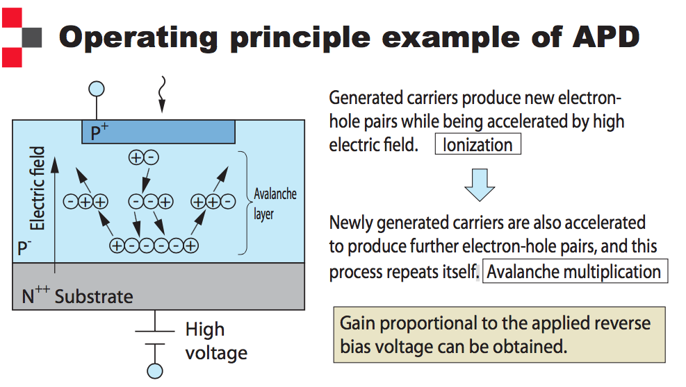
APD

Slide 4
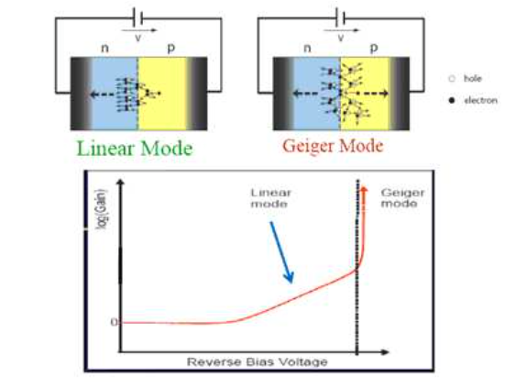
I-V curve
A photodiode working in Geiger mode is polarized with a reverse bias voltage greater than the Breakdown.
In this way, there is a very high electric field in the depletion region, such that one photon interacting will produce the avalanche.

Slide 5
MPPC
The MPPC (multi-pixel photon counter) is one of the devices called silicon photomultipliers (SiPM). It is a photon-counting device using multiple APD (avalanche photodiode) pixels operating in Geiger mode;
When the reverse voltage applied to an APD is set higher than the breakdown voltage, the electric field in the APD becomes high enough to cause a discharge (Geiger discharge) even by input of very weak light. The condition where an APD operates at this voltage level is called Geiger mode;
The Geiger mode allows obtaining a large output by way of the discharge even when detecting a single photon. Once the Geiger discharge begins, it continues as long as the electric field in the APD is maintained.

Slide 6
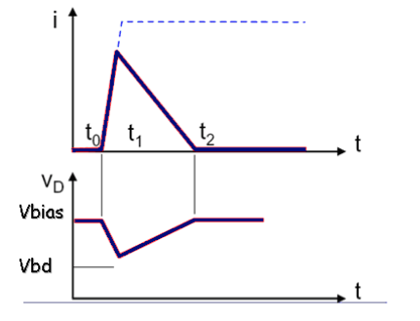
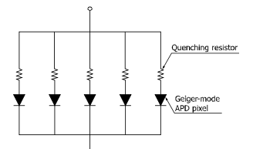
Quenching resistor
One specific example for halting the Geiger discharge is a technique using a so-called quenching resistor connected in series with the APD. This quickly stops avalanche multiplication in the APD because a drop in the operating voltage occurs when the output current caused by the Geiger discharge flows.
w/o the quencing
MPPC Structure
with the quencing

Slide 7
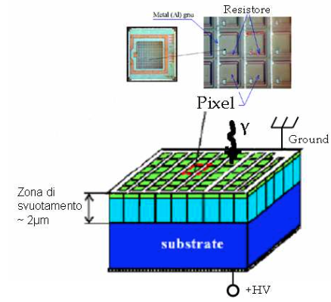
Basic operation
The basic element (pixel) of an MPPC is a combination of the Geiger mode APD and quenching resistor, and a large number of these pixels are electrically connected and arranged in two dimensions;
Each pixel in the MPPC generates a pulse o the same amplitude when it detects a photon. The pulses generated by multiple pixels create the output signal as a superimposition of the single pixel pulses.
depletion area
2 um

Slide 8
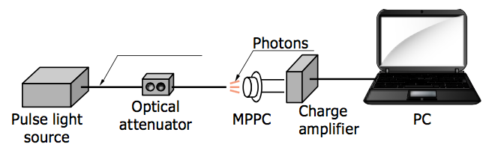
First part of the experience
Due to their high gain (~10⁶), it is simple to polarize the MPPC and readout its signal also without a amplifier;
In the first part of the experience you will build the polarization scheme and you will measure the response of your polarized MPPC to a blue led.
Polarization scheme

Slide 9
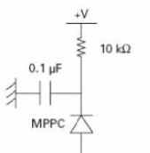

Polarization Scheme
We will use a simple RC filter and we will connect the output directly to the 50 Ohm of the DAQ.
DAQ

Slide 10
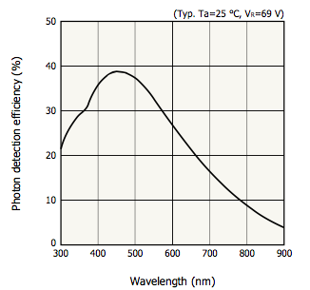
PDE
The photon detection efficiency is the product of 3 components:
1) The quantum efficiency @ the silicon surface
2)The “filling factor” of active area with respect to the total area of the MPPC
3)The avalanche probability (that is function of Vbias)

Slide 11
MPPC Dynamic Range
The MPPC is by construction a “digital” device. We can count single “photons” with a good amplifier but if two photons impinge in the same pixel the response is proportional to one ( inside the so called recovery time”)
The MPPC response for simultaneously incident photons is determined by the number of pixels and photon detection efficiency of the MPPC. As the number of incident photons increases, two or more photons begin to enter one pixel. Even when two or more photons enter one pixel, each pixel can only detect whether or not the photons entered the MPPC. This means that the output linearity degrades as the number of incident photons increases.

Slide 12
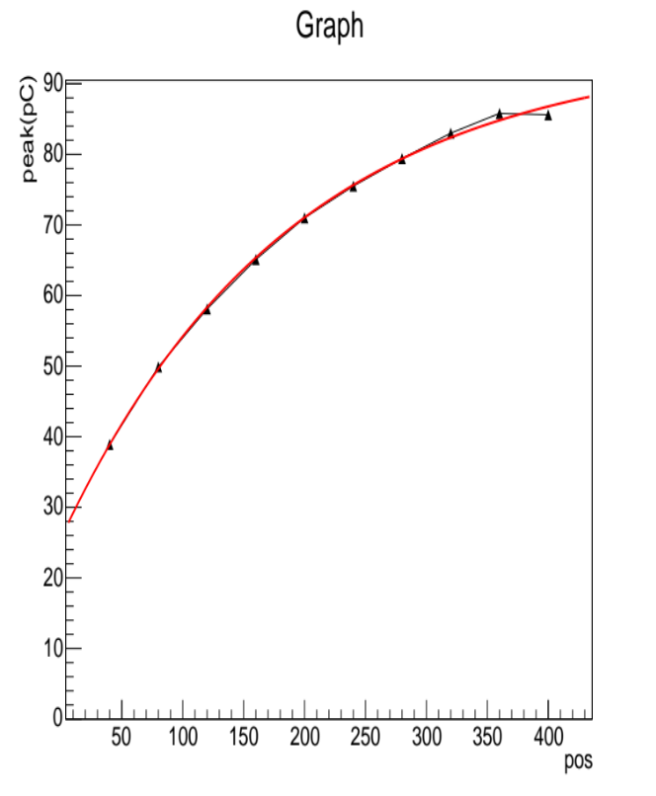
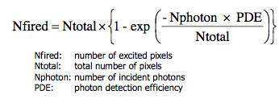
Second part of the experience
In the second part of the experience you will measure the MPPC linearity by changing the light using a graduated polaroid and acquiring a signal with a Caen Flash ADC.
[0]*(1-exp(-([1]*x+[2])/[3]))

Slide 13
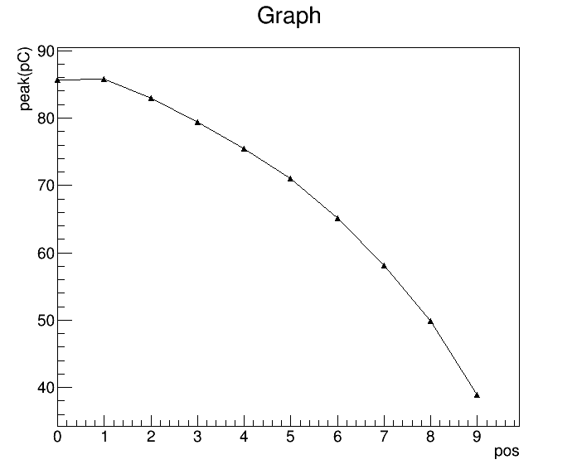
Second part of the experience
In the second part of the experience you will measure the MPPC linearity by changing the light using a graduated polaroid and acquiring a signal with a Caen Flash ADC.

Slide 14
How to run/analyze
1. data taking
create sub-directory where data will be stored:
> godata
> mkdir "namedir”
> godaq2
> RUNDAQ3 start the DAQ program
answer questions: "namedir", number of events, number of positions/runs
shift+W to write on disk
S to start/stop
return to move to next position/next run
2. how to start root
> root -l
3. how to create roottoples (FOR LED/LASER with 0-400 ns integration)
> goroot
> source doroot_edit.csh "namedir" "Nfiles (i.e. readout channels)"

