Slide 1
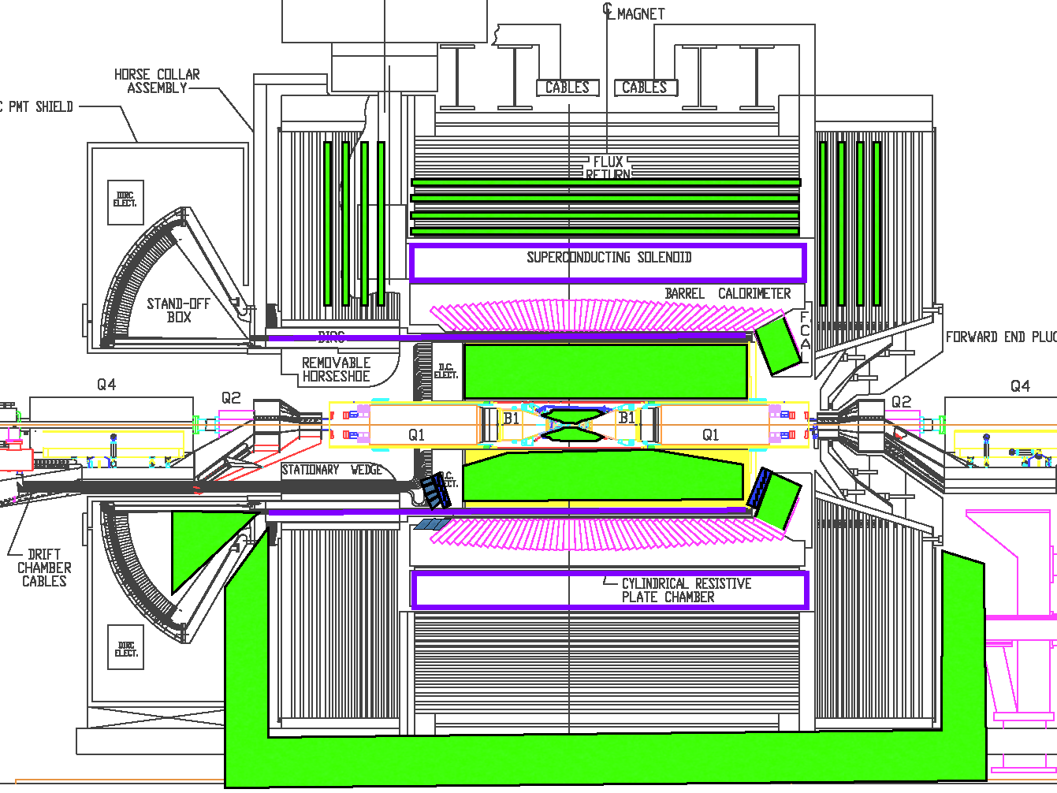


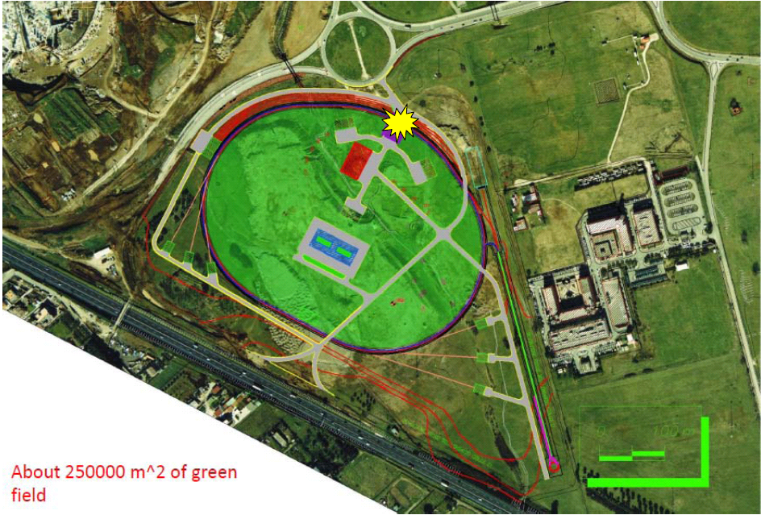
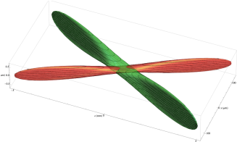
SuperB
Mainly Physics Program
Achille Stocchi - LAL (Université Paris-Sud / IN2P3)

Slide 2
Physics
Program
Why ?
20’
The Machine
How ?
Talk of Pantaleo Raimondi
The Detector
5’

Slide 3
PHYSICS : the Physics Program for a machine with
L= 10³⁶ cm⁻² s⁻¹ running >5 years.
KEY WORD : Complementarity to LHC program
MACHINE : the new collision schemes which make
L= 10³⁶ cm⁻² s⁻¹ possible.
KEY WORD : Very ambitious machine. Unique
opportunity to keep expertise
DETECTOR : reuse part of Babar but largely improved
KEY WORD : New and ambitious detector adapted to
the SuperB Physics program.
Possibility to conceive, construct and
use a detector in a few year time

Slide 4
Next generation of Super asymmetric B factory ≡
L= 10³⁶ cm⁻² s⁻¹ , >100 times the one of the present B-factory
Machine is challenging and based on new accelerating
schemes : “crab waist” : luminosity > 10³⁶ possible !
Success of “Frascati tests” has proven that they work !
The « Japanese » machine finally converged to this solution
Two SuperB factories will be built in this decade.
Both projects have been funded.
SuperKEKB
SuperB

Slide 5
If this kind of machine is constructed from scratch, we can get
L= 10³⁶cm⁻² sec⁻¹ as a baseline option → 15ab⁻¹ per year / regime
no need of high current and easier to be operated
→ Polarisation of at least one beam is possible
→ Possibility of running at the τ-charm threshold
That’s is the B-factory we need !
I try to get thtough you in 20’

Slide 6
Milestones
• 2005-2011: 16 SuperB workshops
• 2007: SuperB CDR
• 2010: 3 SuperB progress reports – accelerator, detector, physics
• December 2010 & 1^{rst} quarter 2011: project approbation by Italy
May 2011: site choosen : Tor Vergata (Rome II University)
May 28th → June 2nd 2011: Kick off SuperB meeting in Elba
Sept 2011 : First Coll. Meeting in London
Oct 2011 : Cabibbo laboratory Consortium created to host SuperB

Slide 7
SuperB
The Physics Program
A discovery machine in the LHC era

Slide 8
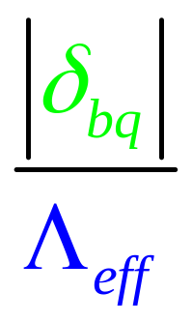
Beyond the Standard Model with flavour physics
The indirect searches look for “New Physics”
through virtual effects from new particles in loop corrections
1
~1970 charm quark from FCNC and GIM-mechanism K⁰→ μμ
~1973 3rd generation from CP violation in kaon (ε_{K}) KM-mechanism
~1990 heavy top from B oscillations Δm_{B}
~2000 success of the description of FCNC and CPV in SM
2
3
4
“Discoveries” and construction of the SM Lagrangian
SM FCNCs and CP-violating (CPV) processes occur at the loop level
SM quark Flavour Violation (FV) and CPV are governed by weak interactions
and are suppressed by mixing angles.
SM quark CPV comes from a single sources ( if we neglect θ _{QCD} )
New Physics does not necessarily share the SM behaviour of FV and CPV

Slide 9
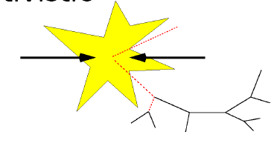
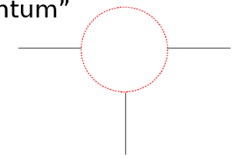
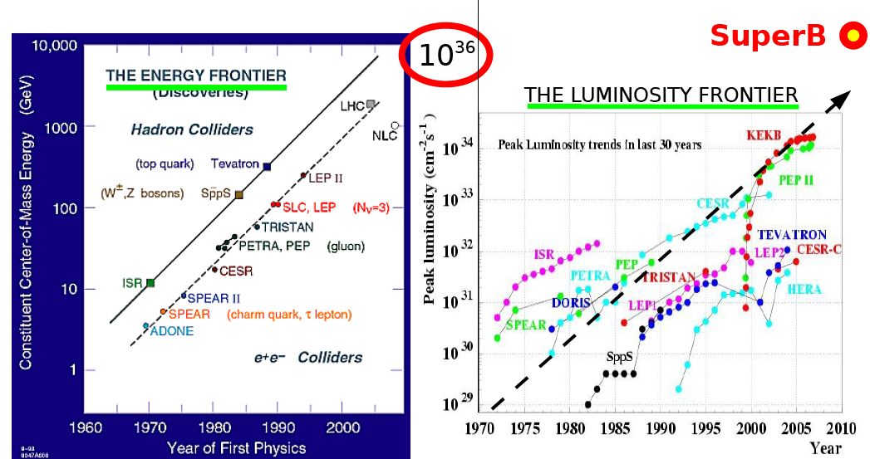
Exploration of two frontiers
“Relativistic path”
“Quantum path”
Crucial : Center-of-mass energy
Crucial : Luminosity
SuperB

Slide 10
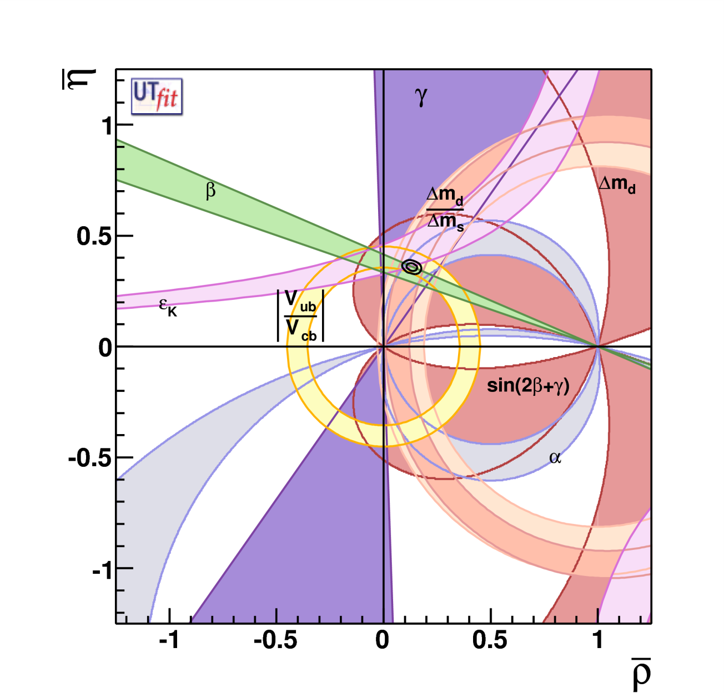
Global Fit within the SM
Coherent picture of FCNC and CPV processes in SM
Consistence on an
over constrained fit
of the CKM parameters
Discovery : absence of
New Particles up to the
~2×Electroweak Scale !
ρ = 0.132 ± 0.020
η = 0.358 ± 0.012
With a precision of
σ(ρ) ∼15% and σ(η) ~4% !
CKM matrix is the dominant source of flavour mixing and CP violation

Slide 11
Is the present picture showing a
Model Standardissimo ?
CKM matrix is the dominant source of flavour mixing and CP violation
σ( ρ)∼15% σ(η) ∼4%
Nevertheless there are tensions here and there that should
be continuously and quantitatively monitored :
sin2β (+2.2σ), ε_{K} (−1.7σ) , Br(B→τ ν) −(3.2σ)
[CP asymmetry in Bs sector (3.1σ)]
To render these tests more effective we need to improve the measurements but also (in same case) the predictions
Other measurements are interesting, not yet stringent tests :
α,γ, β from Penguins, A_{CP} (and Br) in radiative and dileptonic decays…

Slide 12
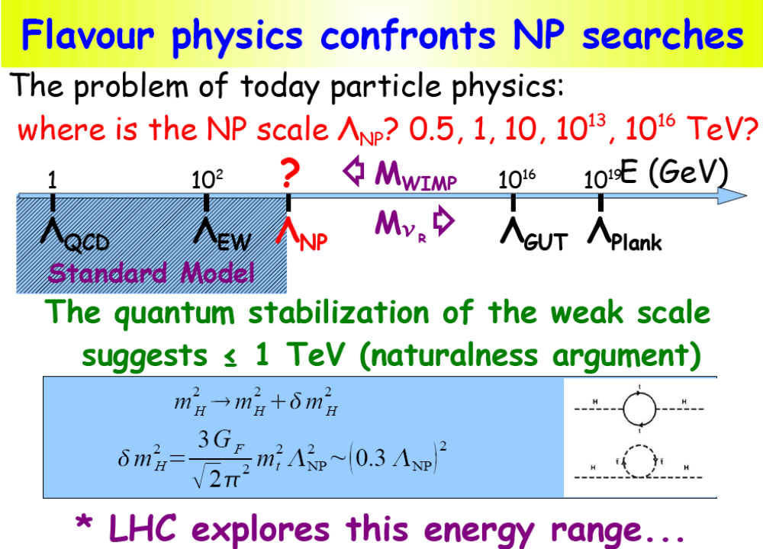
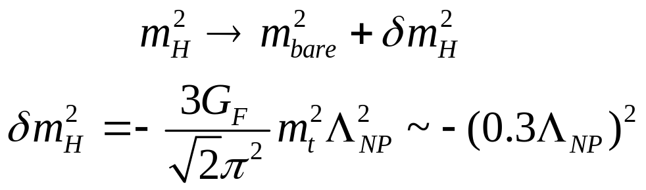
The problem of particle physics today is :
where is the NP scale Λ ~ 0.5, 1…10¹⁶ TeV
LHC will search
on this range
The quantum stabilization of the Electroweak Scale
suggests that Λ~ 1TeV
t
H
H
t
t
H
t
H
Those are arguments of fine tuning…if the NP scale is at 2-3..10 TeV
…naturalness is not at loss yet…

Slide 13
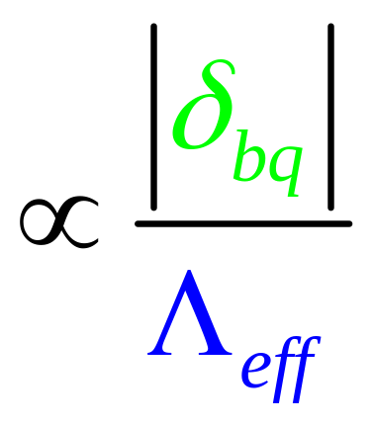
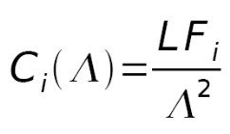
Present and future goals of Flavour Physics
It is a game of couplings and scales
if NP particles are discovered at LHC we have to
be able to study the flavour structure of the NP
(“reconstructing” the NP Lagrangian)
→to have the capability to explore NP scale beyond
the LHC reach
Coupling δ | PRECISION 20% today | PRECISION 10% Tomorrow (2010-2015) (LHCb,MEG,NA62…) | PRECISION 1% after tomorrow (>2015)
Order 1 | Λ_{eff} ~ 20 TeV | Λ_{eff} ~ 30 TeV | Λ_{eff} ~ 100 TeV
“MFV” | Λ_{eff} ~ 180 GeV | Λ_{eff} ~ 250 GeV | Λ_{eff} ~ 800 GeV

Slide 14
Which NP
will be ??
Which NP
will be ??
Which NP
will be ??
Which NP
will be ??
Which NP
will be ??
Which NP
will be ??
Which NP
will be ??
The actors in the
next decade
Which NP
will be ??
The actors in the
next decade
The actors in the
next decade
The actors in the
next decade
Which NP
will be ??
The actors in the
next decade
The actors in the
next decade
The actors in the
next decade
The actors in the
next decade
The actors in the
next decade
Br (B_{s}→ μμ)
Br (B_{s}→ μμ)
Br (B_{s}→ μμ)
Br (B_{s}→ μμ)
Br (B_{s}→ μμ)
Br (B_{s}→ μμ)
Br (B_{s}→ μμ)
Br (B_{s}→ μμ)
Br,ACP (B→ X_{s} l l)
Br (B_{s}→ μμ)
Br,ACP (B→ X_{s} l l)
Br,ACP (B→ X_{s} l l)
Br,ACP (B→ X_{s} l l)
Br,ACP (B→ X_{s} l l)
Br,ACP (B→ X_{s} l l)
Br,ACP (B→ X_{s} l l)
Br,ACP (B→ X_{s} l l)
Br (B→ X_{s} γ)
Br,ACP (B→ X_{s} l l)
Br (B→ X_{s} γ)
Br (B→ X_{s} γ)
Br (B→ X_{s} γ)
Br (B→ X_{s} γ)
Br (B→ X_{s} γ)
Br (B→ X_{s} γ)
Br (B→ X_{s} γ)
Br (B→ X_{s} γ)
NMFV (1-3)
NMFV (1-3)
NMFV (1-3)
NMFV (1-3)
NMFV (1-3)
NMFV (1-3)
NMFV (1-3)
NMFV (1-3)
NMFV (1-3)
MFV
MFV
MFV
MFV
MFV
MFV
MFV
MFV
Br (K⁰→ π⁰νν)
MFV
Br (K⁰→ π⁰νν)
Br (K⁰→ π⁰νν)
Br (K⁰→ π⁰νν)
Br (K⁰→ π⁰νν)
Br (K⁰→ π⁰νν)
Br (K⁰→ π⁰νν)
Br (K⁰→ π⁰νν)
Br (K⁰→ π⁰νν)
β
β
β
β
β
β
β
β
β
MFV-GUT
MFV-GUT
MFV-GUT
MFV-GUT
MFV-GUT
MFV-GUT
MFV-GUT
MFV-GUT
MFV-GUT
Br (μ◊ e γ)
Br (μ◊ e γ)
Br (μ◊ e γ)
Br (μ◊ e γ)
Br (μ◊ e γ)
Br (μ◊ e γ)
Br (μ◊ e γ)
Br (μ◊ e γ)
Br (B→ τν , μυ)
Br (μ◊ e γ)
Br (B→ τν , μυ)
Br (B→ τν , μυ)
Br (B→ τν , μυ)
Br (B→ τν , μυ)
Br (B→ τν , μυ)
Br (B→ τν , μυ)
Br (B→ τν , μυ)
Br (B→ τν , μυ)
RH-currents
RH-currents
RH-currents
RH-currents
RH-currents
RH-currents
RH-currents
RH-currents
RH-currents
NMFV (2-3)
NMFV (2-3)
NMFV (2-3)
NMFV (2-3)
NMFV (2-3)
NMFV (2-3)
NMFV (2-3)
NMFV (2-3)
NMFV (2-3)
(g - 2)_{μ}
(g - 2)_{μ}
(g - 2)_{μ}
(g - 2)_{μ}
(g - 2)_{μ}
(g - 2)_{μ}
(g - 2)_{μ}
(g - 2)_{μ}
(g - 2)_{μ}
Br (K⁺→ π⁺νν)
Br (K⁺→ π⁺νν)
Br (K⁺→ π⁺νν)
Br (K⁺→ π⁺νν)
Br (K⁺→ π⁺νν)
Br (K⁺→ π⁺νν)
Br (K⁺→ π⁺νν)
Br (K⁺→ π⁺νν)
Br (K⁺→ π⁺νν)
H⁺ - high tanβ
H⁺ - high tanβ
H⁺ - high tanβ
H⁺ - high tanβ
H⁺ - high tanβ
H⁺ - high tanβ
H⁺ - high tanβ
H⁺ - high tanβ
H⁺ - high tanβ
Br (τ ◊ μμμ)
Br (τ ◊ μμμ)
Br (τ ◊ μμμ)
Br (τ ◊ μμμ)
Br (τ ◊ μμμ)
Br (τ ◊ μμμ)
Br (τ ◊ μμμ)
Br (τ ◊ μμμ)
Br (τ ◊ μμμ)
Br (B→ K νν)
Br (B→ K νν)
Br (B→ K νν)
Br (B→ K νν)
Br (B→ K νν)
Br (B→ K νν)
Br (B→ K νν)
Br (B→ K νν)
Br (B→ K νν)
A_{CP} (B→ X_{s} γ)
A_{CP} (B→ X_{s} γ)
A_{CP} (B→ X_{s} γ)
A_{CP} (B→ X_{s} γ)
A_{CP} (B→ X_{s} γ)
A_{CP} (B→ X_{s} γ)
A_{CP} (B→ X_{s} γ)
A_{CP} (B→ X_{s} γ)
A_{CP} (B→ X_{s} γ)
Z penguins
Z penguins
Z penguins
Z penguins
Z penguins
Z penguins
Z penguins
Z penguins
Z penguins
LHT Models
LHT Models
LHT Models
Br (B→ K_{S}π⁰γ)
LHT Models
Br (B→ K_{S}π⁰γ)
Br (B→ K_{S}π⁰γ)
Br (B→ K_{S}π⁰γ)
LHT Models
LHT Models
LHT Models
LHT Models
Br (B→ K_{S}π⁰γ)
LHT Models
Br (B→ K_{S}π⁰γ)
Br (B→ K_{S}π⁰γ)
Br (B→ K_{S}π⁰γ)
Br (B→ K_{S}π⁰γ)
Br (τ ◊ μγ)
Br (τ ◊ μγ)
Br (τ ◊ μγ)
Br (τ ◊ μγ)
Br (τ ◊ μγ)
Br (τ ◊ μγ)
Br (τ ◊ μγ)
Br (τ ◊ μγ)
Br (τ ◊ μγ)
ACP(B_{s}→J/ ψ φ)
ACP(B_{s}→J/ ψ φ)
ACP(B_{s}→J/ ψ φ)
ACP(B_{s}→J/ ψ φ)
ACP(B_{s}→J/ ψ φ)
ACP(B_{s}→J/ ψ φ)
ACP(B_{s}→J/ ψ φ)
ACP(B_{s}→J/ ψ φ)
ACP(B_{s}→J/ ψ φ)
Many of these channels could be studied by SuperB

Slide 15
L= 10³⁴ cm⁻² s⁻¹ → 150 fb⁻¹ → 1.5 × 10⁸ Υ(4s) produced by year
L= 10³⁶ cm⁻² s⁻¹ → 15 ab⁻¹ → 1.5 × 10¹⁰ Υ(4s) produced by year
B factories have shown that a variety of
measurements can be performed in the clean environment.
Asymmetric
B factory
The systematic errors are very rarely irreducible and can almost on all cases be controlled with control samples. (up to..50-100ab⁻¹)
High luminosity
Many and interesting measurements at different energies (charm/τ threshold, U(5S), other Upsilons.. )
and with polarised beam
Flavour factories
SuperB factory potential discovery evaluated with 75ab⁻¹

Slide 16
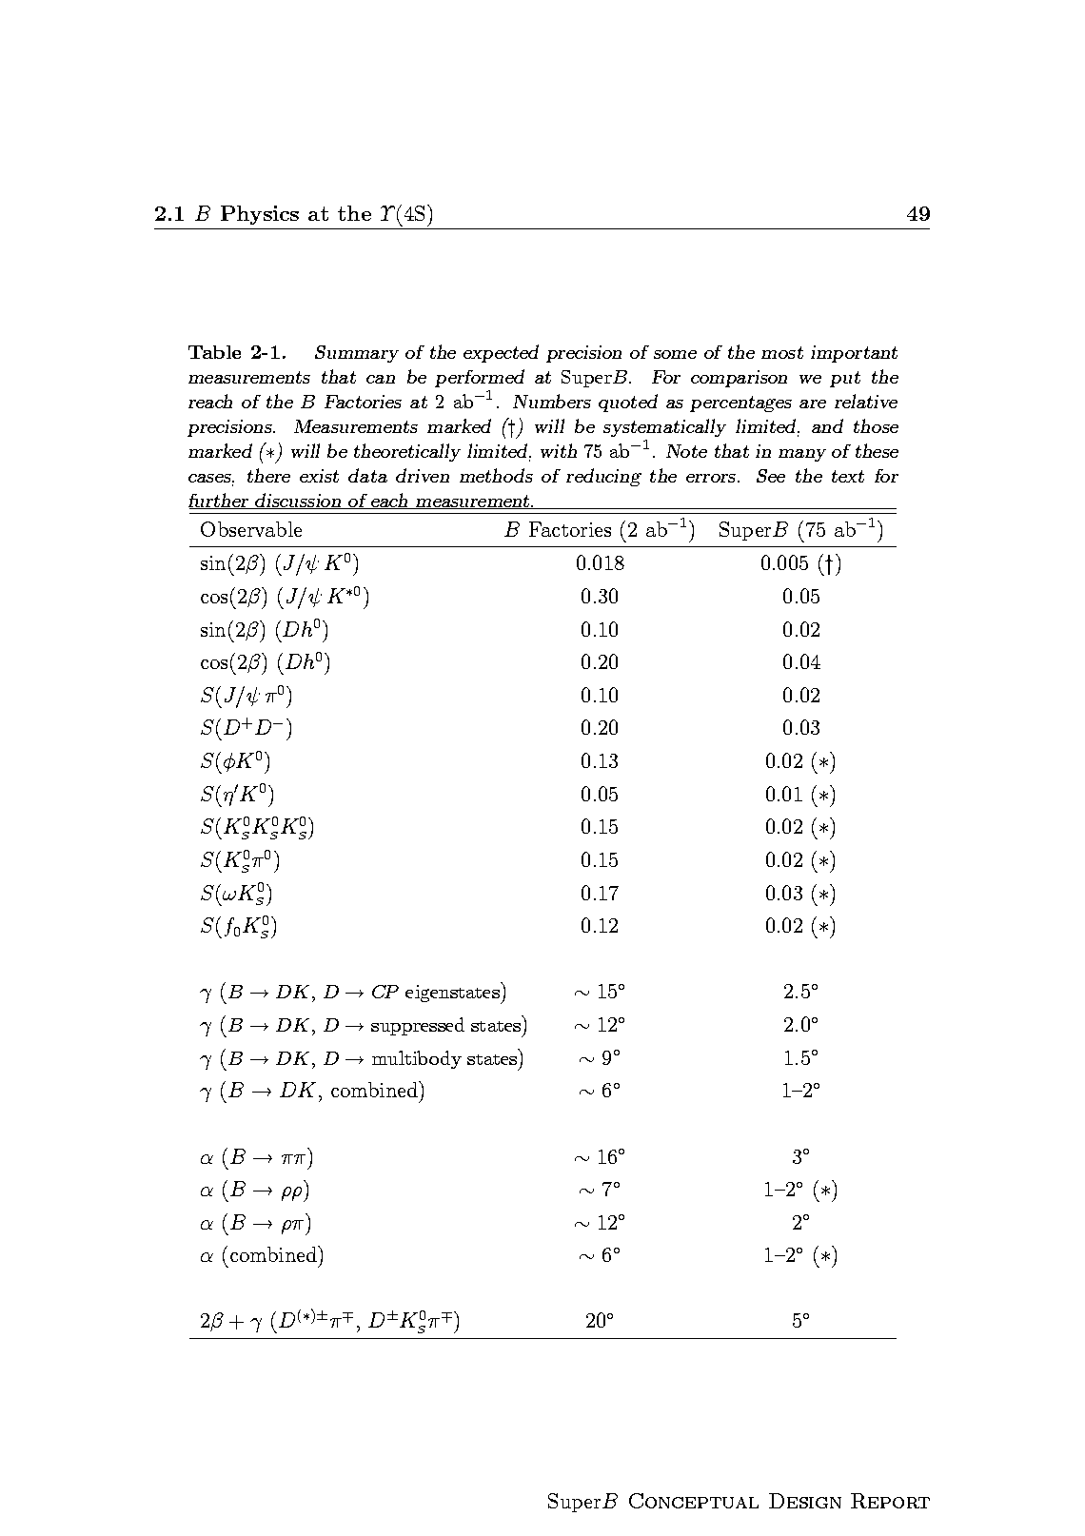
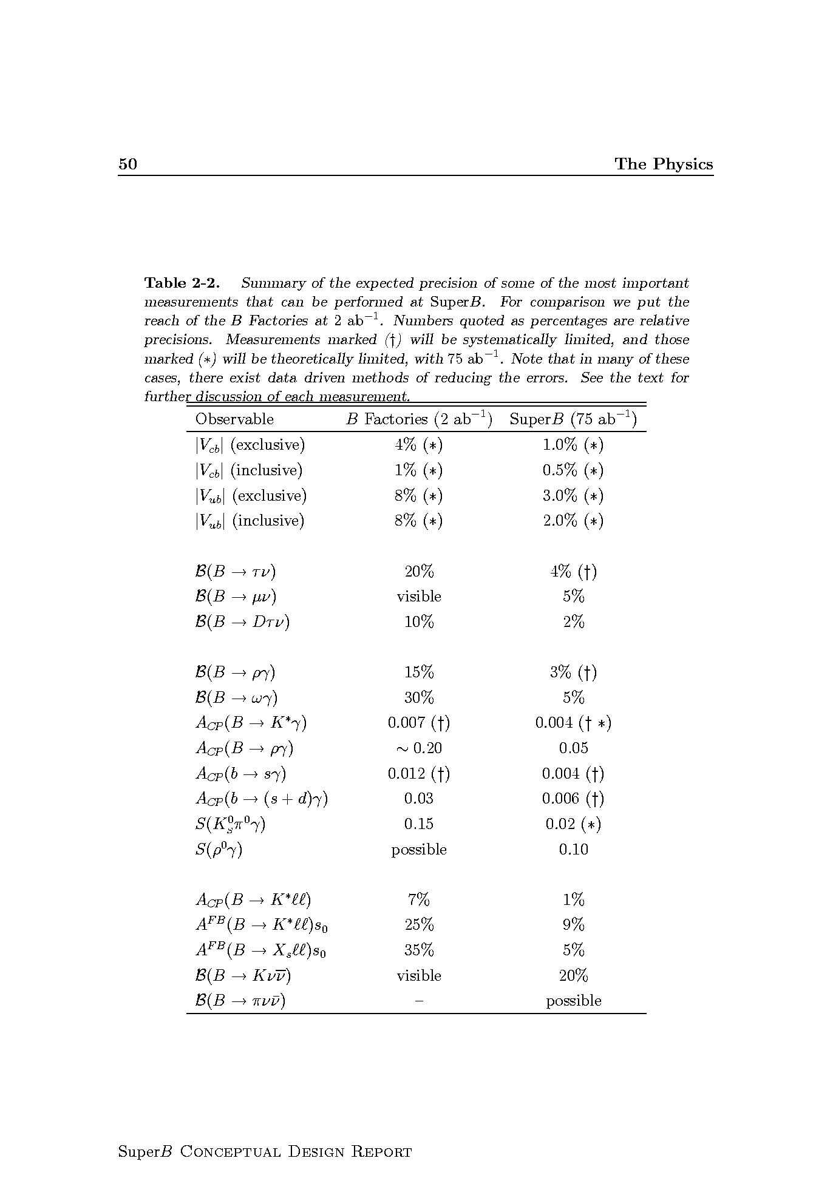
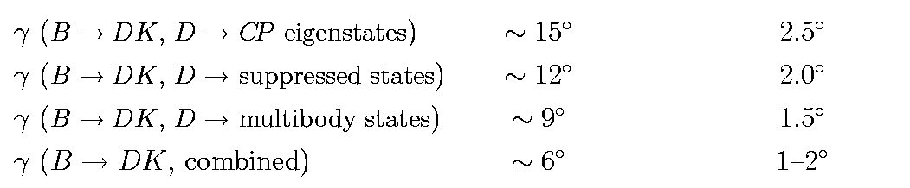
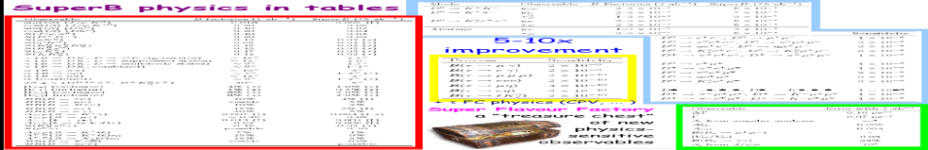
B physics @ Y(4S)
Variety of measurements for any observable
Possible also at LHCb
Similar precision at LHCb
Example of « SuperB specifics »
inclusive in addition to exclusive analyses
channels with π⁰, γ’s, ν, many Ks…

Slide 17
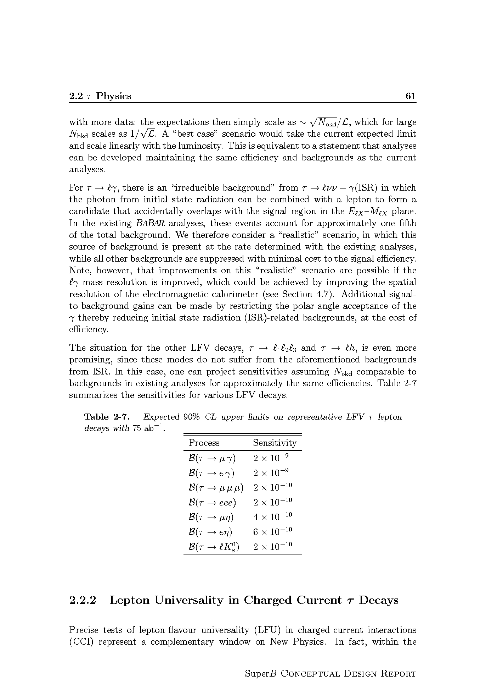
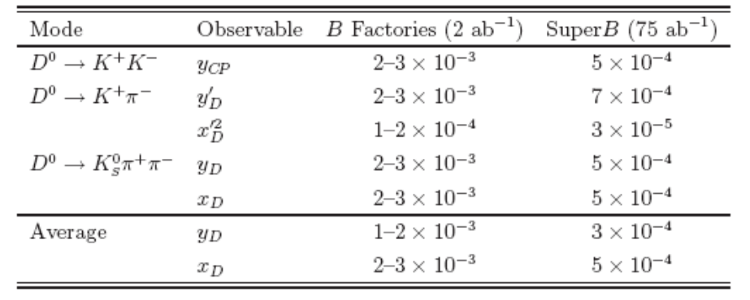
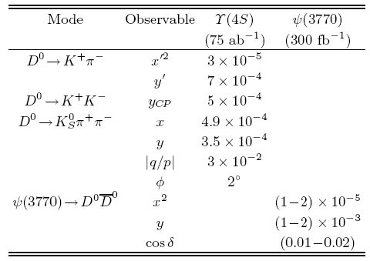
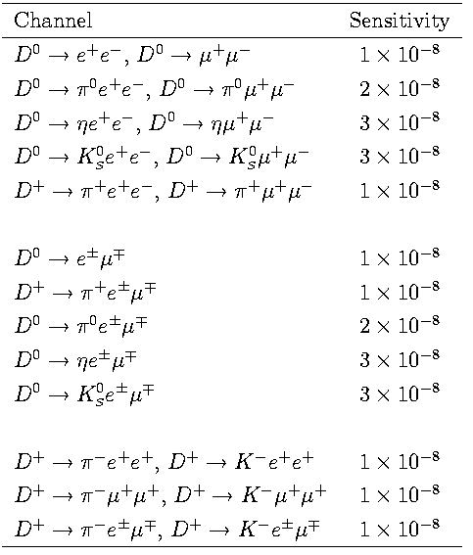
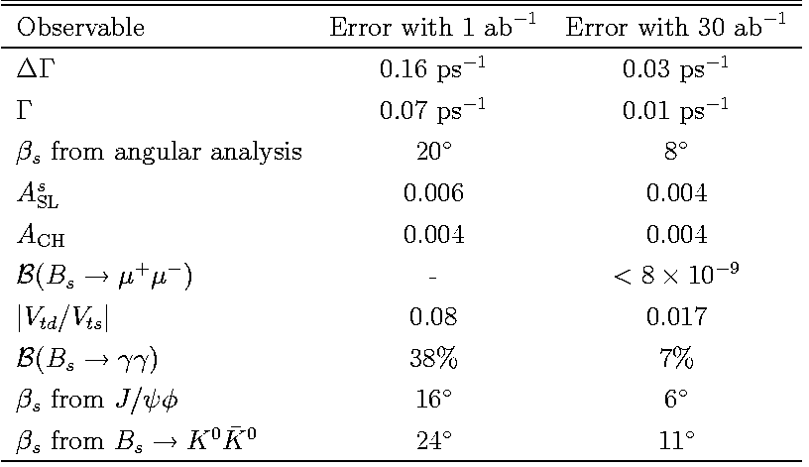
τ physics (polarized beams)
Charm at Y(4S) and threshold
To be evaluated
at LHCb
B_{s} at Y(5S)
Bs : Definitively better at LHCb

Slide 18
The Quantum path
The indirect searches
look for “New Physics”
through virtual effects from new particles in loop corrections
I’ll show
Examples of
golden measurements
for
possible discoveries
Key words :
Precise measurements
→ Luminosity

Slide 19
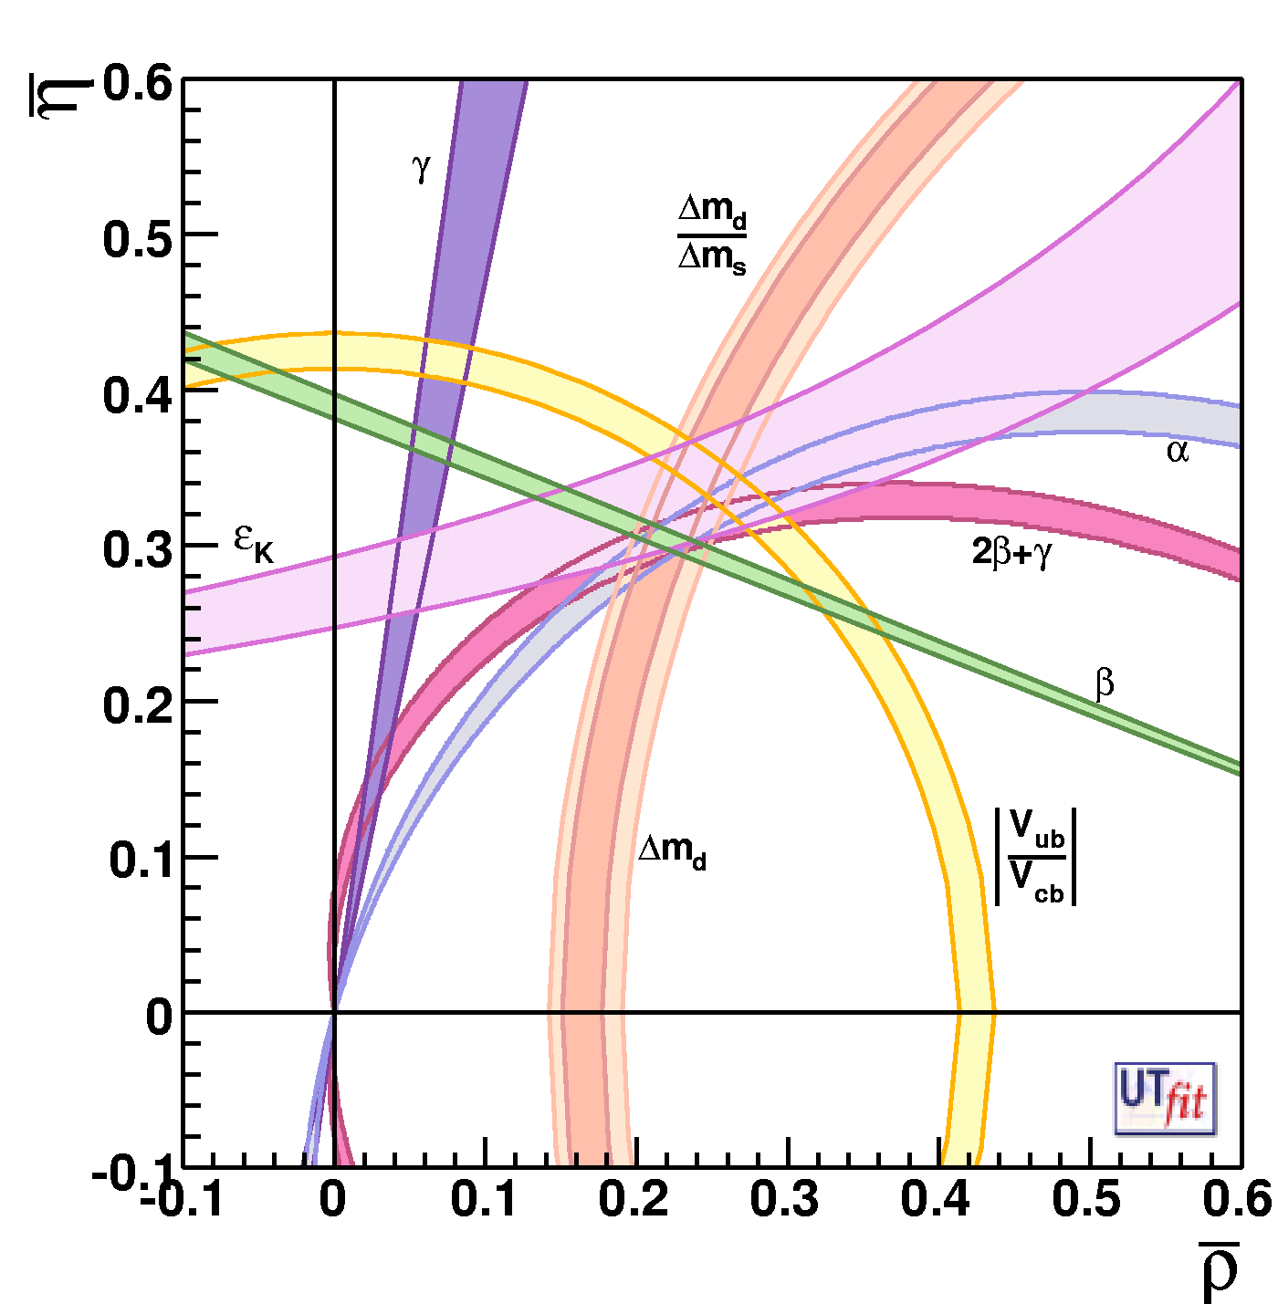
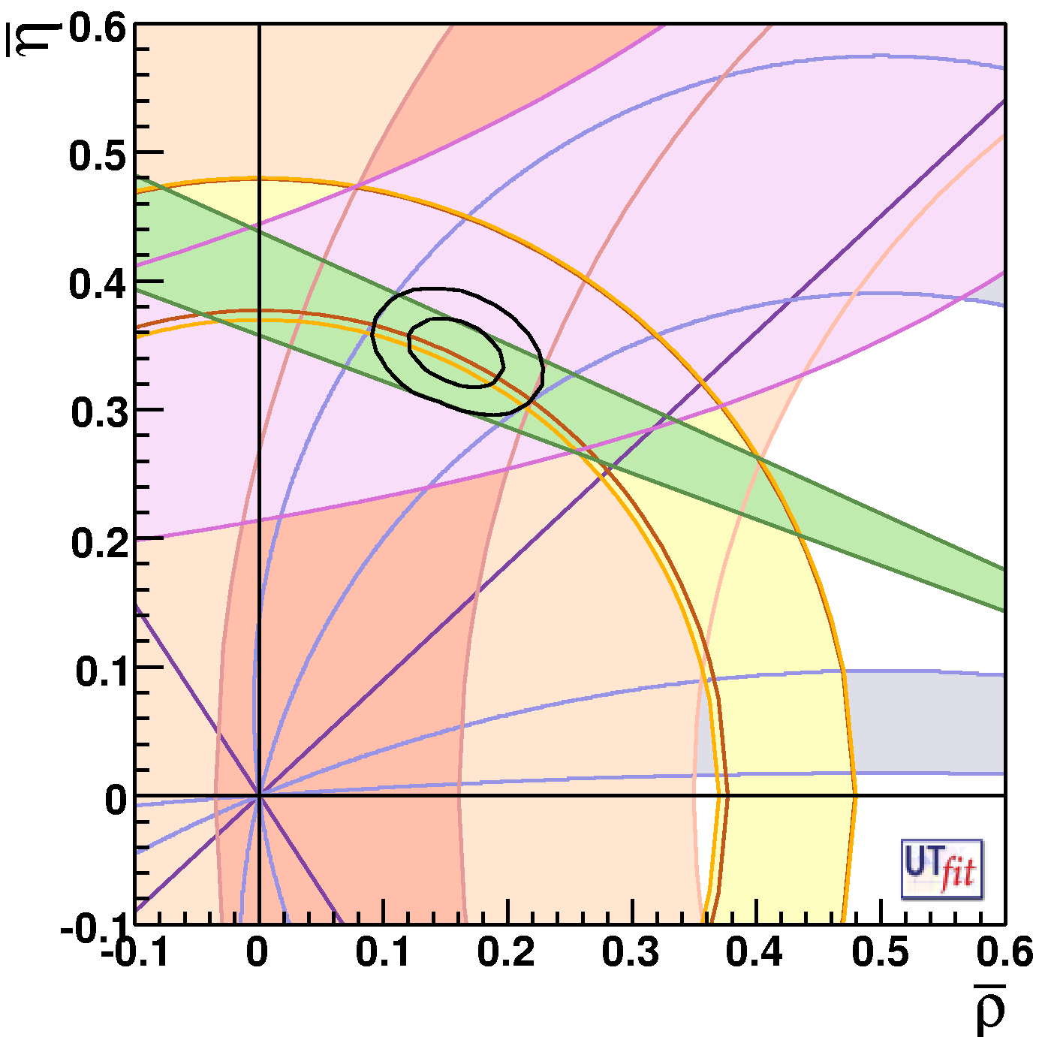
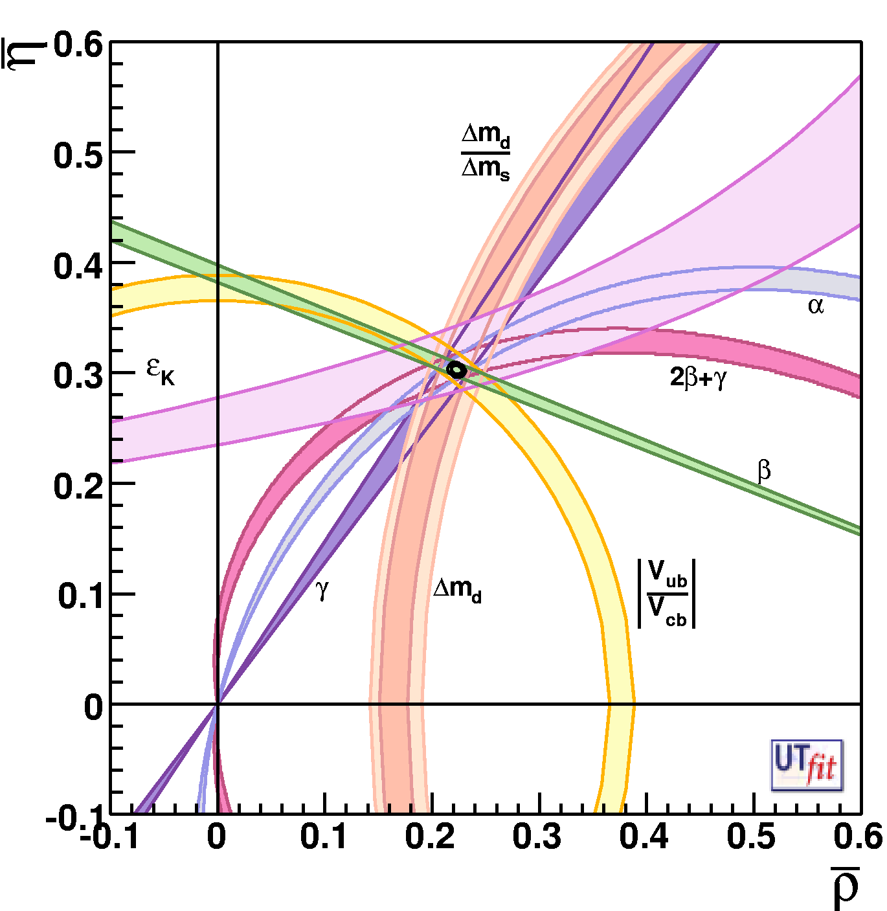
Determination of CKM parameters and New Physics
Today
Future (SuperB) + Lattice improvements
This situation will be different @2015 thanks to LHCb
players are :
γ,α,β..,V_{ub}
and Lattice !
ρ = 0.163 ± 0.028
η = 0.344± 0.016
ρ = ± 0.0028
η = ± 0.0024
Improving CKM is
crucial to look for NP
Important also in K physics :
K→ π ν ν , CKM errors dominated
the error budget

Slide 20
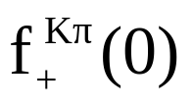


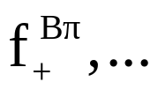
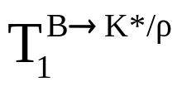
Part of the program could be accomplished if SM theoretical predictions are @ 1%
Shown by Vittorio Lubicz at the SuperB Workshop LNF Dec2009
Hadronic matrix element | Lattice error in 2006 | Lattice error in 2009 | 6 TFlop Year | 60 TFlop Year | 1-10 PFlop Year
 | 0.9% | 0.5% | 0.7% | 0.4% | < 0.1%
 | 11% | 5% | 5% | 3% | 1%
f_{B} | 14% | 5% | 3.5 - 4.5% | 2.5 - 4.0% | 1 – 1.5%
 | 13% | 5% | 4 - 5% | 3 - 4% | 1 – 1.5%
ξ | 5% | 2% | 3% | 1.5 - 2 % | 0.5 – 0.8 %
☞ _{B → D/D*lν} | 4% | 2% | 2% | 1.2% | 0.5%
 | 11% | 11% | 5.5 - 6.5% | 4 - 5% | 2 – 3%
 | 13% | 13% | ---- | ---- | 3 – 4%
[2009]
[2011 LHCb]
[2015 SuperB]
20
20
The expected accuracy has been reached! (except for Vub)

Slide 21
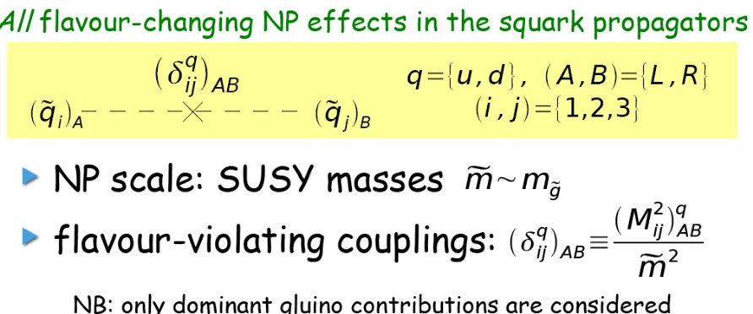

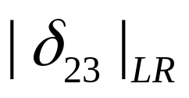
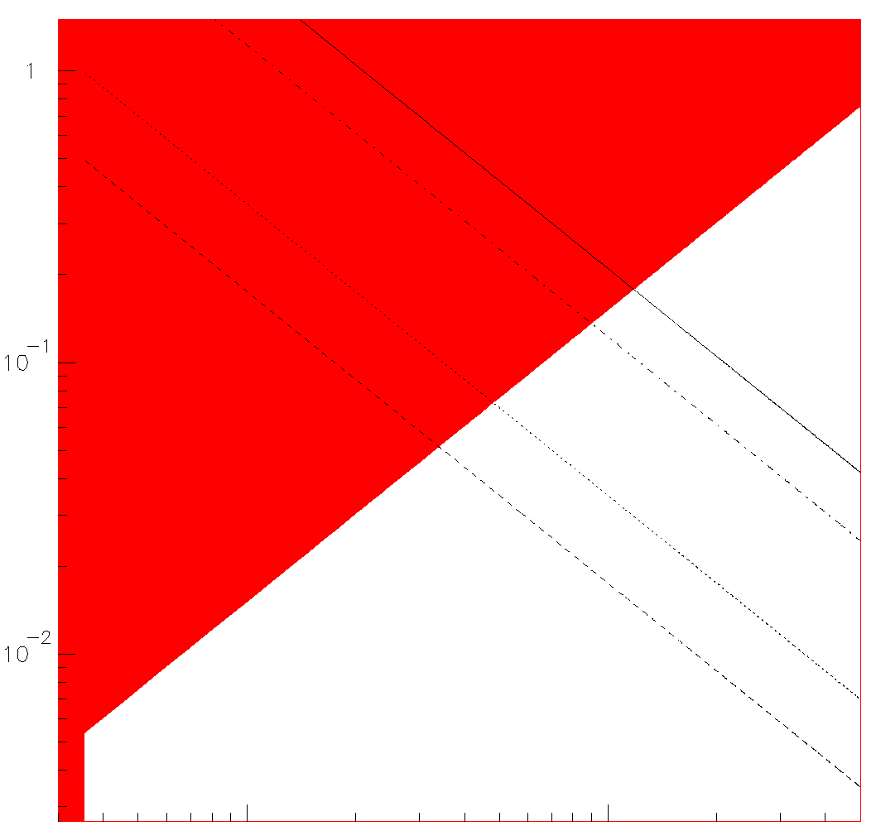
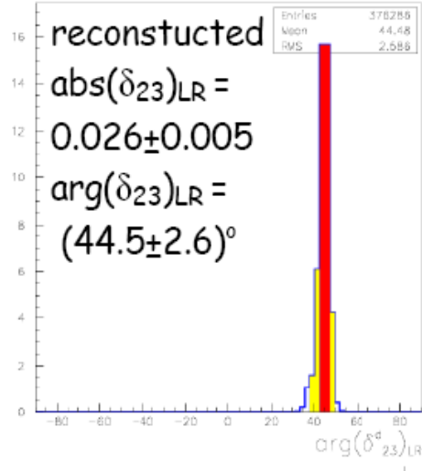
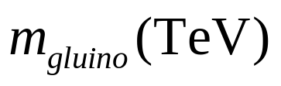
MSSM+generic soft SUSY breaking terms
New Physics contribution
(2-3 families)
Flavour-changing NP effects in the squark propagator
NP scale SUSY mass
flavour-violating coupling
~
g
b
~
~
s
b
s
1
10⁻¹
10⁻²
In the red regions the δ
are measured with a
significance >3σ away
from zero
Here the players are :
= (0.026 ± 0.005)
(B→X_{s} γ)
(B→X_{s} l⁺l⁻)
A_{CP}(B→X_{s} γ)
Arg(δ₂₃)_{LR}=(44.5± 2.6)º
1 10
1 TeV

Slide 22
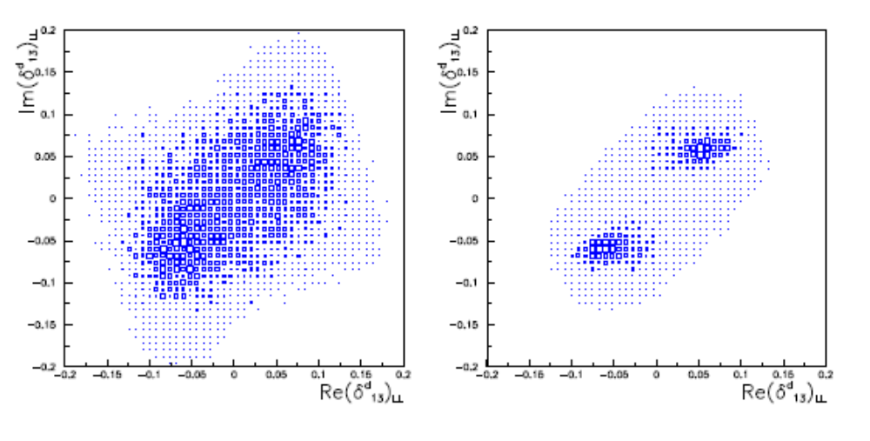
Profit of that to show one clear example where High luminosity is needed :
10ab⁻¹
75ab⁻¹
Determination of Susy mass insertion parameter (δ₁₃)_{LL}
with 10 ab⁻¹ and 75 ab⁻¹
Importance of having very large sample >75ab⁻¹

Slide 23
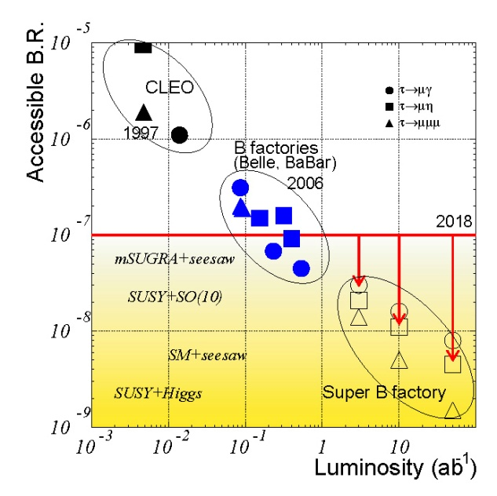
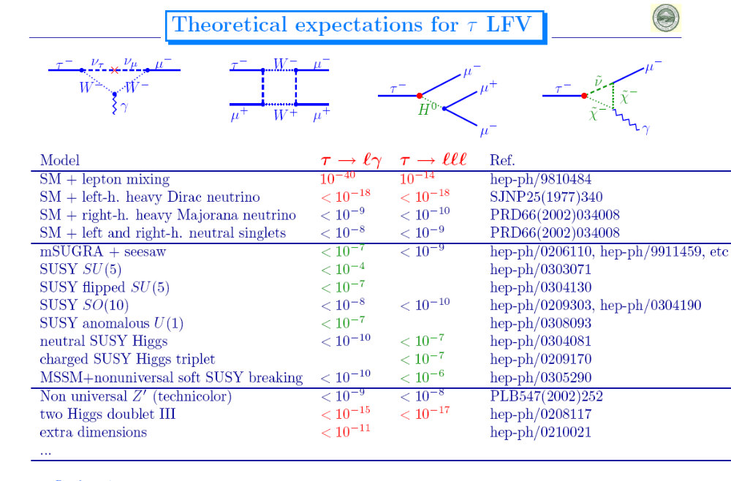
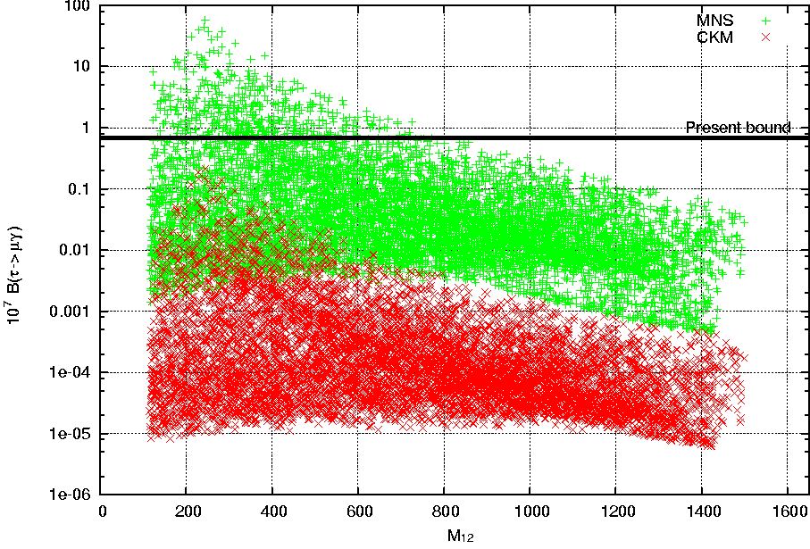
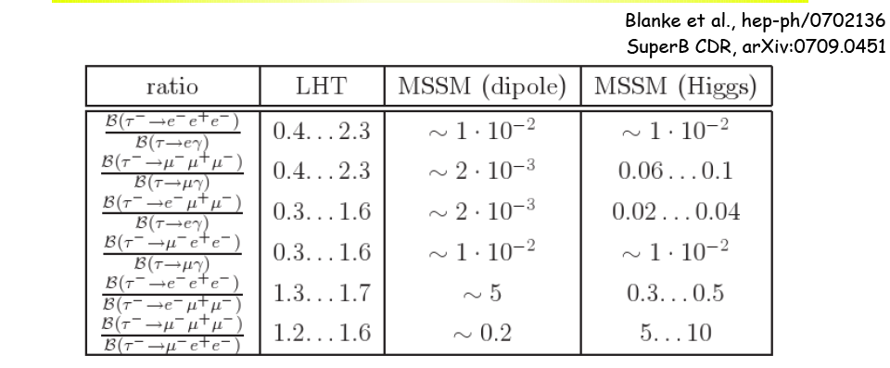
Lepton Flavour Violation in τ decays
ν mixing leads to a low level of
charged LFV (B~10⁻⁵⁴)
Enhancements to observable levels
are possible with new physics
MEG sensitivity μ→eγ ~10⁻¹³
Preliminary results < 3 10⁻¹¹
Masurements and origin of LFV
Discrimination between SUSY and LHT
SO(10) MSSM
10⁷ BR (τ→μγ)
LFV from PMNS
SuperB
LFV from CKM
The ratio τ→ lll / τ◊ μγ is not suppressed in
LHT by α_{e} as in MSSM
M_{1/2}

Slide 24
Which NP
will be ??
Which NP
will be ??
Which NP
will be ??
Which NP
will be ??
Which NP
will be ??
Which NP
will be ??
Which NP
will be ??
The actors in the
next decade
Which NP
will be ??
The actors in the
next decade
The actors in the
next decade
The actors in the
next decade
Which NP
will be ??
The actors in the
next decade
The actors in the
next decade
The actors in the
next decade
The actors in the
next decade
Br (B_{s}→ μμ)
Br (B_{s}→ μμ)
Br (B_{s}→ μμ)
Br (B_{s}→ μμ)
Br (B_{s}→ μμ)
Br (B_{s}→ μμ)
Br (B_{s}→ μμ)
Br,ACP (B→ X_{s} l l)
Br (B_{s}→ μμ)
Br,ACP (B→ X_{s} l l)
Br,ACP (B→ X_{s} l l)
Br,ACP (B→ X_{s} l l)
Br,ACP (B→ X_{s} l l)
Br,ACP (B→ X_{s} l l)
Br,ACP (B→ X_{s} l l)
Br (B→ X_{s} γ)
Br,ACP (B→ X_{s} l l)
Br (B→ X_{s} γ)
Br (B→ X_{s} γ)
Br (B→ X_{s} γ)
Br (B→ X_{s} γ)
Br (B→ X_{s} γ)
Br (B→ X_{s} γ)
Br (B→ X_{s} γ)
NMFV (1-3)
NMFV (1-3)
NMFV (1-3)
NMFV (1-3)
NMFV (1-3)
NMFV (1-3)
NMFV (1-3)
NMFV (1-3)
NMFV (1-3)
MFV
MFV
MFV
MFV
MFV
MFV
MFV
MFV
Br (K⁰→ π⁰νν)
MFV
Br (K⁰→ π⁰νν)
Br (K⁰→ π⁰νν)
Br (K⁰→ π⁰νν)
Br (K⁰→ π⁰νν)
Br (K⁰→ π⁰νν)
Br (K⁰→ π⁰νν)
Br (K⁰→ π⁰νν)
β
β
β
β
β
β
β
β
MFV-GUT
MFV-GUT
MFV-GUT
MFV-GUT
MFV-GUT
MFV-GUT
MFV-GUT
MFV-GUT
MFV-GUT
Br (μ◊ e γ)
Br (μ◊ e γ)
Br (μ◊ e γ)
Br (μ◊ e γ)
Br (μ◊ e γ)
Br (μ◊ e γ)
Br (μ◊ e γ)
Br (B→ τν , μυ)
Br (μ◊ e γ)
Br (B→ τν , μυ)
Br (B→ τν , μυ)
Br (B→ τν , μυ)
Br (B→ τν , μυ)
Br (B→ τν , μυ)
Br (B→ τν , μυ)
Br (B→ τν , μυ)
RH-currents
RH-currents
RH-currents
RH-currents
RH-currents
RH-currents
RH-currents
RH-currents
RH-currents
NMFV (2-3)
NMFV (2-3)
NMFV (2-3)
NMFV (2-3)
NMFV (2-3)
NMFV (2-3)
NMFV (2-3)
NMFV (2-3)
NMFV (2-3)
(g - 2)_{μ}
(g - 2)_{μ}
(g - 2)_{μ}
(g - 2)_{μ}
(g - 2)_{μ}
(g - 2)_{μ}
(g - 2)_{μ}
(g - 2)_{μ}
Br (K⁺→ π⁺νν)
Br (K⁺→ π⁺νν)
Br (K⁺→ π⁺νν)
Br (K⁺→ π⁺νν)
Br (K⁺→ π⁺νν)
Br (K⁺→ π⁺νν)
Br (K⁺→ π⁺νν)
Br (K⁺→ π⁺νν)
H⁺ - high tanβ
H⁺ - high tanβ
H⁺ - high tanβ
H⁺ - high tanβ
H⁺ - high tanβ
H⁺ - high tanβ
H⁺ - high tanβ
H⁺ - high tanβ
H⁺ - high tanβ
Br (τ ◊ μμμ)
Br (τ ◊ μμμ)
Br (τ ◊ μμμ)
Br (τ ◊ μμμ)
Br (τ ◊ μμμ)
Br (τ ◊ μμμ)
Br (τ ◊ μμμ)
Br (τ ◊ μμμ)
Br (B→ K νν)
Br (B→ K νν)
Br (B→ K νν)
Br (B→ K νν)
Br (B→ K νν)
Br (B→ K νν)
Br (B→ K νν)
Br (B→ K νν)
A_{CP} (B→ X_{s} γ)
A_{CP} (B→ X_{s} γ)
A_{CP} (B→ X_{s} γ)
A_{CP} (B→ X_{s} γ)
A_{CP} (B→ X_{s} γ)
A_{CP} (B→ X_{s} γ)
A_{CP} (B→ X_{s} γ)
A_{CP} (B→ X_{s} γ)
Z penguins
Z penguins
Z penguins
Z penguins
Z penguins
Z penguins
Z penguins
Z penguins
Z penguins
LHT Models
LHT Models
LHT Models
Br (B→ K_{S}π⁰γ)
LHT Models
Br (B→ K_{S}π⁰γ)
Br (B→ K_{S}π⁰γ)
Br (B→ K_{S}π⁰γ)
LHT Models
LHT Models
LHT Models
LHT Models
Br (B→ K_{S}π⁰γ)
LHT Models
Br (B→ K_{S}π⁰γ)
Br (B→ K_{S}π⁰γ)
Br (B→ K_{S}π⁰γ)
Br (τ ◊ μγ)
Br (τ ◊ μγ)
Br (τ ◊ μγ)
Br (τ ◊ μγ)
Br (τ ◊ μγ)
Br (τ ◊ μγ)
Br (τ ◊ μγ)
Br (τ ◊ μγ)
ACP(B_{s}→J/ ψ φ)
ACP(B_{s}→J/ ψ φ)
ACP(B_{s}→J/ ψ φ)
ACP(B_{s}→J/ ψ φ)
ACP(B_{s}→J/ ψ φ)
ACP(B_{s}→J/ ψ φ)
ACP(B_{s}→J/ ψ φ)
ACP(B_{s}→J/ ψ φ)

Slide 25
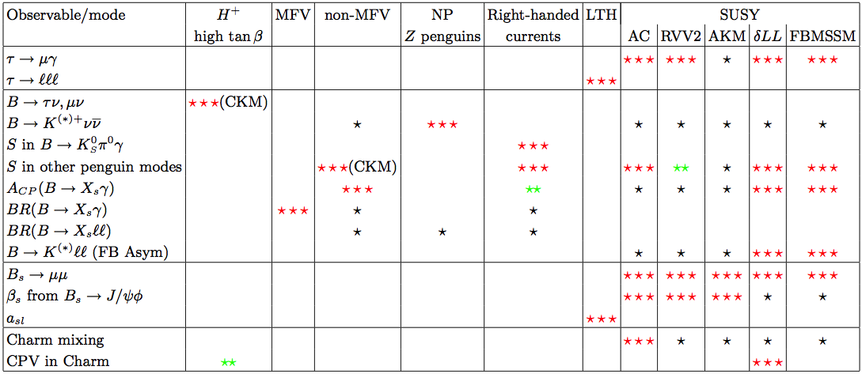
SuperB can deals with many NP scenarii
• More information on the golden matrix can be found in
arXiv:1008.1541, arXiv:0909.1333, and arXiv:0810.1312.
• Combine measurements to elucidate
structure of new physics
SuperB
scope
✓
✓
✓
✓
✓
✓
✓
✓
✓
✓
✓
, Bs→φγ
✓
✓
NP enhancement:
⬇ Observable effect
⬇ ⬇ Moderately large effect
⬇ ⬇ ⬇ Very large effect

Slide 26
Pre-Summary in two sentences
I shown
with specific examples
and
in a model independent way that
CP and Flavour violating measurements (mainly Rare Decays) are necessary for
Studying the NP structure if discovered at LHC
Explore beyond the reach of LHC
If enough luminosity is provided.

Slide 27
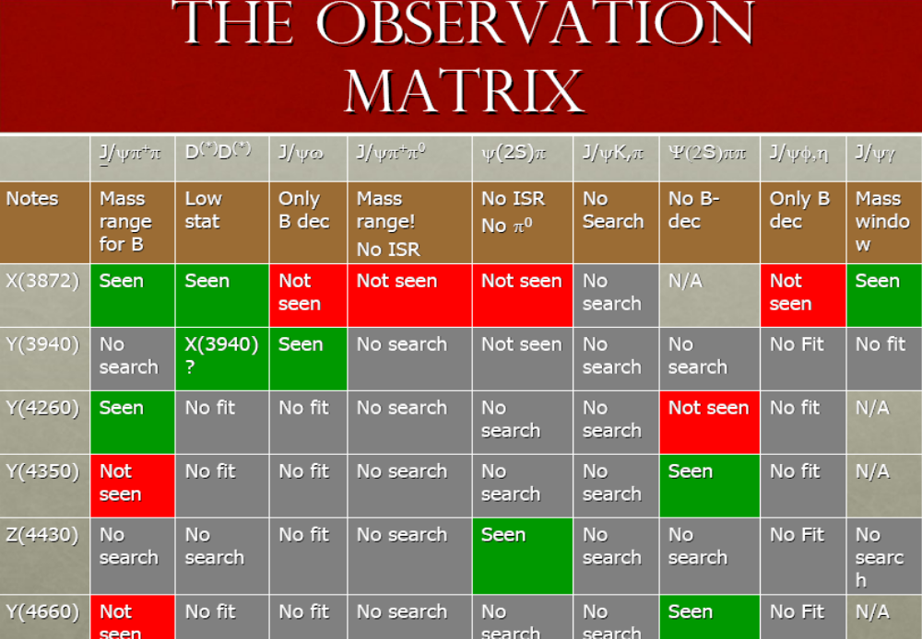
…and in addition SuperB is a machine for Spectroscopy
Hadronic Physics complementary to Panda
→to complete the picture
→ to better studying the recently discovered particle
(quantum numbers, branching fractions…)
After B-factory
More data are needed :

Slide 28
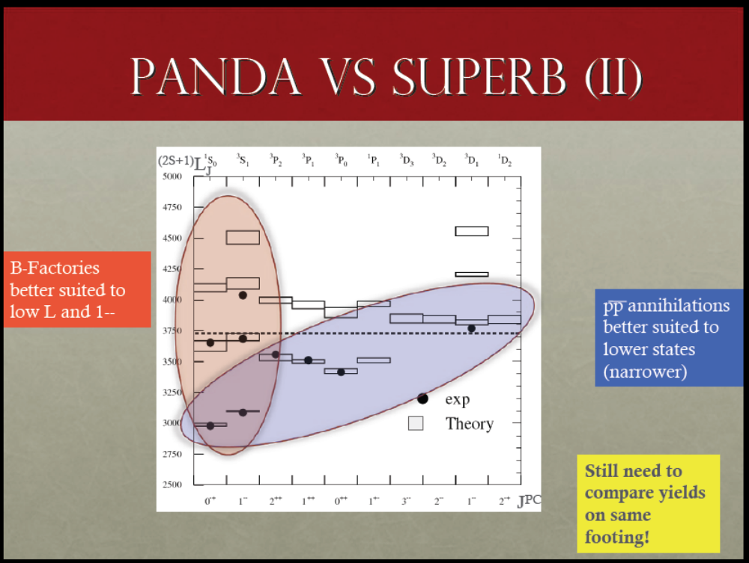
Hadronic community is welcome to join us to better define
the physics case on Spectroscopy

Slide 29
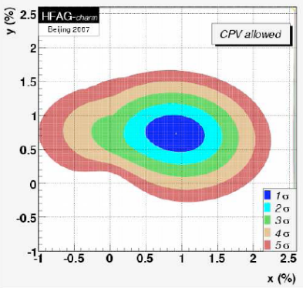
SuperB could run as a τ-CHARM factory
Charm physics using the charm produced at Υ(4S)
Consider that running 2 month at threshold
we will collect 500 times the stat. of CLEO-C
Charm physics at threshold
0.3 ab⁻¹
Strong dynamics and CKM measurements
@threshold(4GeV)
ξ~1%,
exclusive V_{ub} ~ few %
syst. error on γ from Dalitz Model <1º
D decay form factor and decay constant @ 1%
Dalitz structure useful for γ measurement
Rare decays FCNC down to 10⁻⁸
D mixing
Better studied using
the high statistics
collected at Υ(4S)
@threshold(4GeV)
CP Violation in mixing could now addressed

Slide 30
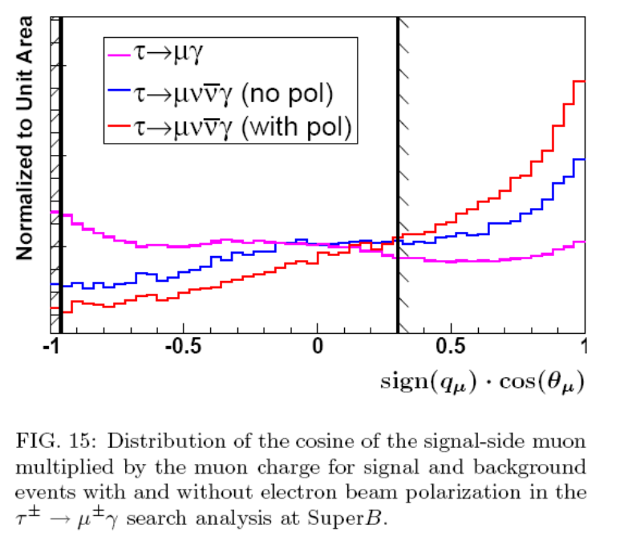
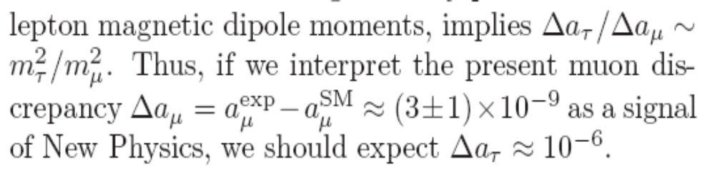
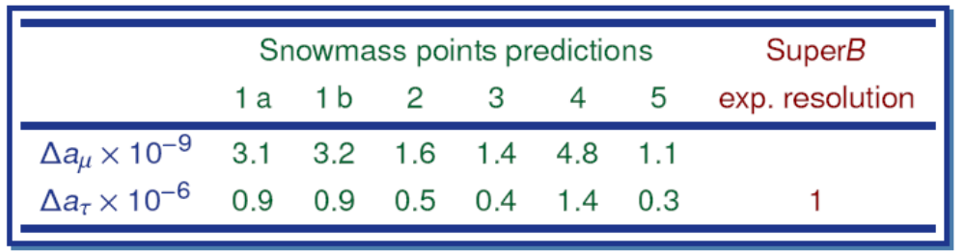
The nice feature of having Polarized beams
Polarized beam is
(SuperB specific)
LFV analyses :
novel additional handle on backgrounds
τ anomalous moment (g-2)
The anomalous tau momentum influence both
the angular distribution and the τ polarization.
Measure the Re(F2) and Im(F2) of the (g-2) from factor
NP effects
~ 10⁻⁶
<
Polarisation is
-an important issue for LFV
-opens the possibility of measuring (g-2)
-electroweak physics (neutral current)

Slide 31
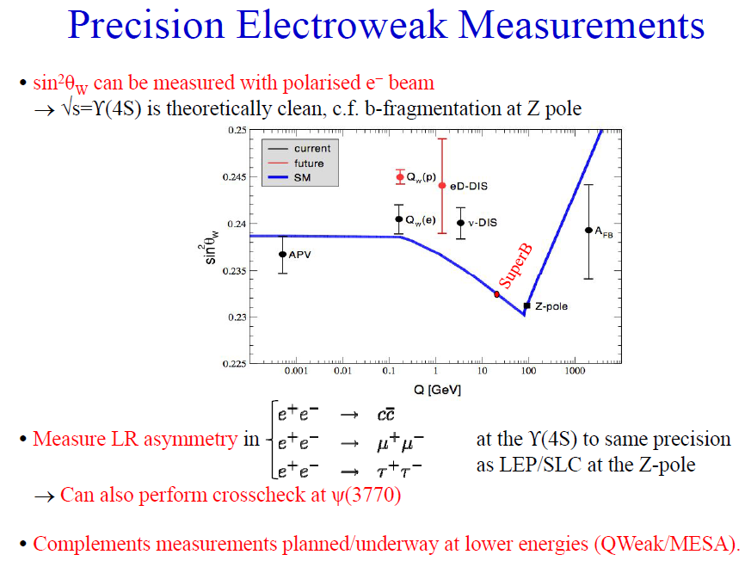

Slide 32
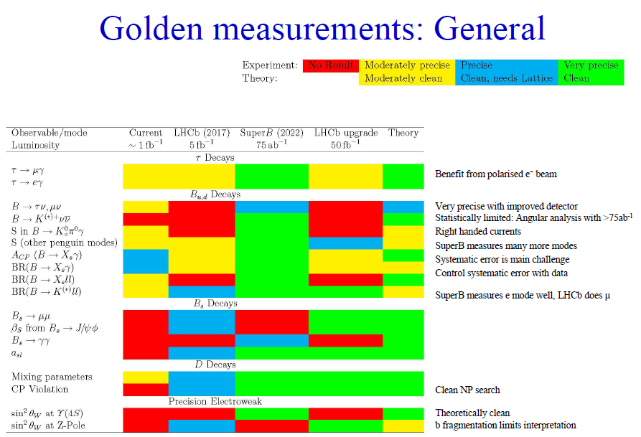
Comparison with LHCb and Upgrade

Slide 33
L= 10³⁶cm⁻² sec⁻¹ → 15ab⁻¹ per year / regime
We need at least 75 ab⁻¹ → L= 10³⁶cm⁻² sec⁻¹ is the baseline option
That’s is the factory we need !
Unprecented precision
SuperB can perform many measurements at <1% level of precision
Precision on CKM parameters will be improved by more than a factor 10
… and do not forget… SuperB could also a Super-Super τ-charm factory,
If we run at threshold.
Unique opportunity of LFV measurements, better if beam polarized.
SuperB Discovery Potential and Complementary to LHC
NP will be studied (measuring the couplings) if discovered at LHC
if NP is not (or “partially”) seen at TeV, SuperB is the way of exploring
NP scales of several TeV (in some scenario several (>10 )TeV..)

Slide 34
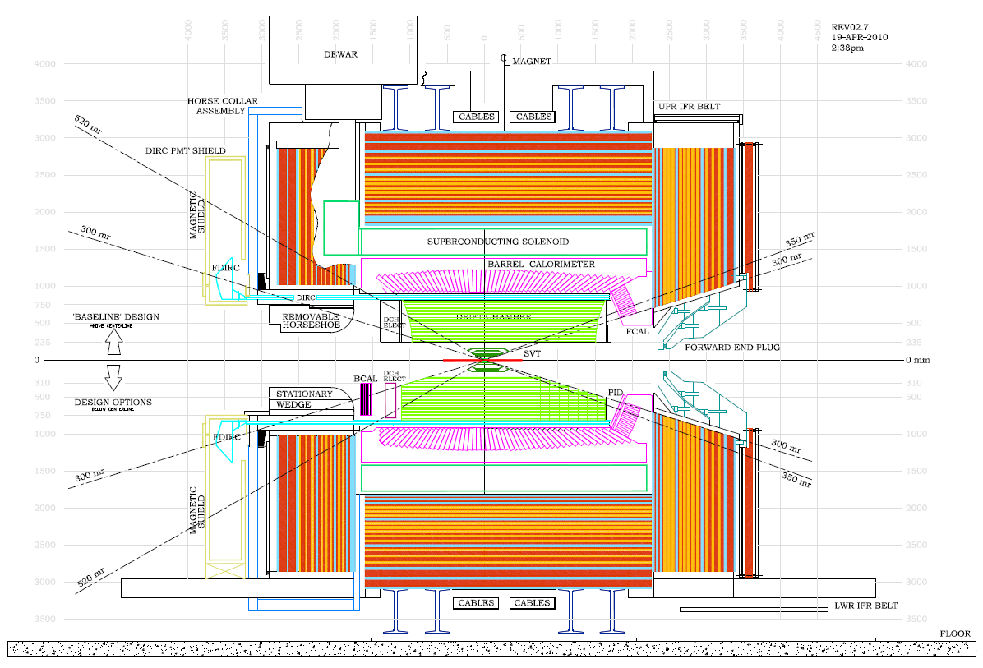
reuse part of Babar but largely improved
New and ambitious detector. Possibility
to conceive, construction
detector in a few year time
The Detector
5’ for detector…

Slide 35
The machine requires more symmetric beams → detector become more symmetric
With reduced boost we need better vertex resolution to get good time resolution
NECESSARY for Time dependent CP analyses (measuring β, γ, Penguins…)
→ Improved vertex detector
Less boost → more symmetric detector
+ improvement in hermeticity : PID, lepton ID and hadronic neutral ID
BETTER for measuring branching fraction
B→τν, b→ sγ, B→kνν….
Best possible detector for the SuperB Physics Program

Slide 36
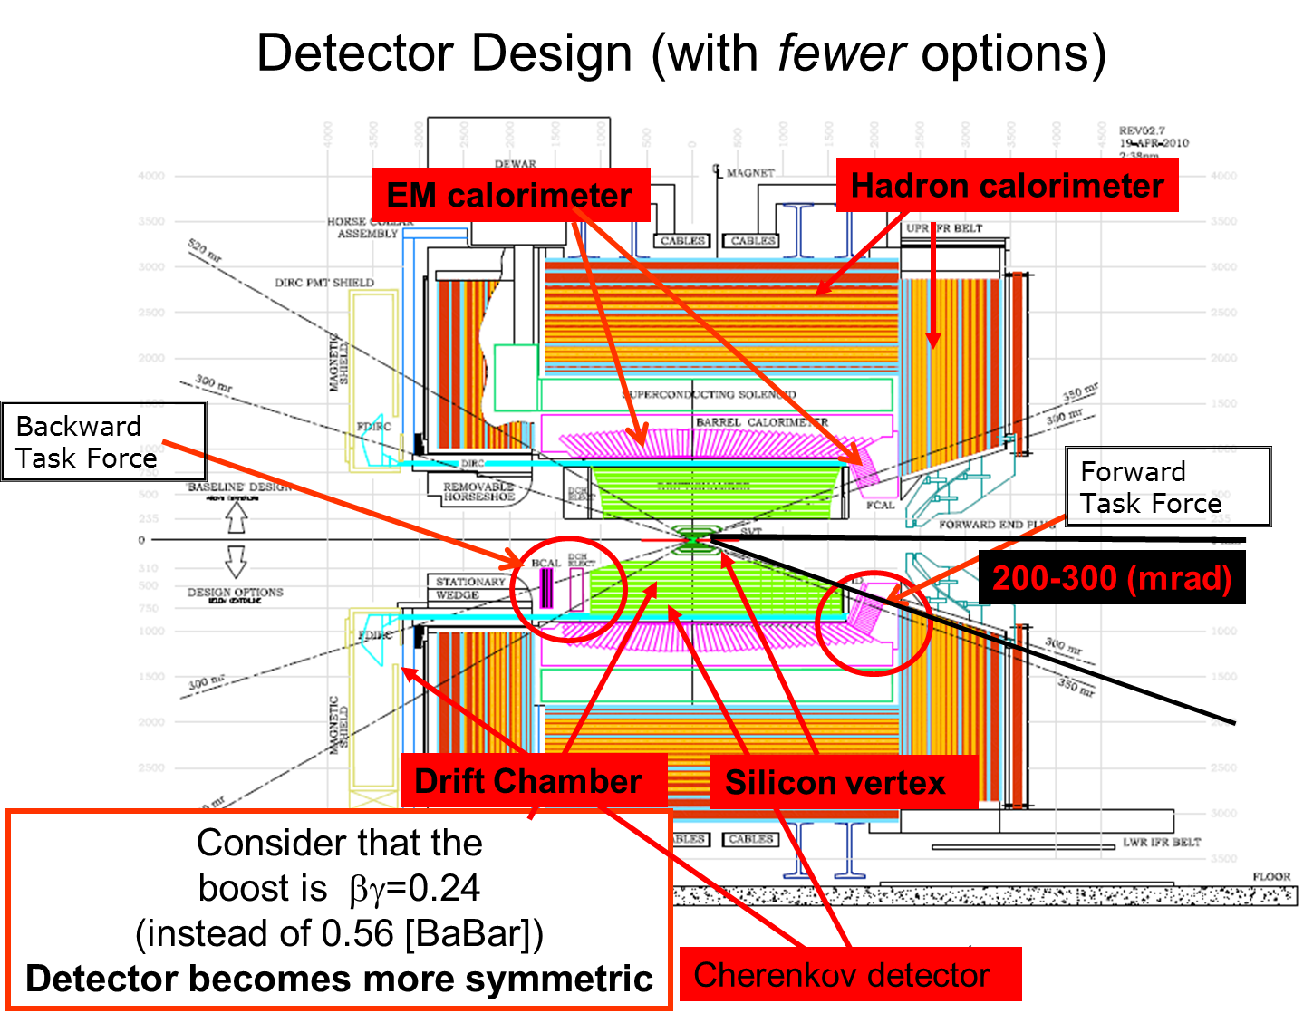

Slide 37
Conclusions
PHYSICS A discovery machine with a program complementary
to LHC
MACHINE ambitious and innovative. A new challenge. Renew and keep expertise in lepton machine.
DETECTOR New generation particle physics detector. Unique opportunity to construct such a detector in few year time with new ideas and technologies

Slide 38
Backup
Material

Slide 39
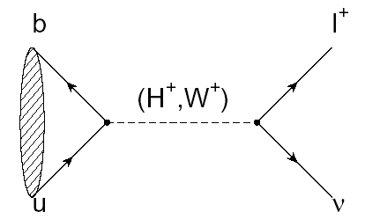
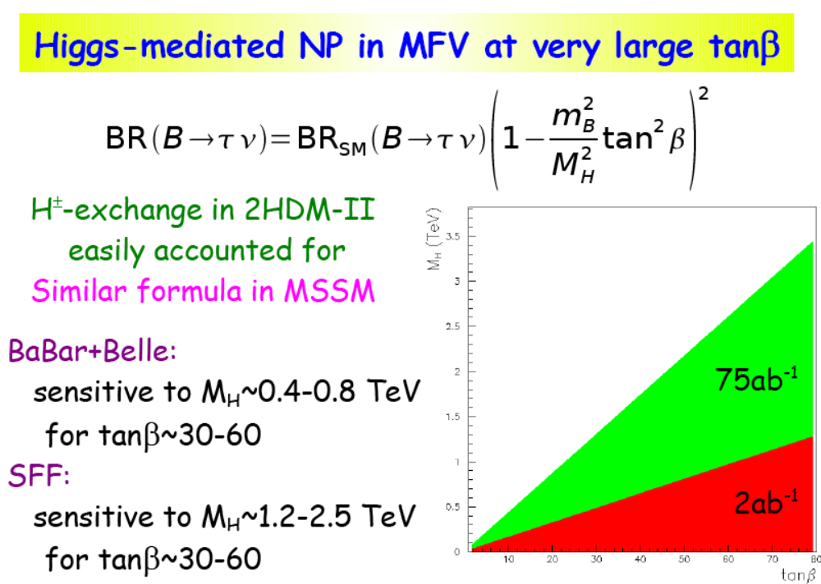



2
Leptonic decay B → l ν
SuperB
SuperB -75ab⁻¹
M_{H}~1.2-2.5 TeV
for tanβ~30-60
2HDM-II
MSSM
75ab⁻¹
2ab⁻¹
LEP m_{H}>79.3 GeV
SuperB
ATLAS 30fb⁻¹
SuperB excludes
SuperB excludes
ATLAS 30fb⁻¹
B-factories exclude
B-factories exclude
ATLAS 30fb⁻¹

Slide 40



5
CP Violation in charm
NOW
To be evaluated
at LHCb
CPV in D system negligible in SM
SuperB
CPV in D sector is a
clear indication of New Physics !

Slide 41
SuperB can deals with many NP scenarii
• More information on the golden matrix can be found in
arXiv:1008.1541, arXiv:0909.1333, and arXiv:0810.1312.
• Combine measurements to elucidate
structure of new physics
SuperB
scope
✓
✓
✓
✓
✓
✓
✓
✓
✓
✓
✓
, Bs→φγ
✓
✓
NP enhancement:
⬇ Observable effect
⬇ ⬇ Moderately large effect
⬇ ⬇ ⬇ Very large effect

Slide 42


Slide 43


Slide 44


Slide 45


